Slide 1
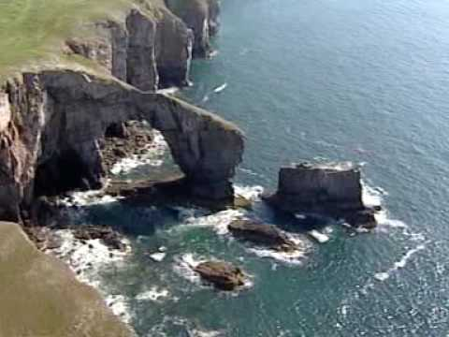
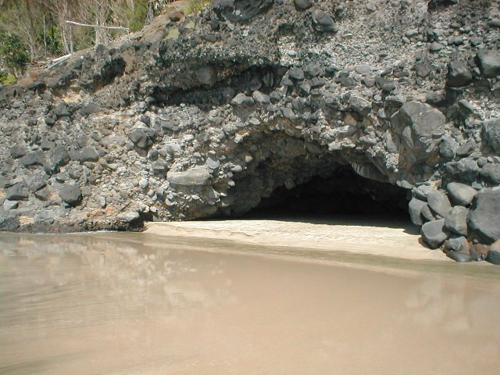
Caves, arches, stacks and stumps
Objective;
Aim: to learn how erosion can produce landforms on headlands

Slide 2
Landforms Created by Erosion caves, arches, stacks and stumps

Slide 3
Coastal erosion: cave, collapsed arch, stack, wave-cut platform?
collapsed arch
stack
wave cut platform
cave
https://www.youtube.com/watch?v=7Th56dhs4Fc
Watch this animation:

Slide 4
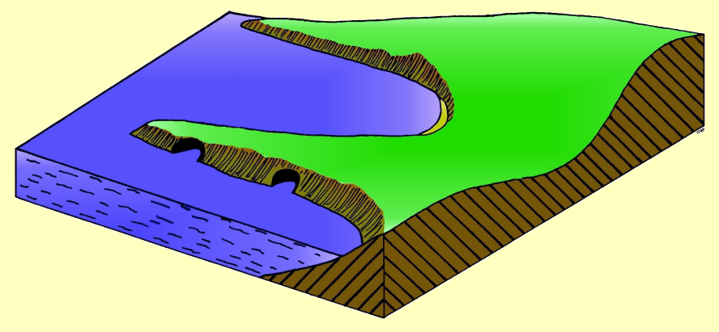
Areas of weakness in the rock will increase in size due to erosion.

Slide 5
Waves attack the
headland cutting
caves on each side

Slide 6
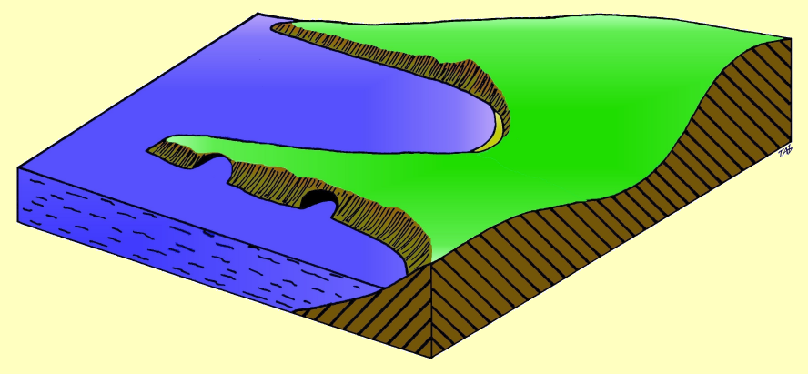

Slide 7
Wave attack opens up the caves
on each side of the headland until
they join and form a natural arch

Slide 8
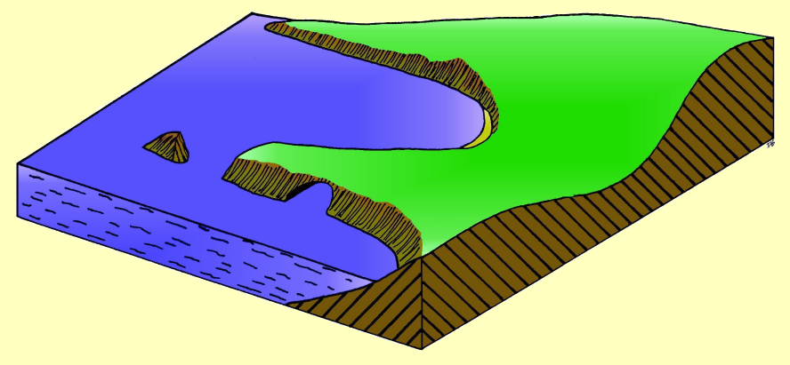

Slide 9
The arch enlarges until it
collapses, leaving a standing
rock called a stack
New arch forms

Slide 10
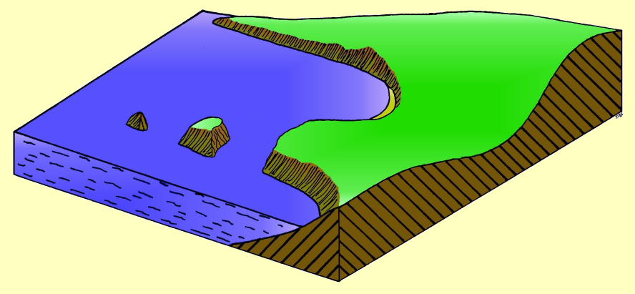

Slide 11
The old stack is worn down
into a stump
Another arch collapses
and a new stack is formed.

Slide 12
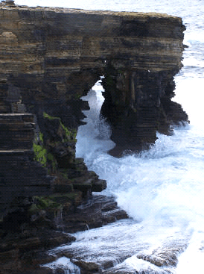

Slide 13
Draw a large well labelled copy
What happens at each arrow?
Headland
When you have finished write a paragraph to explain what processes have caused the above to form

Slide 14
Old Harry’s Rock
C
A
E
B
D

Slide 15
Longshore Drift
__________ is the movement of material along the shore by wave action. It is a process of __________. Longshore drift happens when waves move towards the coast at an ______. The _________ wind (most common wind) usually influences this angle. The ______ (waves moving up the beach) carries material up the beach at an angle. The __________ carries material back down the beach at right angles. This is the result of __________. This process slowly moves material along the beach. Longshore drift provides a link between erosion and deposition. Material in one place is __________, __________ then __________ elsewhere.
Transportation Swash Eroded Backwash
Angle Prevailing Gravity Transported
Longshore drift Deposited

