Slide 1
Class Agreements
No put downs of self or others.
Listen well.
Be willing to try new things.
Participate fully (but you have a right to PASS if you don’t want to share something.)
No gossip about anyone in the classroom, or outside. This includes not telling us stories/information about people we may know.
No gossip following the lesson.
7) If you have any questions relating to puberty, please use a post-it note and put them in the brown envelope, these will be answered in a way that is appropriate to your age.
Please put thumbs up if you agree to this.

Slide 2
Learning Review from our previous lesson:
What is an emotion?
What are the six main emotions?
How can we recognise them in others?
How can we recognise them in ourselves?

Slide 3
Answers:
What is an emotion? A strong inner feeling that affects our body.
What are the six main emotions? Anger, joy, fear, surprise, disgust, sadness.
How can we recognise them in others? Facial expressions, body language, tone of voice.
How can we recognise them in ourselves? Our bodily sensations tell us how we feel. Remember - we can have a mixture of emotions at the same time.

Slide 4
Today we are exploring:
Why do we have emotions?
How might puberty affect our emotions?

Slide 5
Consider – which of these emotions are good and which are bad? Discuss.
ANGER | SADNESS | FEAR
JOY | DISGUST | SURPRISE
What might this quote mean?
“No emotions are good or bad, all are necessary for our survival.”

Slide 6
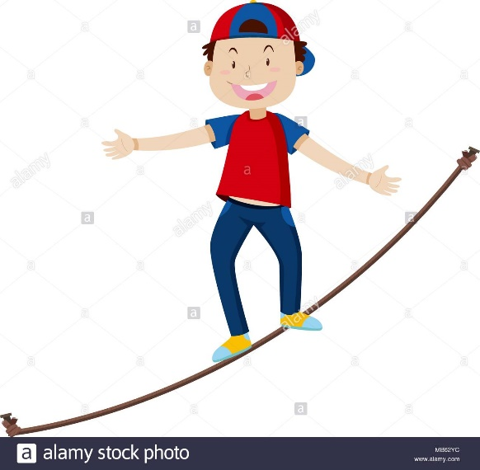
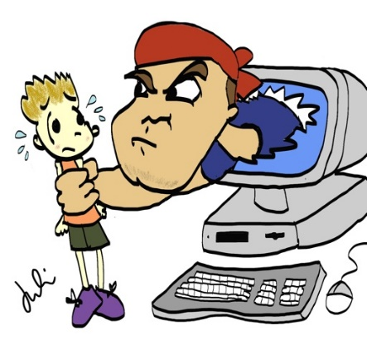
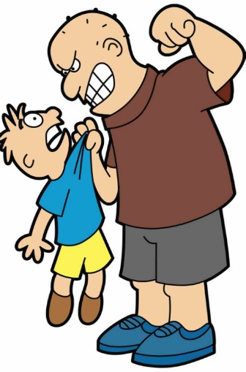
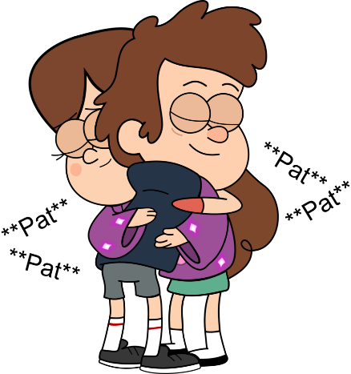
All emotions are important because they gives us messages about what is good/ok/bad/wrong for us, for example…
Why may fear save our lives?
How could anger lead us to not being bullied anymore?
How could sadness lead us to asking for help?

Slide 7
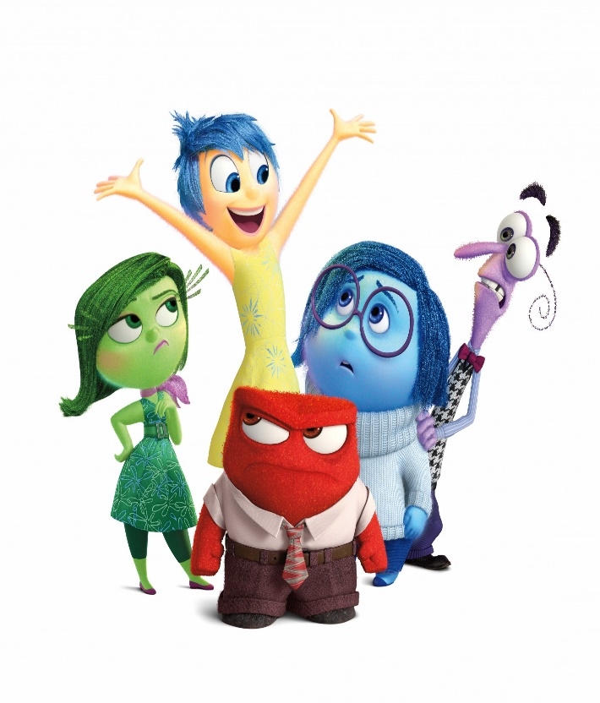
So emotions are trying to give us important messages. If we felt happy all of the time what could go wrong in our life?
Some examples - we might put ourselves in danger, allow a bully to keep hurting us or never ask for help.

Slide 8
Drama Task – I’m important because…
Task 1 – In pairs, discuss what could go wrong in your life if you didn’t have this emotion e.g. if you didn’t have anger you might let someone continue to bully you and get really hurt.
Task 2 – In pairs, each choose an emotion. Now have a debate.
Person 1: (starts) I am fear and I’m more important than you because…
Person 2: (answers back) I am sadness and I’m more important because…
Person 1: Well fear is also more important because…
Keep going back and forth with more reasons until one of you runs out of ideas and the other wins.
ANGER | SADNESS | FEAR
JOY | DISGUST | SURPRISE

Slide 9
So, just like our devices tell us when the battery is low,
or it is overheating, or something else is wrong,
our emotions are like warning lights, or important
messages trying to tell us something important.

Slide 10
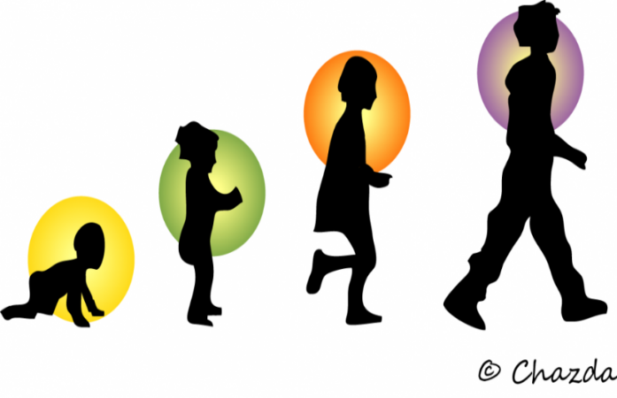
However, puberty is a time when emotions are affected more than usual. We are now going to explore this.

Slide 11
Puberty is a special time of change for young people and it becomes possible for them to reproduce (have a baby.) These changes are both..
Re-cap from Yr 6
Physical = a change that happens to the body
e.g. you grow.
Emotional = changes that happen to feelings
e.g. there are times you may feel sad and not know why.

Slide 12
Puberty – Some Key Facts
Re-cap from Yr 6
Puberty occurs between the ages of 8 and 18 years old.
Puberty is a NORMAL part of growing up.
Each person starts puberty at slightly different times – it’s important to respect these differences.
The whole process can take a few years.
Hormones are special chemical messengers in the body that tell it to go through puberty
Different changes happen depending on the sex of the person (male/female.) But some changes happen in both.

Slide 13
What Changes Happen in Puberty? (Venn Diagram)
Re-cap from Yr 6
Teacher – hand out Venn diagram
In pairs, try to complete this Venn Diagram, describing changes that happen if someone’s sex is a boy, a girl or the changes that happen in both boys and girls. If you are stuck the next slide offers ideas.
NB: please remember, some people may be born a girl/boy but feel that they are a different gender. We will go over this again later in the topic.
GIRLS
BOYS
BOTH

Slide 14
Suggestion slide!
Sometimes hair grows on upper lip
Body grows
Begin periods
Hips get broader, waist narrower
Acne (spots)
Voice gets a lot deeper and breaks
Shoulders and chest grow
Voice can deepen a little
Sperm semen produced
Voice can deepen a little
Hair on legs darker
Hair greasy
Hair grows on the face and chest
Pubic hair
Erections happen
Sweat smells stronger
More hair grows
e.g. underarms/by private parts/ legs
Wet dreams
Sexual feelings/thoughts

Slide 15
Changes in Puberty…
Re-cap from Yr 6
Sometimes hair grows on upper lip
GIRLS
BOTH
BOYS
Voice gets a lot deeper and breaks
Sexual feelings/thoughts
Begin periods
Sweat smells stronger
Shoulders and chest grow
Wet dreams
Hips get broader, waist narrower
More hair grows
e.g. underarms/by private parts/ legs
Erections happen
Breasts grow
Voice can deepen a little
acne
Sperm semen produced
Body grows
Hair on legs darker
Hair grows on the face
Hair greasy
Hair on legs darker
Pubic hair

Slide 16
We have re-capped the physical changes that happen in puberty, but now let’s explore the emotional changes that happen too.

Slide 17
Mood Swings and Puberty…
The human body is amazing. When you reach the age of puberty it sends special messengers throughout your body to tell it to grow and change.
These messengers are called hormones.
But because the hormones are working extra hard and doing a lot of jobs during puberty, it can create strong emotions in you.

Slide 18
Mood Swings and Puberty…
The hormones can then cause you to swing from one emotion to another very quickly and sometimes for no reason.
For example you may be feeling really happy and confident but suddenly something small causes you to swing into anger. Or you may be watching something very simple of the TV and suddenly you feel a lot of sadness. Does anyone want to share another example of this?
These mood swings are normal during puberty. But we are going to explore many ways to help you deal with emotions in this topic and this will hopefully help you with mood swings as well.

Slide 19
Alongside mood swings, there are many other situations caused by puberty that may cause difficult emotions.
We are going to explore some situations today and begin to think about how to deal with these emotions…

Slide 20
To help us…
We are going to add some sub-headings to the emotions…
ANGER -stress | SADNESS -rejected -lonely | FEAR -embarrassment
JOY | DISGUST -awkwardness | SURPRISE

Slide 21
Let’s look at a situation (moral dilemma)...
Tom wants to go out and see his friends at the park. It’s 10pm, his parents say no.
His reaction (Ethical decision) = Tom screams at his parents, throws his bag on to the table, knocking their things on to the floor, storms up stairs and slams his door causing the handle to break.
Discuss –
1) What emotion is Tom experiencing here? Why?
2) Is his reaction helpful for him? Unhelpful for him? Why?
3) What could he DO that is more helpful for him?

Slide 22
Group Challenge…
In groups:
Read each of the situations.
Answer the questions on the sheet together as a group trying to include everyone’s ideas. GO TO NEXT SLIDE TO SHOW EMOTIONS.
Now come up with your own similar situation.
Discuss your own with the teacher before writing it to check if appropriate.
EXT: (optional) as a group dramatize one of these situations and show two endings. One with a helpful reaction and one with an unhelpful reaction.
Now let’s go through these as a class.

Slide 23
To help us identify their emotions… (you can add others)
ANGER -stress | SADNESS -rejected -lonely | FEAR -embarrassment
JOY | DISGUST -awkwardness | SURPRISE

Slide 24
Let’s now discuss the situations as a class. (Please remember you can disagree respectfully.)
Situation 1: Sarah has found out that her friends have been talking about her on a WhatsApp group she wasn’t invited to join.
Her reaction: She approaches them at breaktime and starts a row which leads to her slapping one of them across the face.
1) What emotion is Sarah experiencing here? Why?
2) Is her reaction helpful or unhelpful for her? Why?
3) What could she DO that is more helpful for her?
Situation 2: Amir (they/them) has a Grandfather who has been rushed to hospital and Amir is really upset. Their parents tell them that they has to go to school.
His reaction: They miss school and spend the day in the park with some older students, that they don’t know very well, underage drinking.
1) What emotion is Amir experiencing here? Why?
2) Is their reaction helpful or unhelpful for them? Why?
3) What could they DO that is more helpful for them?

Slide 25
Situation 3: Shannon’s one, and only, friend in school (Isla) has just told her that she is moving away and leaving the school next term.
Shannon’s reaction: She doesn’t speak to Isla for the rest of the day and sits alone, then when at home, she blocks her from social media and eats chocolate until she feels sick.
1) What emotion is Shannon experiencing here? Why?
2) Is her reaction helpful or unhelpful for her? Why?
3) What could she DO that is more helpful for her?
Situation 4: Danny finds the courage to ask out a boy that he has fancied for weeks. The boy laughs at Danny, says no, walks away and tells the rest of the school.
His reaction: He doesn’t tell anyone, he goes home and starts analysing his appearance negatively, he then games until 4am.
1) What emotion is Danny experiencing here? Why?
2) Is his reaction helpful or unhelpful for him? Why?
3) What could he DO that is more helpful for him?

Slide 26
Situation 5: Simon is talking to his friends. They start to compare who has had the most sexual experiences. Simon says that he has only kissed his boyfriend. His mates laugh at him and tease him.
His reaction: When his boyfriend asks if he wants to go further sexually, he isn’t sure. However, he says yes so that he can impress her friends.
1) What emotion is Simone experiencing here? Why?
2) Is her reaction helpful or unhelpful for her? Why?
3) What could she DO that is more helpful for her?
Situation 6: Grace realises she has come on her period while at school. She doesn’t have any sanitary equipment.
Her reaction: She begins to cry and stays in the toilet hiding during the last lesson of the day.
1) What emotion is Grace experiencing here? Why?
2) Is her reaction helpful or unhelpful for her? Why?
3) What could she DO that is more helpful for her?

Slide 27
Situation 7: Levi keeps being asked out by a girl that lots of other boys like. They laugh at him for not saying yes and call him, “gay.” The truth is Levi thinks that he might be gay.
His reaction: He says “yes” to the girl and goes out with her even though he doesn’t want to.
1) What emotion is Levi experiencing here? Why?
2) Is his reaction helpful or unhelpful for him? Why?
3) What could he DO that is more helpful for him?
Situation 8: Tammy has important exams next week.
Her reaction: She is obsessed with the idea that she is going to fail. She begins to experience stress and begins to revise almost every hour she is awake.
1) What emotion is Tammy experiencing here? Why?
2) Is her reaction helpful or unhelpful for her? Why?
3) What could she DO that is more helpful for her?
If time, let’s share some of our own group examples…

Slide 28
We have just explored situations that have provoked a range of the emotions listed below.
ANGER -stress | SADNESS -rejected -lonely | FEAR -embarrassment
JOY | DISGUST -awkwardness | SURPRISE

Slide 29
During the rest of this topic, we are going to explore these situations in more detail and explore other helpful ways of dealing with these difficult emotions.
At the end of the topic, we are going to look at this sheet again and see if we can add to it
(so please keep it safe in one of the group’s folder.)

Slide 30
Learning Review from our previous lesson:
Why are emotions important for us to feel even if they are difficult?
What are mood swings and what causes them in puberty?

Slide 31
Learning Review from our previous lesson:
Why are emotions important for us to feel even if they are difficult?
They are messages/signals that something is right or wrong on our lives.
2) What are mood swings and what causes them in puberty?
When someone changes emotion quickly caused by hormones during puberty (although other ages may experience them.)

