Slide 1
Class Agreements
No put downs of self or others.
Listen well.
Be willing to try new things.
Participate fully (but you have a right to PASS if you don’t want to share something.)
No gossip about anyone in the classroom, or outside. This includes not telling us stories/information about people we may know.
No gossip following the lesson.
7) If you have any questions relating to puberty, please use a post-it note and put them in the brown envelope, these will be answered in a way that is appropriate to your age.
Please put thumbs up if you agree to this.

Slide 2
Let’s look back at a situation from lesson 2.
Situation 5: Simon is talking to his friends. They start to compare who has had the most sexual experiences. Simon says he has only kissed his boyfriend, his mates laugh at him.
His reaction: When his boyfriend asks if he wants to go further sexually, he isn’t sure, but says yes so that he can impress his friends.
What is the main emotion that Simon is feeling here?
Answer = fear (that his friends will laugh at him again/that he doesn’t fit in.)
If he had COURAGE to be himself and do what feels right, why may he feel happier?

Slide 3
L.O: 1) Why is fear a useful emotion? 2) How can you handle fear and have more courage?

Slide 4
In groups make a list of all of the things that scare you (on an A3 sheet of paper.)
Now share with teacher so that they can be written on the whiteboard.

Slide 5
We all have a range of fears…..
Some of our fears are useful and we may need them.
Look at these fears and discuss how they may help you:
*Fear of playing chicken on a railway line.
*Fear of meeting someone online in person that you don’t know.
*Fear of what will happen to your mind if you take an illegal drug.
Bag
of
Fears!

Slide 6
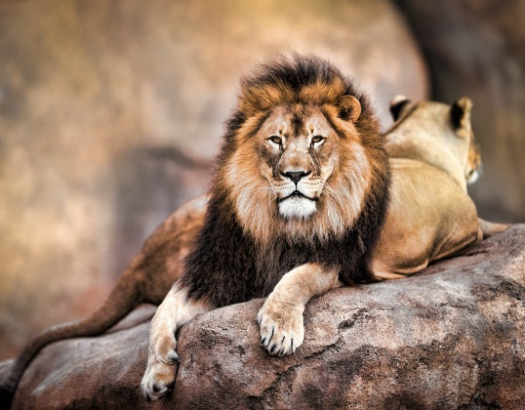
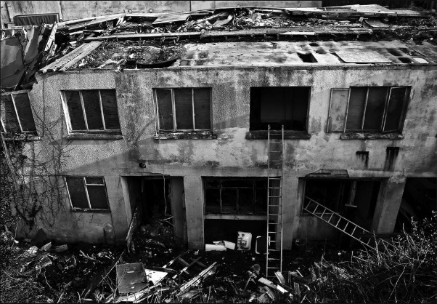
So fear can be useful because it warns us if something is dangerous and can save our lives.
Look at your group list, discuss and tick all of the
fears that you think are helpful.

Slide 7
We are going to explore other fears that aren’t so helpful. Some of these will involve confusion around sexuality and gender. So we will quickly re-cap some terms from previous PASHE topics.

Slide 8
What is the difference between (biological) sex and gender.
(Biological) Sex = whether your body is a male or female.
Gender = whether you feel like a male (boy/man) or female (girl/woman.)
Transgender = when someone doesn’t feel the same gender as their sex.
Some people realise that their gender is non-binary.
Non-binary can mean two things:
*that they sometimes feel like a boy/man and sometimes like a girl/woman.
*that they don’t feel like either.
SEX
GENDER
Watch this…
https://www.youtube.com/watch?v=PzGauky20tc

Slide 9
Important point!
Some of these words and meanings are quite new. So you may meet some people who still think gender and sex mean the same thing.
You also may notice that on questionnaires you are asked for your just your gender or sex. This shows that not everything has caught up with the new meanings of these words yet.
?

Slide 10
What does the word “sexuality” mean?
Sexuality = who you are sexually attracted to which can lead to a relationship and/or marriage.
Some people are sexually attracted to the opposite sex. They are called heterosexual (straight.)
Some people are sexually attracted to the same sex. They are called homosexual (preferred word “gay.”)
Some people are attracted to both bi-sexual (bi)
This means that in some families two women may be living together/married and may have children, and the same for men.

Slide 11
But there are other fears that are not so helpful, and can stop us from living life fully and being ourselves.
Look at these three situations again. Discuss, as a class, how their fear and reaction is stopping them from living life fully.
Simone is scared of her friends disapproval so she says yes to her boyfriend when he wants to go further with her sexually.
Grace is scared of asking for sanitary equipment so she skives in the toilet.
Levi is scared of people knowing he might be gay, so he says yes to a girl who has asked ih out..
In groups, choose one, write their name on your A3 sheet and discuss (write down) what advice you would give this person.
Let’s share ideas as a class. Teacher – please make notes on the whiteboard.

Slide 12
Finding courage do something that is difficult is usually hard. But there are things that can help.
Here are some suggestions (add these to your A3 sheet to help for next task):
Suggestion 1) Say positive things to yourself. (Quick game – stand in pairs. Person A put out your arm and say, “I am weak x3” as Person B pushes down on it. What happens? Now repeat but this time say, “I am strong x 3.”
Switch places. What we say to ourselves matters!

Slide 13
*Take little steps.
Discuss how could the Simone, Grace or Levi do that.
*Use breathing methods to calm you.
Discuss what ones do you know?
(7, 11 breath/ star breath etc.)

Slide 14
*Do a reality check.
Ask yourself what is the worst that happen, and if this does happen what
can I do about it?
*Imagine it going well.
Positive thinking can’t hurt you.

Slide 15
Ask for help…
*Talk to a trusted adult if you think you have a mental health problem.
*There are a range of free services out there to help as well:
*Childline 0800 1111.
*Winston’s Wish text WW to 85258. (Free number for anyone who has lost someone.)
*SHOUT. A free text service for anyone needing emotional help 85258.
*LGBTQ support 10am-10pm 0300 330 0630
Wellbeing Apps:
*Catch it (mental health issues)
*Smiling minds (calming)
*Happify (games etc.)
*Meetwo (securely share with others.)
*Daylio (journal)
*Some people need to see their doctor if things do not improve.

Slide 16
Challenge:
Your teacher is giving you a sheet of cards.
Cut them up and shuffle them.
Choose one. Write down the situation number.
Now discuss and write down advice you would give this person for overcoming their fear.
Repeat if time.
Let’s discuss your advice as a class.

Slide 18
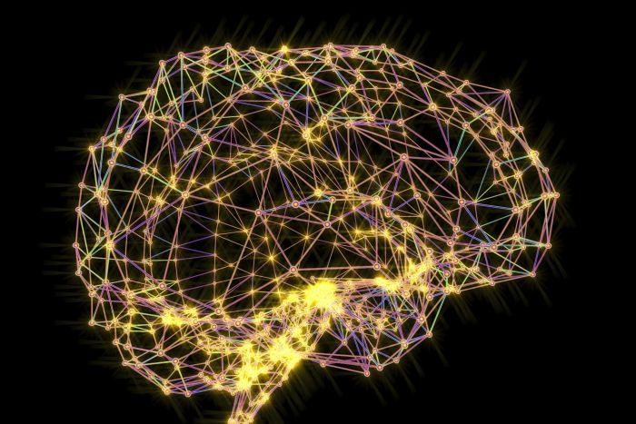
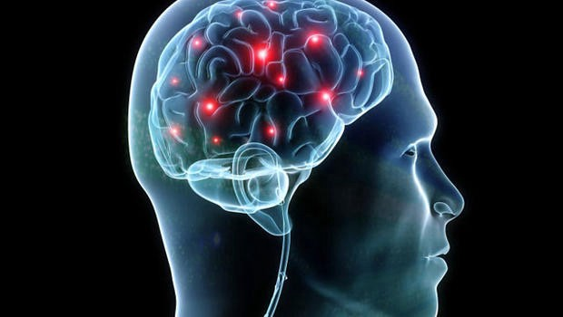
So why do we feel fear?
We learn to be scared of things either from people, the media or from past experiences.
It can also be caused by low self-esteem. We will look at this in another lesson.

Slide 19
But science shows our brain
can change and we can
learn to become more brave.

Slide 20
Scientific evidence shows that the fears we have can (almost) completely go away.
Reflect:
Have you overcome a fear? What helped you?
What things scare you now?
Is it a rational, or irrational fear?
Have you learnt anything today which may help you overcome your current fear?
Suggestions??

Slide 21
https://www.youtube.com/watch?v=doxxfXqpKYA&safe=true

Slide 22
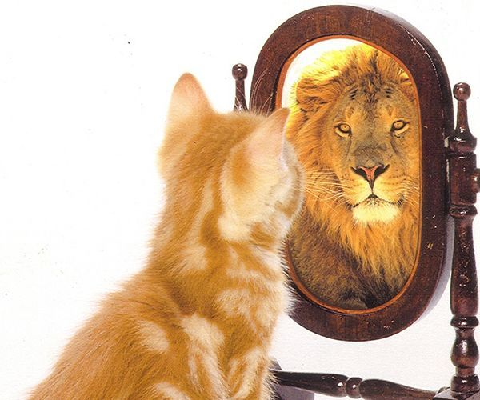
“Courage is not the
absence of
fear, it is the ability to
face fear
and try to overcome it.”
Nelson Mandela

