Slide 1
Make a list of all the things you need to stay clean.
Share with a partner/group/class

Slide 2
Personal Hygiene
Change underwear/socks everyday
Use deodorant every morning
Use deodorant after sports
Try to have a shower or bath everyday washing all parts!
Change bed covers at least once a fortnight.
Wear clean clothes
Others?
Wash hands properly

Slide 3
Watch this clip… https://www.youtube.com/watch?v=39BfmKyYnVI
Think about how you feel as you watch it.
After watching: What do you think we are going to learn about today?

Slide 4
L.O: How do I look after my teeth?
By the end of the lesson you will:
Why are teeth important?
What can go wrong with teeth if you don’t look after them
Know how to look after teeth (including how to brush them properly)

Slide 5
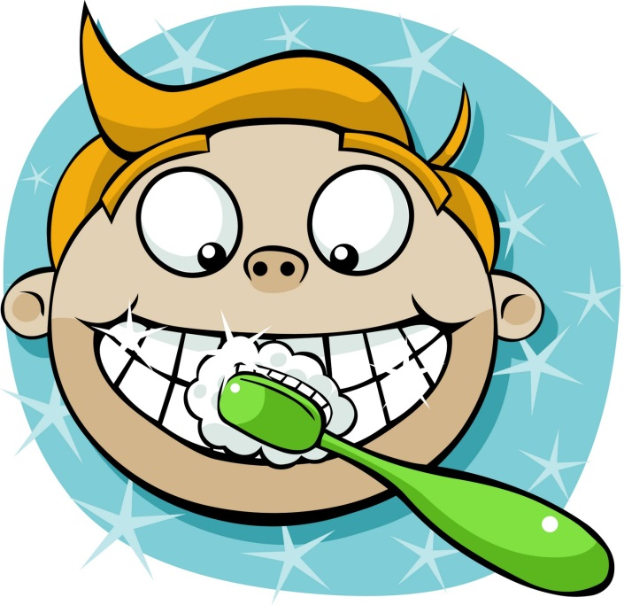
Teeth Write down everything you already know. Share and check facts.

Slide 6
1) Why are teeth important?

Slide 7
Teeth are our friends! Share ideas.
Having nice teeth can also give somebody confidence.

Slide 8
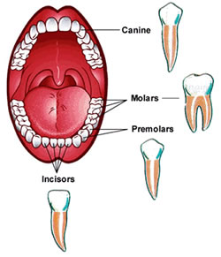
There are different teeth with different jobs so they are all important!
Tearing and ripping food apart
Do you know what the different teeth do?
Crushing and grinding food.
Mashing and grinding food so it can be digested.
Do you need all of these types of teeth?
Answer – yes if you want to be healthy and have a varied diet.
Chopping and cutting food

Slide 9
1) Why are teeth important?
Share what you’ve learnt.
Make a list in your book.

Slide 10
2) What can wrong with your teeth and why? Share ideas.

Slide 11
Clean Teeth!
Read the poem.
Underline in one colour, what the author wishes they’d given up.
Underline in another colour, why they wish they’d given it up.
What does this poem say are the main problems if you don’t look after you teeth?

Slide 12
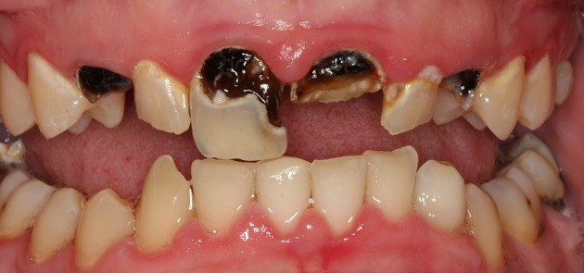
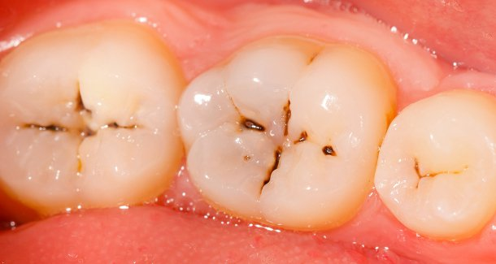
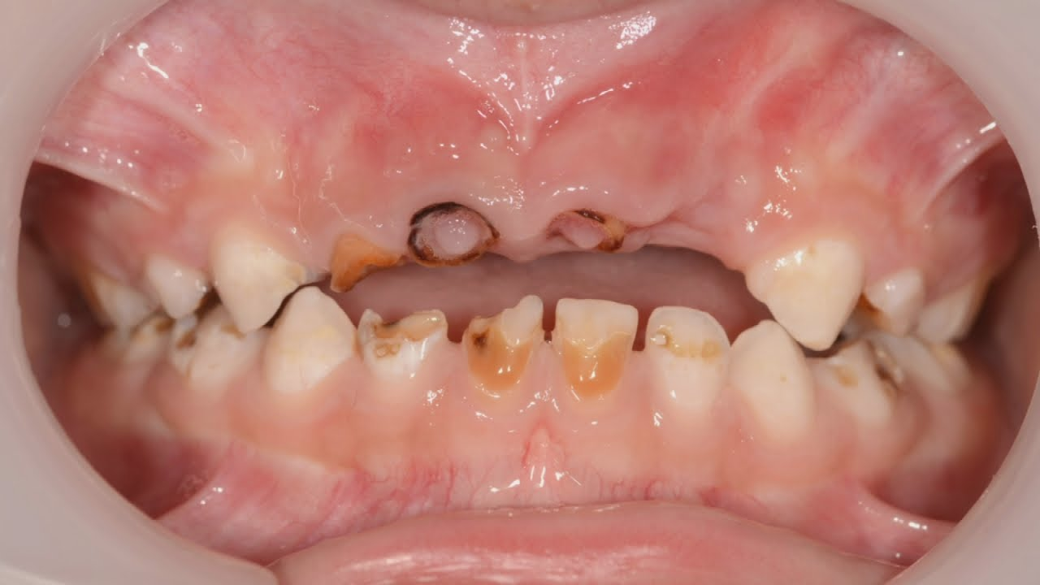
If you don’t look after them they may…
Rot and fall out!

Slide 13
If your teeth fell out, how would your life be affected?

Slide 14
2) What can wrong with your teeth and why?

Slide 15
3) How do you look after your teeth?
Share ideas

Slide 16
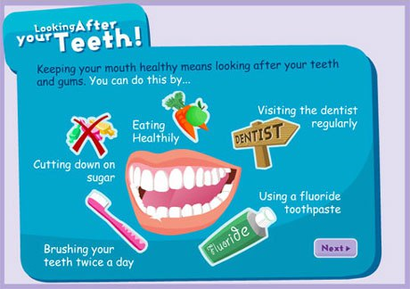
How do you look after your teeth? Share ideas.
Look at your suggestion sheet would you add anything?
When should you brush your teeth?
Twice a day
In the morning, do you brush before or after breakfast?
After breakfast
How often should you go to the dentist?
At least twice a year

Slide 17
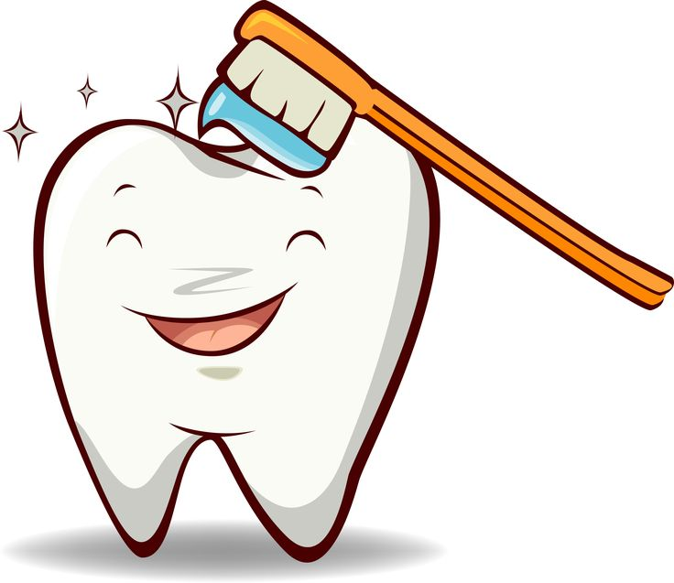
How do you brush your teeth?
https://www.youtube.com/watch?v=hDZXSMU2lAk&safe=true
Your teacher may be able to demonstrate with pretend teeth.

Slide 18
3) How do you look after your teeth?
Look at the suggestion sheet for one minute and try to memories everything. Hide it and now write a list in your book. You may want to add a diagram! Check the suggestion sheet and add, work with a partner to do this.
Have a go at brushing the teeth!

Slide 19
Learning Review:
Why teeth are important?
What can go wrong with your teeth and why?
How do you look after your teeth?

Slide 20
EX: Brushing out Bacteria Game
In pairs play the game.
You need to:
Cut out the teeth counters, one of you is bottom, one is top
Cut out the circle and borrow a matchstick.
Spin the circle. If it lands on 1, the top row moves forward one. Then follow the instructions!
Who can get to the finish point first!!

