Slide 1
Class Agreements
No put downs of self or others.
Listen well.
Be willing to try new things.
Participate fully (but you have a right to PASS if you don’t want to share something.)
No gossip about anyone in the classroom, or outside. This includes not telling us stories/information about people we may know.
No gossip following the lesson.
7) If you have any questions relating to puberty, please use a post-it note and put them in the brown envelope, these will be answered in a way that is appropriate to your age.
Please put thumbs up if you agree to this.

Slide 2
L.O: 1) What is a mental health issue? 2) What is mental health? 3) How can I create good mental health?

Slide 3
Look at this situation again:
Here Tammy is experiencing STRESS due to the emotion FEAR.
Stress is something that we all feel when we are under pressure and feel scared of something that we need to do such as exams, making new friends, doing a performance.
If we handle stress well, it can help motivate us. But we can choose, like Tammy to respond in an unhelpful way.
Situation 8: Tammy has important exams next week.
Her reaction: She is obsessed with the idea that she is going to fail. She begins to experience stress and begins to revise almost every hour she is awake.

Slide 4
What is a mental health issue?
Stress is not a mental health issue.
Difficult emotions, like sadness/anger/fear are not mental health issues either, they are messages trying to tell us something important.
So what is a mental health issue?
Discuss.

Slide 5
What is a mental health issue?
A mental health issue is something that causes someone to have a fairly long period of difficult emotions that do not easily go away. It can affect how the person feels and behave.
If someone feels a lot of fear, most of the time for more than two weeks, they may have a mental health issue called anxiety.
If someone feels very sad and low, most of the time for more than two weeks, they may have a mental health issue called depression.

Slide 6
Where to seek help…
*Talk to a trusted adult if you think you have a mental health problem.
*There are a range of free services out there to help as well:
*Childline 0800 1111.
*Winston’s Wish 08088020021 (Free number for anyone who has lost someone.)
*SHOUT. A free text service for anyone needing emotional help 85258.
*LGBTQ support 10am-10pm 0300 330 0630
Wellbeing Apps:
*Catch it (mental health issues)
*Smiling minds (calming)
*Happify (games etc.)
*Meetwo (securely share with others.)
*Daylio (journal)
*Some people need to see their doctor if things do not improve.

Slide 7
So what is MENTAL HEALTH?
Physical health means the condition of our body (how well is our body?)
Mental health means the condition of our mind (how well is our mind?)
Wellbeing means the condition of your body and mind (how well is your body, how well is your mind?

Slide 8
We all know that we need to do certain things each day to stay physically healthy such as eating healthily, exercising and keeping good hygiene.
But we also need to do certain things each day to stay mentally healthy.
This will help our overall mood each day, but it will also mean that we will be mentally stronger when we are faced with tough times.

Slide 9
So how can you create good mental health?

Slide 10
Task – take out your bookmark from lesson 1.
Re-cap the emotions that you explored then turn the bookmark over.
Now write these letters going down the left side of your book mark.
S
T
O
P
N
O
W
Now watch the STOP NOW film created by Selwood Academy students.
As you watch it, try to write down what each letter stands for.

Slide 11
Answers:
Fill this in on your bookmark, then make notes as you we go through each one now.
S = sleep
T = Tech (am I using too much?)
O = Outdoors/exercise
P = People (am I a good friend/do I have good friends?)
N = Nutrition
O = Oxygen (breathing techniques)
W = Water

Slide 12
Make notes on each one and think about which ones you do well, and which ones you could improve for better mental health.

Slide 13
S
T
O
P
N
O
W
S
T
O
P
N
O
W
S
T
O
P
N
O
W
S
T
O
P
N
O
W
S
T
O
P
N
O
W
S
T
O
P
N
O
W
S
T
O
P
N
O
W
S
T
O
P
N
O
W
S
T
O
P
N
O
W
S
T
O
P
N
O
W
S
T
O
P
N
O
W

Slide 14
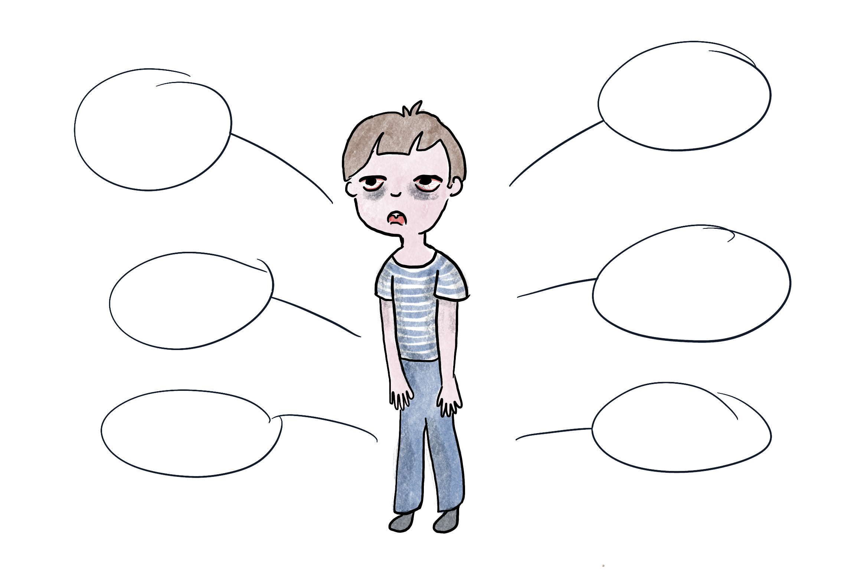
S
T
O
P
N
O
W
= sleep (am I getting enough sleep?)
S
Y
M
P
T
O
M
S
7-13 year olds should get 9-11 hours sleep each night. (If you get up at 7am go to bed between 8-10pm.)
(14-17 years old 8-10 hours)
(Adults 7-9 hours)
Difficulty remembering things
Difficulty concentrating
Tips for better sleep:
Avoid screen time for an hour before bed.
Read to help you sleep.
Avoid sugar/eating a a few hours before bed.
Use YouTube or sleep apps to help you.
Body feels weaker, eyes sore
Makes you feel down/depressed
Can increase worry/stress/bad temper
Long-term it can lead to physical health issues

Slide 15
S
T
O
P
N
O
W
= tech (am I using too much tech?)
It is recommended that young people should spend no more than two hours a day on their tech (screen time.)
F
I
N
D
I
N
G
S
There are many good things about technology but studies have shown too much can lead to some serious problems…
*Shorter attention-span
*Eye problems and headaches
*Difficulty handling emotions
*Addiction to technology which can lead to lots of other problems
Tips for less tech:
Set a timer each day.
Try other, new things that don’t involve tech such as….

Slide 16
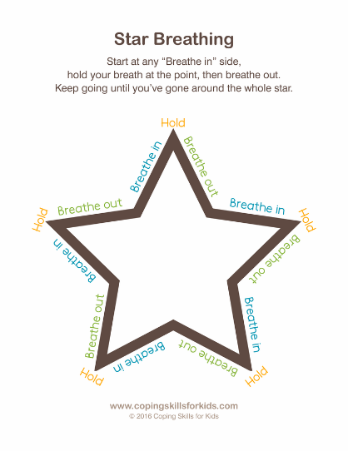
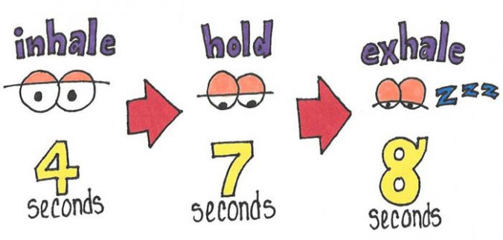
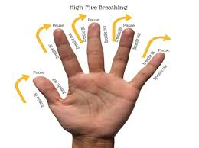
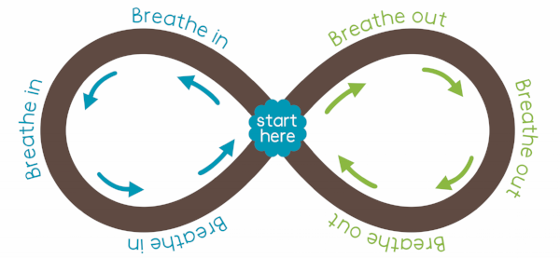
S
T
O
P
N
O
W
Some good free apps to help:
Smiling mind
Happify
Calm
= oxygen (am I using any breathing techniques?)
Breathing exercises can help you relax, because they make your body feel like it does when you are already relaxed. Deep breathing is one of the best ways to lower stress in the body. This is because when you breathe deeply, it sends a message to your brain to calm down and relax.

Slide 17
S
T
O
P
N
O
W
= people (am I being kind to others? How’s my friendships going?)
The people that are in our life have a big effect on the way we feel. It’s actually a self-kindness to be kind to others as it makes us feel good and make better friendships. But it’s also good to ask, how are my friendships going? Are we being nice to each other? Would I like to make new friends? How could I do this?
Tips:
*Try new hobbies to meet new people.
*Speak to one new person every day.

Slide 18
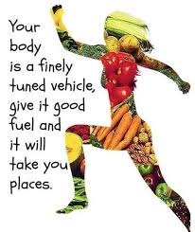
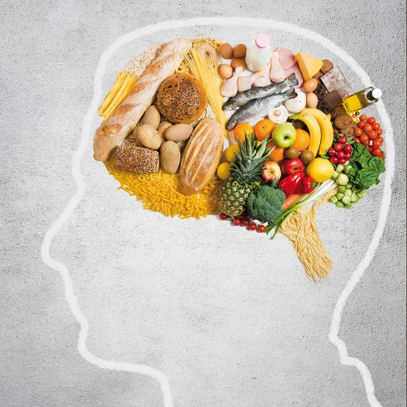
S
T
O
P
N
O
W
Making healthy food choices is one of the kindest you can do for your body and mind. It helps you fight off illness, be strong, gives you more energy and it’s been recently discovered massively helps you feel happier and more awake.
= nutrition (am I eating healthy food?)
Tips:
Try swapping one or two unhealthy snacks for a healthy snack each day.

Slide 19
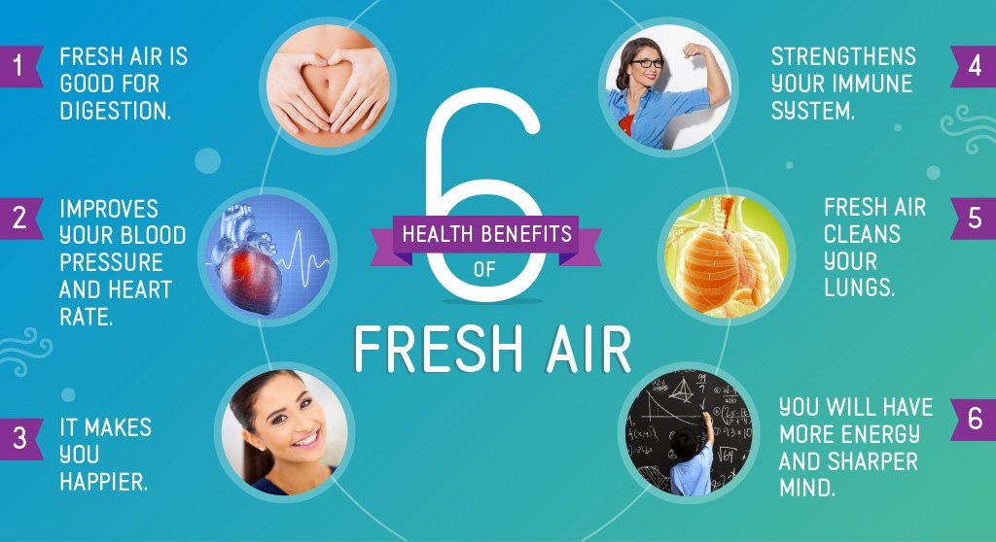
S
T
O
P
N
O
W
Tips:
*Aim to do 1 hour of exercise every day.
*Make plans with friends to exercise/do sports together.
*Join clubs.
*Try things online e.g. Just Dance.
= outdoors and exercise (Am I getting enough?)

Slide 20
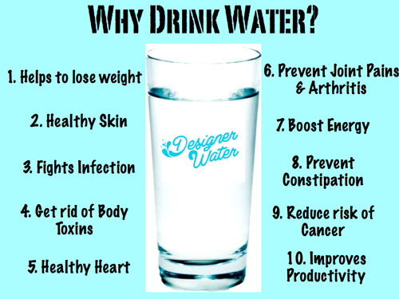
S
T
O
P
N
O
W
Tips for more water:
*Buy a water bottle you like.
*Take it with you everywhere you go.
*Ask yourself halfway through the day if you have drunk enough.
*If you have a headache, feel low or sleepy check your water intake.
= water (am I getting enough?)

Slide 21
Suggestion – what to do next?
Keep this book mark. At the end of each day, go through the letters and tick ones you have done well and cross those you haven’t, set a wellbeing target for the next day. You could do this in a notebook instead. Notice if your mental health/wellbeing improves?
S = sleep
T = Tech
O = Outdoors/exercise
P = People
N = Nutrition
O = Oxygen
W = Water
Quick note:
If you are trying all of these things and your mental health still doesn’t feel good, remember all of the support service mentioned in this topic.

Slide 22
Reminder…
If you are trying all of these things and your mental health still doesn’t feel good, remember all of the support service mentioned in this topic.
*Childline 0800 1111.
**Winston’s Wish text WW to 85258. (Free number for anyone who has lost someone.)
*SHOUT. A free text service for anyone needing emotional help 85258.
*LGBTQ support 10am-10pm 0300 330 0630
Wellbeing Apps:
*Catch it (mental health issues)
*Smiling minds (calming)
*Happify (games etc.)
*Meetwo (securely share with others.)
*Daylio (journal)

Slide 23
Learning review: 1) What is a mental health issue? 2) What is mental health? 3) How can I create good mental health?

Slide 24
Answers:
A mental health issue is something that causes someone to have a fairly long period of difficult emotions that do not easily go away.
Mental health means the condition of your mind (how well is your mind?)
To create good mental health you can use the acronym STOP NOW.

