Slide 1
Class Agreements
No put downs of self or others.
Listen well.
Be willing to try new things.
Participate fully (but you have a right to PASS if you don’t want to share something.)
No gossip about anyone in the classroom, or outside. This includes not telling us stories/information about people we may know.
No gossip following the lesson.
7) If you have any questions relating to puberty, please use a post-it note and put them in the brown envelope, these will be answered in a way that is appropriate to your age.
Please put thumbs up if you agree to this.

Slide 2
We are going to end this topic by focusing on the emotion - joy. We will begin with some drama games to help us explore this emotion.

Slide 3
Drama Game: My Joyful Journey to School!
Task 1:
Person A describes to Person B their ‘incredible journey to school’ (make the description as funny/crazy/magical/unbelievable as you like.)
Person B’s job, as a listener, is to encourage Person A to have confidence in their story and to keep going, saying things like, “Your don’t say! That’s incredible. I wish I’d been there! What happened next?” Swap over.
Task 2:
Now repeat the above task but describe something that has been a real joyful experience (optional challenge – choose an event during lockdown.)

Slide 4
Drama Game: The Birthday Party!
Stage 1: Write down your favourite moment of your favourite birthday.
Stage 2: Now make a statue of this, everyone try to guess what is happening!
Stage 3: In pairs, Person A brings an imaginary gift to another. It may be small, or large, light or heavy and whatever shape they choose. This gives Person B a clue about what it might be.
Stage 4: Then B pretends to open it and absolutely loves it. If they decide it is a bicycle, they can pretend to ride it, then A has to say something to show they have worked out Person B’s mime. For example, ‘Do you need stabilisers to help you ride that bicycle?’
Person B can keep adding to their mime until Person A gets it right!

Slide 5
Drama Game: One-upmanship
Working in pairs, Person A and Person B try to out do each other with joyful stories! It can be silly and funny but try to link it to lockdown.
A: ‘Hey, I’ve got some great news.’
B: That’s good, what is it?
A: My parents have put a swimming pool in my back garden.
B: Oh, yeah, well my parents put a swimming pool in my back garden and filled it with chocolate buttons, they melted in the sun and now we have a chocolate swimming pool.
A: Well my parents…..
Suggested topics: staying at home not going out to play football
not being able to go to the shops Only being able to go for walks/bike rides

Slide 6
L.O: 1) What is joy?
2) How can I bring more joy and happiness to my life?

Slide 7
Look at this situation again…
Why do you think Simone wanted to impress her friends?
Do you think she think thinks highly of herself?
(has good self-esteem/is confident.)
Will this give her more self-esteem?
Situation 5: Simone is talking to her friends. They start to compare who has had the most sexual experiences. Simone says she has only kissed her boyfriend, her friends laugh at her.
Her reaction: When her boyfriend asks if she wants to go further sexually, she isn’t sure, but says yes so that she can impress her friends.
Suggestion – even if her friends are impressed, she might actually feel worse about herself, because she has gone along with something sexually that she wasn’t sure about. She may also feel, deep down, that these aren’t great friends.

Slide 8
How does good self-esteem bring joy?
People who has good self-esteem do not feel so much FEAR about wanting to be liked by others and fit in. So they often make CHOICES that are right for THEM. Long-term this will bring more joy to your life.
Example:
Friend 1: So did you sleep with him?
Simone: No.
Friend 2: Why? (laughs)
Simone: Because I didn’t want to. No other reason (she smiles.)
Simone has good self-esteem so she doesn’t care if her friends judge her or not, she is happy with herself and her decisions.

Slide 9
How do you develop good self-esteem?
From the moment we are born, we take in positive or negative messages given to us. Some people have family and friends that build them up, others don’t. The negative or positive voices then go within and we hear them as thoughts.

Slide 10
If we think lots of negative thoughts about ourselves and are easily persuaded to do things, we may not have very high self-esteem.
But we can change the way we think about ourselves by:
*Focusing on positive things about ourselves.
*Focusing on positive things we have achieved.
*Focusing on positive things that people say to us.

Slide 11
Task 1: You need the spiral and different colours.
Think of five to ten things that you like about yourself, or that you have achieved. Write them on the spiral.
Now pass it to the two people next to you to add things.
Write in the spiral like this…

Slide 12
Another way of developing good self-esteem and joy, is to DO things that make you happy.
These things could be big or small.
Task 2: Add ten or more things to your spiral that bring you joy. As a class you may want to share ideas to help everyone complete this task.
Write in the spiral like this…

Slide 13
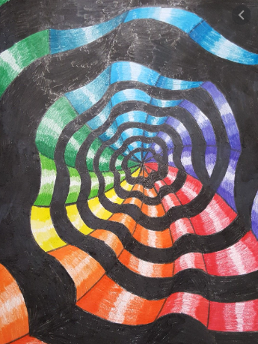
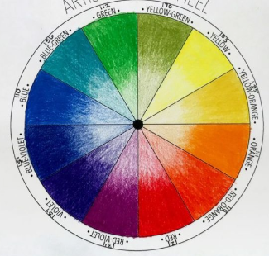
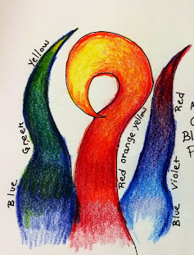
Task 3: Adding Colour To Your Spiral
a) Watch the YouTube clip on tips on how to blend colouring pencils.
https://www.youtube.com/watch?v=wchtknP-xoo
b) Spend 5 minutes practicing blending colours together in your jotter.
c) Colour in your spiral. Use the colour wheel as inspiration, BUT PLEASE COLOUR LIGHTLY SO THAT YOUR POEM CAN STILL BE READ.

Slide 14
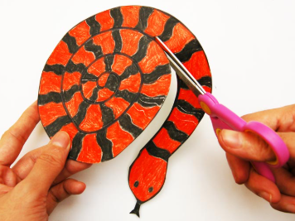
Task 4: Cut out your spiral. Then cut out a small hole where the red dot is located. The easiest way to do this is to fold the paper and cut a small diamond shape.
Stage five: Cut your piece of wool in half. Put one piece away for next week.
Thread the other piece through the hole and tie a knot, so that it can be hung on the Hope tree next week!

Slide 15
You can display these at home, or in school, to remind you that you can create your own joy by what you choose to say to yourself and the choices you make.

