Slide 1
Selwood SATs Evening

Slide 2
What are SATs and why are they important?

Slide 3
SATs at Selwood

Slide 4
When and what does it look like?

Slide 5
4th March revision week
11th March Mock SATs week
1st May – 10th May Revision week
13th May SATs week

Slide 6
Last years paper
Maths
59% knowledge taught in years 3-5
40/40 on Arithmetic paper leaves you needing 18 Marks out of 70 on remaining two papers
Reading
Started with inference – test resilience
Easier questions as last two questions
Testing them as readers not their ability to answer test questions
GPS
Less than 50% of pupils nationally got capital letters and full stop question correct.
60% of the paper is word classes and punctuation

Slide 7
Reassure your child/children they will be fine.
The tests are important but all we ask is you try your best.
Revise
Teach skills you know every day at home- Time, Money, Fractions
Read and talk lots
Timetables are key
Make sure they eat and sleep well on SATs week.

Slide 8
MATHS

Slide 9
The Numeracy tests have undergone the biggest change.
Paper 1 - ‘Arithmetic’ (30 minutes), covering calculation methods for all operations, including use of fractions, percentages and decimals.
Questions gradually increase in difficulty.

Slide 10
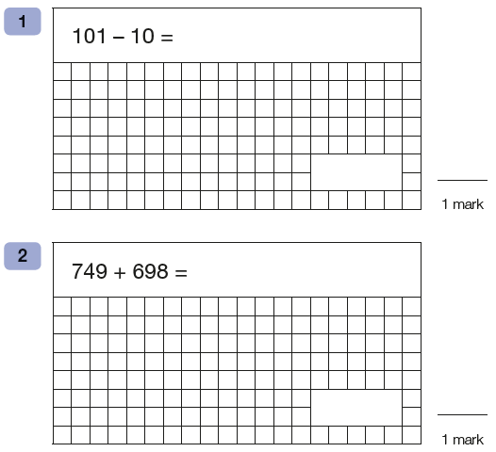

Slide 13
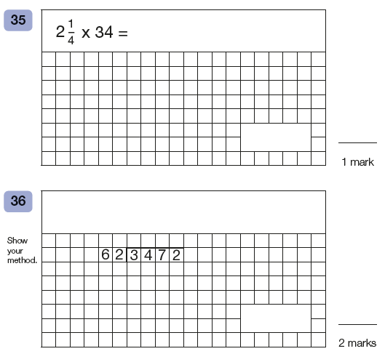

Slide 14
Arithmetic seen as the easier paper = no reading required.
Fantastic range of free resources available online to support with knowledge.
E.G – www.myminimaths.co.uk

Slide 15
Papers 2 and 3 - Problem Solving and Reasoning (40 minutes each).
Pupils will still require calculation skills but will need to answer questions in context and decide what is required to find a solution. (no calculators allowed)

Slide 16
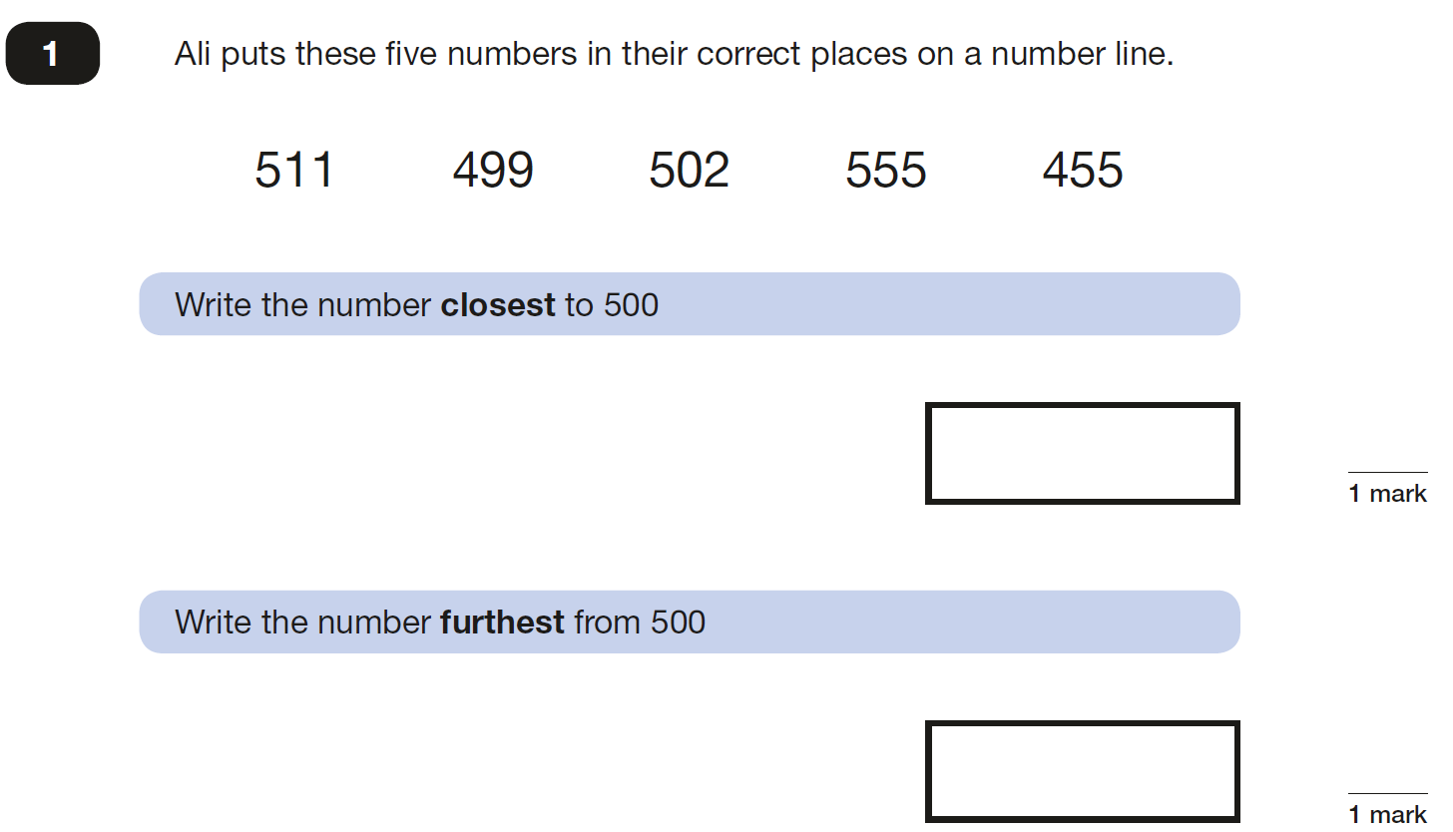

Slide 25
Types of Skills we are building and assessing:
Fluency
Reasoning
Problem-solving

Slide 26
Fluency
Recalling maths knowledge quickly and accurately
Applying knowledge of calculations and methods across contexts

Slide 27
Reasoning
Using calculations and mathematical language to prove an ‘argument’
Being able to generalise using a strategy or method

Slide 28
Problem-solving
Applying maths knowledge to situations that are familiar as well as new contexts
Breaking down problems into smaller steps, and knowing what order to do the calculations

Slide 29
Resources to use at home (on website/google classroom):
www.sats-papers.co.uk
www.myminimaths.co.uk
If you would like more resources, or any specific information – please email or phone:
Oliver.Littlewood@Selwood-academy.co.uk

Slide 30
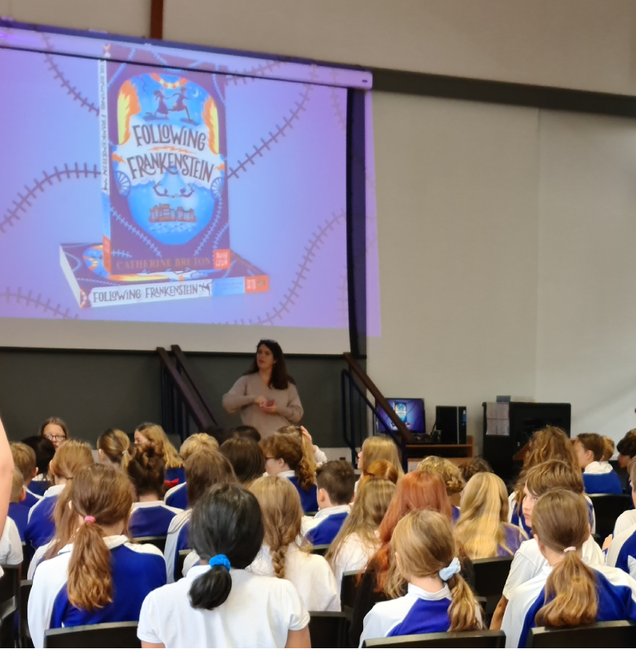
English

Slide 31
What does the curriculum look like for English?

Slide 32
What will be assessed or tested?
There are four elements to English SATs:
Grammar, Punctuation
Spelling
Reading
Writing

Slide 33
What assessments happen at the end of Key Stage Two?
Reading – tested under examination conditions
Spelling - tested under examination conditions
Punctuation and grammar – tested under examination conditions.
Writing - skills will be teacher assessed and will reflect a variety of different writing styles and skills.

Slide 34
To help prepare students …
Reading and grammar skills are embedded in our lessons and schemes of work.
We run practice SATs papers throughout Year 5 and Year 6 – results sent out to students and parents.
Year 6 have a SATs dedicated lesson once a week.
Additional intervention run for students where required.

Slide 35
Reading – KS2
Reading is not just made up of one thing: reading is in fact a collection of different skills which help contribute to our understanding of texts and the world around us.
These skills range from being able to skim and scan texts to locate key information, using comprehension to ensure a text’s meaning is understood, through to using inference and deduction to work out the implied meaning behind a text.
Throughout KS2 the children move from decoding words to interpretation and deduction.

Slide 36
Reading Paper
Three texts, usually a mixture of fiction, non-fiction and poetry.

Slide 37
Reading Paper

Slide 38
How we support students’ reading
At Selwood we use the reciprocal reading strategy to help students understand how the process of reading works. It also helps them to break down and tackle more challenging texts.
This is used in combination with discrete reading lessons, which introduce students to a wide variety of high-quality texts and help build their SATs skills.
We also use a bespoke homework programme called Bedrock.

Slide 39
How to support students’ reading at home
Students should be encouraged to read a wide range of texts at home – not just fiction texts but non-fiction as well. Suggested reading will be made available on the school website.
Talking to your child about what they are reading and encouraging them to use the reciprocal reading strategy when they read.
Encouraging students to think about the Purpose Audience and Format (or PAF) of what they are reading.

Slide 40
Writing – KS2
As a life skill, writing is central for students’ ability to communicate with the outside world.
At KS2 students can expect to write in a variety of different styles and for a variety of different purposes. They will also look at the difference between formal and informal types of writing.

Slide 41
Example assessments
Write a non-fiction magazine entry with the theme of ‘Dragons’.
Write a diary entry from the perspective of a character.
Write a news report based on the short story we have just read.

Slide 42
How we support students’ writing
Introducing students to a range of different text types and writing styles.
Explicit modelling of examples.
Ensuring that tasks are relevant and that the skills are revisited and built on frequently.
High quality texts used as examples.
Writing intervention sessions.

Slide 43
Spelling and Grammar – KS2
As a life skill, grammar goes hand-in-hand with students ability to write and communicate.
Grammar rules are taught throughout the curriculum and are embedded into units of work.
Bedrock supports the teaching of grammar and there are discrete grammar sessions in English.

Slide 44
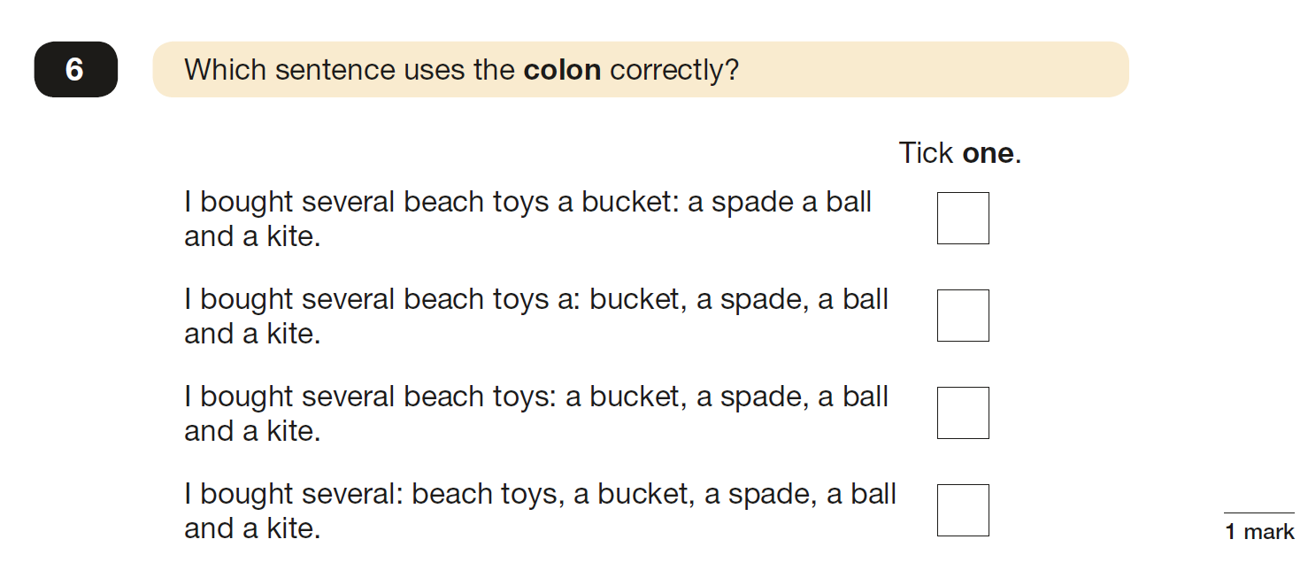
Punctuation and Grammar paper

Slide 45
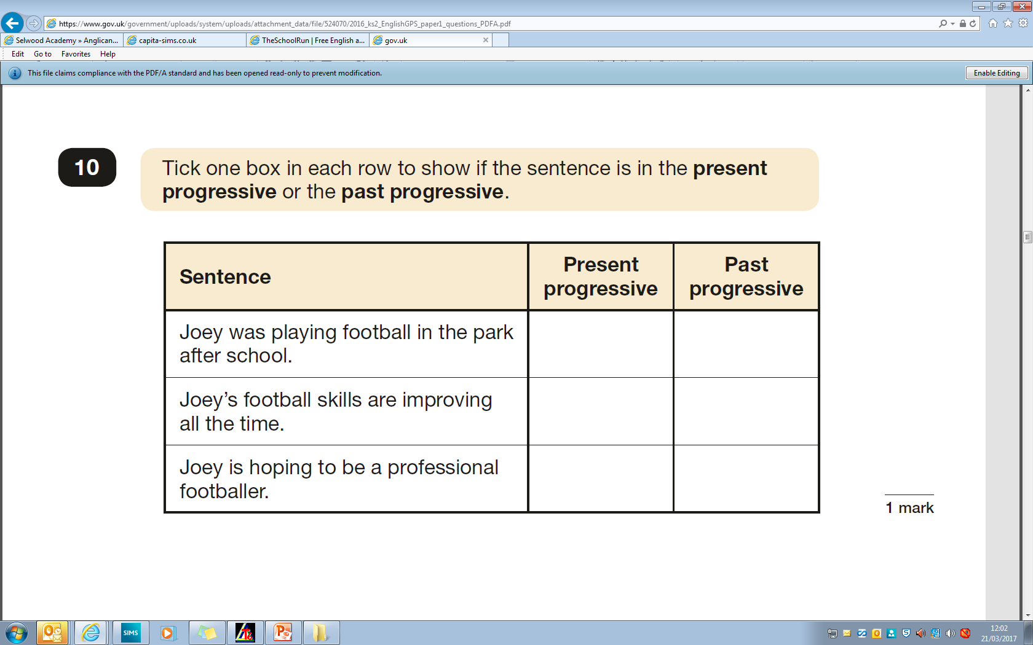
Punctuation and Grammar paper

Slide 46
Spelling Paper
Examples of spellings
1. healthy 7. physical
2. advantage 8. process
3. varieties 9. available
4. remember 10. medicine
5. release ( There are 20
6. surprising spellings in total )

Slide 47
Thank you for coming!

