Slide 1


Slide 2
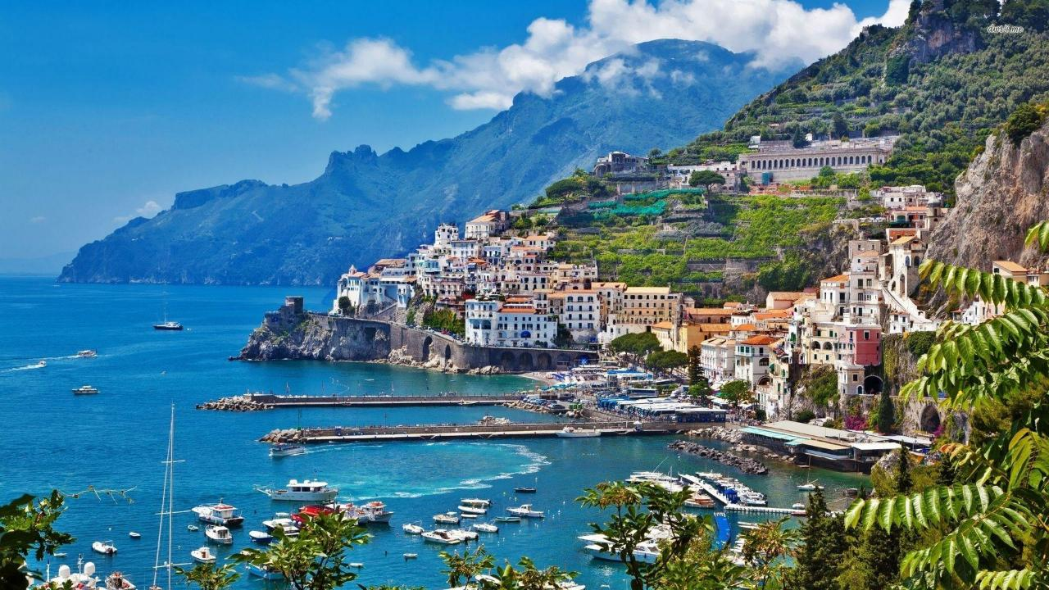
Selwood Academy
Geography tour to Sicily
7th – 10th October 2026

Slide 3
Objectives
To experience Italian culture
To visit Europe’s most active volcano - Mt. Etna
To explore plate tectonics, eruptions and management
To observe coastal erosion, beach types and management
To assess the impact of tourism on Taormina
To think about how Sicily can protect its fragile volcano and beach ecosystems while welcoming thousands of holiday makers each year.
To have fun!!!

Slide 4
The Rayburn Tours Difference
The Rayburn Tours Team
A family-run company
Unforgettable international experiences for young people
Over 50 years’ experience
Team of dedicated specialists
Delivering on promises of safety, support, service and experience time and time again
Our Customers
Taking care of the travel arrangements for 23,000 young people each year
Average customer service rating of 4.7 out of 5
Notes:
The Rayburn Tours Team
We are a family-run company who have been creating unforgettable international experiences for young people for over 50 years.
With a wealth of expertise, our team of specialists are dedicated to ensuring we deliver our promises of safety, support, service and experience time and time again.
Our Customers
Taking care of the travel arrangements for 23,000 young people each year and with an average customer service rating of 4.7 out of 5, your child is at the centre of everything we do.

Slide 5
Tour Inclusions
Return flights with Ryanair from London Stansted to Vincenzo Bellini Catania Airport
3 nights’ accommodation at San Pietro Hotel
Meals on a full board basis - packed lunch provided 8th, 9th and 10th October, 7th pizza making
Travel on the island
All activities and excursions
Comprehensive Travel Insurance

Slide 6
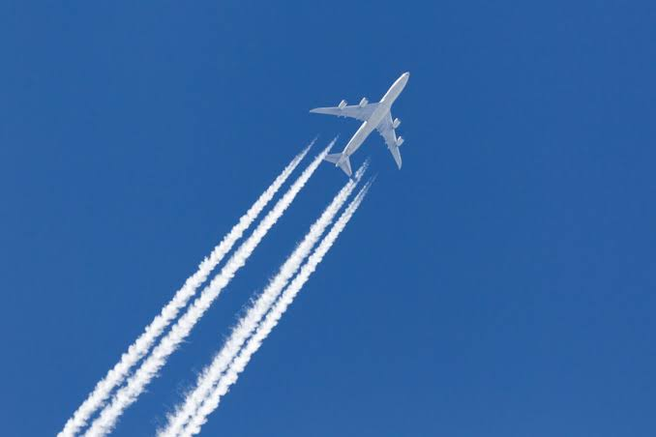
Flights
Inbound Flight:
Saturday 10th October 2026
Flight number: FR8543
Departing from: Catania Airport
Arriving at: London Stansted Airport
Outbound Flight:
Wednesday 7th October 2026
Flight number: FR5059
Departing from: London Stansted Airport
Arriving at: Catania Airport
Check-in opens | 04.20
Flight departs London | 06.20
Flight arrives in Sicily | 10.30
Check-in opens | 10.20
Flight departs Sicily | 13.20
Flight arrives in London | 15.40

Slide 7


Luggage Allowance
1 item of hold luggage weighing no more than 10kg per person. Make sure you can carry this as there is a walk to the hotel. Wheeled is best!
1 item of cabin luggage with dimensions no more than 40 x 30 x 20 per person and must fit under the seat in front of you
Please refer to the Ryanair website for further information regarding luggage restriction

Slide 8
Accommodation
3 Nights at San Pietro Hotel
En-suite rooms of varying size mostly triples and quads
Breakfast, packed lunch (not on Day 1 will be pizza making and eating) & evening meal
Soap and towels are provided in the rooms
Drinks, except tap water, are not included with meals
Dietary requirements should have been shared!

Slide 9
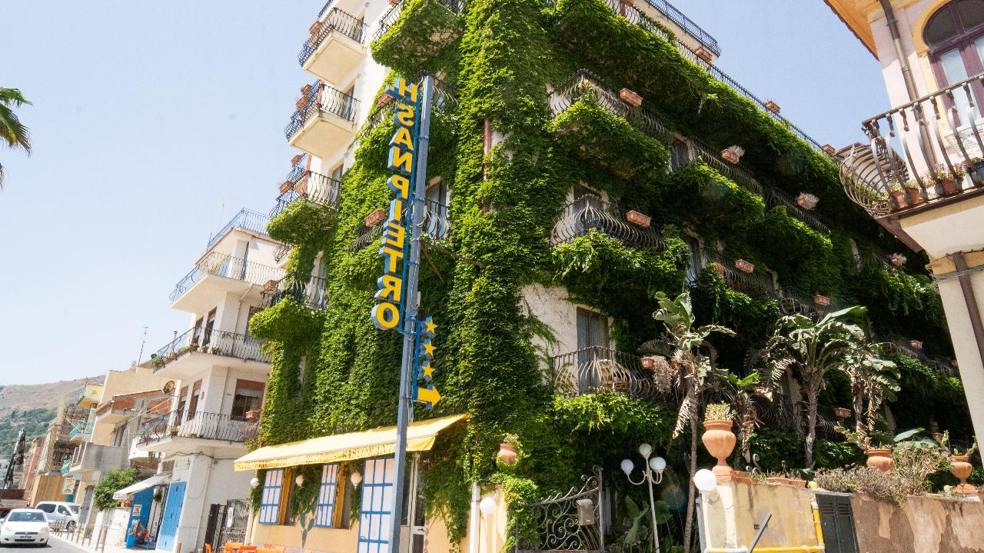
San Pietro Hotel

Slide 10
Depart school 00:30
Day 1: Wednesday 7th October 2026
06.20
10.30
12.30
12.45
15.45
19.00
Flight departs London Stansted Airport
Flight arrives at Vincenzo Bellini Catania Airport
Coach arrives at the coach parking terminal at the Porta Catania in Taormina
Ristorante Pizzeria Porta Messina - pizza making and eating
Free time in Taormina
Evening meal at the accommodation

Slide 11
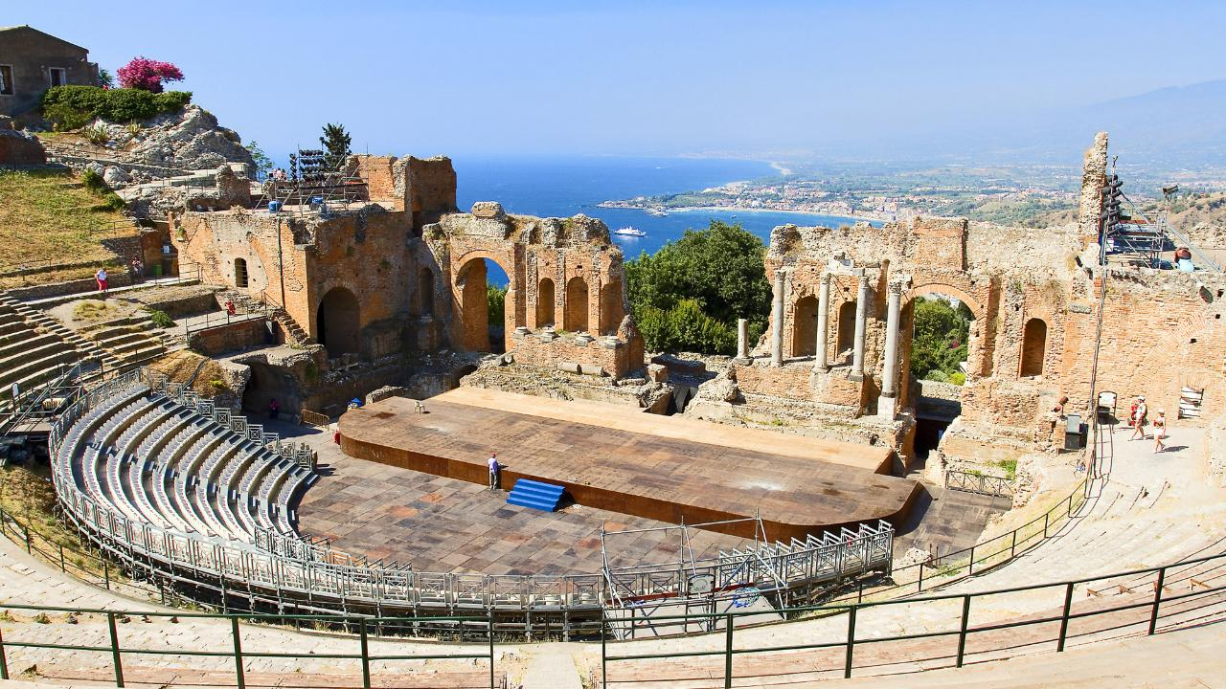
Taormina

Slide 12
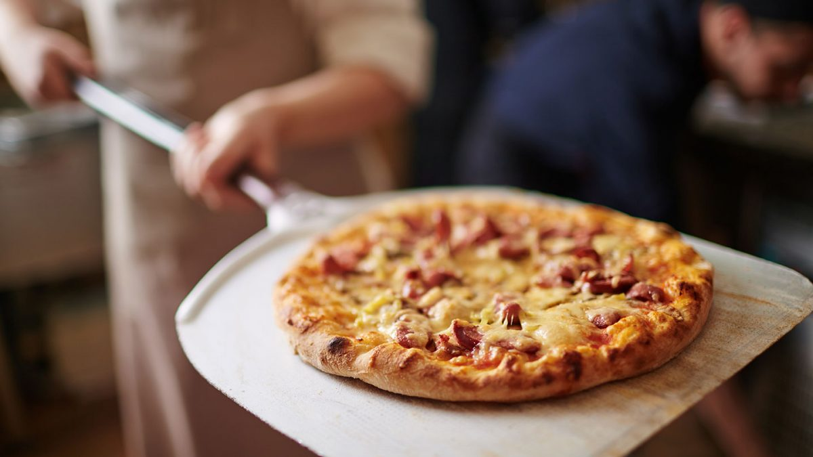
Pizza lunch

Slide 13
Day 2: Thursday 8th October 2026
08.30 | Breakfast at the accommodation and collect packed lunches and walk to coach pick up point
 | Colata Lavica 1991/93 (Zafferana)
 | Oro D’Etna honey shop & factory
 | Mount Etna Sud
 | Cable car and jeep ride
 | Coach departs for the accommodation
19.30 | Evening meal at accommodation and remainder of evening at leisure Early to bed up at 05:00 on Friday
Uneven ground - sturdy shoes and layers
1 hour walk
6 people per cable car

Slide 14
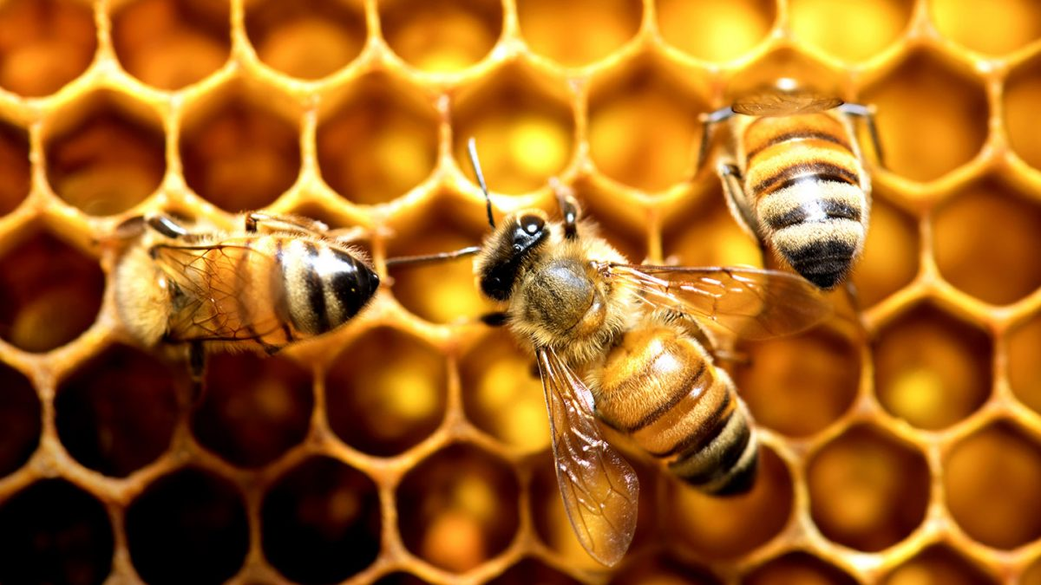
Oro d’Etna Honey Shop and Factory

Slide 15
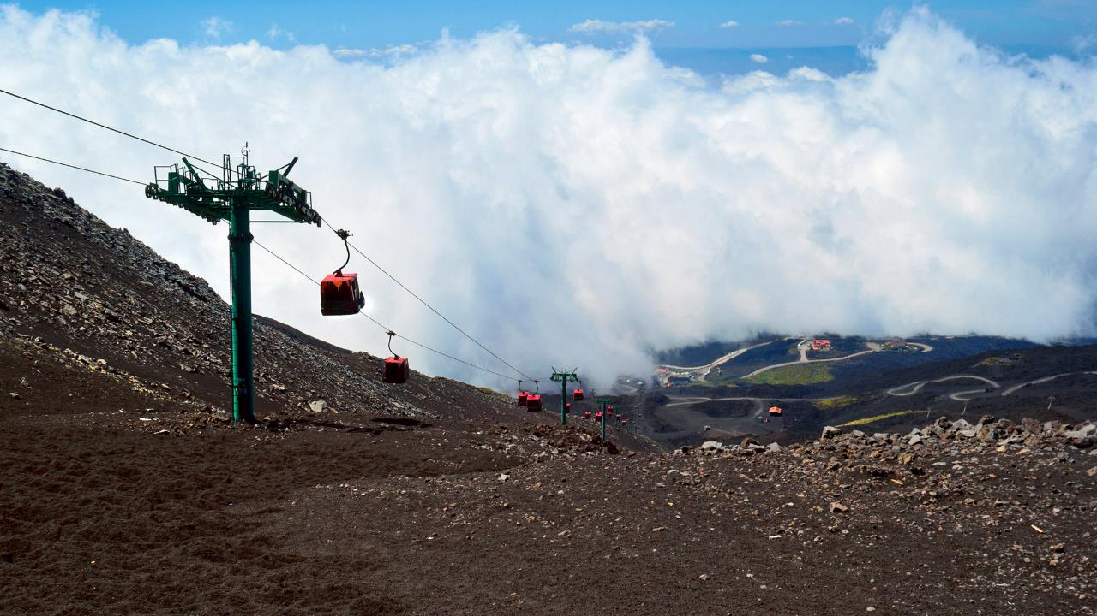
Mount Etna Cable Car

Slide 16
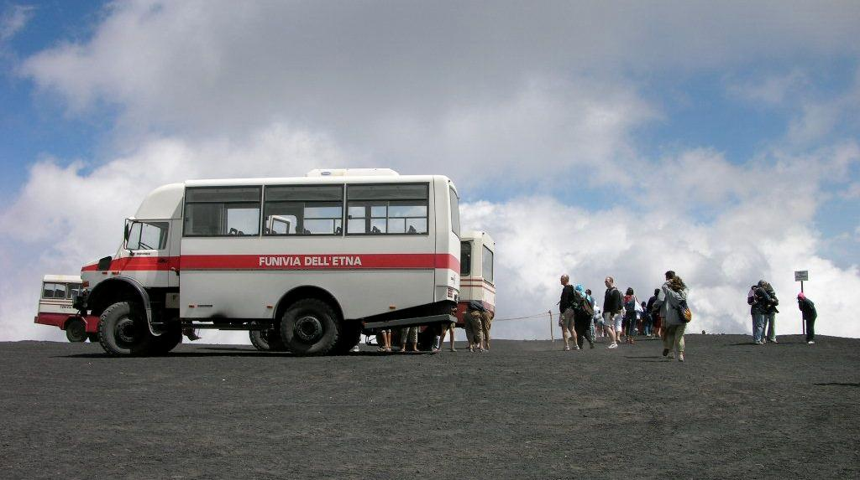
Mount Etna 4 x 4 Experience

Slide 17
Day 3: Friday 9th October 2026
05.45 | Collect packed breakfast and lunch and walk to the coach pick up point
 | Coach arrives at Milazzo Harbour
 | Ferry leaves Milazzo harbour for Vulcano harbour
 | Ferry arrives at Vulcano harbour for a guided hike to Gran Cratere
 | Ferry arrives at Milazzo Harbour
 | Coach departs for the accommodation
19.30 | Evening meal at accommodation and remainder of evening at leisure
4km hike
Uneven ground and loose
Sturdy shoes and layers

Slide 18
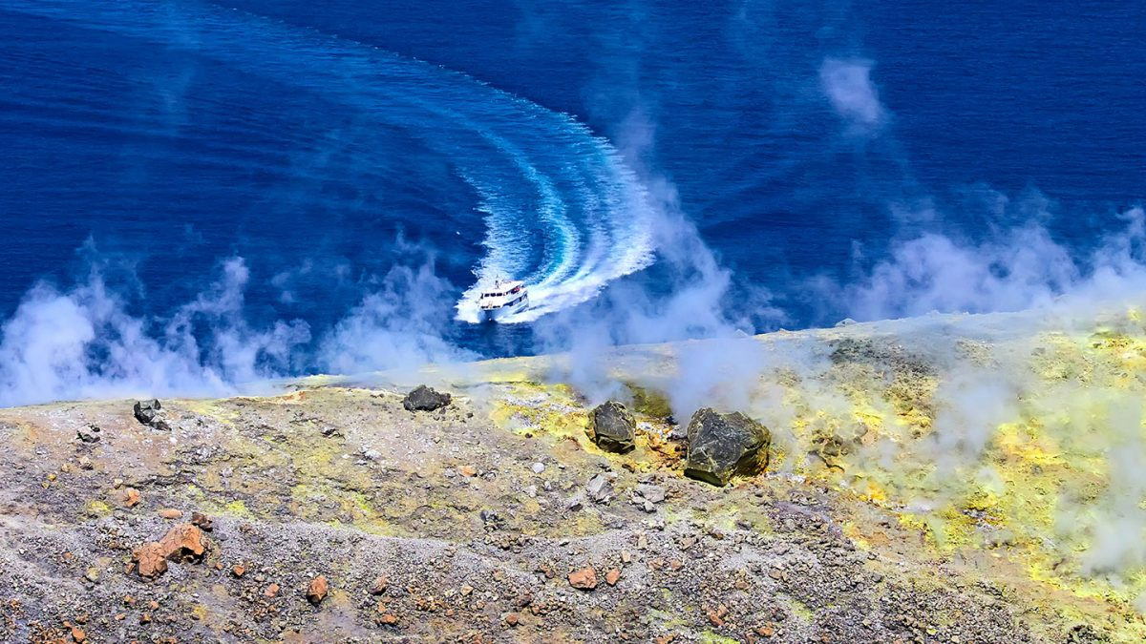
Vulcano Ferry Crossing

Slide 19
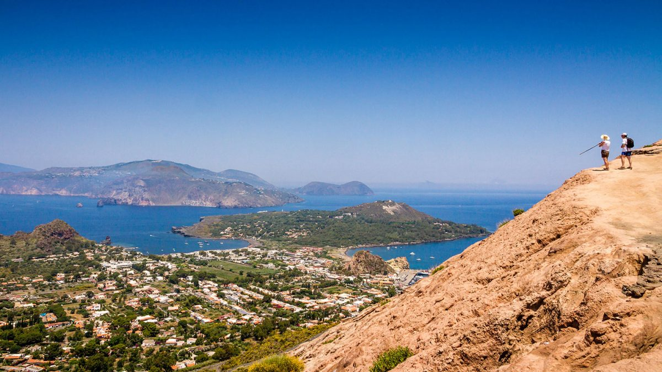
Guided Trek up Gran Cratere, Vulcano

Slide 20
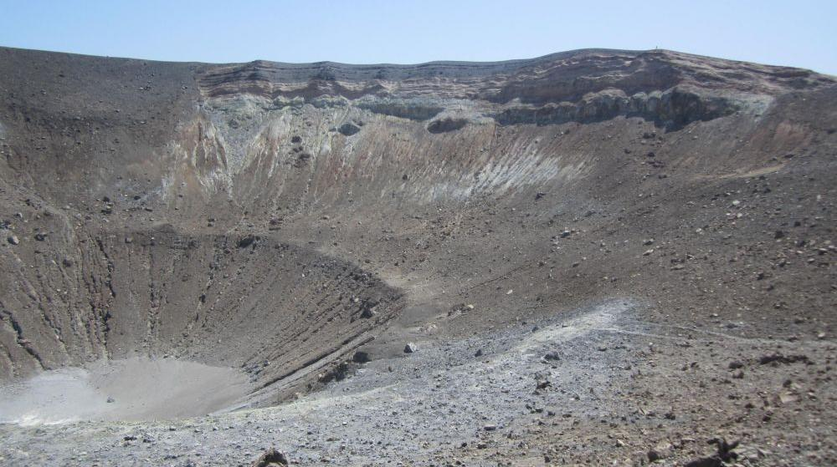
Gran Cratere

Slide 21
Day 4: Saturday 10th October 2026
07.45
09.00
10.20
13.20
15.40
Breakfast at accommodation and collect packed lunches
Coach departs for Vincenzo Bellini Catania Airport
Coach arrives at Vincenzo Bellini Catania Airport
Flight departs for London Stansted Airport
Flight arrives at London Stansted Airport
ETA at Selwood 19:45

Slide 22
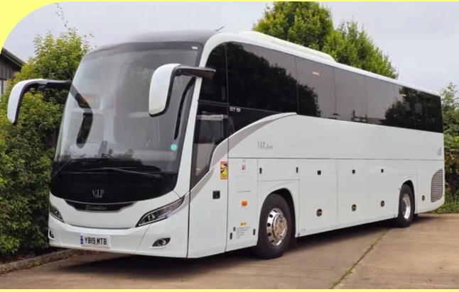
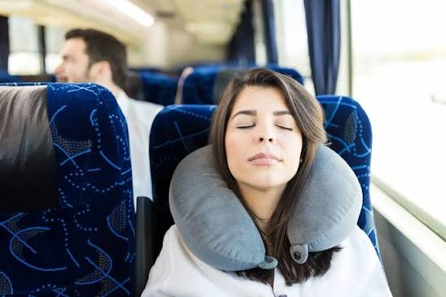
You will be excited but you must sleep during the journey to Stansted. Eye mask and pillow strongly recommended.
Seat belts to be worn at all times
Travel sickness people to sit at the front
No eating
Small sips of water allowed

Slide 23
You will be put in a group of approx. 10 and you will have a group leader.
You will find out who is in your activity group before we leave.
Your group leader will be in charge of you in the airport, through security and will hold your passport and boarding pass.

Slide 24
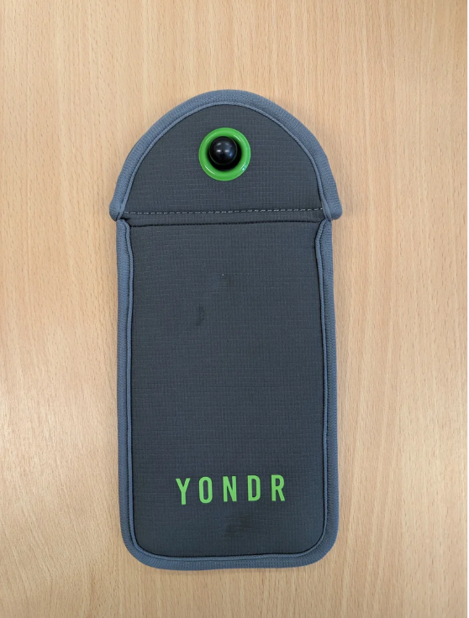
MNSP Policy on phones on international trips
Mr. Owen
Not allowed on any coach journey
An itinerary will be given to you before we leave which will tell you when you are allowed to use your phone
2 windows per day - after breakfast (if time allows) and after dinner and definitely before bed
No photos/videos to be taken in any room

Slide 25
Closer to the 7th October
A rooming request form
Who you want to be with during the day
Packed lunch form
Remember paddling and swimming is strictly forbidden

Slide 26
Questions?

