Slide 1
Year 8 Knowledge Organiser
UNDERSTANDING PERCENTAGES and FRACTIONS
Key Concept
FDP equivalence
Key Words
Fraction: A fraction is made up of a numerator (top) and a denominator (bottom).
Integer: Whole number.
Ascending Order: Place in order, smallest to largest.
Descending Order: Place in order, largest to smallest.
Examples
$\frac{3}{4}$ $\frac{3}{8}$ $\frac{1}{2}$ $\frac{7}{8}$ $\frac{1}{4}$
F | D | P
$$\frac{1}{100}$$ | 0.01 | 1%
$$\frac{1}{10}$$ | 0.1 | 10%
$$\frac{1}{5}$$ | 0.2 | 20%
$$\frac{1}{4}$$ | 0.25 | 25%
$$\frac{1}{2}$$ | 0.5 | 50%
$$\frac{3}{4}$$ | 0.75 | 75%
Make the denominators the same.
$\frac{6}{8}$ $\frac{3}{8}$ $\frac{4}{8}$ $\frac{7}{8}$ $\frac{2}{8}$
4
2
3
5
1
$\frac{1}{4}$ $\frac{3}{8}$ $\frac{1}{2}$ $\frac{3}{4}$ $\frac{7}{8}$
56% $\frac{3}{4}$ 0.871 23% $\frac{6}{7}$
Convert them all to decimals.
0.56 0.75 0.871 0.23 0.857…
2 3 5 1 4
23% 56% $\frac{3}{4}$ $\frac{6}{7}$ 0.871
Tip
- A larger denominator does not mean a larger fraction.
- To find equivalent fractions multiply/divide the numerator and denominator by the same number.
Questions
1) Place these lists in ascending order.
a) b) c)
ANSWERS: 1) $\frac{7}{12},\frac{2}{3},\frac{3}{4},\frac{5}{6}$ 2) $0.2,\frac{3}{7},0.49,\frac{1}{2}$ 3) $0.05,\frac{7}{32},25\%,\frac{29}{100}$

Slide 2
Year 8 Knowledge Organiser
FRACTIONS & PERCENTAGES AS OPERATORS
Key Concept
Multipliers
For reverse percentage problems you can divide by the multiplier to find the original amount.
Key Words
Percentage: Is a proportion that shows a number as parts per hundred.
Fraction: A fraction is made up of a numerator (top) and a denominator (bottom).
Multiplier: A quantity by which a given number is to be multiplied.
Examples
Non-Calculator
Find 15% | $$×0.15$$
Increase by 15% | $$×1.15$$
Decrease by 15% | $$×0.85$$
$$\frac{3}{4} of 32=32÷4×3=24$$
$$16\% of 240$$
$$10\%=24$$
$$=24+12+2.4$$
$$5\%=12$$
$$=38.4$$
$$1\%=2.4$$
Calculator
Find 32% of 54.60 = 0.32 × 54.60 = 17.472
Increase 45 by 12% = 45 × 1.12 = 50.4
Tip
There is a % function on your calculator.
To find 25% of 14 on a calculator:
2, 5, SHIFT, ( , ×, 1, 4, =
Questions
1) Find these fractions of amounts:
a) $\frac{1}{3} of 15$ a) $\frac{1}{5} of 65$ a) $\frac{2}{7} of 14$ a) $\frac{4}{9} of 45$
2) a) 35% of 140 b) 21% of 360 c) Increase 60 by 15%
ANSWERS: 1) a) 5 b) 13 c) 4 d) 20 2) a) 49 b) 75.6 c) 69

Slide 3
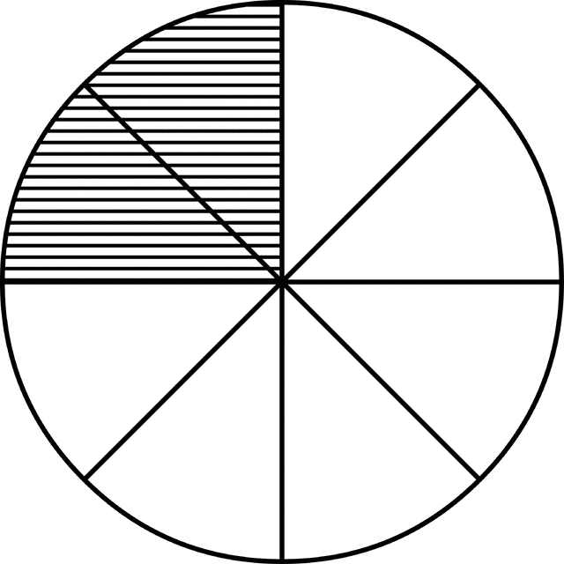
Year 8 Knowledge Organiser
RATIO
Key Concept
Key Words
Ratio: Relationship between two numbers.
Part: This is the numeric value ‘1’ of, would be equivalent to.
Simplify: Divide both parts of a ratio by the same number.
Equivalent: Equal in value.
Convert: Change from one form to another.
Examples
2:6
=
1:3
Simplify 60 : 40 : 100
Write 2: 5 in the form 1 : n
2 parts
6 parts
$$÷10$$
2 : 5
1 : 2.5
This could have been done in one step by dividing by 20.
6 : 4 : 10
$$÷2$$
$$÷2$$
$$÷2$$
3 : 2 : 5
=
Share £45 in
the ratio 2 : 7
2 : 7
Joy and Martin share money in the ratio 2 : 5. Martin gets £18 more than Joy. How much do they each get?
5
5
5
5
2 : 5
45 ÷ 9 = 5
=10
5
6
6
5
6
6
=
$$\frac{1}{4}$$
5
6
£10 : £35
5
18 ÷ 3 = 6
6
5
£12 : £30
6
=35
=12
=30
Tip
Its often useful to write the letters above the ratio. This helps you keep the order the correct way round.
Questions
Simplify a) 45 : 63 b) 66 : 44 c) 320 : 440
Write in the form 1 : n a) 5 : 10 b) 4: 6 c) $x:x^{2}+x$
Share 64 in the ratio 3 : 5 4) Write the ratio 1 : 4 as a fraction.
ANSWERS: 1) a) 5 : 7 b) 3 : 2 c) 8 : 11 2) a) 1 : 2 b) 1 : 1.5 c) $1:x+1$
3) 24 : 40 4) $1/5$

Slide 4
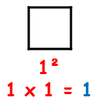
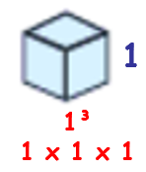
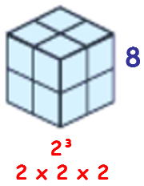
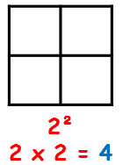
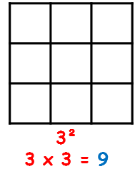
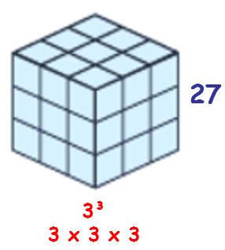
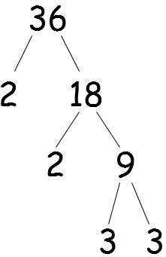
Year 8 Knowledge Organiser
POWERS AND ROOTS
Key Concept
Key Words
Square: A square number is the result of multiplying a number by itself.
Cube: A cube number is the result of multiplying a number by itself twice.
Root: A root is the reverse of a power.
Prime number: A prime is a number that has only two factors which are 1 and itself.
Reciprocal: This is found by doing 1 divided by the number.
Factor: A number that fits into another number exactly.
Examples
Square
numbers
Cube
numbers
What is 2⁴ ? 2 × 2 × 2 × 2 = 16
What is $\sqrt{64}$ ? 8² = 64, so $\sqrt{64}$ = ± 8
What is the reciprocal of 5? $\frac{1}{5}$
Write 36 as a product of prime factors
$$36=2×2×3×3=2^{2}×3^{2}$$
Product means ‘multiply’
Questions
1) a) $2^{5}$ b) $3^{3}$ c) $1^{17}$ d) $\sqrt{81}$ e) $\sqrt{16}$ f) $\sqrt[3]{64}$
Find the reciprocal of: a) 4 b) $\frac{1}{3}$ c) 0.25
Write 72 as a product of primes.
Tip
A number with an odd amount of factors must be a square number.
ANSWERS: 1) a) 32 b) 27 c) 1 d) ± 9 e) ± 4 f) 4
2) a) $\frac{1}{4}$ b) 3 c) 4 3) $2^{3}×3^{2}$

Slide 5
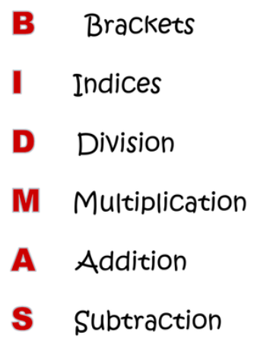
Year 8 Knowledge Organiser
ORDER OF OPERATIONS
Key Concept
Key Words
Operation: In maths these are the functions × ÷ + -.
Commutative: Calculations are commutative if changing the order does not change the result.
Associative: In these calculations you can
re-group numbers and you will get the same answer.
Indices: These are the squares, cubes and powers.
Examples
$$5×4−8÷2$$
$$20 − 4 =16$$
$${\left(2^{2}+6\right)}^{2}×4−8$$
$${\left(4+6\right)}^{2}×4−8$$
$${\left(10\right)}^{2}×4−8$$
If a calculation contains the looped calculations work from left to right.
$$100×4−8$$
$$400−8=392$$
Questions
1) $7−10÷2$ 2) $4^{3}−13×4$ 3) $21÷7−2$
4) $12÷\left(7−3\right)$ 5) $20÷2^{2}$ 6) $\left(16−13\right)÷3$
7) Place brackets to make the calculation work $20÷5−3=10$
Tip
- Put brackets around the calculations which need to be done first.
- Indices also includes roots.
ANSWERS: 1) 2 2) 12 3) 1 4) 3 5) 5 6) 1 7) $20÷\left(5−3\right)=10$

Slide 6
Year 8 Knowledge Organiser
SIMPLIFYING & MANIPULATING ALGEBRA
Key Concept
Formula
Expression
Equation
Identity
Key Words
Formula: A rule written using symbols that describe a relationship between different quantities.
Expression: Shows a mathematical relationship whereby there is no solution.
Equation: A mathematical statement that shows that two expressions are equal.
Identity: A relation which is true. No matter what values are chosen.
Examples
Simplify:
4a + 3b – a + 2b
Expand and simplify:
$$9a−2\left(3a−4\right)$$
$$9a−6a+8$$
= 3a + 5b
$$3a+8$$
Factorise:
Expand and simplify:
$$9x^{2}+6x$$
$$2\left(4a+2b\right)−2\left(a+3b\right)$$
Factorising is the opposite of expanding brackets
$3x$ is common to both terms
$$8a+4b−2a−6b$$
$$3x\left(3x+2\right)$$
$$6a−2b$$
Questions
1) 5x + 3y – 2x + 4y 2) 2p – 6q + 2q + 4p 3) $12b−3\left(2b+5\right)$ 4) Factorise a) $4x+10$ b) $8a^{2}−10a$
Tip
When expanding brackets be careful with negatives.
ANSWERS: 1) $3x+7y$ 2) $6p−4q$ 3) $6b−15$
4) a) $2\left(2x+5\right)$ b) $2a\left(4a−5\right)$

Slide 7
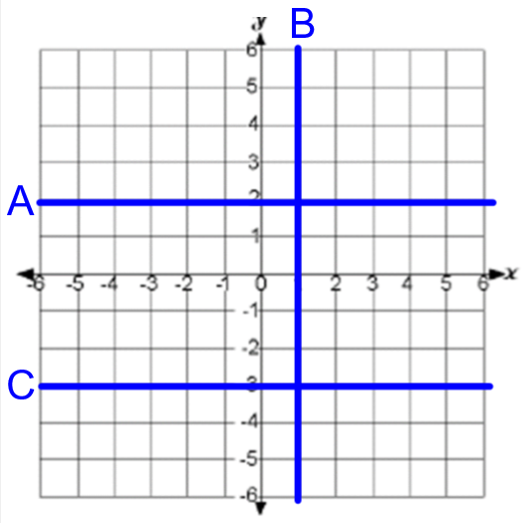
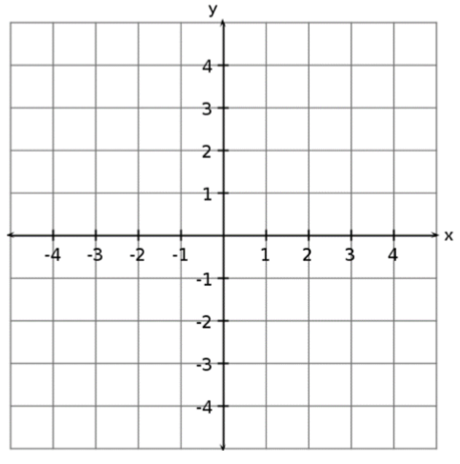
Year 8 Knowledge Organiser
PLOTTING AND INTERPRETTING GRAPHS
Key Concept
Substitution – This is where you replace a number with a letter
If a = 5 and b = 2
Key Words
Intercept: Where two graphs cross.
Gradient: This describes the steepness of the line.
y-intercept: Where the graph crosses the y-axis.
Linear: A linear graph is a straight line.
Quadratic: A quadratic graph is curved, u or n shape.
Examples
D
Draw the graph of y = 2x - 1
-5
-3
-1
1
3
a + b = | 5 + 2 = 7
a – b = | 5 – 2 = 3
3a = | 3 × 5 = 15
ab = | 5 × 2 = 10
a² = | 5² = 25
A: y = 2 B: x = 1
C: y = -3 D: y = x
Notice this graph has a gradient
of 2 and a y-intercept of -1.
Tip
Parallel lines have the same gradient.
Questions
1) What are the gradient and y-intercept of:
y = 4x – 3 b) y = 4 + 6x c) y = - 5x – 3
2) Draw the graph of y = 3x – 2 for x values from -3 to 3 using a table.
Formula
$$Gradient=\frac{difference in y^{′}s}{difference in x^{′}s}$$
ANSWERS: 1) a) m = 4, c = -3 b) m = 6, c = 4 c) m = -5, c = -3

Slide 8
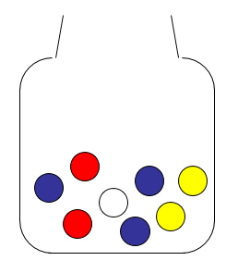
Year 8 Knowledge Organiser
INTRODUCING PROBABILITY
Key Concept
Chance
Probability
Key Words
Probability: The chance of something happening as a numerical value.
Impossible: The outcome cannot happen.
Certain: The outcome will definitely happen.
Even chance: The are two different outcomes each with the same chance of happening.
Expectation: The amount of times you expect an outcome to happen based on probability.
Examples
$$\frac{1}{}$$
1) What is the probability that a bead chosen will be yellow.
Show the answer on a number line.
$$Probability=\frac{Number of favourable outcomes}{Total number of outcomes}$$
$$P\left(Yellow\right)=\frac{2}{8}=\frac{1}{4}$$
Probabilities can be written as:
- Fractions
- Decimals
- Percentages
2) How many yellow beads would you expect if you pulled a bead out and replaced it 40 times?
$$\frac{1}{4}×40=\frac{1}{4}of40=10$$
Tip
Probabilities always add up to 1.
Questions
In a bag of skittles there are 12 red, 9 yellow, 6 blue and 3 purple left. Find: a) P(Red) b) P(Yellow) c) P(Red or purple) d) P(Green)
Formula
$$Expectation=Probability×no. of trials$$
ANSWERS: 1) a) $\frac{12}{30}=\frac{2}{5}$ b) $\frac{9}{30}=\frac{3}{10}$ c) $\frac{15}{30}=\frac{1}{2}$ d) 0

Slide 9
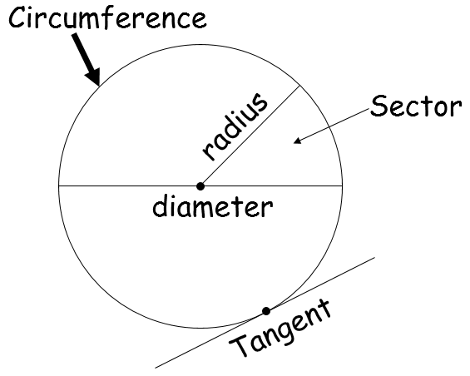
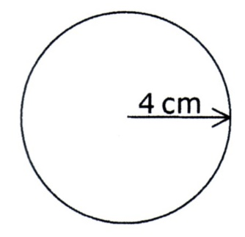
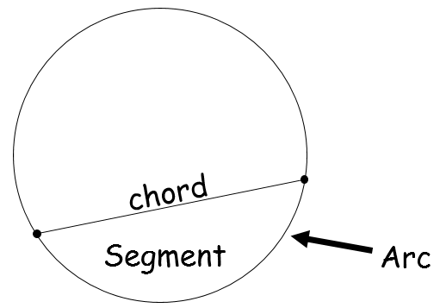
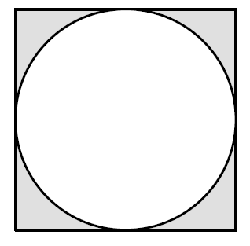
Year 8 Knowledge Organiser
CIRCLES AND COMPOUND AREA
Key Concepts
Key Words
Diameter: Distance from one side of the circle to the other, going through the centre.
Radius: Distance from the centre of a circle to the circumference.
Chord: A line that intersects the circle at two points.
Tangent: A line that touches the circle at only one point.
Compound (shape): More than one shape joined to make a different shape.
Examples
$$\frac{1}{}$$
Find the area and circumference to 2dp.
$$Circumference=π×d$$
$=π×8=25.13cm$
$$Area=π×r^{2}$$
$=π×4^{2}=50.27{cm}^{2}$
Find shaded area to 2dp.
$$Square area=10×10$$
$=100m^{2}$
$$Circle area= π×r^{2}$$
$=π×5^{2}$
$=78.54 m^{2}$
10m
$$Shaded area=100−78.54=21.46m^{2}$$
Tip
If you don’t have a calculator you can leave your answer in terms of π.
Questions
1) Find to 1dp the area and circumference of a circle with:
a) Radius = 5cm b) Diameter = 12mm c) Radius = 9m
2) Find the area & perimeter of a semi-circle with diameter of 15cm.
Formula
$$Circle Area=π×r^{2}$$
$$Circumference=π×d$$
ANSWERS: 1) a) A = 78.5cm², C = 31.4cm b) A = 113.1mm², C = 37.7mm
c) A = 254.5m², C = 56.5m 2) A = 88.4cm², P = 38.6cm

Slide 10
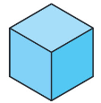
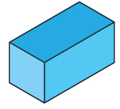
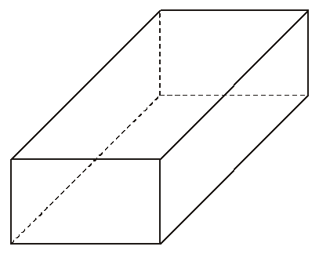
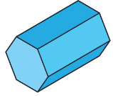
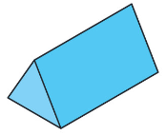
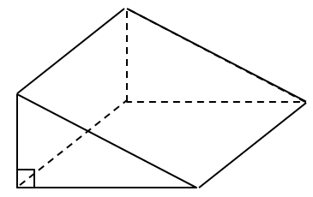
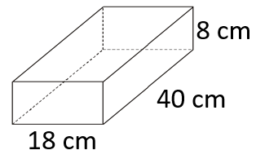
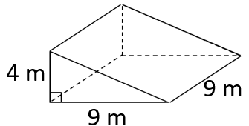
Year 8 Knowledge Organiser
3D SHAPES, CAPACITY AND VOLUME
Key Concept
Key Words
Volume: The amount of space that an object occupies.
Capacity: The amount of space that a liquid occupies.
Cuboid: 3D shape with 6 square/rectangular faces.
Vertices: Angular points of shapes.
Face: A surface of a 3D shape.
Edge: A line which connects two faces on a 3D shape.
Examples
Cube
Cuboid
2 cm
$$Volume=4×9×2$$
Faces – 6
Edges – 12
Vertices – 8
Faces – 6
Edges – 12
Vertices – 8
9 cm
$$=72{cm}^{3}$$
Hexagonal Prism
Triangular Prism
4 cm
$$Area of triangle=\frac{5×7}{2}$$
$$=17.5{mm}^{2}$$
Faces – 8
Edges – 18
Vertices – 12
Faces – 5
Edges – 9
Vertices – 6
5 mm
11 mm
$$Volume=17.5×11$$
7 mm
$$=192.5{mm}^{3}$$
Tip
Remember the units are cubed for volume.
Questions
Find the volume of these shapes: 1) 2)
Formula
$$Cuboid Volume=l×w×h$$
$$Prism Volume=$$
$$area of cross section ×length$$
ANSWERS: 1) 5760 cm³ 2) 162 m³

Slide 11
Year 8 Knowledge Organiser
PROPORTION
Key Concept
Proportion states that two fractions or ratios are equivalent.
$$\frac{4}{6}=\frac{2}{3}$$
$$4:2=2:1$$
Key Words
Ratio: Relationship between two numbers.
Scale: The ratio of the length in a drawing to the length of the real thing.
Proportion: A name we give to a statement that two ratios are equal.
Exchange rate: The value of one currency for the purpose of conversion to another.
Examples
Write 2: 5 in the form 1 : n
Cake recipe for 6 people.
3 eggs
300g flour
150g sugar
What would you need for 8 people?
2 : 5
1 : 2.5
$$÷2$$
$$÷2$$
a:b = 4:5 and b:c = 6:7
Find a:b:c.
$$÷3$$
$$4$$
The LCM of 5 and 6 is 30
 | 6 | 2 | 8
eggs | 3 | 1 | 4
flour | 300g | 100g | 400g
sugar | 150g | 50g | 200g
a : b : c
4 : 5
6 : 7
24 : 30 : 35
$$=$$
$×$6
$$×5$$
Tip
Working with ratio or proportion requires multiplying or dividing the numbers. Do not add or subtract.
Questions
Write in the form 1 : n a) 4 : 8 b) 3 : 12 c) 4 : 6
a : b = 3 : 10 and b : c = 4 : 12. Find a:b:c.
Pancakes for 4 people need 2 eggs, 120g flour and 60ml milk. How much for 6 people?
ANSWERS: 1) a) 1:2 b) 1:4 c) 1:1.5 2) 12:40:120 3) 3 eggs, 180g flour, 90 ml milk.

Slide 12
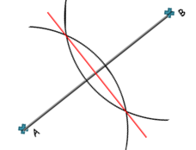
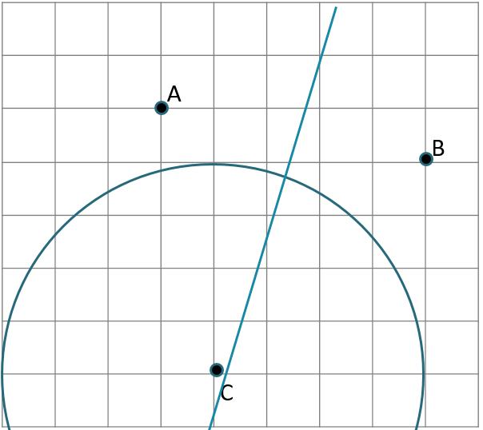
Year 8 Knowledge Organiser
CONSTRUCTIONS
Key Concept
Line Bisector
Angle Bisector
Key Words
Construction: To draw a shape, line or angle accurately using a compass and ruler.
Loci: Set of points with the same rule.
Parallel: Two lines which never intersect. Perpendicular: Two lines that intersect at 90°.
Bisect: Divide into two parts.
Equidistant: Equal distance.
Examples
Line bisector
of A and B
Shade the region that is:
- closer to A than B
- less than 4 cm from C
Circle with radius 4cm
Tip
Watch for scales.
For a scale of:
1 cm = 4 km.
20 km = 5 cm
6 cm = 24 km
Questions
1) Draw these angles then bisect them using constructions:
a) 46° b) 18° c) 124°
2) Draw these lines and bisect them: a) 6cm b) 12cm

Slide 13
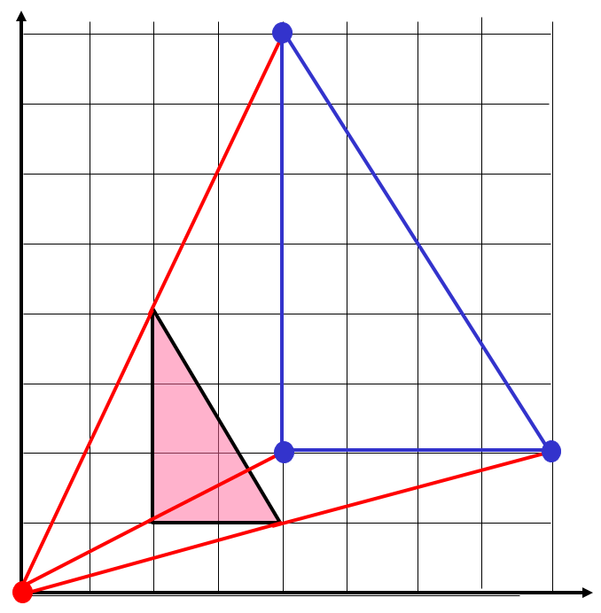
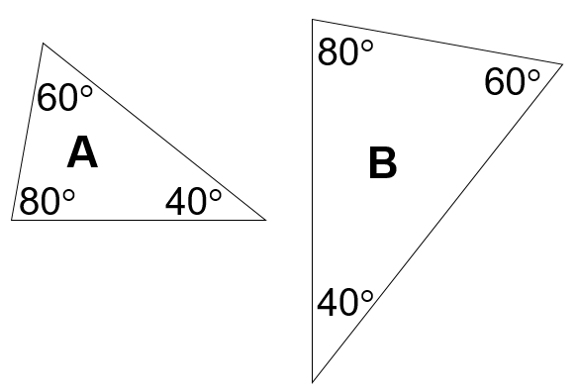
Year 8 Knowledge Organiser
ENLARGEMENT, SIMILARITY & CONGRUENCE
Key Concept
Properties of similar shapes:
- The corresponding angles will be the same if shapes are similar.
- Corresponding edges must remain in proportion.
Key Words
Transformation: This means something about the shape has ‘changed’.
Reflection: A shape has been flipped.
Rotation: A shape has been turned.
Translation: A movement of a shape.
Enlargement: A change in size, either bigger or smaller.
Congruent: These shapes are the same shape and same size but can be in any orientation.
Similar: Two shapes are mathematically similar if one is an enlargement of the other.
Examples
Enlarge shape A, scale factor 2, centre (0, 0).
Scale factor 2 - Double the distance between each vertex and the centre of enlargement.
A
Questions
A triangle has lengths 3cm, 4cm and 5cm. What will they be if enlarged scale factor 3.
Rectangle A measures 3cm by 5cm, B measures 15cm by 25cm. What is the scale factor of enlargement?
Tip
To find the centre of enlargement connect the corresponding vertices.
ANSWERS: 1) 9cm, 12cm and 15cm 2) 5.

Slide 14
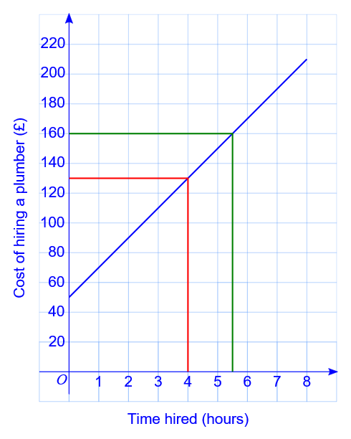
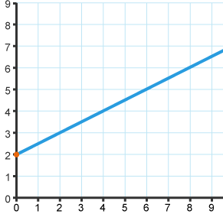
Year 8 Knowledge Organiser
APPLIED GRAPHS
Key Concept
Key Words
Conversion graph: A graph which converts between two variables.
Intercept: Where two graphs cross.
y-intercept: Where a graph crosses the y-axis.
Gradient: The rate of change of one variable with respect to another. This can be seen by the steepness.
Simultaneous: At the same time.
Examples
What is the minimum taxi fair?
£2, this is the y-intercept.
What is the charge per mile?
50p, every extra mile adds on 50p.
Taxi Fare in £s
Gradient – The extra cost incurred for every extra hour.
y-intercept – The minimum payment to the plumber.
Journey in miles
How much would a journey of 5 miles cost?
£4.50, See line drawn up from 5 miles to the graph, then drawn across to find the cost.
Tip
The solution to two linear equations with two unknowns is the coordinates of the intercept (where they cross).
Questions
1) For the graph above a) A journey is 8 miles, what is its cost?
b) A journey cost just £3, how far was the journey?
2) Draw a graph to show the exchange rate £1 = $1.4.
ANSWERS: 1) a) £6 b) 2 miles

Slide 15
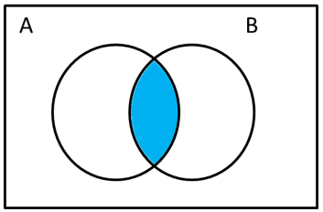
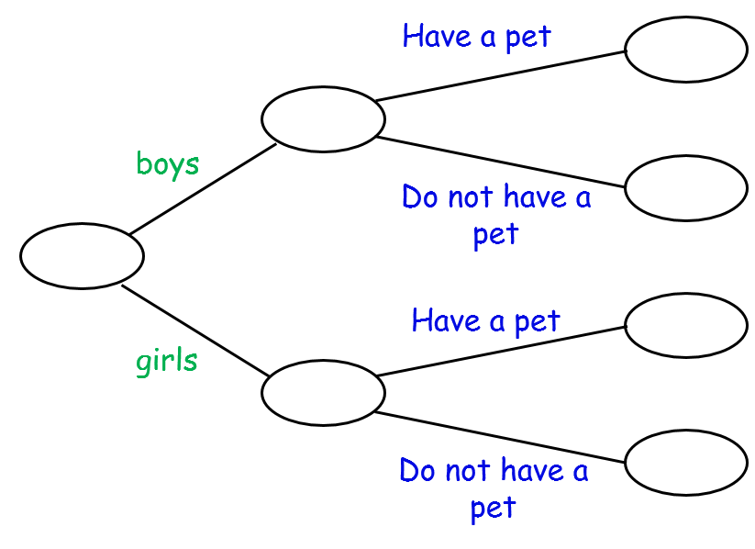
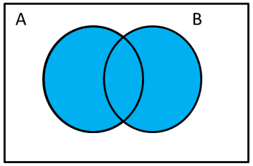
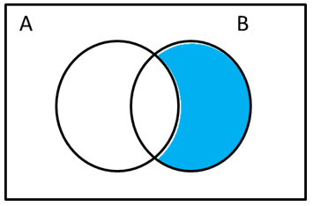
Year 8 Knowledge Organiser
FURTHER PROBABILITY
Key Concept
Key Words
Probability: The chance of something happening as a numerical value.
Impossible: The outcome cannot happen.
Certain: The outcome will definitely happen.
Even chance: The are two different outcomes each with the same chance of happening.
Mutually Exclusive: Two events that cannot both occur at the same time.
Examples
In Hannah’s class there are 32 students.
15 of these students are boys.
7 of the boys have a pet.
9 girls do not have a pet.
P(A ∩ B)
7
P(A U B)
15
$$P\left(boy\right)=\frac{15}{32}$$
8
32
P(A’ ∩ B)
8
$$P\left(Girl with pet\right)$$
$$=\frac{8}{32}$$
17
9
Questions
Draw a two-way table for the question above.
Find the probability that a pupil chosen is a boy with no pets.
A girl is chosen, what is the probability she has a pet?
Formula
$$P\left(A∩B\right)=P\left(A\right)×P\left(B\right)$$
$$P\left(A∪B\right)=P\left(A\right)+P\left(B\right)$$
$$or \left(non ME\right) P\left(A∪B\right)=P\left(A\right)+P\left(B\right)−P\left(A∩B\right)$$
ANSWERS: 2) $\frac{8}{32}$ 3) $\frac{8}{17}$

