Slide 1
Year 6 OAA
https://youtu.be/QCMURQnctFM?feature=shared

Slide 2
Why?
To take part in the PE departments Outdoor and Adventurous activities (OAA) thread of the National Curriculum.
Life long learning of resilience, respect, risk taking and team work.
To have fun!!

Slide 3
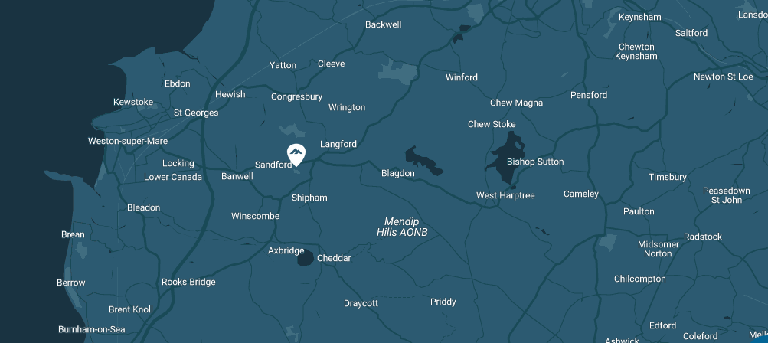
Where - https://www.mendip.co.uk

Slide 4
When and which groups?
There are two groups attending the camp over one week:
Group 1 – Monday 7th July to Wednesday 9th July 2025
Group 2 – Wednesday 9th July to Friday 11th July 2025
We try to keep tutor groups together with their tutor if they are going.

Slide 5
Example activity programme Day 1
Arrive at school normal time and put bags in hall.
10:30am: Leave school
11:35am: Arrive at Mendip and drop off kit.
12:00am: Have packed lunch (please provide this on the first day).
13:00: Arrive at Hewish Water-sports Venue
13:30-16:00 Assault Course & paddle sports
16:00-17:00 Mini bus transport to Mendip Activity Centre
17:30-18:30 Evening Meal with Pudding
19:00-21:00 Instructor Led Night Walk

Slide 6
Day 2
08:30-09:30 Cooked Breakfast
10:00-12:30 Abseiling & Climbing
12:30-13:30 Packed Lunch
13:30-16:00 Abseiling & Climbing
17:30-18:30 Evening meal with pudding
19:00-21:00 Instructor Led Wide Games

Slide 7
Day 3
08:30-09:30 Cooked Breakfast
10:00-12:30 Paddle sports & Assault Course (which ever one you didn’t do on day 1)
12:30 Departure with packed lunch
Return to school for 1:30pm (leave school at 3:10)

Slide 8
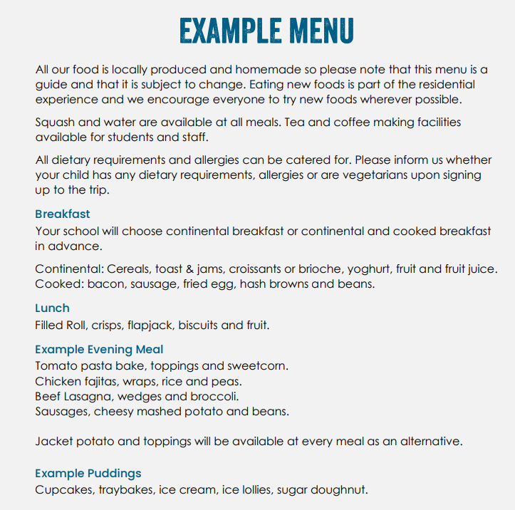

Slide 9
Rooms
https://www.mendip.co.uk/mendip-lodge
Your child can pick up to four friends to share with. We will try to guarantee that they are with at least one of these friends.
Please take the time to fill this out by the deadline set. Any late requests will not be taken into account.

Slide 10
All you have to do is sign up and pay a £50 deposit. This will secure your place.

