Slide 1
The concept I am learning is…
Last lesson I learnt about… and the key learning was…
This lesson I am learning about…
This is so I can…

Slide 2
The concept I am learning is to learn to be well and safe.
Last lesson I learnt about…how to look after ourselves and the key learning was wellbeing
This lesson I am learning about STOP NOW
This is so I can be healthy human being

Slide 3
This term we are continuing to explore how
to look after ourselves. Last term we looked
At how to support our inner world or emotions.
This term we are exploring how to look after our
Inner and outer world.
Complete the RAG sheet for this topic – How do we keep ourselves well and happy?

Slide 4
Types of Wellbeing…
Mental Wellbeing – how well do I
look after my mental health?
Physical Wellbeing – how well do I look
after my physical health?

Slide 5
Definition of Wellbeing…
Wellbeing = How well do I look after
my mental and physical health?
(so that I become well, healthy, confident,
have a sense of purpose and
be able to manage stress.)

Slide 6
L.O: To Re-cap what STOP NOW means.
On a piece of rough paper, write the letters STOP NOW down the page. Try to write down what each letter stands for when thinking about how to look after our wellbeing. Share.
Now watch the film made by the silver ambassadors 2 years ago to check.

Slide 7
What does STOP NOW stand for?
S
T
O
P
N
O
W
= sleep (am I getting enough sleep?)
= tech (am I using too much?)
= outdoors and exercise.
= People (do I have support? Good
connections?)
= Nutrition (am I eating healthily?)
= Oxygen (breathing techniques)
= water (am I getting enough?)

Slide 8
S
T
O
P
N
O
W
= sleep (am I getting enough sleep?)
Sleep deprivation can lead to many health issues e.g. high blood pressure/diabetes. One in seven Brits survive on under five hours a night.
Things that can help:
*Getting a good sleep routine 30 minutes to an hour before bed.
*Use sleep music on YouTube.
*Try a brain dump. Explained in this clip: https://www.youtube.com/watch?v=Xk4Q6mED2cs

Slide 9
S
T
O
P
N
O
W
= tech (am I using too much tech?)
Things that can help:
*Create rules for yourself e.g. 1 hour a day.
*Put a hair band around your phone.
Other ideas?

Slide 10
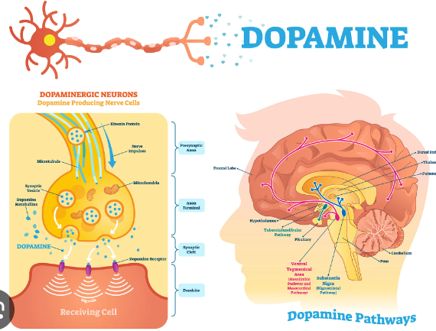
Studies have shown that it can affect the way the brain experiences joy.

Slide 11
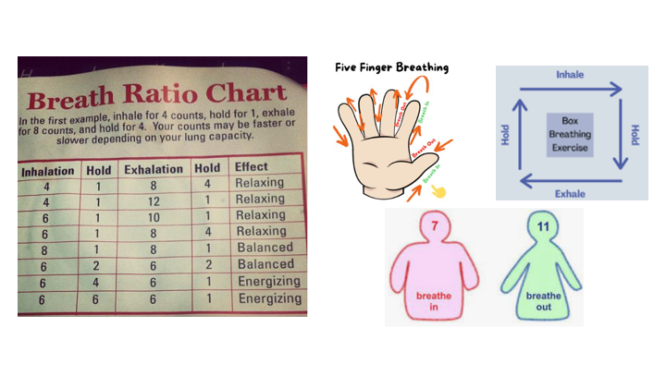
S
T
O
P
N
O
W
Breathing exercises are a type of mediation that can improve how you feel. They can relax/balance or energise you. See next slide for examples.
= oxygen (am I using any breathing techniques?)
Things that can help!

Slide 12
S
T
O
P
N
O
W
= people (do I have good support? Good connections? Kindness/empathy? )
Suggestion:
Discuss – how could we improve the way our tutor group treats each other, so we are even nicer.
E.g. a secret buddy system.

Slide 13
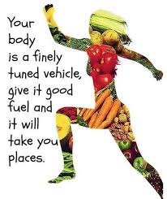
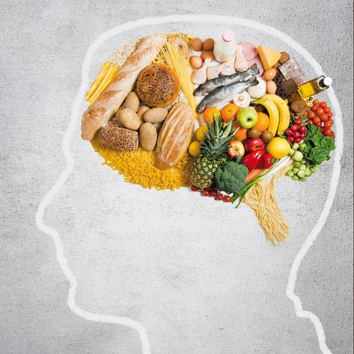
S
T
O
P
N
O
W
Things that help:
The sugarsmart app.
Discuss other ideas.
= nutrition (am I eating healthy food?)

Slide 14
Supplements…
If someone is feeling low in energy or mood it could be to do with vitamin deficiency, especially in the darkest months.
Some notes…
Not all supplements are equal. It may be worth investing in higher quality supplements found in wholefood shops or on websites such as https://naturaldispensary.co.uk/
You may need to take vitamins separately to get a higher dose, but good quality multivitamins can be helpful.
Vitamin D and C are particularly helpful during the darker months.
Supplements don’t replace a healthy diet/lifestyle.

Slide 15
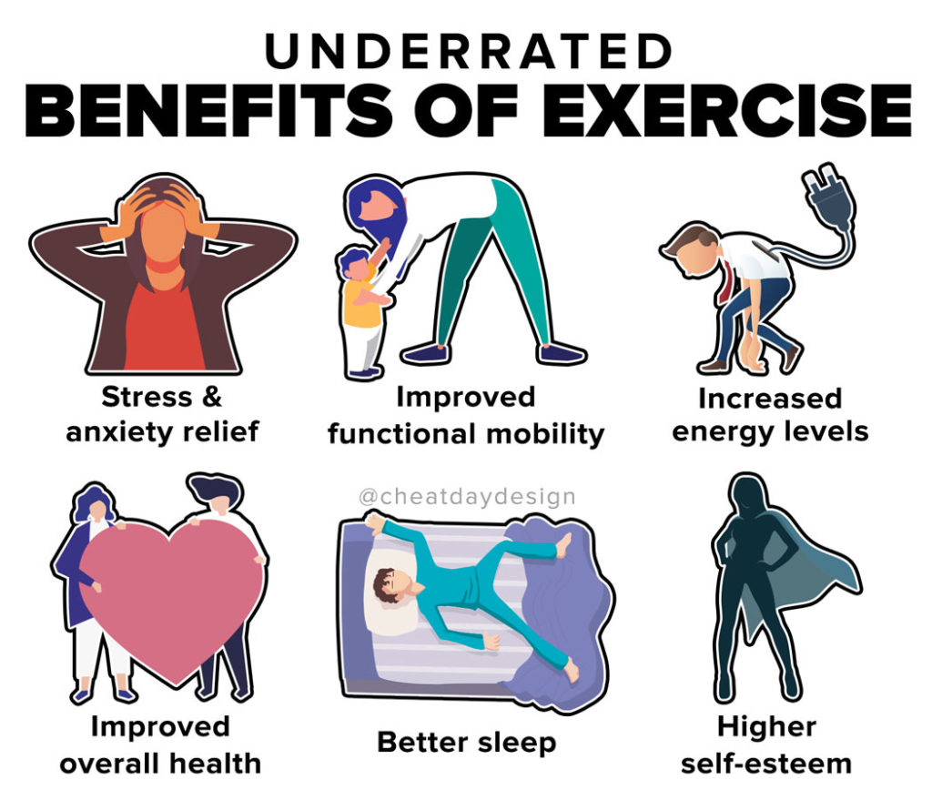
S
T
O
P
N
O
W
Resources:
*NHS Couch to 5K
*Free apps – Nike Training App -Learn Dance
*30 days of Yoga with Adrienne on YouTube https://www.youtube.com/watch?v=TXU591OYOHA&list=PLui6Eyny-UzwxbWCWDbTzEwsZnnROBTIL
*Free Joe Wicks app
https://uk.linkedin.com/posts/joe-wicks-aa2726106_the-body-coach-app-free-access-for-teachers-activity-6970696816472293376-nwyF?trk=public_profile_like_view
The NHS recommend 150 minutes a week or 20 minutes a day. At least two strength sessions.
= outdoors and exercise (Am I getting enough?)

Slide 16
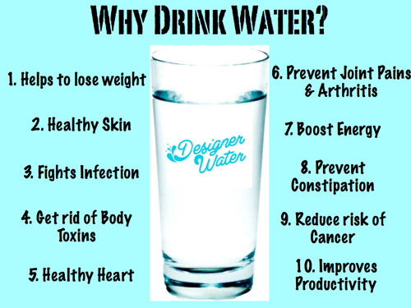
S
T
O
P
N
O
W
Research found only 1 in 10 Britons are sufficiently hydrated each day.
Resources:
Free apps:
Aqualert
Watertracker
= water (am I getting enough?)

Slide 17
Now look at the information
You have collected.
Present this in any chosen format.
A bookmark
A poster
A leaflet
A YouTube clip

