Slide 1
Learning objectives:
In today’s lesson, we are going to explore…
What will help me deal with stress?

Slide 2
What are emotions?
What are they?
Dictionary definition = strong inner feelings (as anger, love, joy, or fear) often accompanied by a physical reaction ( for example – “She flushed with emotion.”
One minute challenge: Draw all the emoji's (that express emotions) that you know and write the emotion beneath them (e.g. the poo emoji doesn’t count!)
Count your emojis. Stand up. The teacher will start counting from 1. When you hear the number of emojis you have sit down. The last person standing is the winner!

Slide 3
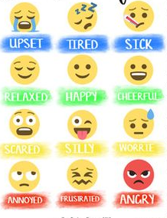
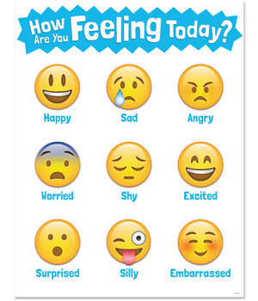
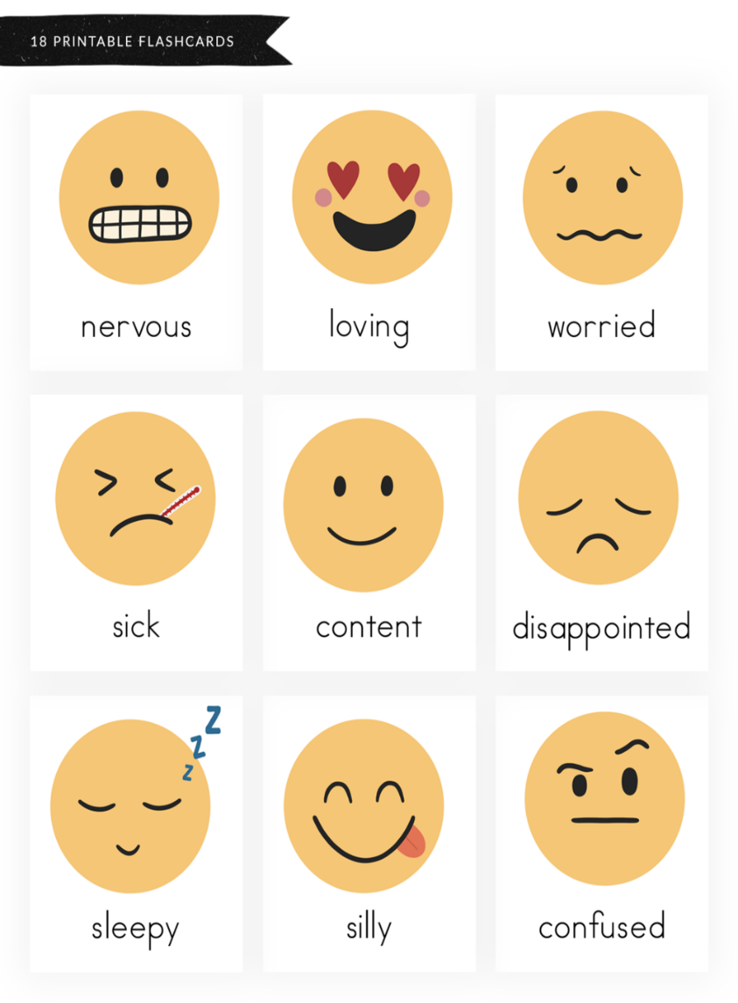
Here are some possible answers…
relaxed
happy
cheerful
silly
scared
worried

Slide 4
What are the six main emotions we feel?
Watch this to help you answer the question.
(NB: the film leaves one out.)
https://youtube.com/watch?v=x__NgnMBHV0&feature=share

Slide 5
Although there are many emojis,
It is widely accepted that these could be reduced
To SIX MAIN HUMAN EMOTIONS FELT BY ALL.
They are..
ANGER SADNESS FEAR JOY/HAPPINESS
DISGUST SURPRISE

Slide 6
Drama Game – The Emotion Gallery
Task 1: In pairs, Person 1 gets into a position to express one of the six emotions. Person 2 guesses it. Swap a few times.
Task 2: Person 1 (with permission) moves Person 2s body into a psotion to express one fo the emotions. All the sculptors walk around the room, guessing the meotion. Swap.
JOY | FEAR | ANGER
SADNESS | DISGUST | SURPRISE
So we spot how others feel by the position of their body (body language.)
But it can also be the tone of their voice and ofcourse what they say.

Slide 7
So what is stress?
Stress is when we are worried due to a difficult situation and when we feel under pressure.
Drama task – In pairs, Person 1 now sculpt Person 2 to show them stressed. Swap over. What do you notice happens to your body when stressed? What else happens to you?
Discuss – what are the reasons someone may get stressed?

Slide 8
Some people say a little bit of stress is good for you and helps motivate you to do things well.
Can you give an example of this? Real or imagined?
But when stress builds up, and you don’t know what to do about it, then it can affect your MENTAL HEALTH negatively.
Some people say that a little bit of stress can be motivating and help us do something well.
Can you think of an example? (Real or imagined?)
But when stress builds up, and you don’t know what to do to de-stress, this can affect your MENTAL HEALTH negatively.

Slide 9
So what is MENTAL HEALTH?
Physical health means the condition of our body (how well is our body?)
Mental health means the condition of our mind (how well is our mind?)
Wellbeing means the condition of your body and mind (how well is your body, how well is your mind?)

Slide 10
We all know that we need to do certain things each day to stay physically healthy such as eating healthily, exercising and keeping good hygiene.
But we also need to do certain things each day to stay mentally healthy.
This will help our overall mood each day, but it will also mean that we will be mentally stronger when we are faced with tough times.

Slide 11
If you look after your mental health on a daily basis, you will be better able to cope with stress.
But when you are in a stressful situation, like exams, the following things will help you feel less stressed too.

Slide 12
Task – Each person needs a blank bookmark.
Re-cap the emotions that you explored then turn the bookmark over.
Now write these letters going down the left side of your book mark.
S
T
O
P
N
O
W
Now watch the STOP NOW film created by Selwood Academy students.
As you watch it, try to write down what each letter stands for.

Slide 13
Answers:
Fill this in on your bookmark, then make notes as you we go through each one now.
S = sleep
T = Tech (am I using too much?)
O = Outdoors/exercise
P = People (am I a good friend/do I have good friends?)
N = Nutrition
O = Oxygen (breathing techniques)
W = Water

Slide 14
As we go through each letter, you can add tips to help you do these things (use words or images.)

Slide 15
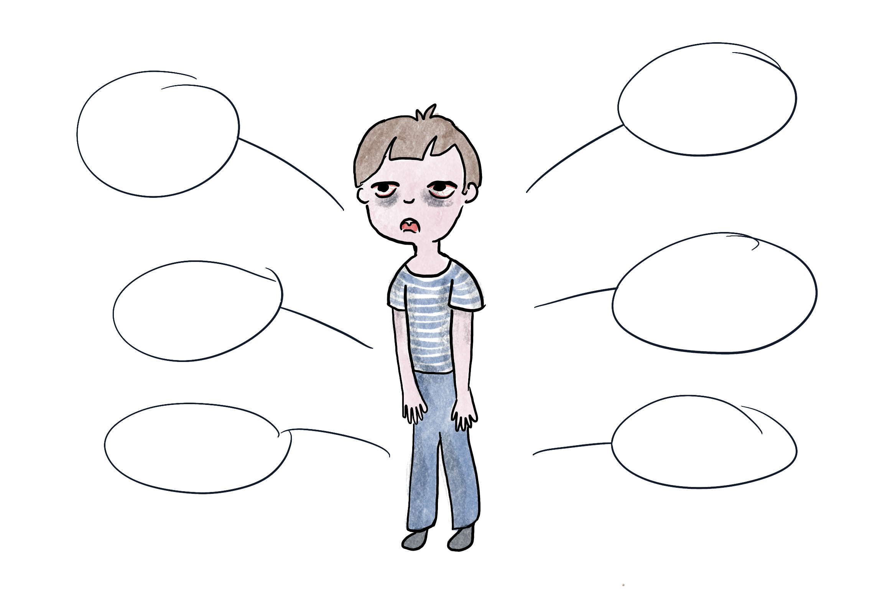
S
T
O
P
N
O
W
= sleep (am I getting enough sleep?)
S
Y
M
P
T
O
M
S
7-13 year olds should get 9-11 hours sleep each night. (If you get up at 7am go to bed between 8-10pm.)
(14-17 years old 8-10 hours)
(Adults 7-9 hours)
Difficulty remembering things
Difficulty concentrating
Tips for better sleep:
Avoid screen time for an hour before bed.
Read to help you sleep.
Avoid sugar/eating a a few hours before bed.
Use YouTube or sleep apps to help you.
Body feels weaker, eyes sore
Makes you feel down/depressed
Can increase worry/stress/bad temper
Long-term it can lead to physical health issues

Slide 16
S
T
O
P
N
O
W
= tech (am I using too much tech?)
It is recommended that young people should spend no more than two hours a day on their tech (screen time.)
F
I
N
D
I
N
G
S
There are many good things about technology but studies have shown too much can lead to some serious problems…
*Shorter attention-span
*Eye problems and headaches
*Difficulty handling emotions
*Addiction to technology which can lead to lots of other problems
Tips for less tech:
Set a timer each day.
Try other, new things that don’t involve tech such as….

Slide 17
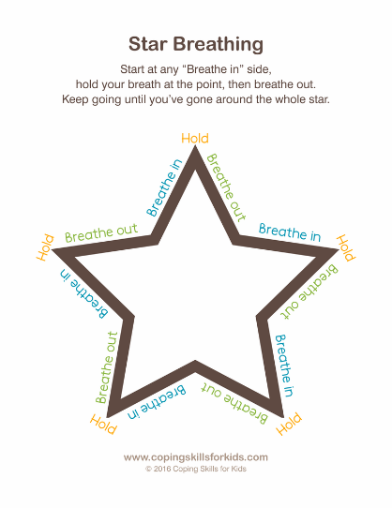
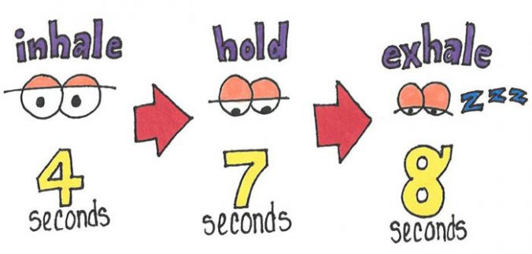
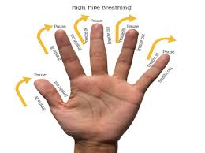
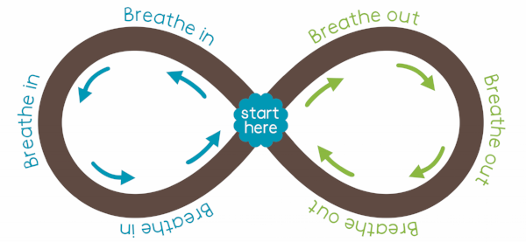
S
T
O
P
N
O
W
This is a very good one for STRESS. Breathing methods will calm you down.
= oxygen (am I using any breathing techniques?)
Breathing exercises can help you relax, because they make your body feel like it does when you are already relaxed. Deep breathing is one of the best ways to lower stress in the body. This is because when you breathe deeply, it sends a message to your brain to calm down and relax.

Slide 18
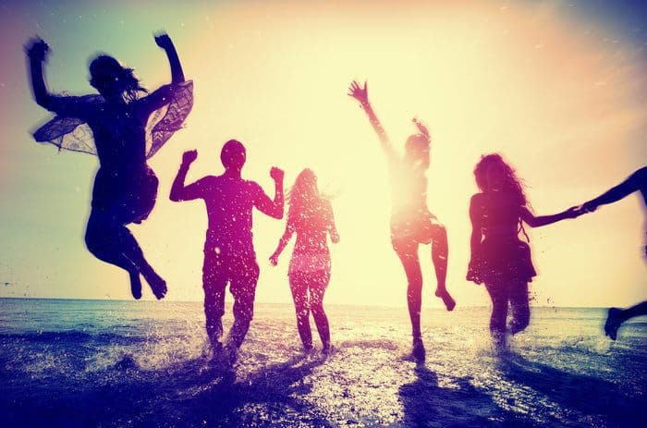
S
T
O
P
N
O
W
= people (am I being kind to others? How’s my friendships going?)
The people that are in our life have a big effect on the way we feel. It’s actually a self-kindness to be kind to others as it makes us feel good and make better friendships. But it’s also good to ask, how are my friendships going? Are we being nice to each other? Would I like to make new friends? How could I do this?
Tips:
*Try new hobbies to meet new people.
*Speak to one new person every day.

Slide 19
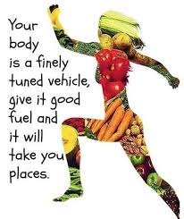
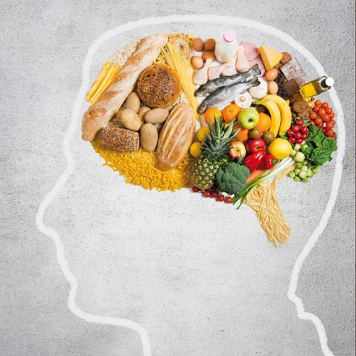
S
T
O
P
N
O
W
Making healthy food choices is one of the kindest you can do for your body and mind. It helps you fight off illness, be strong, gives you more energy and it’s been recently discovered massively helps you feel happier and more awake.
= nutrition (am I eating healthy food?)
Tips:
Try swapping one or two unhealthy snacks for a healthy snack each day.

Slide 20
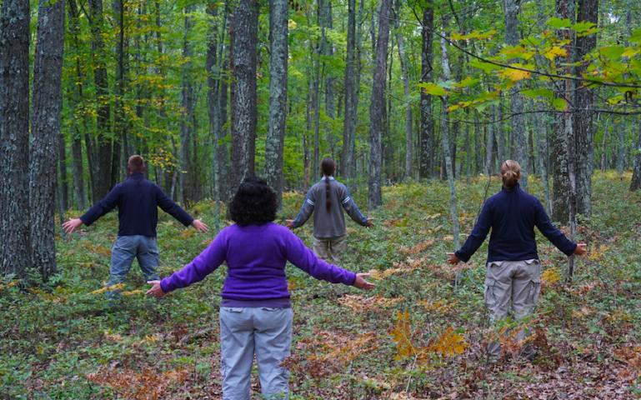
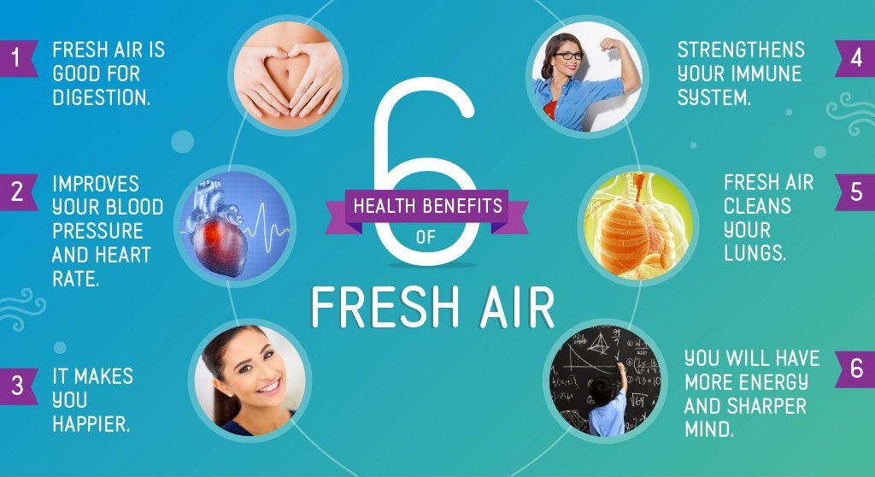
S
T
O
P
N
O
W
Tips:
*Aim to do 1 hour of exercise every day.
*Make plans with friends to exercise/do sports together.
*Join clubs.
*Try things online e.g. Just Dance.
= outdoors and exercise (Am I getting enough?)

Slide 21
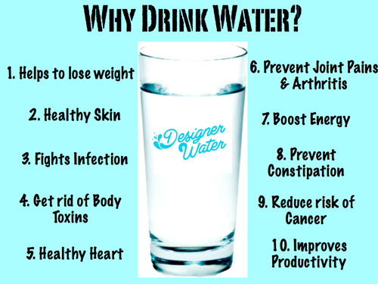
S
T
O
P
N
O
W
Tips for more water:
*Buy a water bottle you like.
*Take it with you everywhere you go.
*Ask yourself halfway through the day if you have drunk enough.
*If you have a headache, feel low or sleepy check your water intake.
= water (am I getting enough?)

Slide 22
Suggestion – what to do next?
Keep this book mark. At the end of each day, go through the letters and tick ones you have done well and cross those you haven’t, set a wellbeing target for the next day. You could do this in a notebook instead. Notice if your mental health/wellbeing improves?
S = sleep
T = Tech
O = Outdoors/exercise
P = People
N = Nutrition
O = Oxygen
W = Water

Slide 23
Reaching for support will also help you when you are stressed…

Slide 24
Now turn the bookmark over. Here are free services that you can access, make a note of any that interest you.
If you are trying all of these things and your mental health still doesn’t feel good, remember all of the support service mentioned in this topic.
Wellbeing Apps:
*Happify (wellbeing games etc.)
*Catch it (app support)
*Smiling minds (calming)
*Meetwo (securely share with others.)
*Daylio (journal)
Call/text:
*Childline 0800 1111.
*Winston’s Wish text WW to 85258. (Free number for anyone who has lost someone.)
*SHOUT. A free text service for anyone needing emotional help 85258.
*LGBTQ free support 10am-10pm 0300 330 0630

Slide 25
Learning review: What re you going to do to help improve your mental health?

