Slide 1
This term we are focusing on Relationships and Wellbeing.
Please complete the RAG sheet.

Slide 2
L.O: What different types of relationships exist?
Success criteria:
You know difference between (biological) sex and gender.
I know what the terms non-binary and transgender mean.
I know what sexuality/sexual orientation means and can name the main ones.

Slide 3
“A family is made up of a mum, a dad and 1 or more children.”
Thumbs up if you agree.
Thumbs down if you don’t.
Thumbs in the middle if you’re not sure.
Discuss your thoughts as a class.

Slide 4
Here are some images of different families who live together… (what do you notice?)
Have any of you changed your mind?

Slide 5
The Family Game
You have 15 minutes to create as many different families as you can on a sheet of a paper. The aim of the game is to work out how many different combinations you can make with the family members.
Using the codes
M = Mum D = Dad Da = daughter S = son ? = add others (write who they are.)
*Challenge – think about where a non-binary, or transsexual, person fits into this game.
For example…
1) M D Da S
2) M Da
3) D M S ? = Grandmother
And so on…
This would be families consisting of:
Mum Dad Daughter Son
Mum Daughter
Dad Mum Son Grandmother

Slide 7
Now it’s time to..
Count up all of your combinations.
Put your hands up. The teacher will count up from 1.
Drop your hand when they reach your number.
The person with their hand up last is the winner.
Please can the winner tell us all of their combinations.
(The teacher may want to write these on the whiteboard.)
Who could the ? be? Let’s share ideas!
Did you get any of the following?

Slide 8
Grandparents (=?)
In some countries/cultures it is still very normal for older relatives (e.g. Grandparents) to live with their son or daughter’s family. This could be so that they can be looked after. Especially in poorer countries which may not have facilities like the NHS.
In the UK, many older people live in Retirement Homes or in Supported Living Areas.
Do you think this is better? Why/Why not? What can be gained from living with
Grandparents?
Some children may be bought up by their Grandparents, or other relatives, because their parents don’t live with them.

Slide 9
Foster Parent (=?)
It is normal for some young people to not live with their actual parents. They may be adopted (which means they will live with a family permanently.)
Or, they may live with a foster parent. Usually, a foster parent looks after a young person until they move back with their parent/s or are adopted.

Slide 10
It may be that the people in the family may choose to identify in other ways, such as non-binary/trans.
We are now going to explore this more….

Slide 11
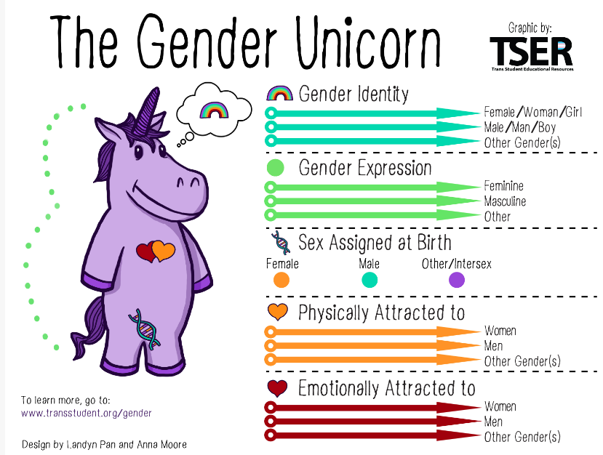
Here is a well-known image explaining gender and sexuality. We are going to explore this now.

Slide 12
Gender Identity
Do you know what these terms means? As you watch the clip on the next slide, try to work out what they mean.
Assigned Sex (Biological sex)
Gender Expression

Slide 13
Watch this clip:
The Gender Unicorn | Pop'n'Olly | Olly Pike – YouTube

Slide 14
Gender Identity
Assigned Sex (Biological sex)
What someone is labelled as at birth, whether that be male/female/intersex. This is based on body parts/hormones/chromosomes.
The gender the inner world sense of being male/female/neither of these/both or another gender.
Gender Expression
The gender someone wants to express on their outer world through things such as clothes/voice. It might be changeable.

Slide 15
Someone who is non-binary or trans (?=)
Biological Sex = whether your body is a male or female.
Gender = whether you feel like a male (boy/man) or female (girl/woman.)
Trans = when someone doesn’t feel the same gender as their sex.
Some people realise that their gender is non-binary.
Non-binary can mean two things:
*that they sometimes feel like a boy/man and sometimes like a girl/woman.
*that they don’t feel like either.
SEX
GENDER

Slide 16
What’s cisgender? Watch this clip to find out…
https://www.youtube.com/watch?v=Zm9vssgYcHU
SEX
GENDER
Someone who identifies with a gender that is the same as their assigned sex. A cisgender person may sign their name with (she/her) (he/him) to show this and that they support others choices.

Slide 17
Another mum or dad (? = mum 2)
Sexuality/sexual orientation = who you are attracted to sexually and/or want to have a relationship with.
Some people are attracted to the opposite sex. They are called heterosexual (straight.)
Some people are attracted to the same sex. They are called gay.
Some people are attracted to both bi-sexual (bi,) Some people are
pansexual meaning you could be attracted to anyone regardless on gender.
This means that in some families two women may be living together/married and may have children, and the same for men.

Slide 18
Someone’s sexuality and labels are decided by them (and not those around them) and someone’s sexuality may even change over time, it is not necessarily fixed.

Slide 19
There are some people who don’t feel sexual attraction to anyone. They are called…
Asexual
(or ace.)
Aromantic
They don’t want to have a romantic or sexual relationship and feel little, or no attraction. This could change.
They may still have a romantic relationship but without sex. This could change.
Important point – some people don’t start feeling sexual attraction until Year 8 or even older. If you don’t feel attraction to anyone yet, you may do as you get older.
If someone is single, it doesn’t mean they identify as asexual or aromantic, they may just not have met someone they want to be in a relationship with yet.

Slide 20
Important point!
Some of these words and meanings are quite new. So you may meet some people who think gender and sex mean the same thing.
You also may notice that on questionnaires you are asked for your just your gender or sex. This shows that not everything has caught up with the new meanings of these words yet.
?

Slide 21
The LGBTQIA community refer to anyone who does not identify as straight (heterosexual) and/or cisgender.
Lesbian
Gay
Bi-sexual
Transgender
Queer (someone questioning.)
Intersex (someone who is born with both sexes.)
Asexual
This is a well-known symbol that represent the LGBTQ+ community.

Slide 22
Time for a quiz!
As you watch the following clip, try to complete the quiz!
https://www.youtube.com/watch?v=k47AiatNvoM

Slide 23
Questions:
1) What does assigned sex mean?
2) What does gender mean?
3) What is the name for someone who feels their gender is different to their assigned sex?
4) What is the word for someone who feels like different genders on different days or no gender?
5) What does sexuality mean?
6) What does being straight mean?
7) What does being gay mean?
8) What does being bi-sexual mean?
9) What does being asexual mean?

Slide 24
ANSWERS:
1) What does assigned sex mean? Whether your body is a boy or girl at birth.
2) What does gender mean? Whether you feel like a boy or girl.
3) What is the name for someone who feels their gender is different to
their sex Trans.
4) What is the word for someone who feels like different genders on
different days or no gender? Non-binary.
5) What does sexuality mean? Who you are sexually and/or romantically
attracted to.
6) What does being straight mean? You are sexually attracted to the
opposite sex.
7) What does being gay mean? You are sexually attracted to the same sex.
8) What does being bi-sexual mean? You are sexually attracted to both sexes.
9) What does being asexual mean? You are not sexually attracted to anyone.

Slide 25
If you have time play the card game – see next slide if not go to the final slide.

Slide 26
Now let’s play a game!
Your teacher will give you a sheet of cards in pairs.
Cut them up.
Try to match the words to it’s definition with picture.
Now split the cards in to two piles.
Pile 1 = words
Pile = pictures
(Shuffle the cards and play snap with your partner.)

Slide 27
Final learning check:
Success criteria:
What is the difference between assinedsex and gender?
What do the terms non-binary and transgender mean?
What does sexuality/sexual orientation means and can name the main ones?

