Slide 1
Class Agreements
No put downs of self or others.
Listen well.
Be willing to try new things.
Participate fully (but you have a right to PASS if you don’t want to share something.)
No gossip about anyone in the classroom, or outside. This includes not telling us stories/information about people we may know.
No gossip following the lesson.
Others? Questions about any?
Please put thumbs up if you agree to this.

Slide 2
What can you remember about our last PASHE lesson?
Our new topic is:
“What does it mean to belong to a family?”
Last week we explored our own family.
Can you remember who is in the family Madrigal?
Optional – watch clip from last week again…
https://www.youtube.com/watch?v=Yp5nPGWWMh4

Slide 3
L.O: What are families like?
Success criteria:
You have completed the family game and can answer the question who might live together as a family?

Slide 4
“A family is made up of a mum, a dad and 1 or more children.”
Stand in the room on a scale on 1 – 5.
The left side of the room is 1 – I definitely don’t agree.
The right side of the room is 5 = I definitely agree.
Now tell the person next to you, why you stood here.
Now let’s discuss this as a class, at any moment you can move position.

Slide 5
Here are some images of different families who live together… (what do you notice?)
Now watch the clip “Modern Family” (Netflix) https://www.youtube.com/watch?v=Ub_lfN2VMIo

Slide 6
“A family is made up of a mum, a dad and 1 or more children.”
Have you changed your mind or do you still think the same?

Slide 7
Imagine…
Disney would like to create a new film showing all of the different types of family that exist.
They ask you to research all the different types of family to help them make the film.
In order to do this, you are going to play the “Family Game” in pairs!

Slide 8
The Family Game
What you need (in pairs):
*A ‘family members sheet’ that you are going to cut up.
*A house sheet that you are going to draw/write on.
*Pens/scissors.
You don’t glue these on, you simply use them like counters to try and help you work out all of the different combinations.
Task 1 – Cut the family members so that they are small boxes.
Mum M | Dad D | Daughter Da | Son S | ?

Slide 9
Challenge 2:
The aim of the game is to work out how many different combinations you can make with the family members.
Use the squares to help you then record the different combinations on the sheet using the letters M D Da S and….
Important point – the question mark square can become anyone you want but you have to write their name in the ‘house.’ For example…
D S ? = a Gran Or M D Da ? = Mum 2

Slide 10
Some ideas to get you started!
Decide on a time limit with your teacher
(suggestion - 20 mins.)
M D Da S | M D Da | M Da ? = Gran
See next slide for images to help you…

Slide 13
Now it’s time to..
Count up all of your combinations.
Put your hands up. The teacher will count up from 1.
Drop your hand when they reach your number.
The person with their hand up last is the winner.
Please can the winner tell us all of their combinations.
(The teacher may want to write these on the whiteboard.)
Who could the ? be? Let’s share ideas!
Did you get any of the following?

Slide 14
In your game did you add…Grandparents (=?)
In some countries/cultures it is still very normal for older relatives (e.g. Grandparents) to live with their son or daughter’s family. This could be so that they can be looked after. Especially in poorer countries which may not have facilities like the NHS.
In the UK, many older people live in Retirement Homes or in Supported Living Areas.
Do you think this is better? Why/Why not? What can be gained from living with
Grandparents?
Some children may be bought up by their Grandparents, or other relatives, because their parents don’t live with them.

Slide 15
In your game did you add…Foster Parent (=?)
It is normal for some young people to not live with their actual parents. They may be adopted (which means they will live with a family permanently.)
Or, they may live with a foster parent. Usually, a foster parent looks after a young person until they move back with their parent/s or are adopted.

Slide 16
In your game did you add… people who may identify as non-binary/trans?

Slide 17
It may be that the people in the family may choose to identify in other ways, such as non-binary/trans.
We are now going to explore this more….

Slide 18
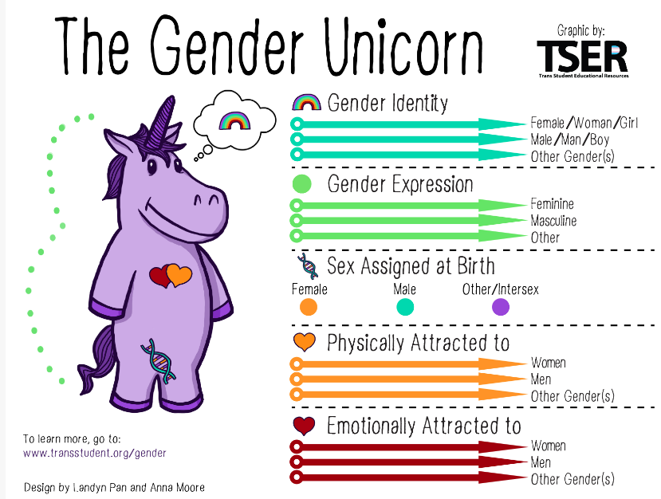
Here is a well-known image explaining gender and sexuality. We are going to explore this now.

Slide 19
Gender Identity
Do you know what these terms means? As you watch the clip on the next slide, try to work out what they mean.
Assigned Sex (Biological sex)
Gender Expression

Slide 20
Watch this clip:
The Gender Unicorn | Pop'n'Olly | Olly Pike – YouTube

Slide 21
Gender Identity and Gender Expression…

Slide 22
Gender Identity
Assigned Sex (Biological sex)
What someone is labelled as at birth, whether that be male/female/intersex. This is based on body parts/hormones/chromosomes.
The gender the inner world sense of being male/female/neither of these/both or another gender.
Gender Expression
The gender someone wants to express on their outer world through things such as clothes/voice. It might be changeable.

Slide 23
Someone who is non-binary or trans (?=)
Assigned Sex = whether your body is a male or female.
Gender = whether you feel like a male (boy/man) or female (girl/woman.)
Trans = when someone doesn’t feel the same gender as their sex.
Some people realise that their gender is non-binary.
Non-binary can mean two things:
*that they sometimes feel like a boy/man and sometimes like a girl/woman.
*that they don’t feel like either.
ASSIGNED
SEX
GENDER

Slide 24
What’s cisgender?
SEX
GENDER
Someone who identifies with a gender that is the same as their assigned sex. A cisgender person may sign their name with (she/her) (he/him) to show this and that they support others choices.

Slide 25
Sexual Orientation…

Slide 26
In your game did you add…two mums or dads (? = mum 2)
Sexuality/sexual orientation = who you are attracted to sexually and/or want to have a relationship with.
Some people are attracted to the opposite sex. They are called heterosexual (straight.)
Some people are attracted to the same sex. They are called gay.
Some people are attracted to both bi-sexual (bi,) Some people are
pansexual meaning you could be attracted to anyone regardless on gender.
This means that in some families two women may be living together/married and may have children, and the same for men.

Slide 27
There are some people who don’t feel sexual attraction to anyone. They are called…
Asexual
(or ace.)
Aromantic
They don’t want to have a romantic or sexual relationship and feel little, or no attraction. This could change.
They may still have a romantic relationship but without sex. This could change.
Important point – some people don’t start feeling sexual attraction until Year 8 or even older. If you don’t feel attraction to anyone yet, you may do as you get older.
If someone is single, it doesn’t mean they identify as asexual or aromantic, they may just not have met someone they want to be in a relationship with yet.

Slide 28
Someone’s sexuality and labels are decided by them (and not those around them) and someone’s sexuality may even change over time, it is not necessarily fixed.

Slide 29
Important point!
Some of these words and meanings are quite new. So you may meet some people who think gender and sex mean the same thing.
You also may notice that on questionnaires you are asked for your just your gender or sex. This shows that not everything has caught up with the new meanings of these words yet.
?

Slide 30
The LGBTQIA community refer to anyone who does not identify as straight (heterosexual) and/or cisgender.
Lesbian
Gay
Bi-sexual
Transgender
Queer (someone questioning.)
Intersex (someone who is born with both sexes.)
Asexual
This is a well-known symbol that represent the LGBTQ+ community.

Slide 31
Turn to the back of your RAG sheet.
Look at the question - Who might live together as a family.
Do you want to change your original answer?
If so write it underneath.
Now let’s answer that question as a class based on today’s lesson!

