Slide 1

The concept I am learning is how to be well and safe.
Last lesson I learnt about how to improve my overall wellbeing using STOP NOW.
This lesson I am learning about how to do basic First Aid.
This is so I can…know what to do in an emergency.

Slide 2
Discuss in groups:
We will be discussing these terms.
The Recovery Position
CPR
A Defibrillator
We will go back over this at the end of the lesson.

Slide 3
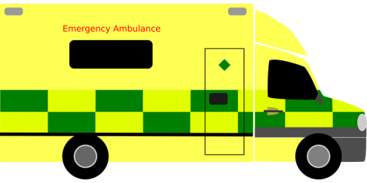
Discuss: Why could someone collapse/become unconscious?
Some possible reasons:
a head injury
drugs.
alcohol.
substance abuse.
epilepsy.
low blood sugar.
stroke.
lack of oxygen to the brain.
*a heart attack
Notes:
Explain the heart needs air (oxygen) and it’s a muscle that pumps blood around the body.
What can go wrong to cause a problem to the air and blood circulating? (circulation = "circling" the body)
Brief explanation and onto worksheet
General discussion - hit head, run over, choking etc. Emphasis on if it affects breathing, brain or heart (circulation) then this can cause unresponsiveness.

Slide 4
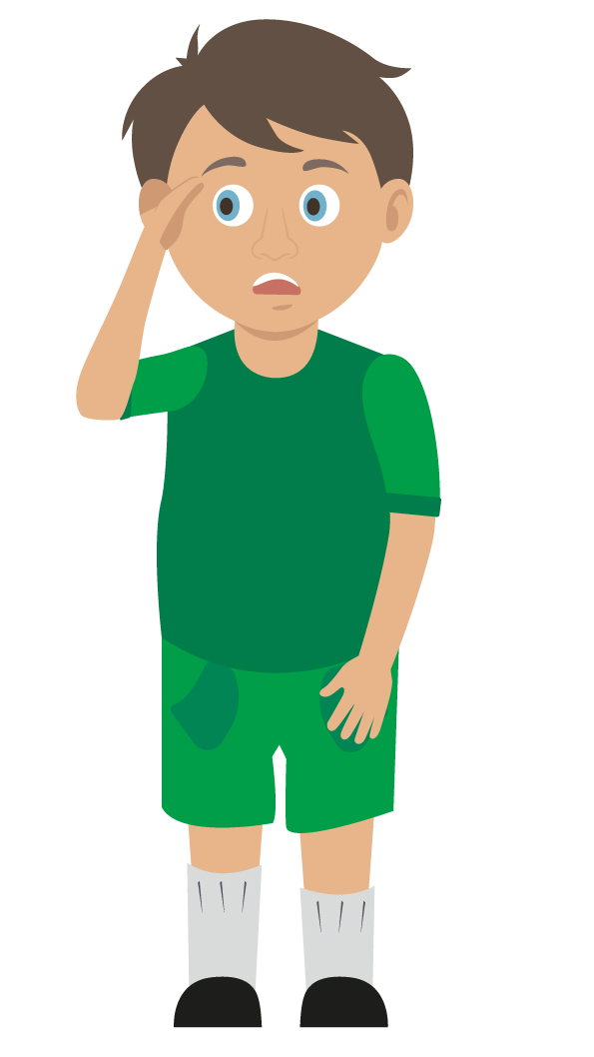
We are now going to learn what to do if you see someone who has collapsed and is unconscious.
(This person can be called a casualty.)

Slide 5

Stage one:
You need to do something called a:PRIMARY SURVEY.
This involves 5 steps…
Primary Survey - Basic Life Support - First Aid Teaching Resources - St John Ambulance (youtube.com)
Watch this clip (above), then try to put these in the correct order:
1) Airway – lift chin (gently)
2) Danger – remove any objects/dangers out of the way
3) Response – ask if they can hear you, gently shake shoulders.
4) Breathing – listen and look for breath for 10 seconds
5) Shout/call for help (tell someone to call 999.)

Slide 6
Stage one:
This is the correct order for a PRIMARY SURVEY.
Watch this clip, then try to put these in the correct order:
2) Danger – remove any objects/dangers out of the way
3) Response – ask if they can hear you, gently shake shoulders.
5) Shout/call for help (tell someone to call 999.)
1) Airway – lift chin (gently)
4) Breathing – listen and look for breath for 10 seconds

Slide 7
Stage two:
What you do next, depends on whether they are breathing…
CHECK BREATHING?
Can you finish this diagram?
YES
NO
OPTION 1: PUT THEM IN THE RECOVERY POSITION
OPTION 2: DO CPR/USE A defibrillator

Slide 8
OPTION 1:The Recovery Position
If the person is still breathing NORMALLY, you put them in the recovery position and wait for the ambulance. This is to prevent them choking.
Challenge 2 – Get into pairs.
Can you remember the recovery position? Have a go. Swap over.
Recovery Position - Basic Life Support - First Aid Teaching Resources - St John Ambulance (youtube.com)

Slide 9


Challenge 1: Your turn: In pairs have a go! Check for breathing
2. Response
Check the casualty’s response. Ask questions and gently tap shoulders. Say “open your eyes!”
3. Shout for help
Anyone nearby can assist you
1. Check for danger
Always make sure the area is safe
5. Breathing
Check for normal breathing. Do not put your face next to theirs, instead look at chest rising and falling only. (Remember 10 seconds!)
4. Airway
If not clear, then open by tilting the head back, use one hand on forehead and two fingers under the chin
6. Circulation (only if breathing normally)
Check the casualty for bleeding
NB
At this time do not put your face near to theirs to check for breathing, instead look at chest rising and falling only
If the casualty is not breathing normally call 999/112 then start CPR
If the casualty is breathing normally place them in the recovery position then call 999/112
Notes:
Scenario cards are available which the teacher can use to make the practical activity relevant in a certain context for students.
Trainer demonstrates then gets the students to practice using either the PP slide as a prompt or the sheet in the workbook. Trainer circulate and correct as necessary

Slide 10
Challenge 2: Now have go!
Putting someone into recovery position
1. Kneel
By the side of your casualty
3. Hand to cheek
Bring the arm furthest away across the chest and place the back of their hand against the cheek nearest to you
Hold it there
2. Angle arm
Put the arm nearest to you to make a right angle. Palm facing upwards
5. Knee pull
Pull on the knee to roll the casualty towards you onto their side
Adjust them as necessary
4. Knee bend
With other hand, bend their far knee up so that the foot is flat on the floor
6. Ensure airway is open
Recheck breathing
Call 999/112
Stay and monitor casualty until help arrives
KS3 – Basic life support
Notes:
Trainer demonstrates then gets the students to practice using either the PP slide as a prompt or the sheet in the workbook. Trainer circulate and correct as necessary
Scenario cards are available which the teacher can use to make the practical activity relevant in a certain context for students.

Slide 11
OPTION 2:
If they are not breathing, make sure 999 is called. Do CPR or use a defibrillator.
Discuss:
What can you remember about CPR?
Stand up and use the table to demonstrate to each other in pairs.

Slide 12
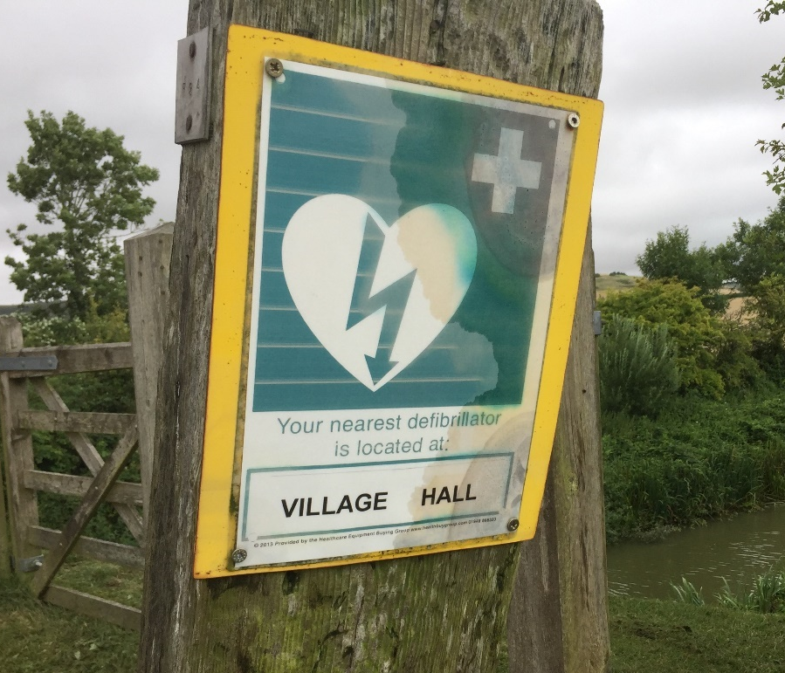
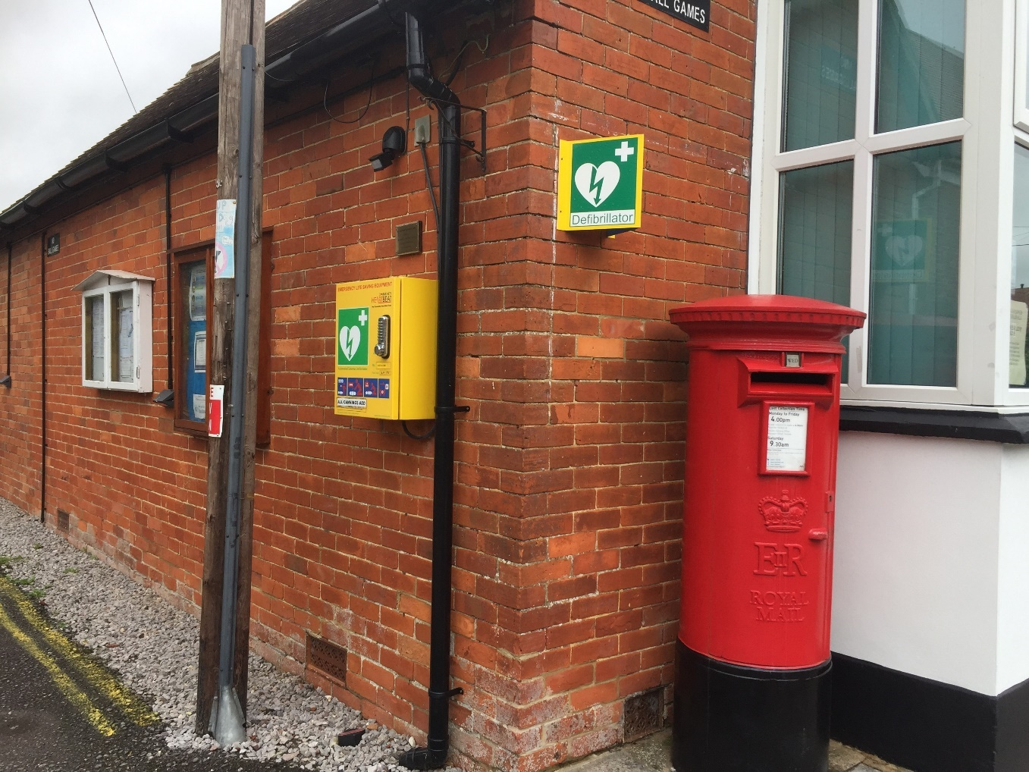
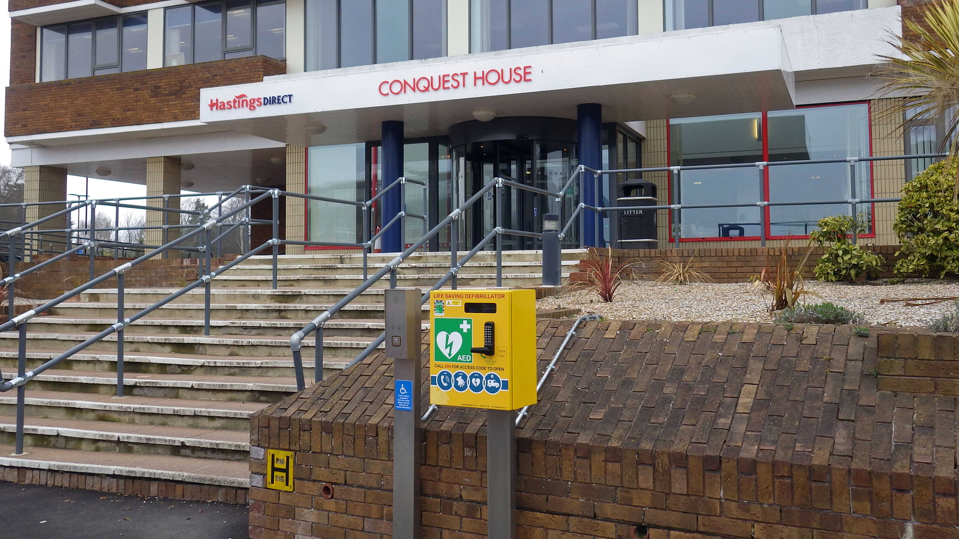
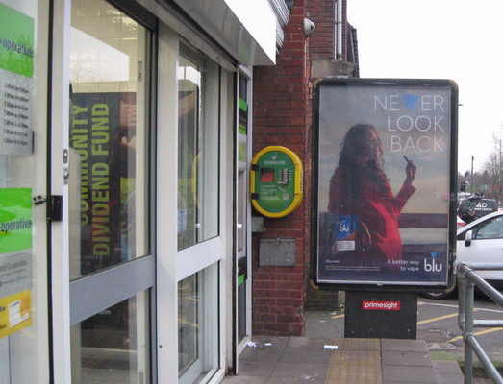
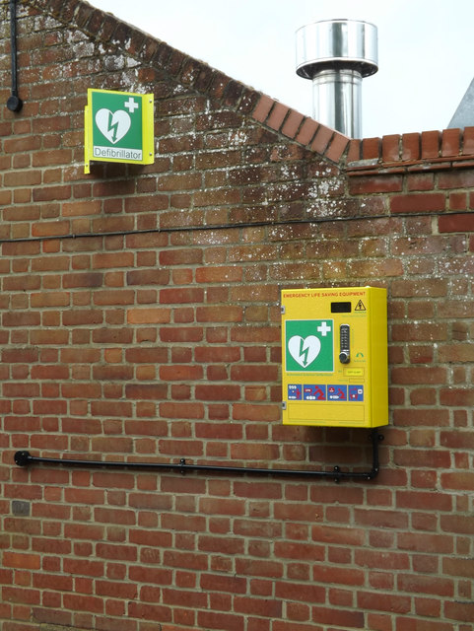
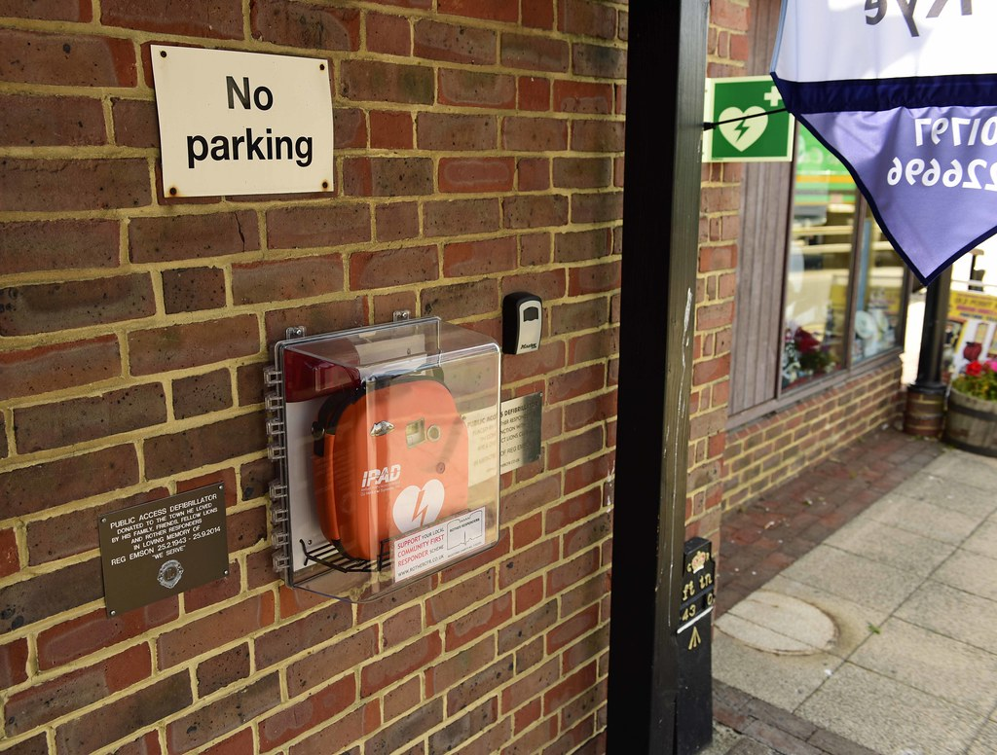
Public Access Defibrillators
You can find AEDs in many public places, including offices, schools, shopping centres, supermarkets and airports. It is important that public places have AEDs because in the event of a cardiac arrest these would need to be accessed quickly; the sooner an AED is attached the sooner it can restart the heart.
KS3 – Basic life support

Slide 13
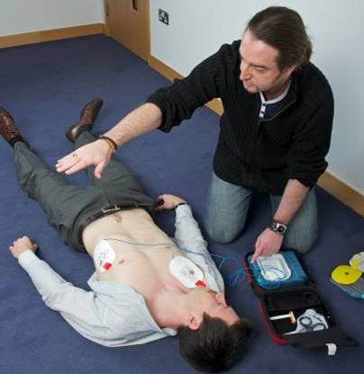
Using the DEFIBRILLATOR (AED)
AED stands for automated external defibrillator. This is an emergency life-saving device used in the event of sudden cardiac arrest. The device analyses the heart rhythm and administers an electrical charge to the heart if needed to establish a regular heartbeat.
  Turn the AED on
  Follow all the AED voice prompts
  Ensure no one is touching the casualty when it is analysing
  Ensure no one is touching the casualty before pushing the shock button
KS3 – Basic life support

Slide 14
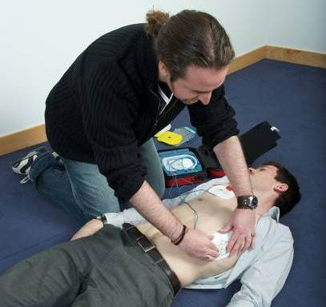
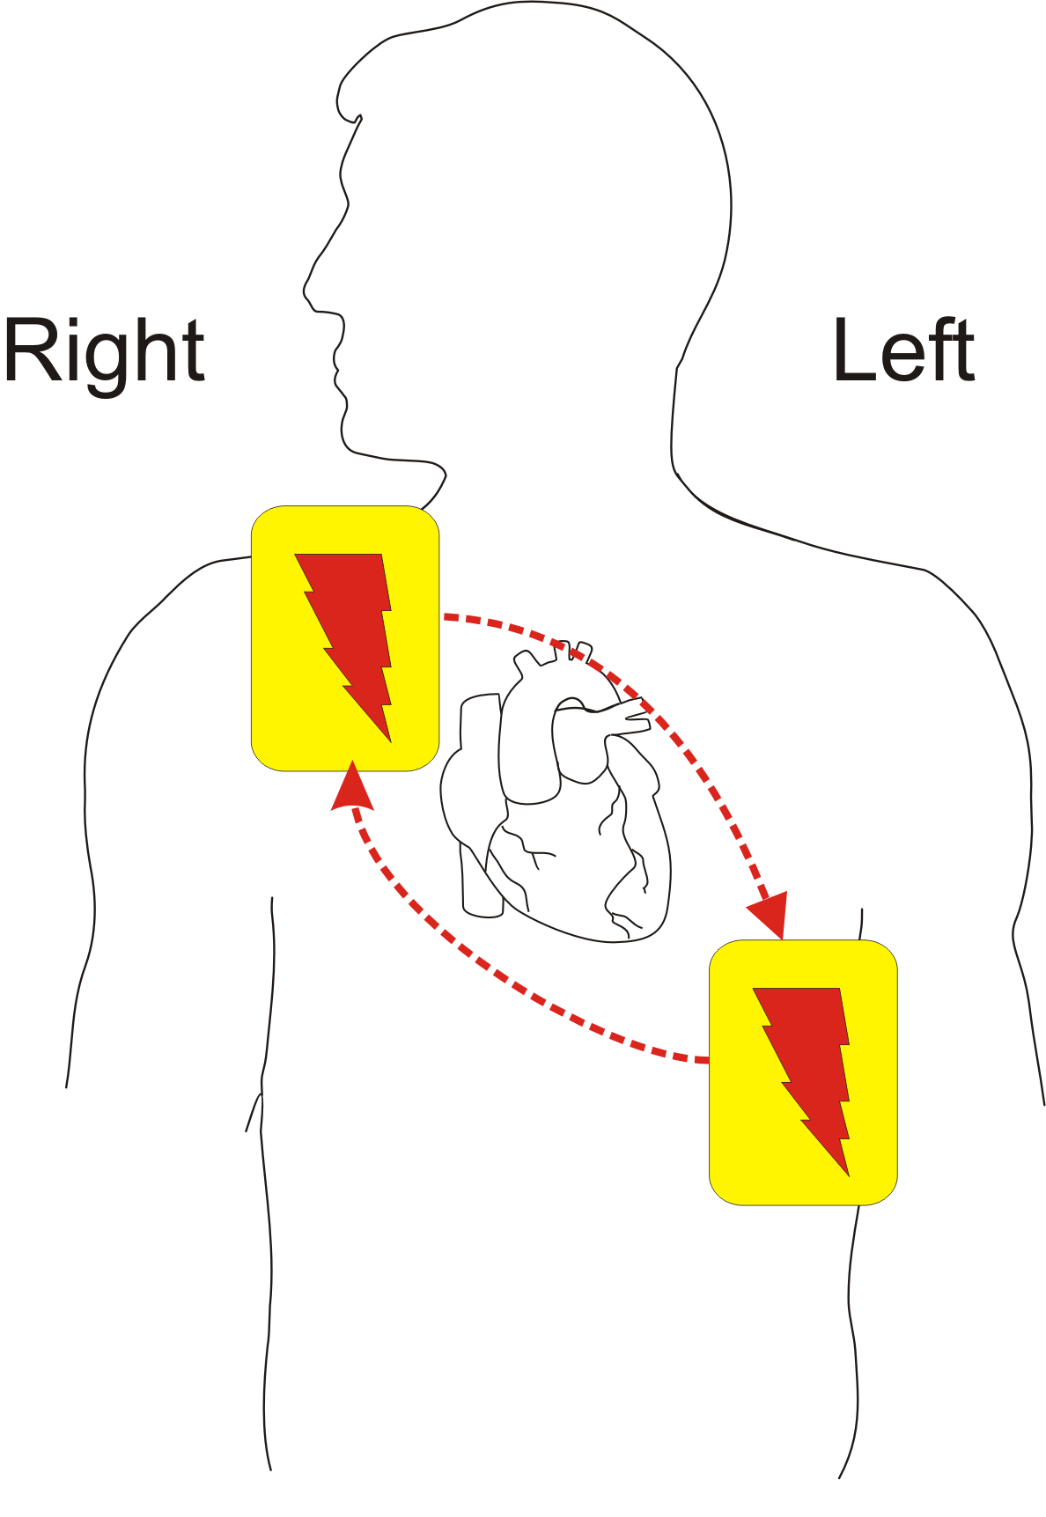
Connecting the AED pads
  Ensure that the chest is dry
  Consider shaving the chest if it is hairy
  Use the pre-prepared pads that come with the AED, they are ready to use.
  Stick the pads onto the chest as indicated on the pads.
  Ensure each pad is securely attached
KS3 – Basic life support

Slide 15
CPR remember…
You may not be strong/confident enough to do CPR on a casualty. That’s OK, you can tell someone else what they need to do
It is important to understand that sometimes even CPR cannot save somebody
Anything you can do to help, even just calling someone else to help, could be lifesaving
Never do CPR on someone if they are responsive and breathing normally

Slide 16
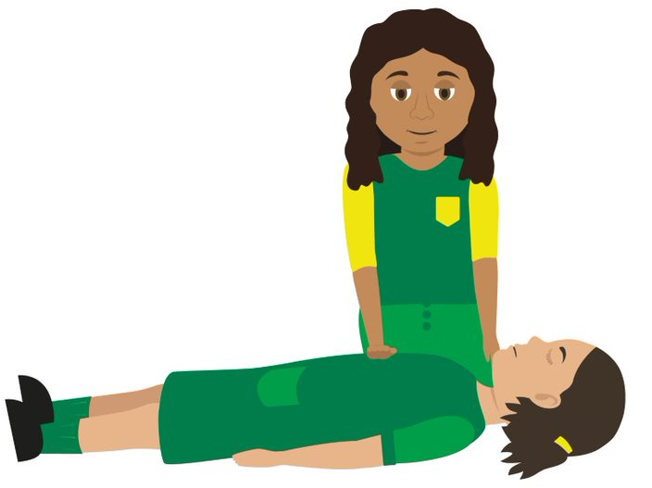

Watch this video
(click on CPR)
CPR
Challenge 3: Now stand up above the table or a char. Arms straight and have a pretend go at CPR. DO NOT DO THIS ON EACHOTHER.
KS3 – Basic life support

Slide 17


What are the 5 stages?
1) Danger – remove any objects/dangers out of the way
2) Response – ask if they can hear you, gently shake shoulders.
3) Shout/call for help (tell someone to call 999.)
4) Airway – lift chin (gently)
5) Breathing – listen and look for breath for 10 seconds
Recap
Primary Survey
What comes next?
Breathing normally
Not breathing normally
What comes next?
Recovery position
999, ask someone to get a defibrillator if able.
Make sure an ambulance is coming and make sure someone is always with the person.
CPR (don’t stop until the paramedics take over.)
Notes:
Just a recap, quick Q and A around room to check learning informally

Slide 18
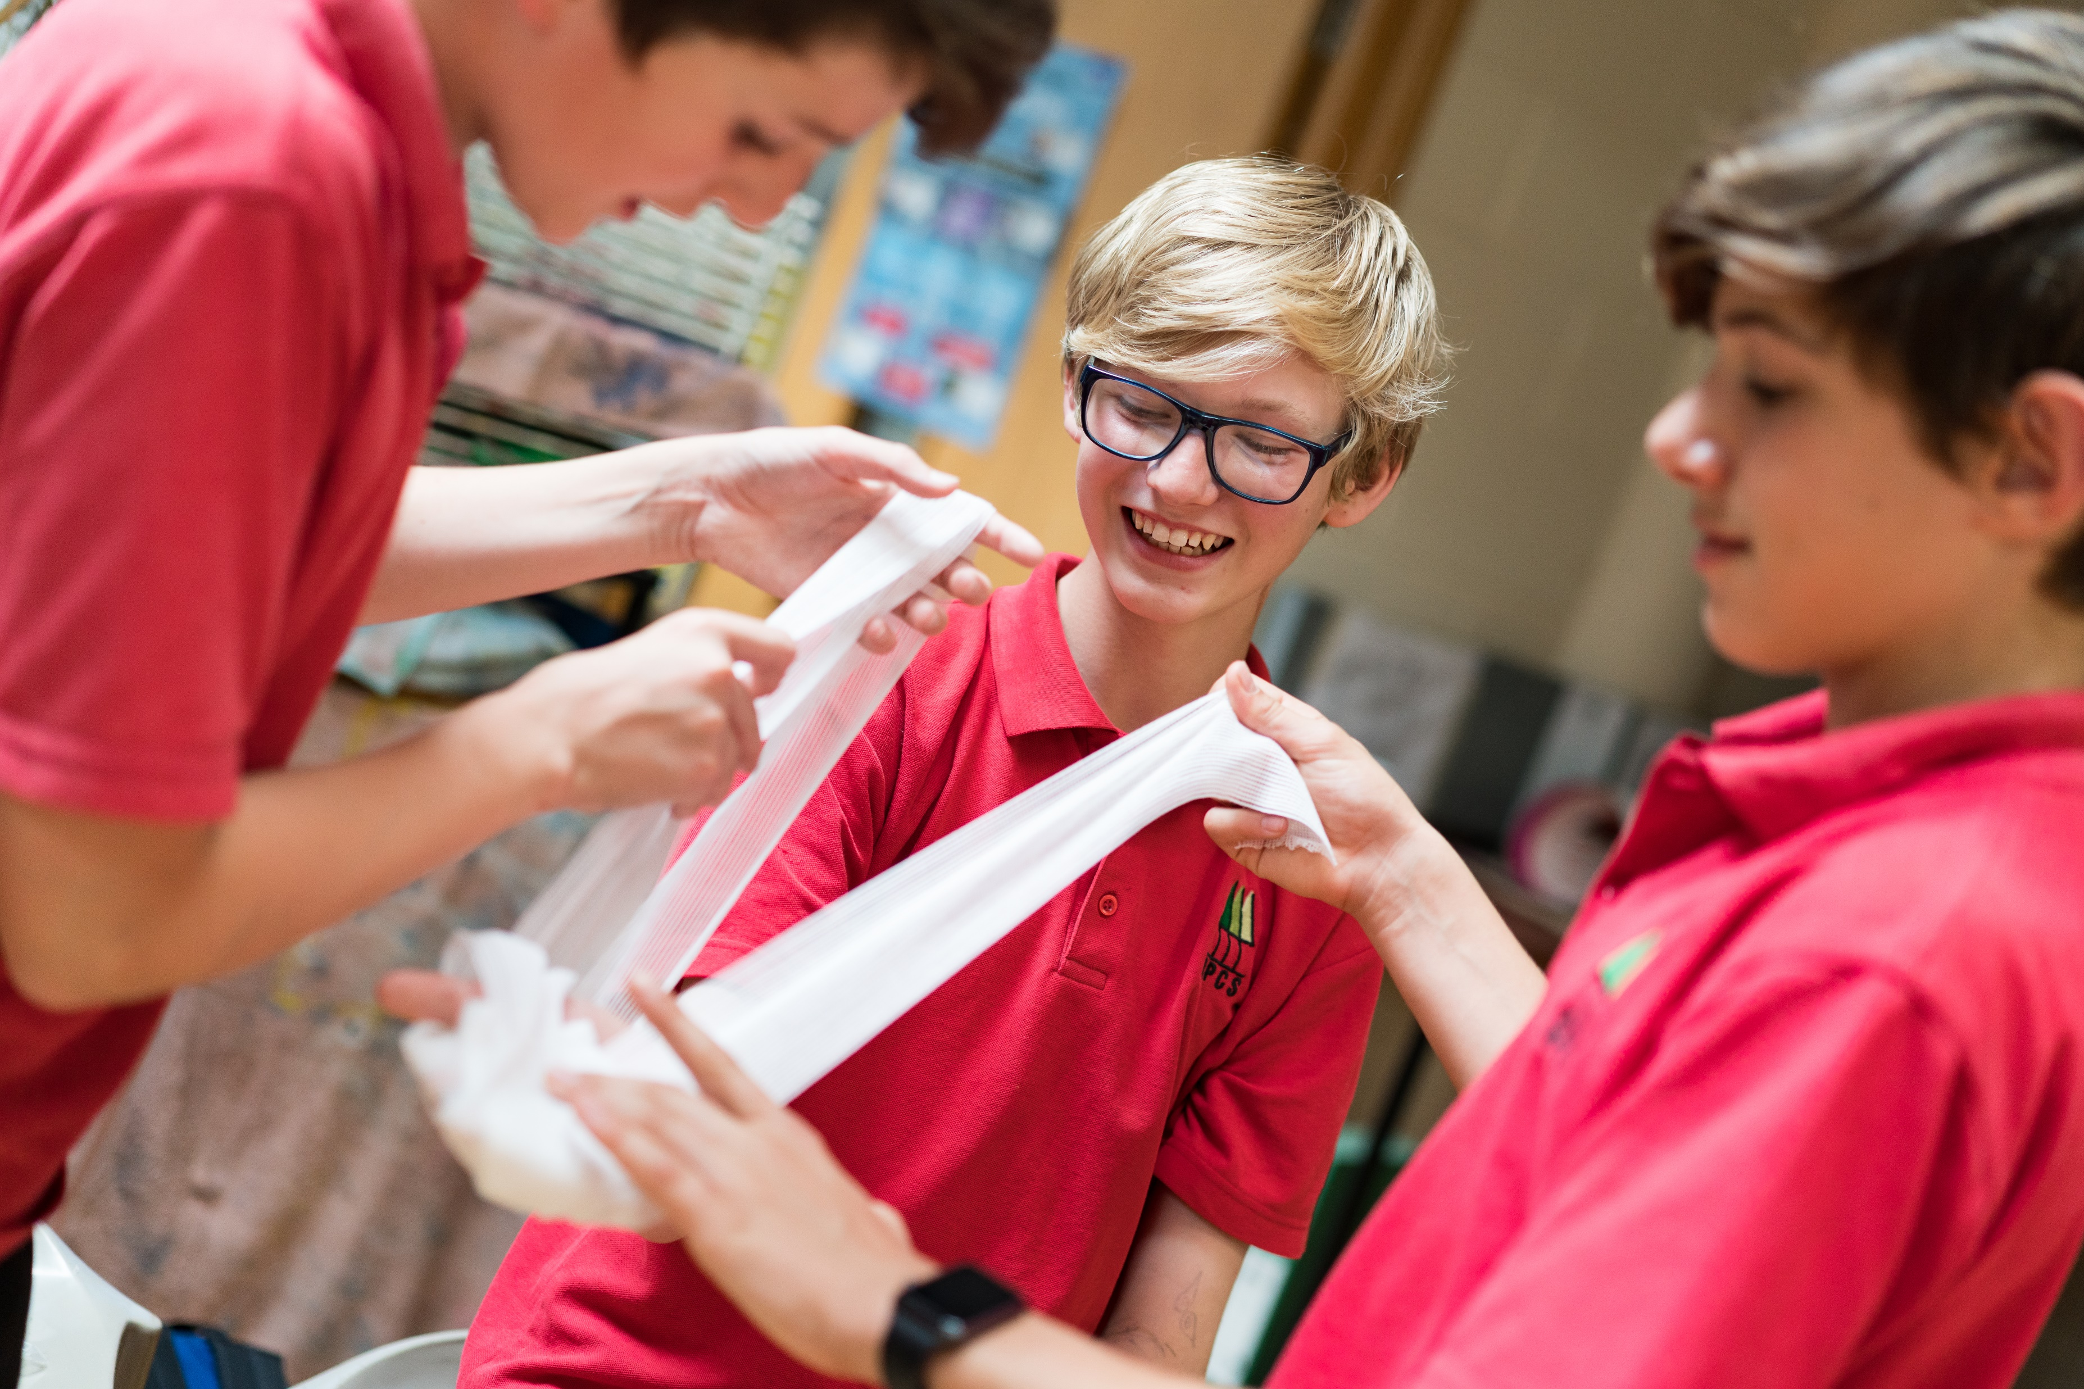


Bleeding
KS3 - Bleeding

Slide 19
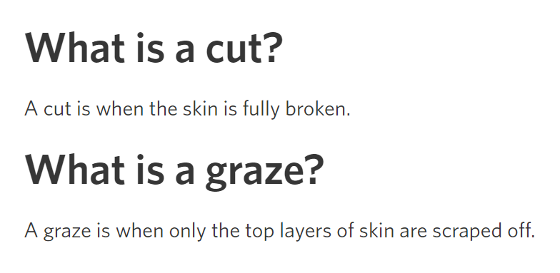
Cuts and Grazes
Watch this to learn how to deal with them:
https://www.youtube.com/watch?v=4e7evinsfm0&t=6s

Slide 20
Bleeding… if someone has an accident, they may bleed internally or externally. What might be the signs?
Signs and symptoms of someone with an internal or external bleed could be:
pale, clammy, cold skin
rapid pulse/heart beat
rapid breathing/shortness of breath
feeling dizzy
distress and anxiety
grey/blue tinge to the lips
bruising and pain at site of the injury
loss of responsiveness
If you suspect someone is bleeding internally you won’t see the blood but they may have these symptoms. Call 999 straight away. If you see blood there are things that you can do…

Slide 21
Watch this video (warning content contains scenes of bleeding)
SEVERE BLEED

Slide 22
Here are the stages of support. Optional – act it out.
3. Apply a dressing to the wound
the pad goes over the injury
use bandage to secure it in place
make sure the bandage is not too tight
call 999/112
2. Apply pressure to the wound
(but only if there is nothing stuck in it)
1. Put on gloves
5. If an object is in the wound, do NOT remove
put a pad on either side of the object
bandage carefully over the pads without pushing the object in any further
4. Apply second dressing, if needed
no more than two dressings at a time
Notes:
Scenario cards are available which the teacher can use to make the practical activity relevant in a certain context for students.

Slide 23
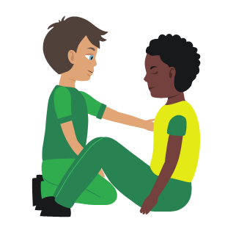
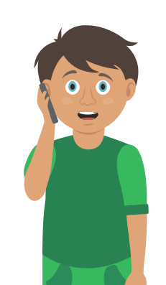
Nosebleed Stages of support. Optional act It out.
1. Sit
the casualty down leaning forward
2. Ask
them to pinch the soft part of their nose for 10 minutes
3. Check
if the bleeding has stopped
if still bleeding pinch nose for a further 10 minutes
4. Recheck
if still bleeding pinch for a further 10 minutes
5. Help
if bleeding has not stopped after a maximum of 30 minutes seek medical help
Notes:
Scenario cards are available which the teacher can use to make the practical activity relevant in a certain context for students.

Slide 24
Shock
What is shock?
Shock is a life-threatening medical condition which is caused by a lack of blood flow to tissues and organs in the body.
The decreased blood flow means there is a lack of oxygen to the organs, this can lead to tissue damage. Shock requires quick treatment to prevent organ failure.
Signs and symptoms of someone suffering from shock could be:
Rapid, shallow breathing
Cold, clammy skin
Rapid, weak pulse
Dizziness or fainting
Weakness
Sweating
Chest pain

Slide 25
Watch this video
SHOCK

Slide 26
Dealing with shock. Optional. Act it out.
1 Treat
any injuries that may have caused shock
2 Help
the casualty to sit down, then lie down
3 Raise
and support the casualty’s legs if possible
5 Reassure
them and loosen any tight clothing
4 Call
999
6 Keep
the casualty warm
Notes:
Scenario cards are available which the teacher can use to make the practical activity relevant in a certain context for students.

Slide 27
Learning Review:
Tell the person next to you five important things you have learnt today.
Let’s share.

