Slide 1
Ground Rules
No questions will be answered during the lesson:
If you have any questions, about the topic we are covering today, please write them on a post-it note.
Please write your tutor group on the post-it. You can write your name, but you do not have to, if you don’t want to.
Please put your question in the tutor’s envelope at the end of the lesson.
All questions will be looked at, but only questions relating to the topic being taught will be answered and then given back to tutor groups.
Questions will be answered in an age-appropriate manner.
Questions that do not relate to the topic or that are not age-appropriate, will be addressed by signposting you to when the subject matter of your question will be taught.
During the lesson:
Please only give your opinions during discussions when asked.
Do not say anything that could IDENTIFY anybody during the lesson.
Be respectful of each other during the lesson.

Slide 2
The concept I am learning is to learn to be well and safe.
Last lesson I learnt about…how to perform First Aid so that I can help keep others safe.
This lesson I am learning how to look after my personal hygiene.
This is so I can be a well and healthy person.

Slide 3
So far in this topic we have looked at how to be well using STOP NOW.
What does STOP NOW stand for?
We then explored how to help keep others safe and re-capped First Aid.
We are now focusing on how to keep ourselves safe and well as we grow older and go through puberty.

Slide 4
Puberty is a special time of change for young people and it becomes possible for them to reproduce (have a baby) when they are old enough. These changes are both..
Re-cap from Yr 6
Physical = a change that happens to the body
e.g. you grow.
Emotional = changes that happen to feelings
e.g. there are times you may feel sad and not know why.

Slide 5
Puberty – Some Key Facts
Re-cap from Yr 6
Puberty occurs between the ages of 8 and 18 years old.
Puberty is a NORMAL part of growing up.
Each person starts puberty at slightly different times – it’s important to respect these differences.
The whole process can take a few years.
Hormones are special chemical messengers in the body that tell it to go through puberty
Different changes happen depending on the sex of the person (male/female.) But some changes happen in both.

Slide 6
As you go through puberty, and become older, it becomes even more important to think about your personal hygiene.
What does personal hygiene mean?
Personal hygiene is about keeping your body/teeth clean. It is also about helping you avoid illness.

Slide 7
Re-cap from Year 6…
Drama game –
In pairs, take it in turns.
Mime an action showing someone taking care of their personal hygiene.
When guessing, add as much detail when describing as possible e.g. brushing your teeth twice a day at least two minutes.
When you’ve guessed correctly swap places!

Slide 8
Re-cap from Year 6…
The teacher is going to write personal hygiene in middle of the board. Now play the mime game as a class.
When everyone guesses correctly, we will add their ideas to the board.
Let’s compare your ideas as a class to the next slide.

Slide 9
Personal Hygiene
*Use deodorant
*Shower regularly
*Look after your hair (Hair care)
*Look after your skin (Skin care)
*Handwashing
*Dental hygiene
*Clean clothes/bedding
*Menstrual wellbeing (periods)
You will now need the notes sheet (one each.) Make notes next to each heading.

Slide 10
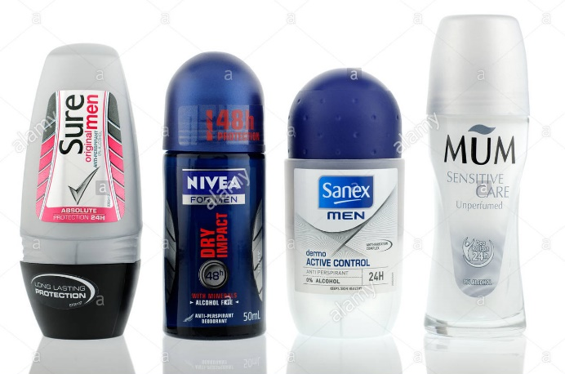
*Use deodorant
The smell of sweat becomes stronger during puberty and adulthood.
You therefore need to..
Use deodorant in the morning and after exercise.
Body sprays do not count.

Slide 11
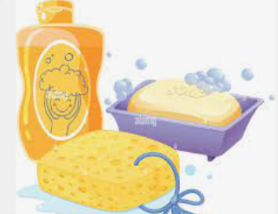
*Shower regularly
Ideally you should shower or bath daily.
Remember to wash particularly well, under the arms and your private parts.

Slide 12
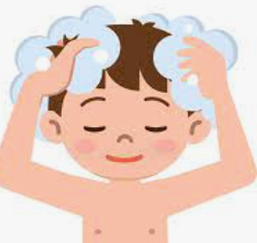
*Look after your hair (Hair care)
Ideally wash your hair daily. Remember to use shampoo and conditioner. Wash it all out well before drying.

Slide 13
*Look after your skin (Skin care)
During puberty your skin gets very greasy, this is normal due to hormonal changes. This ca create acne.
Skin care – wash face morning and evening.
Buy a makeup remover is wearing makeup, take off every evening thoroughly.
Don’t squeeze spots! Buy spot cream, Superdrugs own is very good.

Slide 14
*Handwashing
Think back to Covid! Handwashing is still very important to avoid getting ill, especially before eating.
Wash your hands for 20 seconds at least using warm water and soap.
https://www.youtube.com/watch?v=3zElj70dYJ4

Slide 15
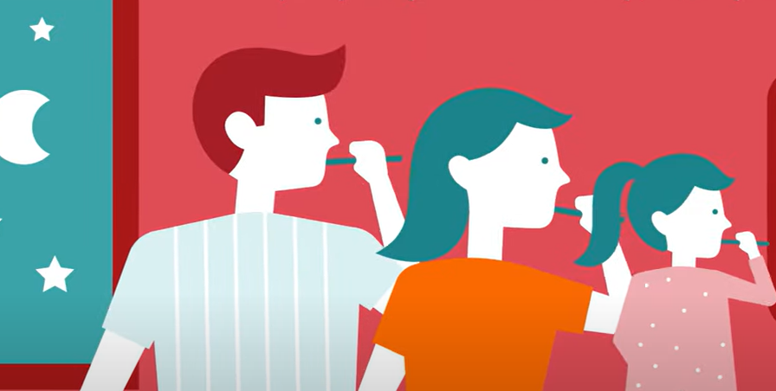
*Dental hygiene
Brush your teeth at least twice a day.
You need to brush for at least two minutes.
https://www.youtube.com/watch?v=1q10LWifXkw
NB:You need two visit the dentist twice a year for dental check-ups.

Slide 16
*Clean Clothes
You need to change your clothes everyday.
This includes underwear and socks.
Bedding should be changed between one to two weeks.

Slide 17
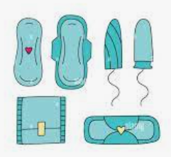
*Menstrual wellbeing (periods)
Re-cap – you can use sanitary towels or tampons.
Ideally, change your pad/tampon every three/four hours depending on how heavy you are. If you don’t do this you can create infections and other issues.
Remember – you can ask for sanitary towels from your Mrs Parker, your tutor, reception or the b block office.
For everyone – if you have issues passing urine it’s really important to tell and adult as you may have a urine infection. Drinking more water can help but you made need medication.

Slide 18
Now…
Use your other sheet to create a poster using all of your notes.
Take this home and put it somewhere to remind you how to look after your personal hygiene.

Slide 19
Learning Review…
Count on your fingers, five ways to look after your personal hygiene!

