Slide 1
Ground Rules
No questions will be answered during the lesson:
If you have any questions, about the topic we are covering today, please write them on a post-it note.
Please write your tutor group on the post-it. You can write your name, but you do not have to, if you don’t want to.
Please put your question in the tutor’s envelope at the end of the lesson.
All questions will be looked at, but only questions relating to the topic being taught will be answered and then given back to tutor groups.
Questions will be answered in an age-appropriate manner.
Questions that do not relate to the topic or that are not age-appropriate, will be addressed by signposting you to when the subject matter of your question will be taught.
During the lesson:
Please only give your opinions during discussions when asked.
Do not say anything that could IDENTIFY anybody during the lesson.
Be respectful of each other during the lesson.

Slide 2
What Changes Happen in Puberty? Try to jot down some changes that you can remember in your GNB.
Teacher – hand out Venn diagram and squares to cut up to pairs.
Now put the cards you were looking at away.
Cut out the Venn Diagram squares and try to sort into them.
GIRLS
BOYS
BOTH

Slide 3
What Changes Happen in Puberty?
GIRLS
BOTH
BOYS
Voice gets a lot deeper and breaks
Feelings stronger/shy
Begin periods
Sweat more
Shoulders and chest grow
Hips get broader, waist narrower
More hair grows
e.g. underarms/by private parts/ legs
Erections happen
Voice can deepen a little
acne
Sperm semen produced
Body grows
Breasts grow
Hair greasy
Hair on legs darker
Pubic hair
Hair grows on the face

Slide 4
Look at these different scenarios:
Tom’s voice cracks and breaks in class. Everyone laughs.
Is this kind?
How may Tom feel and why?
Is this in his control?
Lisa has woken up with bad acne. She tries to cover it with concealer.
Her friend, Sarah, points this out in a really loud voice.
Is Sarah being a good friend here? Why/why not?
How may Lisa feel and why?
Is this in her control?
Tara and her friends are getting changed for PE.
A girl called Tina laughs at Tara for wearing a bra and accuses her of stuffing it with tissue.
How do you think Tara feels and why?
What would you say to Tara? Sarah?
Is the speed at which Tara’s body grows in her control?
When Sam comes in after PE, his tutor group make a point of moving away from him and holding their noses. One boy turns to him and says, “you always smell mate, do you wash?”
How may Sam feel and why? What would you say to Sam if he smelt of body odour? Is this in his control?

Slide 5
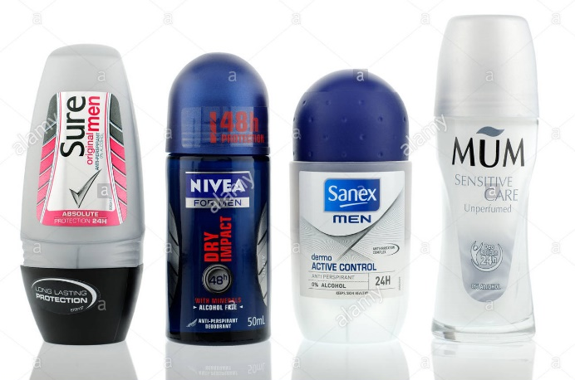
As you go through puberty, you will notice many changes. One of these changes is that you will sweat more, sometimes for no reason and you may notice odours that were never there before.
During the process of puberty your body also produces more oil which makes your hair greasier and can cause acne (spots.)
This is all very normal but can cause discomfort for you and others. But the good news is there are many things you can do to improve your confidence and hygiene. But it is your responsibility to remember.

Slide 6
L.O: To know how to look after your hygiene.
Success criteria: You can suggest a number of ways to look after your hygiene.

Slide 7
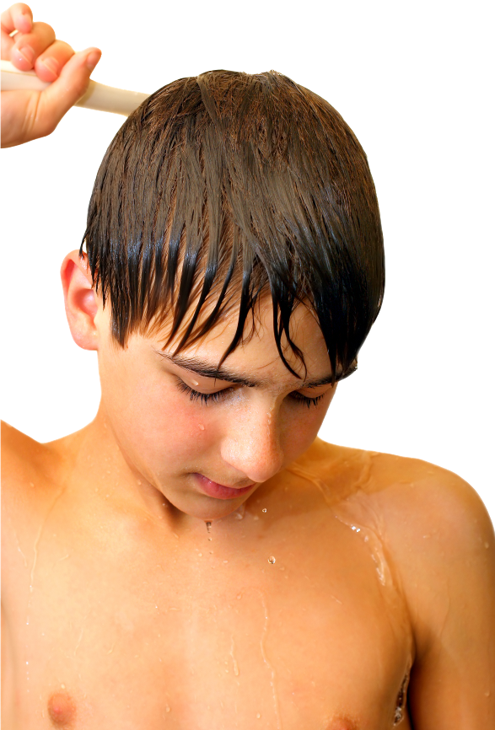
Personal hygiene
Hygiene refers to cleanliness. Personal hygiene refers to the way we care for our bodies and keep them clean.
Imagine you are Sam’s friend. You have walked into the tutor group to find everyone laughing and holding their noses.
On paper, write:
Advice I would give to Sam…
(now make a list of at least three things.)
Notes:
Photo © Shutterstock.

Slide 8
Drama Game
In pairs.
Imagine one of you is Sam and one of you is his friend.
You don’t want the others to overhear you in case they laugh.
So mime to Sam three things he could do to improve his hygiene.
Sam has to try and guess.
Now swap roles.

Slide 9
Personal Hygiene in Puberty
Your teacher will now collect ideas on the board.
Then watch this.
Can you add any ideas?
Use a deodorant spray or roll on every morning and after exercise
Don’t use a body spray (it won’t work)
Wear clean clothes every day (or every other day if they don’t smell)
Wear clean underwear and socks everyday
Shower or have a bath everyday
Wash your face with soap or a face wash every night
If you wear makeup take the makeup off before washing face
Use acne cream if needed, don’t pick or squeeze spots
Talk to a trusted adult if any of these issues upset you

Slide 10
Creative Task
Choose a creative method to teach young people
How to Handle Hygiene!
It could be a:
Poem
Advert
Youtube clip
Radio show
Poster
Other?
Work on your own or in groups!
Good luck!

Slide 11
Find a deodorant you like!
Have a look at the real examples of deodorant and body spray.
NB: Body spray is not the same as deodorant and won’t protect you from smells!
But there’s other things as well…

Slide 12
Creative Task!
Let’s share out work!

