Slide 1
Ground Rules
No questions will be answered during the lesson:
If you have any questions, about the topic we are covering today, please write them on a post-it note.
Please write your tutor group on the post-it. You can write your name, but you do not have to, if you don’t want to.
Please put your question in the tutor’s envelope at the end of the lesson.
All questions will be looked at, but only questions relating to the topic being taught will be answered and then given back to tutor groups.
Questions will be answered in an age-appropriate manner.
Questions that do not relate to the topic or that are not age-appropriate, will be addressed by signposting you to when the subject matter of your question will be taught.
During the lesson:
Please only give your opinions during discussions when asked.
Do not say anything that could IDENTIFY anybody during the lesson.
Be respectful of each other during the lesson.

Slide 2
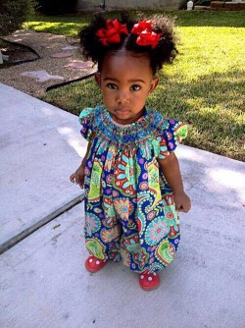
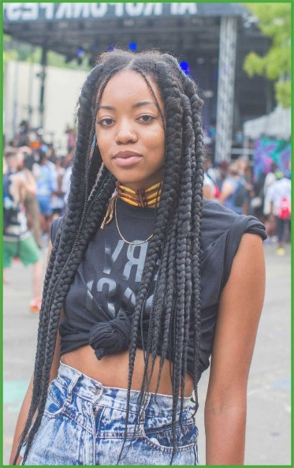
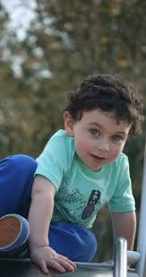
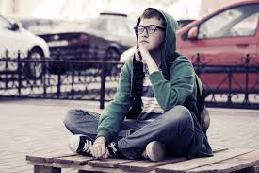
Make a list – what changes have these people gone through since the age of 2 to 14 years of age? EX: add emotional changes if you haven’t already.
Share ideas in groups and with the class.

Slide 3
One of the words some of you may have mentioned is…
PUBERTY
Do you know what this word means? Discuss.

Slide 4
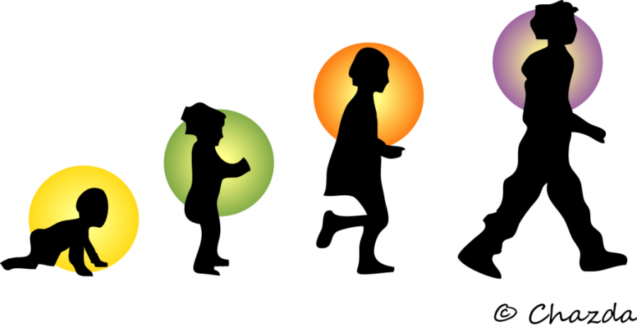
L.O: To learn more about puberty.
Success criteria:
* You know what the word “puberty” means.
* You can list the main physical changes which take place during puberty.

Slide 5
Puberty is a special time of change when young people change and it becomes possible for them to reproduce (have a baby.) These changes are both..
Physical = a change that happens to the body
e.g. you grow.
Emotional = changes that happen to feelings
e.g. there are times you may feel sad and not know why.

Slide 6
Puberty – some key facts
Puberty occurs between the ages of 8 and 18 years old.
Puberty is a NORMAL part of growing up.
Each person starts puberty at slightly different times – it’s important to respect these differences.
The whole process can take a few years.
Hormones are special chemical messengers in the body that tell it to go through puberty
And another important thing to consider is…

Slide 7
Which of these images link to boys, which to girls, make a table in your book to show this.
The differences between boys and girls during puberty.
Was anyone annoyed at doing this task? Why?
This task shows that some people jump to conclusions about the difference between boys and girls, but this is not right, it is called stereotyping.

Slide 8
But there are ways that boys and girls are different. This is to do with their bodies and the way they change during puberty.
Watch the clip – “changes – body parts”
to learn more (optional – tutor.)

Slide 9
CARD TASK - boys
In your pairs you have been given two sets of different coloured cards.
Some cards have on them the names of the changes that will take place as boys go through puberty.
Some cards have information on about those changes. It’s your task to match them all up correctly.
Which pair can do it correctly first? Be ready to have them checked!

Slide 10
TASK
Video Link
Watch this clip then discuss these questions as a class:
Is there a definite age that you will experience a growth spurt
during puberty?
Why shouldn’t you be embarrassed
about erections?
What do we call it when a boy ejaculates during
his sleep?
Why are lots of girls taller than boys when they start to
go through puberty?

Slide 11
CARD TASK - girls
What are all these changes?
In your pairs you have been given two sets of different coloured cards.
Some cards have on them the names of the changes that will take place as girls go through puberty.
Some cards have information on about those changes. It’s your task to match them all up correctly.
Which pair can do it correctly first? Be ready to have them checked!

Slide 12
TASK
Video Link
Watch this clip then discuss these questions as a class….
During puberty, do both breasts grow at the same rate?
What is cellulite?
How long does a period last for most women and girls?
Where are the eggs released from during the menstrual cycle?
What is the purpose of the blood that lines the uterus
(also known as a womb) that is lost during a period?

Slide 13
What Changes Happen in Puberty? (Venn Diagram)
Teacher – hand out Venn diagram and squares to cut up to pairs.
Now put the cards you were looking at away.
Cut out the Venn Diagram squares and try to sort into them.
GIRLS
BOYS
BOTH

Slide 14
What Changes Happen in Puberty? (Venn Diagram)
GIRLS
BOTH
BOYS
Voice gets a lot deeper and breaks
Feelings stronger/shy
Begin periods
Sweat more
Shoulders and chest grow
Hips get broader, waist narrower
More hair grows
e.g. underarms/by private parts/ legs
Erections happen
Voice can deepen a little
acne
Sperm semen produced
Breasts grow
Body grows
Hair greasy
Hair on legs darker
Pubic hair
Hair grows on the face

Slide 15
One of the changes that happens to everyone during puberty is a change in…
HOW WE FEEL

Slide 16
Emotions and Puberty
HORMONES are special chemical messengers in the body that tell it to go through puberty, but these hormones can also affect emotions during the process.
Watch these two clips and add to your VENN DIAGRAM.
Discuss. Have any of these things happened to you? Brothers/sisters?
Friends? (please don’t’ share this information out loud.)
What suggestions did she give to help people through this process?
Can you add any suggestions?
https://www.youtube.com/watch?v=_RoI097B6lI&safe=true
https://www.youtube.com/watch?v=QZCnySLwTCQ&safe=true

Slide 17
Learning Review…
What does the word puberty mean?
Name two changes that happen to:
-Boys
-Girls
-Both

