Slide 1
Instructions for teachers: Print the next two slides back to back so there is a matching cube net on both sides.
Pupils write on the side with lines (cracks) in lesson 5. (Issues that families may face.)
Then decorate the other side (e.g. colour flames) and make cards to go inside it for lesson 6

Slide 2
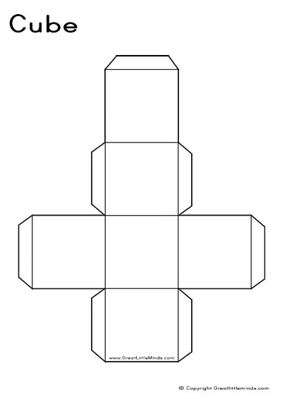

Slide 4
Cards for lesson 6. Write down more ways that you can improve your family relationships even in each box. Cut them up and put them in your cube box. Pull one out each day, or each week, or when sad and do it!
Google “fun with family” and try one of the 100 ideas! | Play a boardgame/game with family members. | Remind yourself of your favourite thing about each family member. | Wash up today!

