Slide 1
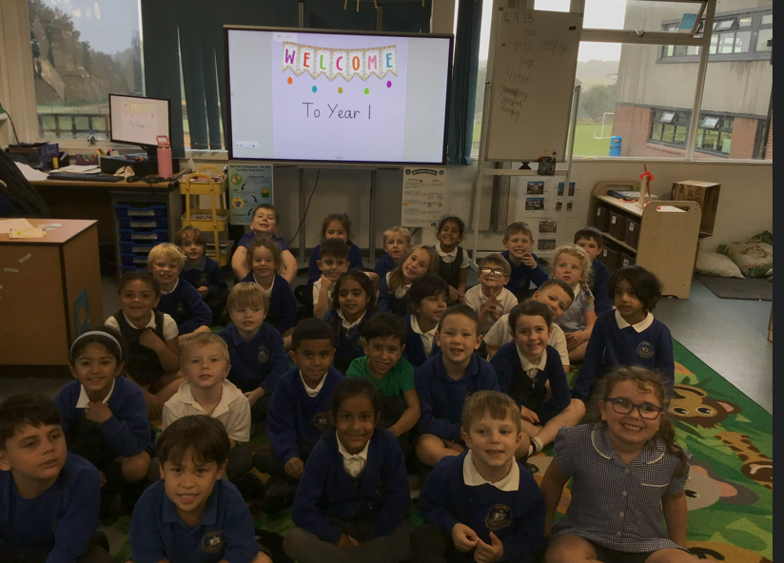

Welcome to Class One Parent Information Session

Slide 2
Everyday information
Doors to school open at 8.50am and close at 9.00am.
School closes at 3.30pm.
Water bottles – named and appropriate size.
Snacks – All children can bring in a piece of fresh fruit or vegetables as a snack. Children in Reception and KS1 are provided with one snack per day.
Messages to the teacher –email via the office. offices@leedsfederation.org
Notes:
Messages to teachers – remind parents that teachers will get back to them in a reasonable amount of time.
2

Slide 3
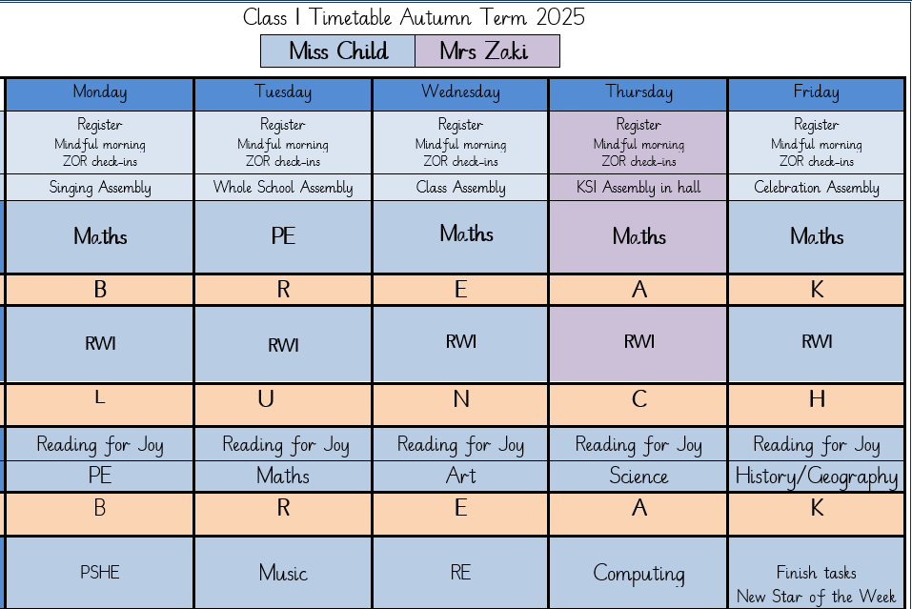
A typical week in our class

Slide 4
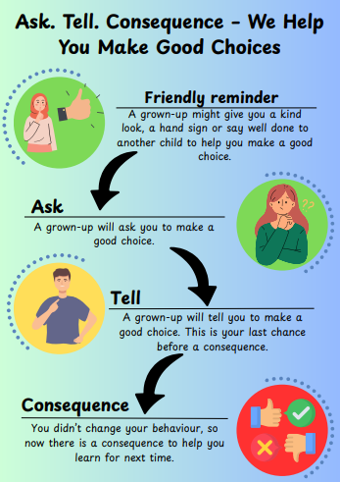
Notes:
Behaviour in school. We follow the Ask, Tell, Consequence model.

Slide 5
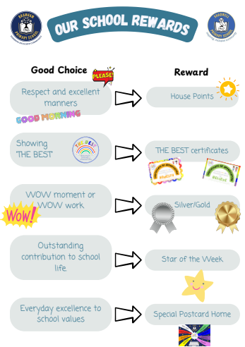

Slide 6
PE
Our PE days are on Monday and Tuesday
On PE days, children are to wear PE kit all day.
Just a reminder our school PE kit is
House-colour plain t-shirt (no logos) - these can be purchased via the school office
Black or navy shorts or tracksuit bottoms.
Trainers
Dark-coloured (navy or black) fleece, jumper or jacket.
Notes:
Can add in about swimming in here for Yr 3 and 4.

Slide 7
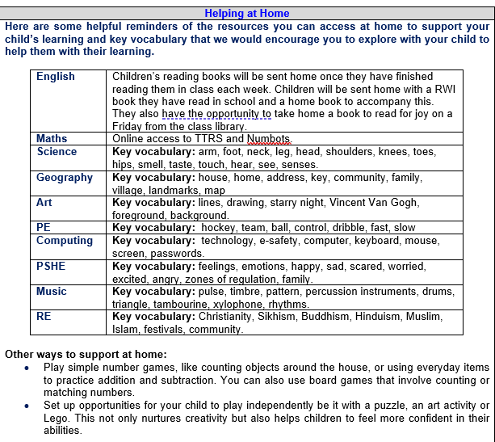
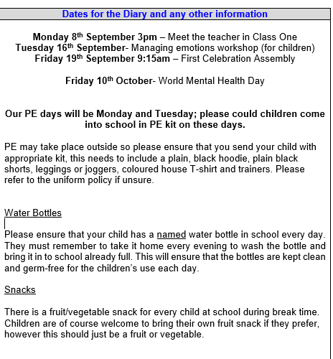
Curriculum Newsletter
Notes:
Share with parents the following:
Maths and English will outline explicit objectives for the half term. In KS2, if you child has a tutor, for example, this could be given to the tutor to let them know what we are focusing on.
Curriculum – what we are learning and the key elements of learning.
Vocabulary – this is specialist vocabulary that we want children to be confident with, it would be very helpful if you could use it or talk about it at home to build confidence.

Slide 8
Homework (KS1)
Numbots
Reading
The purpose is help with fluency of basic skills.
Please aim for a little and often approach; 5 – 10 minutes most days is ideal!
Notes:
Teacher to explain to parents that homework shouldn't take children longer that 30 minutes and shouldn't cause upset and distress at home.

Slide 9
Reading Books
Two types of reading books coming home:
Scheme Books: Learning to Read –
Levelled books targeted at current reading level.
Please listen to your child read to you and support.
Ideally, read the same book more than once to build fluency.
Keep in bag daily for regular return
Joy Books: Learning to LOVE reading
Free choice from the reading corner/ library every Friday (or home if children prefer).
Might be trickier to read, may need help or could read together.
Notes:
Explain to parents that we say typically on this day because for example with RWI book, we only send them home when we are confident they are fluent – so if takes an extra day of of reading, we will delay if necessary.
In Yr 6 if they have completed the scheme, it is free choice reading so just add this in.

Slide 10
Dates for your Diary
First celebration assembly- 19th September
Flu immunisations- 22nd September
Individual photos- 30th September
Read Write Inc Parent information meeting- 2:30-3:00 2nd October
Training day- 28th November
Parents Evening- Monday 20th October & Thursday 23rd October 3:45
Phonics Screening Check- June 2026

Slide 11

Life in Year One
Tapestry will still be used to share learning
Continuous provision
Observing seasonal changes
The Arctic and Antarctica
Growing our own plants
Seaside holidays
Egg experiment
Ledston trip
Learning and celebrating about different religions and cultures- please share any special celebrations you have on Tapestry as the children love sharing these.

Slide 12

Thank you! Any questions?

