Slide 1

Welcome to Class One
Parent Information Session

Slide 2
Everyday information
Doors to school open at 8.50am and close at 9.00am.
School closes at 3.30pm.
Water bottles – named and appropriate size.
Snacks – All children can bring in a piece of fresh fruit or vegetables as a snack. Children in Reception and KS1 are provided with one snack per day.
Messages to the teacher –email via the office. offices@leedsfederation.org
Notes:
Messages to teachers – remind parents that teachers will get back to them in a reasonable amount of time.
2

Slide 3
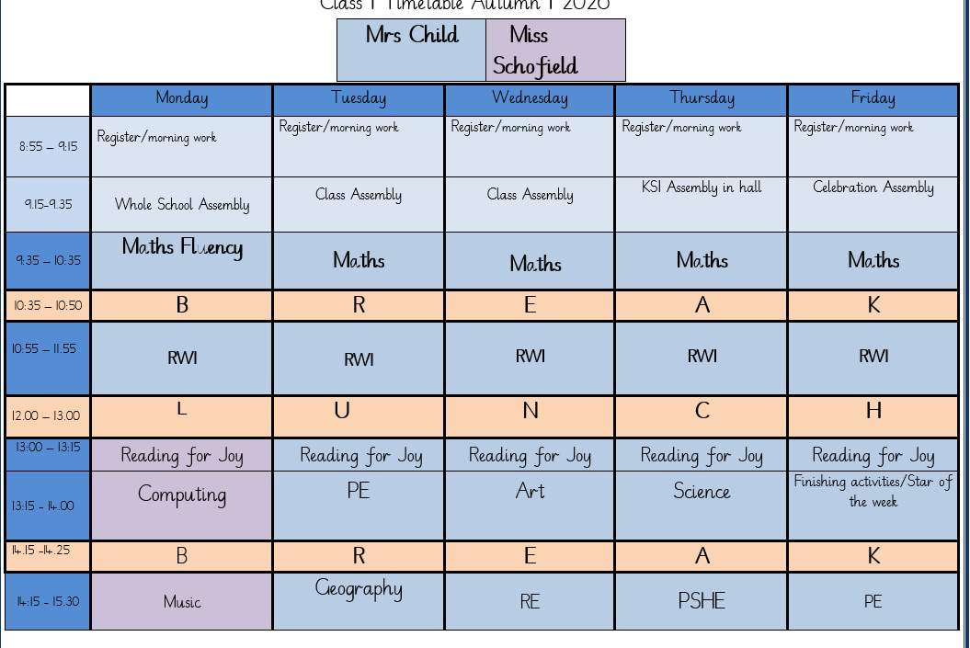
A typical week in our class

Slide 4
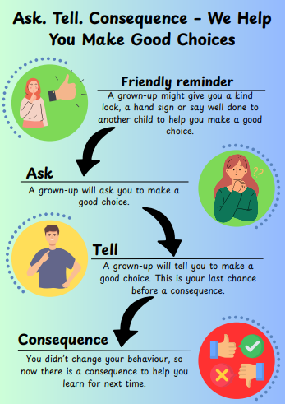
Notes:
Behaviour in school. We follow the Ask, Tell, Consequence model.

Slide 5
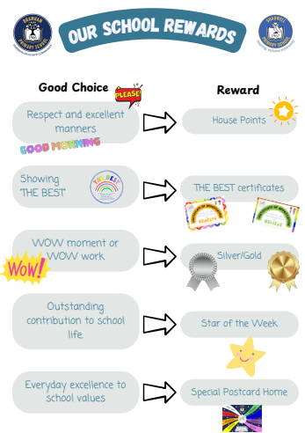

Slide 6
PE
Our PE days are on Tuesday and Friday.
On PE days, children are to wear PE kit all day.
Just a reminder our school PE kit is
  House-colour plain t-shirt (no logos) - these can be purchased via the school office
  Black or navy shorts or tracksuit bottoms.
  Trainers
  Dark-coloured (navy or black) fleece, jumper or jacket.
Notes:
Can add in about swimming in here for Yr 3 and 4.

Slide 7
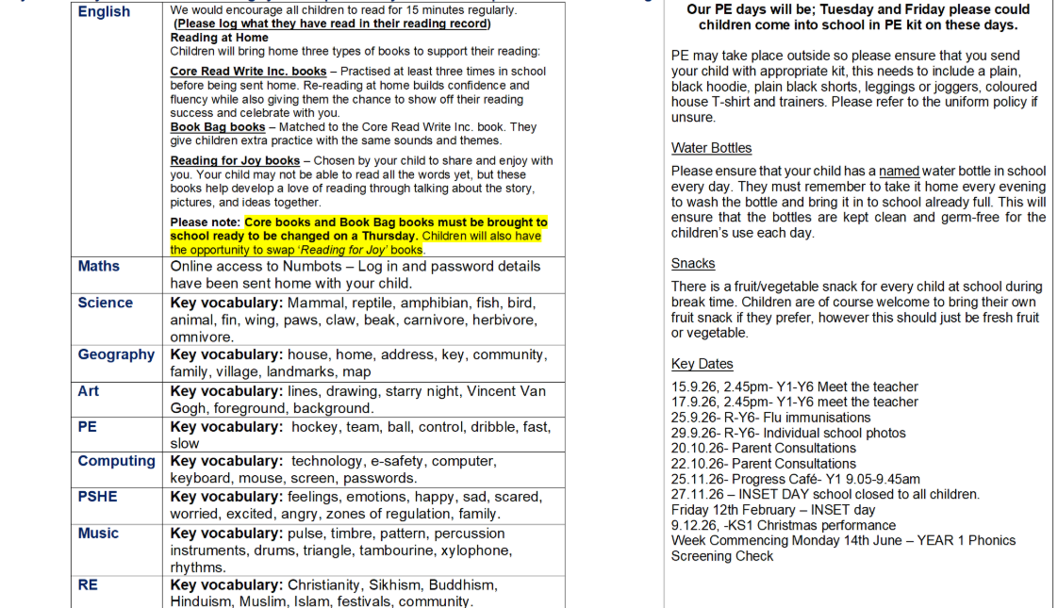
Curriculum Newsletter
Notes:
Share with parents the following:
Maths and English will outline explicit objectives for the half term. In KS2, if you child has a tutor, for example, this could be given to the tutor to let them know what we are focusing on.
Curriculum – what we are learning and the key elements of learning.
Vocabulary – this is specialist vocabulary that we want children to be confident with, it would be very helpful if you could use it or talk about it at home to build confidence.

Slide 8


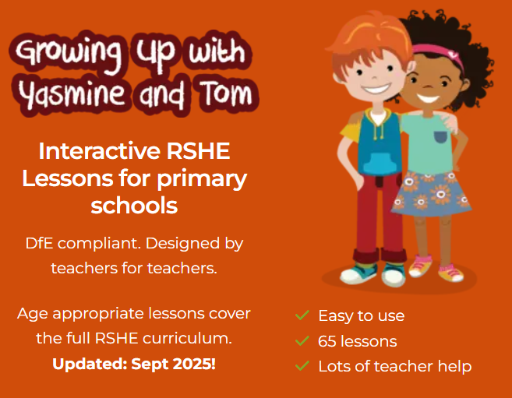


Our PSHE Curriculum
Through PSHE, we help children develop the knowledge and skills they need to be happy, healthy, safe and prepared for life.
Learning includes relationships, physical and mental wellbeing, personal safety, online safety, diversity, life changes and financial education.
Lessons are age-appropriate and interactive, with clear ground rules and plenty of discussion.
Children can ask questions safely through a Worry Box/Ask-it Basket.
Learning is enriched through assemblies and events such as Picture News, Anti-Bullying Week and Children’s Mental Health Week.
Relationships and Health Education is statutory. In Year 6, some additional non-statutory sex education is taught, and information is shared with parents beforehand.
Our PSHE and RSE policies are available on the school website. Please speak to us if you have any questions or concerns.
Notes:
PSHE stands for Personal, Social, Health and Economic Education. Its purpose is to give children the knowledge, language and practical skills they need to build healthy relationships, look after their wellbeing, stay safe and make informed decisions.
Our curriculum is carefully sequenced and appropriate to the children’s age and emotional maturity. We use high-quality and professionally approved resources such as Pol-Ed and Yasmin and Tom.
We agree ground rules so that children can contribute safely and respectfully. Children are never expected to share personal experiences. They can also ask questions privately through the Worry Box or Ask-it Basket.
We reinforce PSHE through assemblies and wider opportunities across the year, including Picture News and events such as Anti-Bullying Week and Children’s Mental Health Week.
Relationships and Health Education is a statutory part of the primary curriculum. Our PSHE and RSE policies are available on the school website. If you have any questions or concerns about the curriculum, please speak to us.

Slide 9

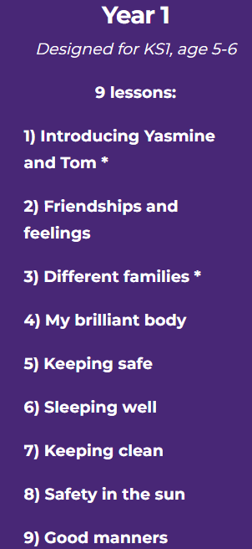
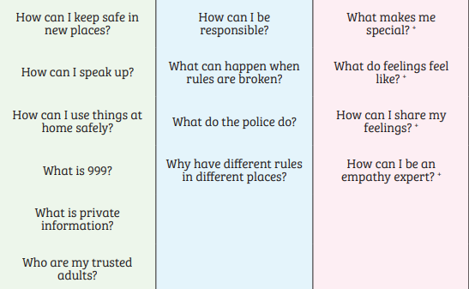
PSHE in Y1 – some of the lessons we may teach
Notes:
Use a combination of lessons
May recap but avoid duplication – select most appropriate lesson/scheme

Slide 10
Homework (KS1)
Numbots
RWI videos
Reading
The purpose is help with fluency of basic skills.
Please aim for a little and often approach; 5 – 10 minutes most days is ideal!
Notes:
Teacher to explain to parents that homework shouldn't take children longer that 30 minutes and shouldn't cause upset and distress at home.

Slide 11
Reading Books
Two types of reading books coming home:
Scheme Books: Learning to Read –
Levelled books targeted at current reading level.
Please listen to your child read to you and support.
Ideally, read the same book more than once to build fluency.
Keep in bag daily for regular return
Joy Books: Learning to LOVE reading
Free choice from the reading corner/ library every Friday (or home if children prefer).
Might be trickier to read, may need help or could read together.
Notes:
Explain to parents that we say typically on this day because for example with RWI book, we only send them home when we are confident they are fluent – so if takes an extra day of of reading, we will delay if necessary.
In Yr 6 if they have completed the scheme, it is free choice reading so just add this in.

Slide 12
Dates for your Diary
First celebration assembly- 18th September
Flu immunisations- 25th September
Individual photos- 29th September
Parents Evening- 20th October & 22nd October 3:45
Phonics Screening Check- w/c 14th June 2027
Progress Café- 9:05-9:45 25th November
INSET day- 27th November
9th & 10th December- Christmas performance

Slide 13

Life in Year One
Tapestry will still be used to share learning
Continuous provision
Observing seasonal changes
The Arctic and Antarctica
Growing our own plants
Seaside holidays
Egg experiment
Ledston trip
Learning and celebrating about different religions and cultures- please share any special celebrations you have on Tapestry as the children love sharing these.

Slide 14
Thank you!
Any questions?

