Slide 1

Welcome to Class 2
Parent Information Session

Slide 2
Everyday information
Doors to school open at 8.50am and close at 9.00am.
School closes at 3.30pm.
Water bottles – named and appropriate size.
Snacks – All children can bring in a piece of fresh fruit or vegetables as a snack. (children in Reception and KS1 are provided with one snack per day and children in KS2 will need to bring a snack if they would like one – Delete as appropriate for your year group)
Messages to the teacher – planners (KS2), email via the office.
Planners (KS2 only)
Notes:
Messages to teachers – remind parents that teachers will get back to them in a reasonable amount of time.
2

Slide 3
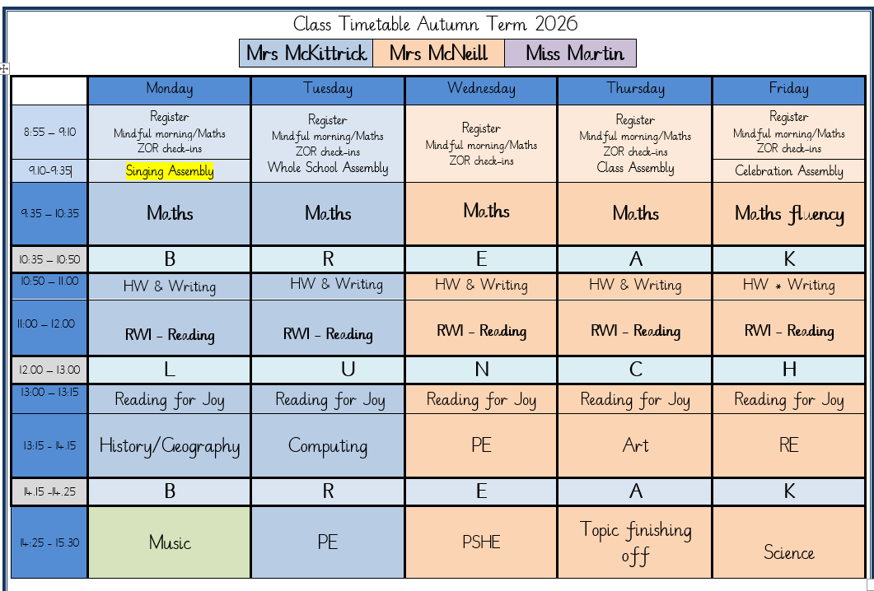
A typical week in our class

Slide 4
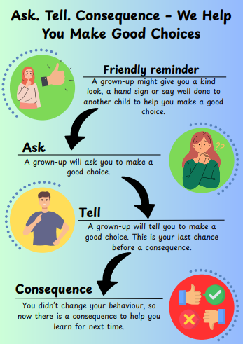
Notes:
Behaviour in school. We follow the Ask, Tell, Consequence model.

Slide 5
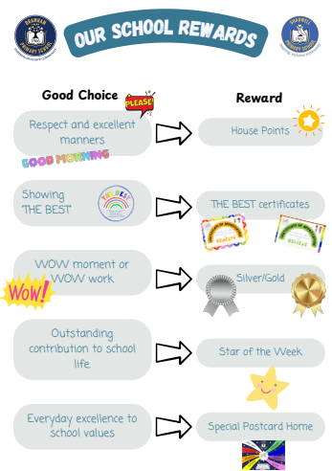

Slide 6
PE
Our PE days are on Tuesdays and Wednesdays
On PE days, children are to wear PE kit all day.
Just a reminder our school PE kit is
  House-colour plain t-shirt (no logos) - these can be purchased via the school office.
  Black or navy shorts or tracksuit bottoms.
  Trainers
  Dark-coloured (navy or black) fleece, jumper or jacket.
Notes:
Can add in about swimming in here for Yr 3 and 4.

Slide 7
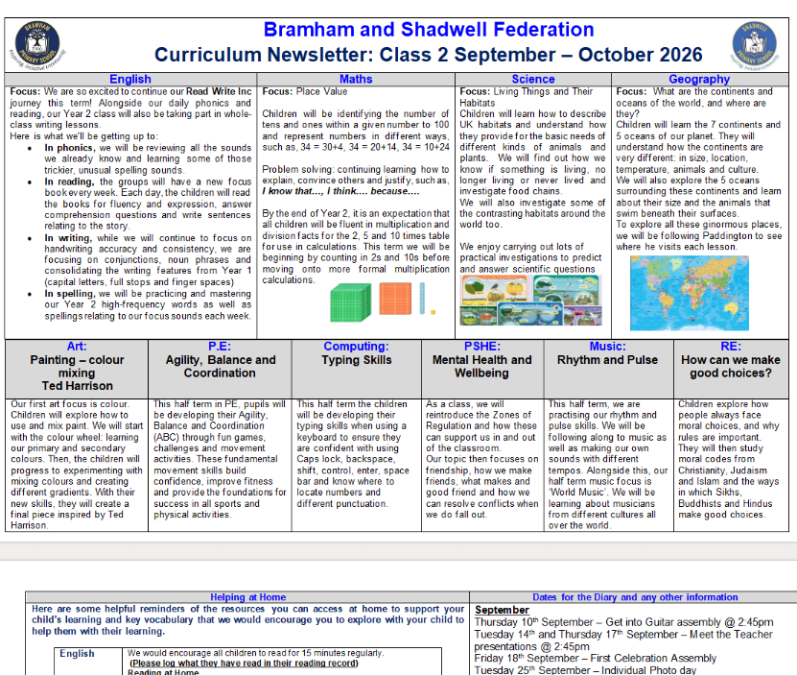
Curriculum Newsletter
Notes:
Share with parents the following:
Maths and English will outline explicit objectives for the half term. In KS2, if you child has a tutor, for example, this could be given to the tutor to let them know what we are focusing on.
Curriculum – what we are learning and the key elements of learning.
Vocabulary – this is specialist vocabulary that we want children to be confident with, it would be very helpful if you could use it or talk about it at home to build confidence.

Slide 8
Homework (KS1)
Numbots and TT rockstars (Year 2)
Reading
The purpose is help with fluency of basic skills.
Please aim for a little and often approach; 5 – 10 minutes most days is ideal!
Notes:
Teacher to explain to parents that homework shouldn't take children longer that 30 minutes and shouldn't cause upset and distress at home.

Slide 9
Reading Books
Two types of reading books coming home:
Scheme Books: Learning to Read – typically sent home on a Thursday
Levelled books targeted at current reading level.
Please listen to your child read to you and support.
Ideally, read the same book more than once to build fluency.
Keep in bag daily for regular return
Joy Books: Learning to LOVE reading
Free choice from the reading corner every Thursday (or home if children prefer).
Might be trickier to read, may need help or could read together.
Notes:
Explain to parents that we say typically on this day because for example with RWI book, we only send them home when we are confident they are fluent – so if takes an extra day of of reading, we will delay if necessary.
In Yr 6 if they have completed the scheme, it is free choice reading so just add this in.

Slide 10
Dates for your Diary
Class Photos Tuesday 29th September
Progress café Year 2 Wednesday 25th November
Parents Evenings Tuesday 20th and Thursday 22nd October
KS1 Nativity Wednesday 9th December and Thursday 10th December
Flu immunisations Friday 25th September
Inset Day – School closed Friday 27th November

Slide 11
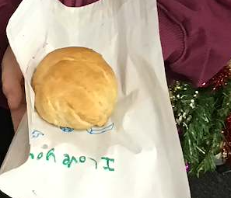
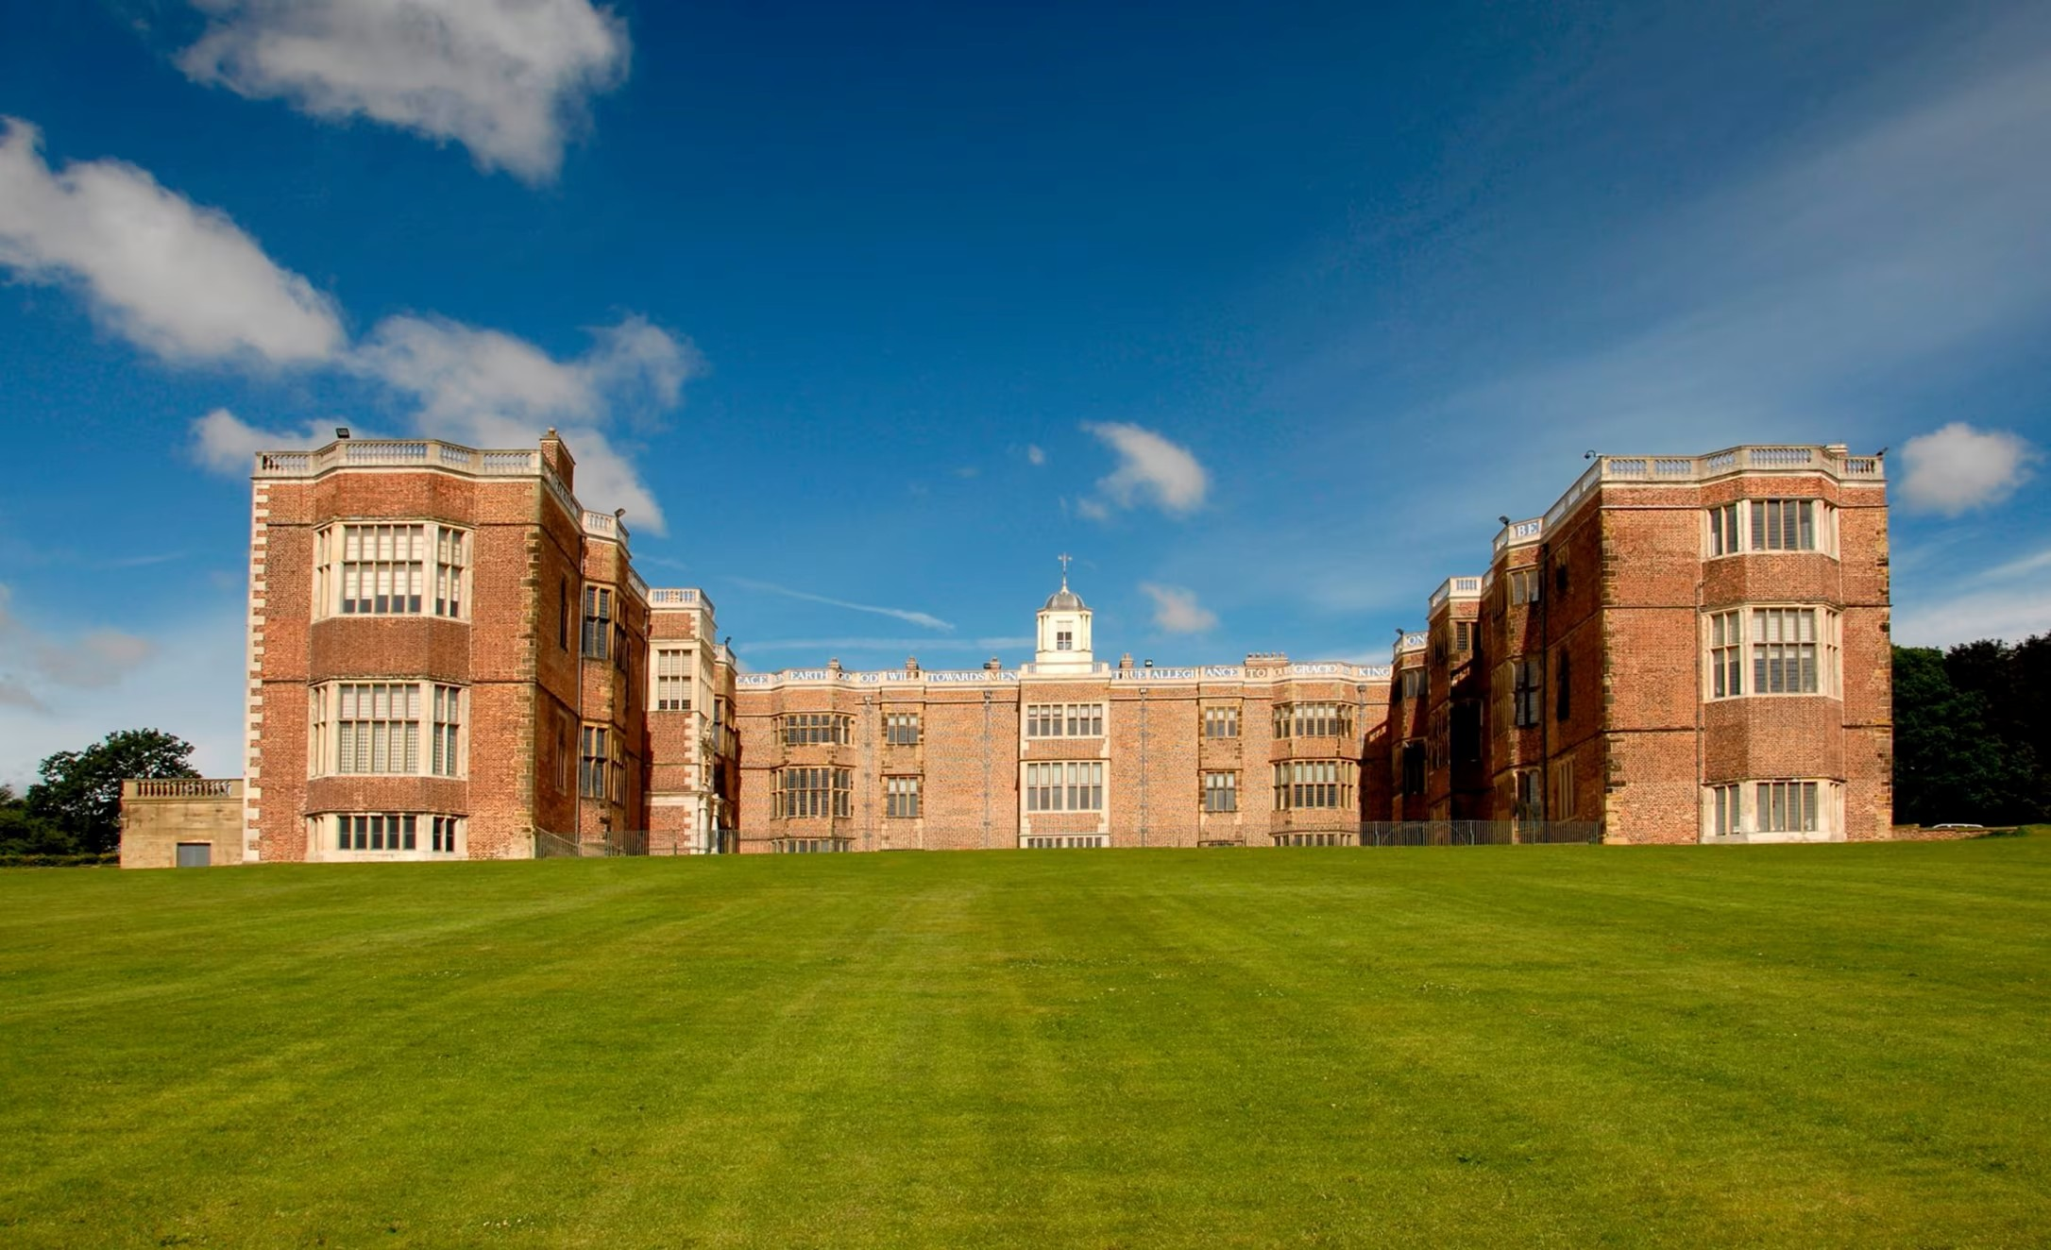
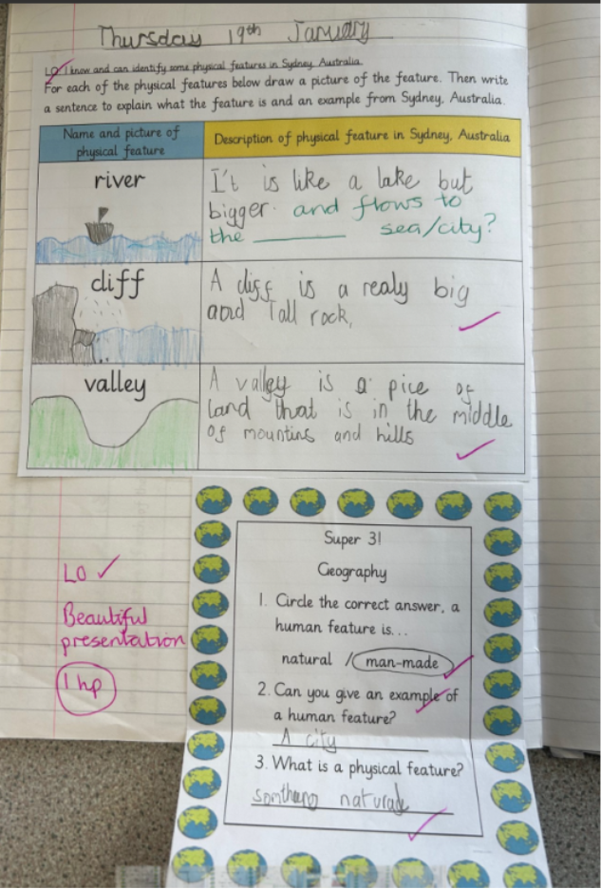
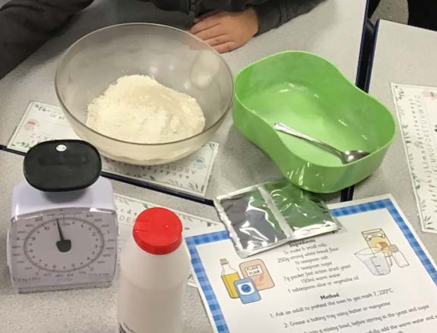
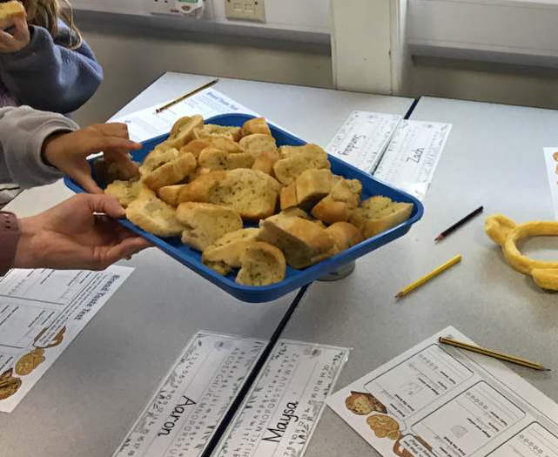
Life in Year 2

Slide 12


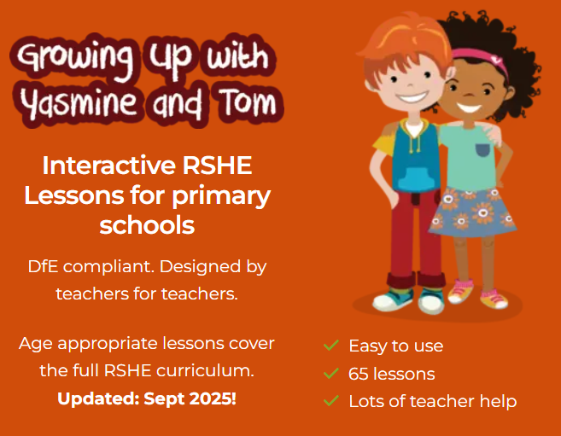


Our PSHE Curriculum
Through PSHE, we help children develop the knowledge and skills they need to be happy, healthy, safe and prepared for life.
Learning includes relationships, physical and mental wellbeing, personal safety, online safety, diversity, life changes and financial education.
Lessons are age-appropriate and interactive, with clear ground rules and plenty of discussion.
Children can ask questions safely through a Worry Box/Ask-it Basket.
Learning is enriched through assemblies and events such as Picture News, Anti-Bullying Week and Children’s Mental Health Week.
Relationships and Health Education is statutory. In Year 6, some additional non-statutory sex education is taught, and information is shared with parents beforehand.
Our PSHE and RSE policies are available on the school website. Please speak to us if you have any questions or concerns.
Notes:
PSHE stands for Personal, Social, Health and Economic Education. Its purpose is to give children the knowledge, language and practical skills they need to build healthy relationships, look after their wellbeing, stay safe and make informed decisions.
Our curriculum is carefully sequenced and appropriate to the children’s age and emotional maturity. We use high-quality and professionally approved resources such as Pol-Ed and Yasmin and Tom.
We agree ground rules so that children can contribute safely and respectfully. Children are never expected to share personal experiences. They can also ask questions privately through the Worry Box or Ask-it Basket.
We reinforce PSHE through assemblies and wider opportunities across the year, including Picture News and events such as Anti-Bullying Week and Children’s Mental Health Week.
Relationships and Health Education is a statutory part of the primary curriculum. Our PSHE and RSE policies are available on the school website. If you have any questions or concerns about the curriculum, please speak to us.

Slide 13

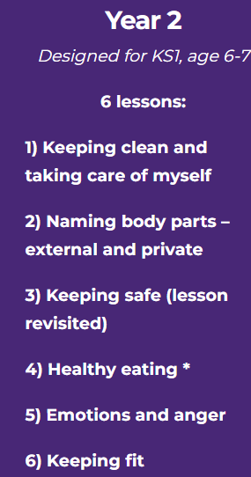
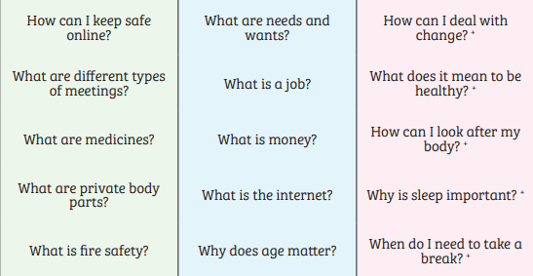
PSHE in Y2 – some of the lessons we may teach
Notes:
Always use scientific names for body parts – ensures consistency across school and is a safeguarding necessity
The correct names of body parts, including the penis, vulva, vagina, testicles, scrotum, nipples. Pupils should understand that all of these parts of the body are private and have skills to understand and express their own boundaries around these body parts.

Slide 14
Thank you!
Any questions?

