Slide 1
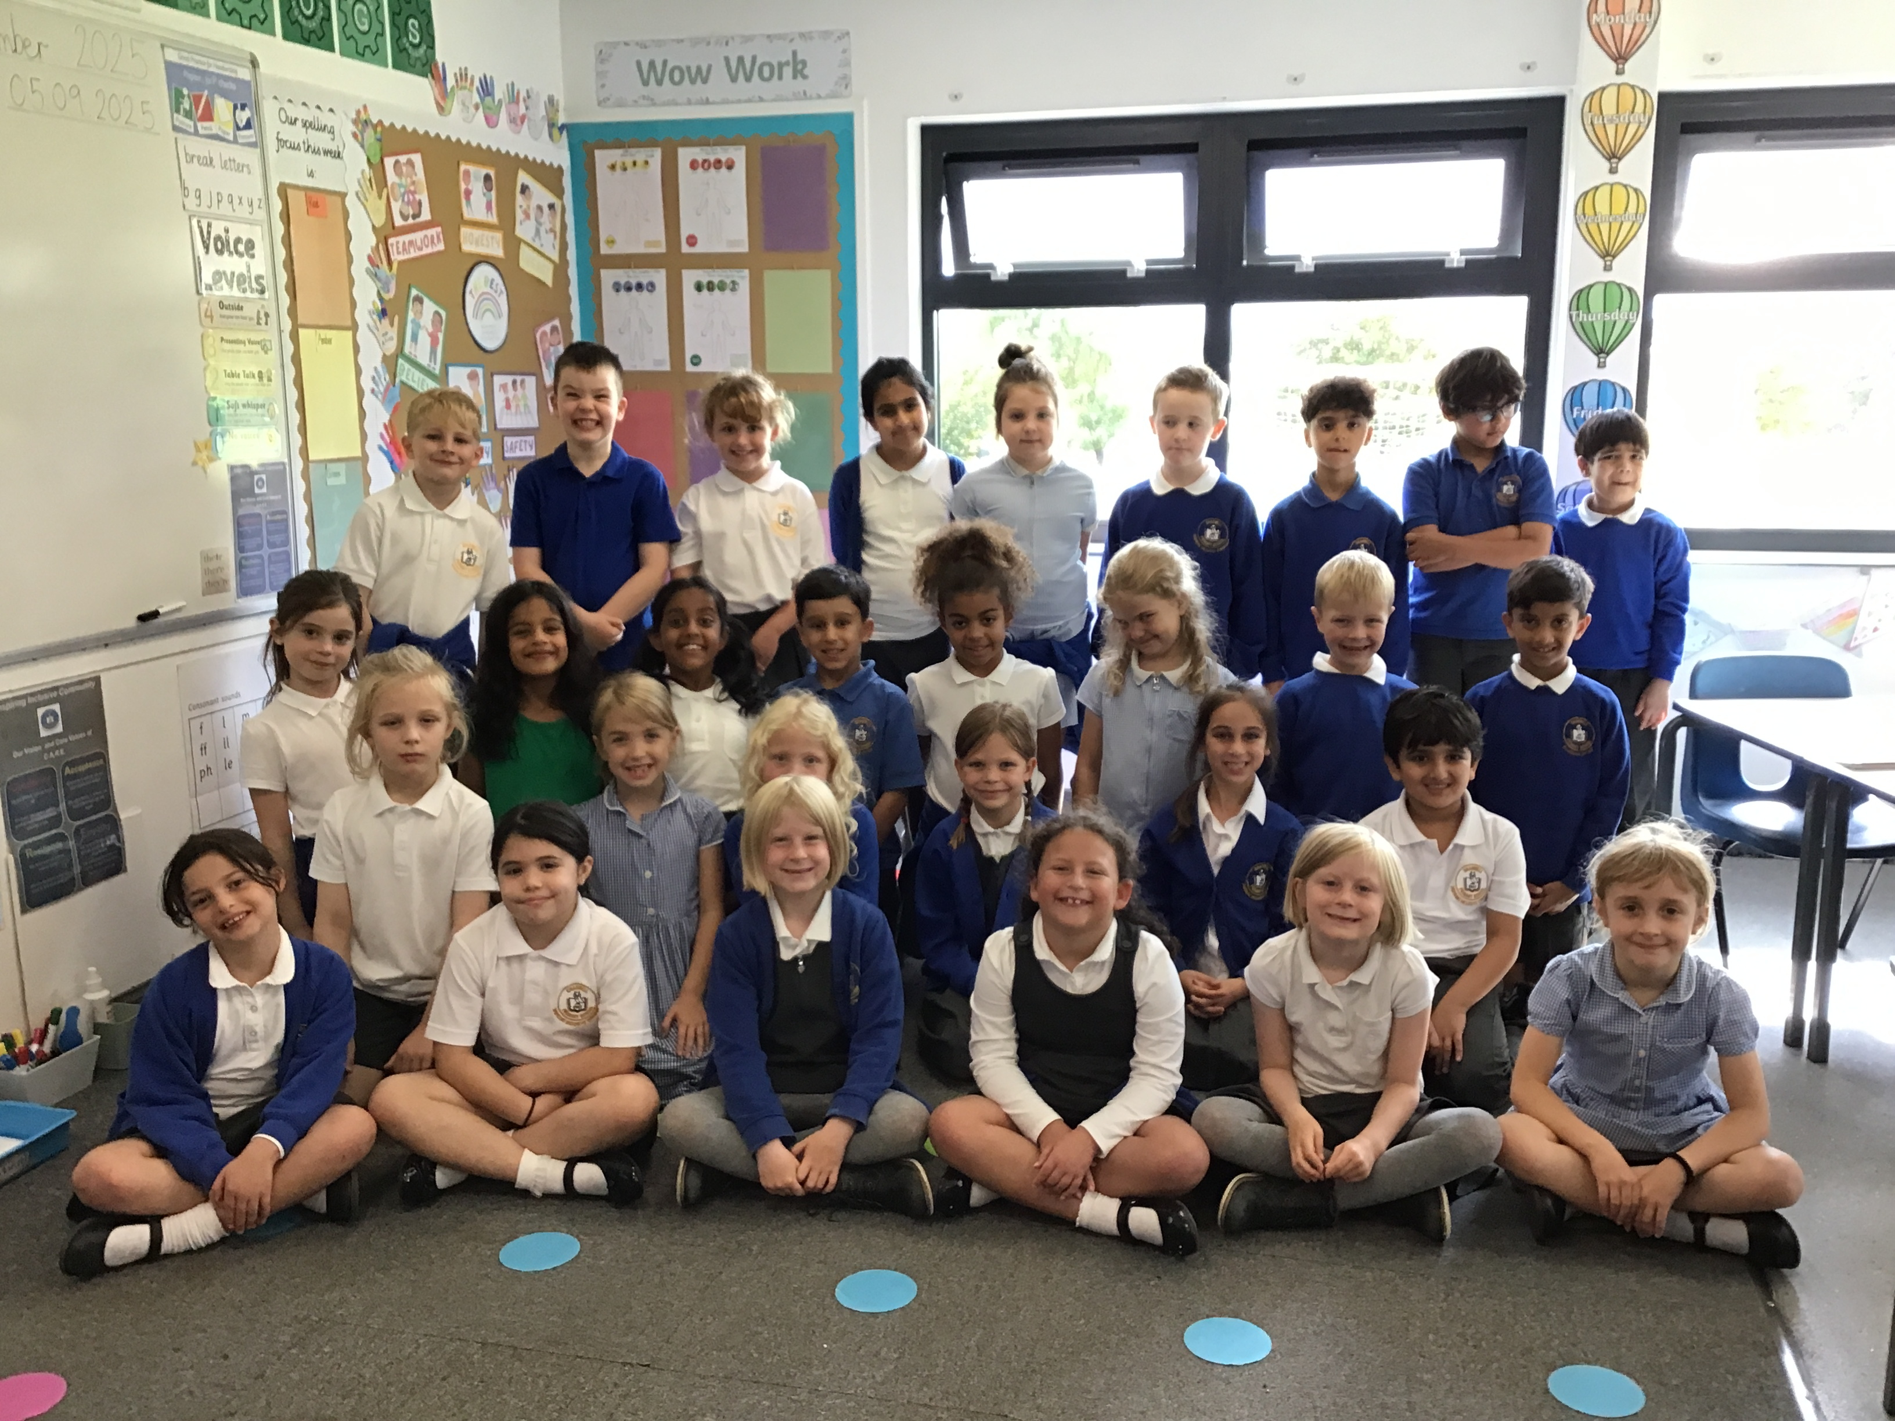

Welcome to Class 3 Parent Information Session

Slide 2
Everyday information
Doors to school open at 8.50am and close at 9.00am.
School closes at 3.30pm.
Water bottles – named and appropriate size.
Snacks – All children can bring in a piece of fresh fruit or vegetables as a snack; KS2 will need to bring a snack if they would like one.
Messages to the teacher – email via the office.
Year 3 - Reading Records
Notes:
Messages to teachers – remind parents that teachers will get back to them in a reasonable amount of time.
2

Slide 3
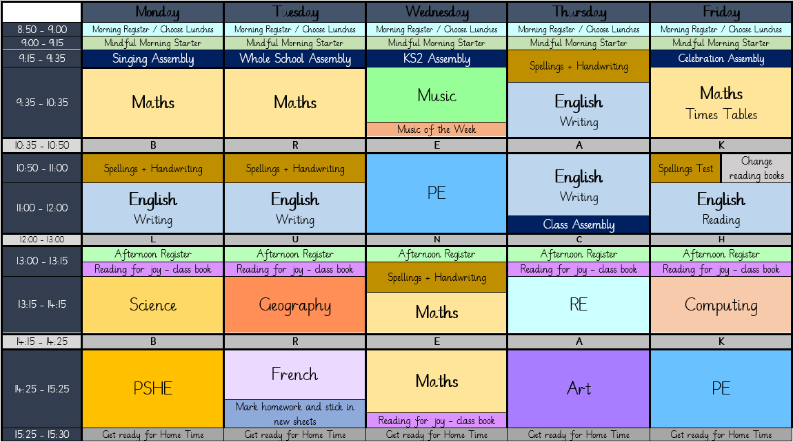
A typical week in our class

Slide 4
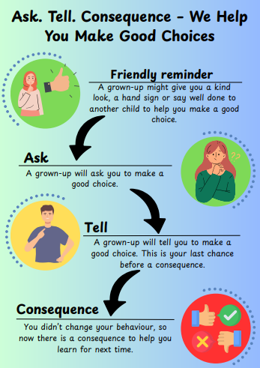
Notes:
Behaviour in school. We follow the Ask, Tell, Consequence model.

Slide 5
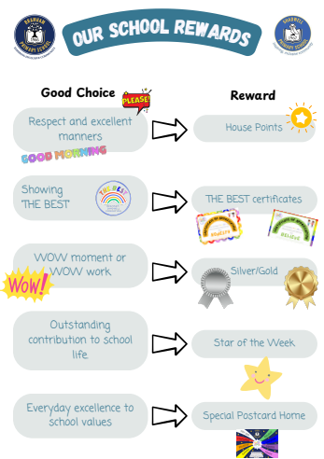

Slide 6
PE
Our PE days are on Wednesday and Friday
On PE days, children are to wear PE kit all day.
Just a reminder our school PE kit is
House-colour plain t-shirt (no logos) - these can be purchased via the school office
Black or navy shorts or tracksuit bottoms.
Trainers
Dark-coloured (navy or black) fleece, jumper or jacket.

Slide 7
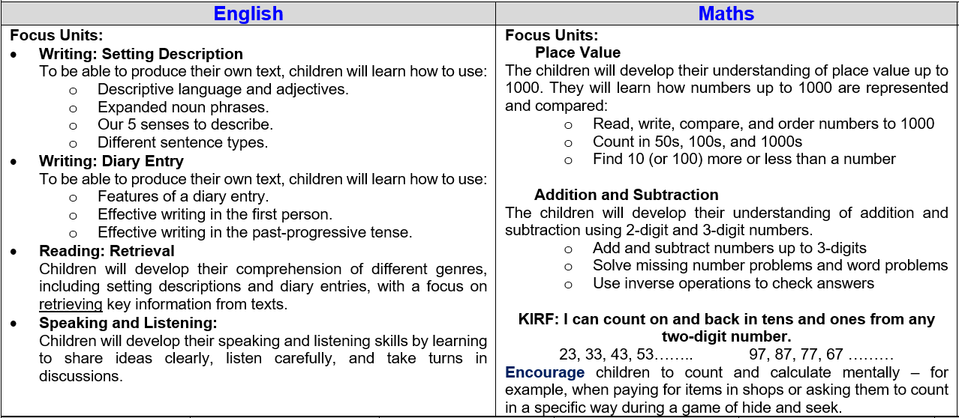
Curriculum Newsletter
Notes:
Share with parents the following:
Maths and English will outline explicit objectives for the half term. In KS2, if you child has a tutor, for example, this could be given to the tutor to let them know what we are focusing on.
Curriculum – what we are learning and the key elements of learning.
Vocabulary – this is specialist vocabulary that we want children to be confident with, it would be very helpful if you could use it or talk about it at home to build confidence.

Slide 8
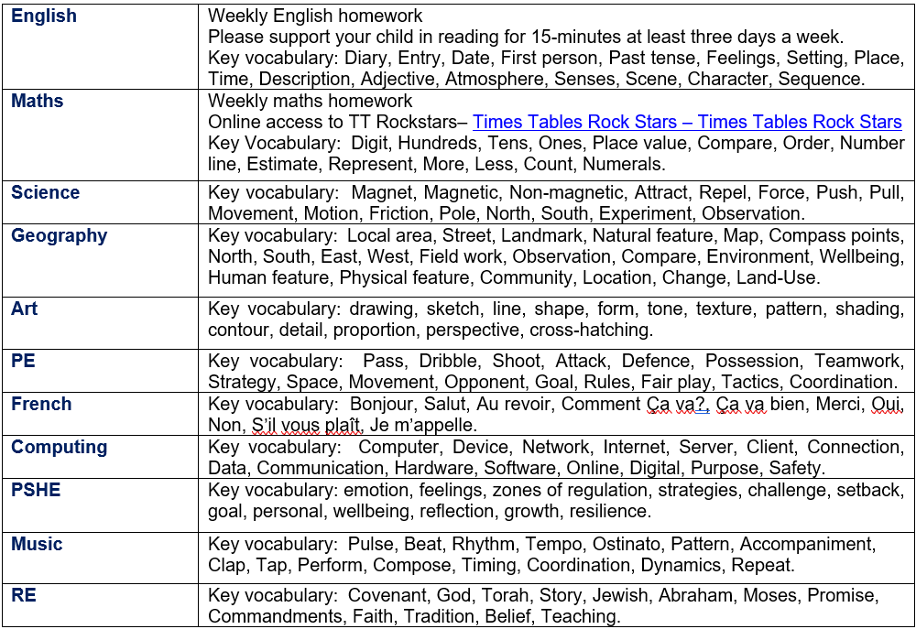
Curriculum Newsletter
Notes:
Share with parents the following:
Maths and English will outline explicit objectives for the half term. In KS2, if you child has a tutor, for example, this could be given to the tutor to let them know what we are focusing on.
Curriculum – what we are learning and the key elements of learning.
Vocabulary – this is specialist vocabulary that we want children to be confident with, it would be very helpful if you could use it or talk about it at home to build confidence.

Slide 9
Homework (KS2)
Homework is given out on a Thursday and returned on a Tuesday.
Any homework given will be to revise previous learning (for example Year 2 refresher) or consolidate recent learning.
We would encourage children to complete homework independently.
Homework presentation should be given the same care as it would be schoolwork.
If a child is stuck, encourage them to come and ask for help on either a Friday or a Monday.
Each week homework is marked as a class.
Notes:
Teacher to explain to parents that homework shouldn't take children longer that 30 minutes and shouldn't cause upset and distress at home.

Slide 10
Reading Books
Two types of reading books coming home:
Scheme Books: Learning to Read – typically sent home on a Friday
Levelled books targeted at current reading level.
Please listen to your child read to you and support.
Ideally, read the same book more than once to build fluency.
Keep in bag daily for regular return
Joy Books: Learning to LOVE reading
Free choice from the reading corner/ library every Friday (or home if children prefer).
Might be trickier to read, may need help or could read together.

Slide 11
Dates for your Diary
Class 3 French Brunch – Monday 15th September
Flu Immunisations Monday 22nd September
Individual Photos – Tuesday 30th September
Geography fieldwork – a walk around Shadwell Village – Week 6
Parents Evenings – Monday 20th and Thursday 23rd October
Swimming starts on Monday 1st December
INSET Day – Friday 28th November (school closed to children)

Slide 12
Life in Year 3
KS2 playground, trim trail and field!
Starting French and French Brunch
Geography fieldwork
Practical science experiments
Swimming
Egyptians
Romans
Harlow Carr in Summer Term

Slide 13

Thank you! Any questions?

