Slide 1

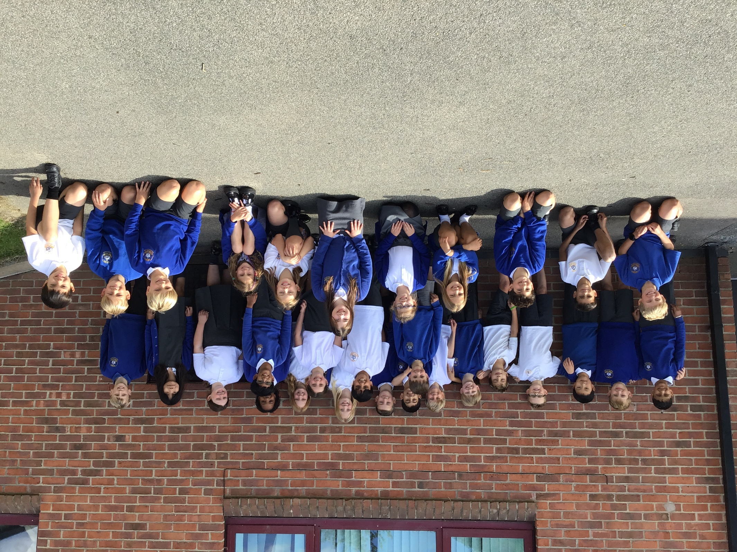
Welcome to Class 5
Parent Information Session

Slide 2
Everyday information
Doors to school open at 8.50am and close at 9.00am.
School closes at 3.30pm.
Water bottles – named and appropriate size.
Snacks – All children can bring in a piece of fresh fruit or vegetables as a snack.
Messages to the teacher – planners (KS2), email via the office.
Notes:
Messages to teachers – remind parents that teachers will get back to them in a reasonable amount of time.
2

Slide 3
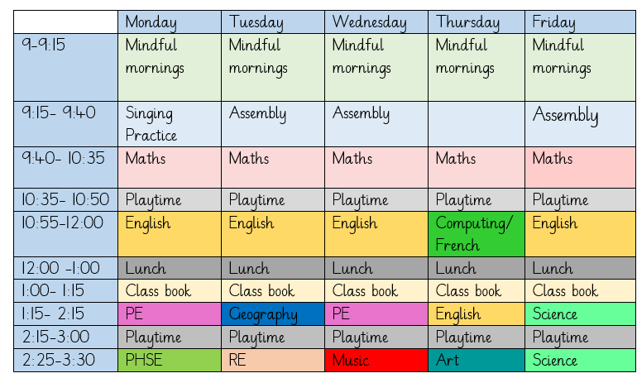
A typical week in our class

Slide 4
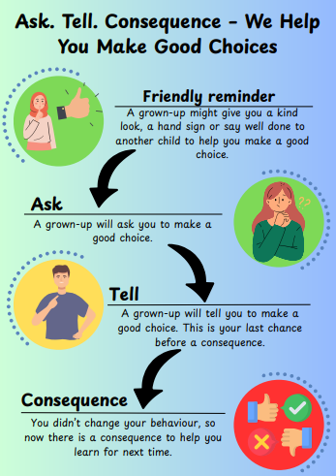
Notes:
Behaviour in school. We follow the Ask, Tell, Consequence model.

Slide 5
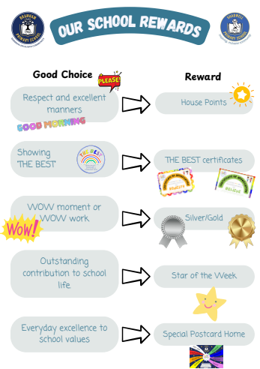

Slide 6
PE
Our PE days are on Monday and Wednesday
On PE days, children are to wear PE kit all day.
Just a reminder our school PE kit is
  House-colour plain t-shirt (no logos) – the office is selling the last of the stock for £2
  Black or navy shorts or tracksuit bottoms.
  Trainers
  Dark-coloured (navy or black) fleece, jumper or jacket.
Notes:
Can add in about swimming in here for Yr 3 and 4.

Slide 7
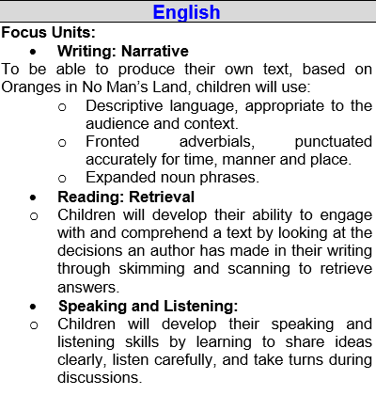
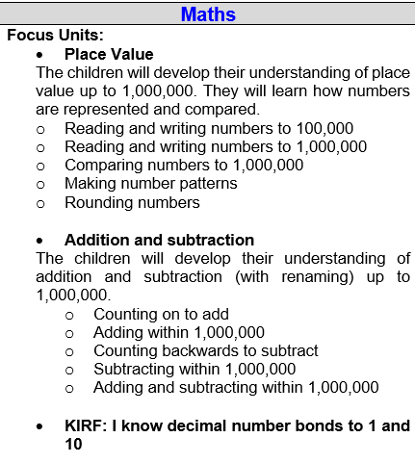
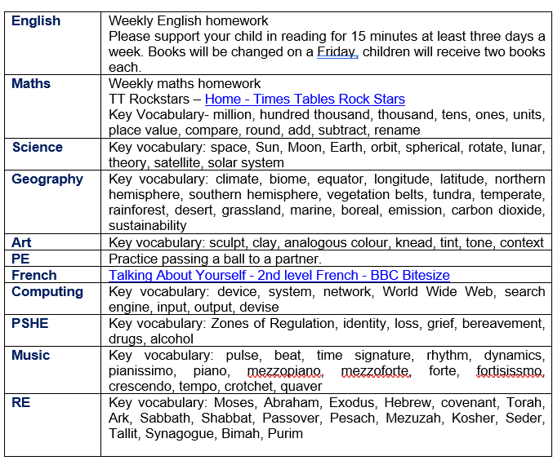
Curriculum Newsletter
Notes:
Share with parents the following:
Maths and English will outline explicit objectives for the half term. In KS2, if you child has a tutor, for example, this could be given to the tutor to let them know what we are focusing on.
Curriculum – what we are learning and the key elements of learning.
Vocabulary – this is specialist vocabulary that we want children to be confident with, it would be very helpful if you could use it or talk about it at home to build confidence.

Slide 8
Homework (KS2)
Homework is given out on a Thursday and returned on a Tuesday.
Any homework given will be to revise previous learning (for example year previous refresher) or consolidate recent learning.
We would encourage children to complete homework independently.
Homework presentation should be given the same care as it would be schoolwork.
If a child is stuck, encourage them to come and ask for help on either a Friday or a Monday.
Each week homework is marked as a class.
Notes:
Teacher to explain to parents that homework shouldn't take children longer that 30 minutes and shouldn't cause upset and distress at home.

Slide 9
Reading Books
Two types of reading books coming home:
Scheme Books: Learning to Read – typically sent home on a Friday
Levelled books targeted at current reading level.
Please listen to your child read to you and support.
Ideally, read the same book more than once to build fluency.
Keep in bag daily for regular return
Joy Books: Learning to LOVE reading
Free choice from the reading corner/ library every Friday (or home if children prefer).
Might be trickier to read, may need help or could read together.
Notes:
Explain to parents that we say typically on this day because for example with RWI book, we only send them home when we are confident they are fluent – so if takes an extra day of of reading, we will delay if necessary.
In Yr 6 if they have completed the scheme, it is free choice reading so just add this in.

Slide 10
Dates for your Diary
Class Photos: Tuesday 30th September
Parents Evenings: Monday 20th October and Thursday 23rd October (3:45)

Slide 11
Life in Year 5
Lots of interesting history topics such as the Ancient Greeks and Mayans
Learning about space
Learning sign language
Buddying with Year 1
New responsibilities around school such as counting house points
Trip to Boston Spa in the Spring term
Making clay flower sculptures
Different clubs throughout the year

Slide 12

Thank you!
Any questions?

