Slide 1
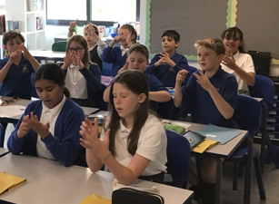
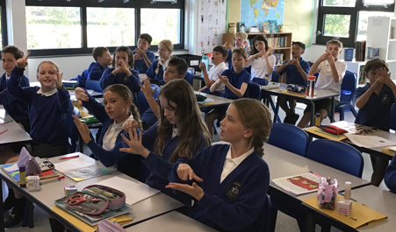

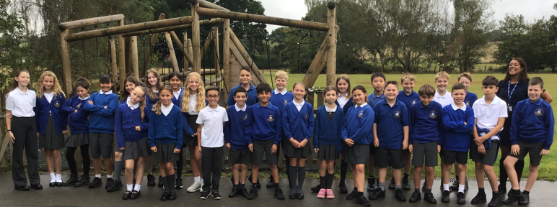
Welcome to Class 6 Parent Information Session

Slide 2
Everyday information
Doors to school open at 8.50am and close at 9.00am.
School closes at 3.30pm.
Water bottles – named and appropriate size.
Snacks – All children can bring in a piece of fruit or vegetables as a snack.
Children in Yr 6 who walk home will need an up-to-date consent form
Mobile phones – handed into the office at the beginning of the day and collected at the end of the day.

Slide 3
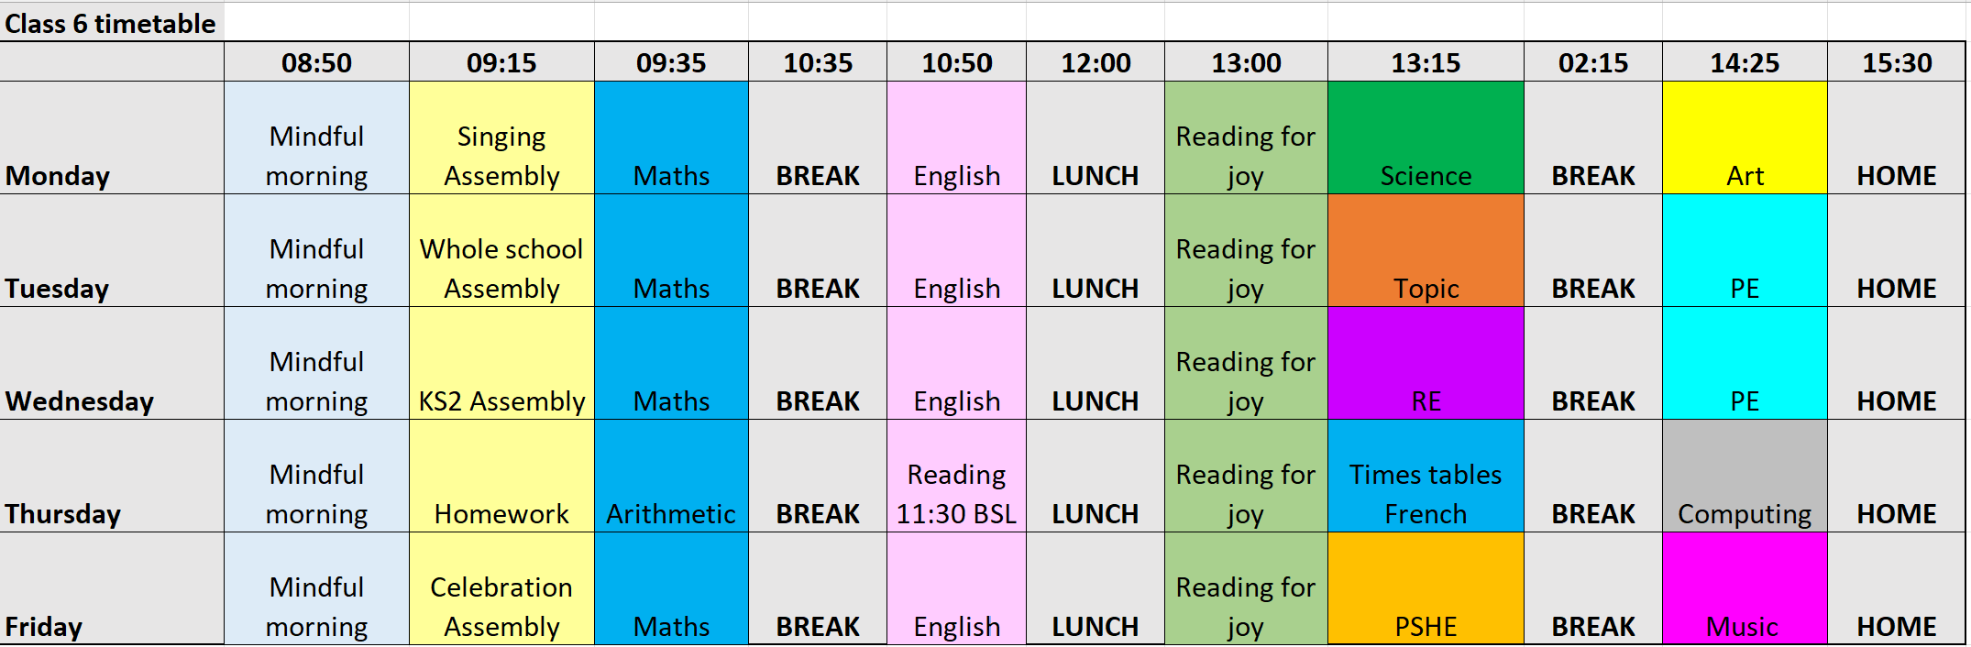
A typical week in our class
ADD OVERVIEW OF YOUR WEEKLY TIMETABLE (SIMPLE VERSION).

Slide 4
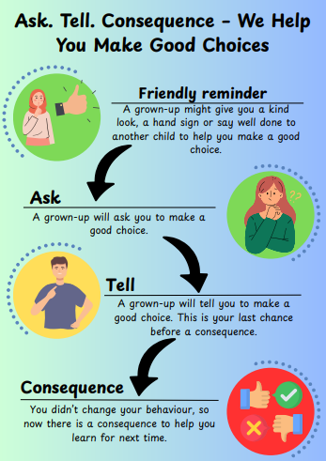
Notes:
Behaviour in school. We follow the Ask, Tell, Consequence model.

Slide 5
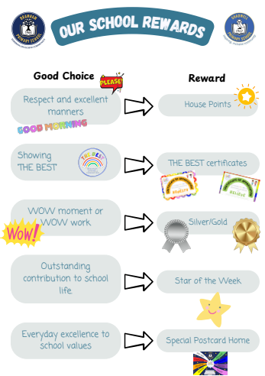

Slide 6
PE
Our PE days are on Tuesday and Wednesday
On PE days, children are to wear PE kit all day.
Just a reminder our school PE kit is
House-colour plain t-shirt (no logos) - these can be purchased via the school office?
Black or navy shorts or tracksuit bottoms.
Trainers
Dark-colour (navy or black) fleece, jumper or jacket.
Notes:
Can add in about swimming in here for Yr 3 and 4.

Slide 7
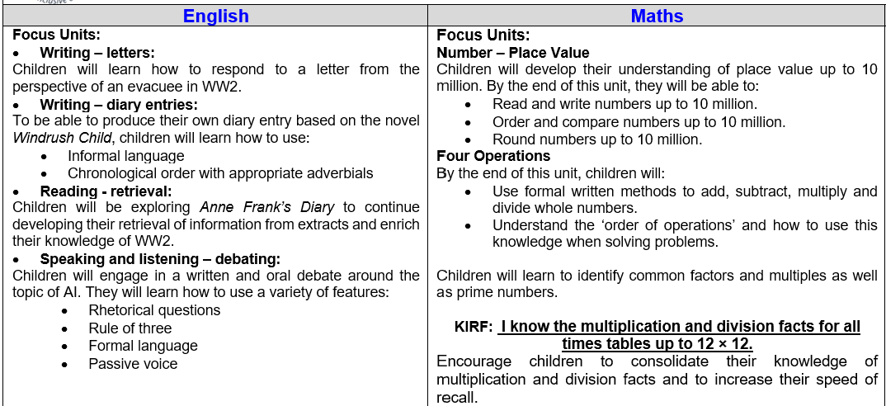
Curriculum Newsletter
ACTION: Add snips of your curriculum newsletter to share key information elements.
Notes:
Share with parents the following:
Maths and English will outline explicit objectives for the half term. In KS2, if you child has a tutor, for example, this could be given to the tutor to let them know what we are focusing on.
Curriculum – what we are learning and the key elements of learning.
Vocabulary – this is specialist vocabulary that we want children to be confident with, it would be very helpful if you could use it or talk about it at home to build confidence.

Slide 8
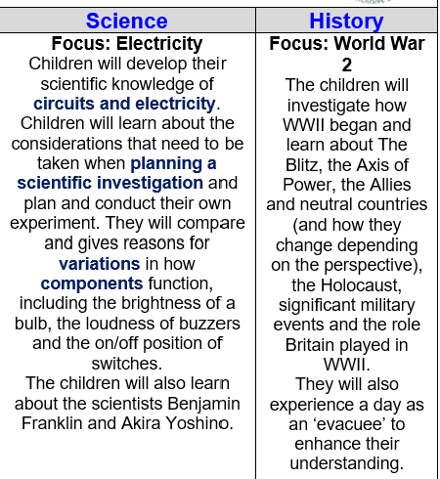

Curriculum Newsletter
ACTION: Add snips of your curriculum newsletter to share key information elements.
Notes:
Share with parents the following:
Maths and English will outline explicit objectives for the half term. In KS2, if you child has a tutor, for example, this could be given to the tutor to let them know what we are focusing on.
Curriculum – what we are learning and the key elements of learning.
Vocabulary – this is specialist vocabulary that we want children to be confident with, it would be very helpful if you could use it or talk about it at home to build confidence.

Slide 9
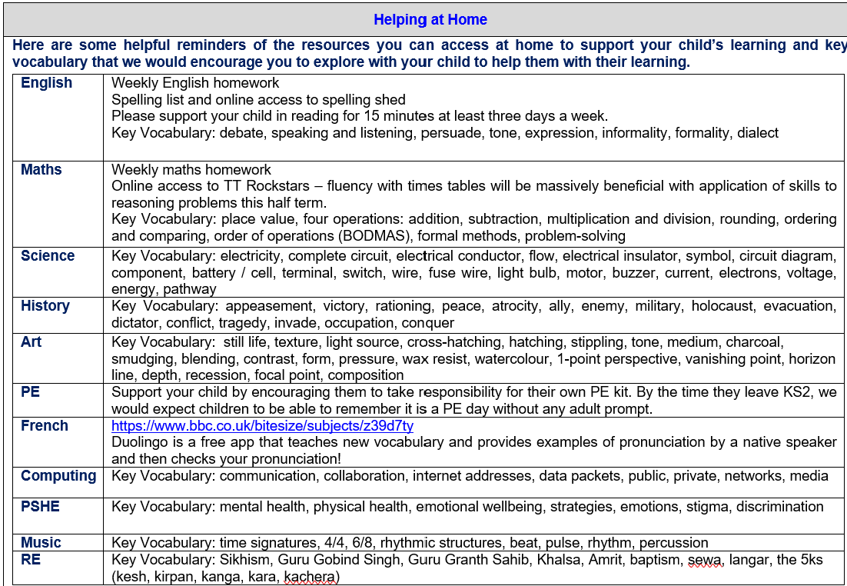
Curriculum Newsletter
ACTION: Add snips of your curriculum newsletter to share key information elements.
Notes:
Share with parents the following:
Maths and English will outline explicit objectives for the half term. In KS2, if you child has a tutor, for example, this could be given to the tutor to let them know what we are focusing on.
Curriculum – what we are learning and the key elements of learning.
Vocabulary – this is specialist vocabulary that we want children to be confident with, it would be very helpful if you could use it or talk about it at home to build confidence.

Slide 10
Homework (KS2)
Homework is given out on a Thursday and returned on a Tuesday.
Homework presentation should be given the same care as it would be schoolwork.
Any homework given will be to revise previous learning (for example year previous refresher) or consolidate recent learning.
We would encourage children to complete homework independently.
If a child is stuck, encourage them to come and ask for help on either a Friday or a Monday.
Each week homework is marked as a class.
Notes:
Teacher to explain to parents that homework shouldn't take children longer that 30 minutes and shouldn't cause upset and distress at home.

Slide 11
Reading Books
Two types of reading books coming home:
Scheme Books: Learning to Read – typically sent home on a Friday
Levelled books targeted at current reading level.
Please listen to your child read to you and support.
Ideally, read the same book more than once to build fluency.
Keep in bag daily for regular return
Joy Books: Learning to LOVE reading
Free choice from the reading corner/ library every Friday (or home if children prefer).
Might be trickier to read, may need help or could read together.
Notes:
Explain to parents that we say typically on this day because for example with RWI book, we only send them home when we are confident they are fluent – so if takes an extra day of of reading, we will delay if necessary.
In Yr 6 if they have completed the scheme, it is free choice reading so just add this in.

Slide 12
Dates for your Diary
Wetherby High trip – this Thursday
Residential - Wednesday 18th March – Friday 20th March 2026
SATs - Monday 11 May to Thursday 14 May 2026
Class Photos and Evacuee Day – Tuesday 30th September
RSE information sessions – November
Yorkshire air museum – Thursday 13th November
Parents Evenings - Monday 20th and Thursday 23rd October

Slide 13

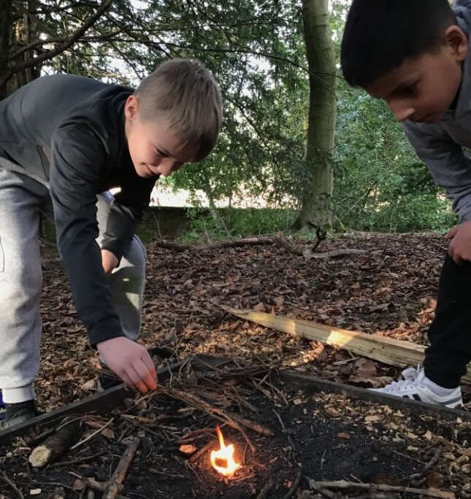
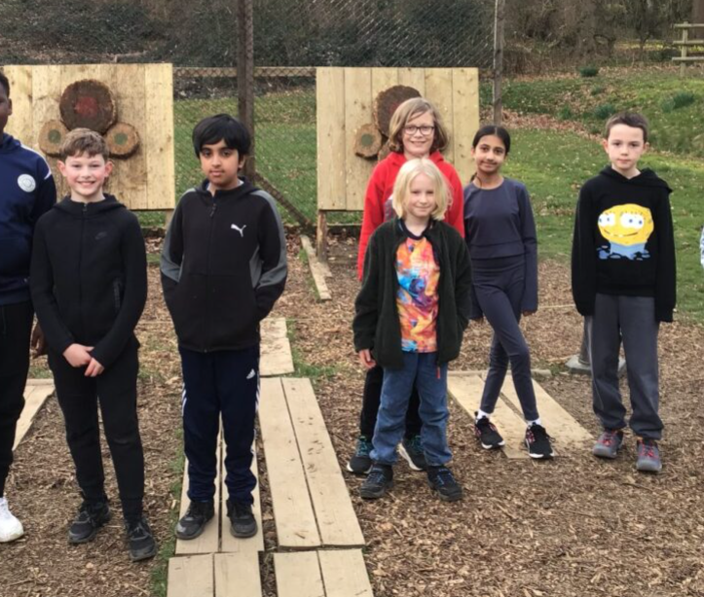
Residential 2026: Willersley Castle
Wednesday 18th March – Friday 20th March 2026
Inclusive venue – we can look at support to ensure all children join us!
£253.59 includes:
Two nights accommodation within Willersley Castle
9 adventure activities
Meals
Coach transport
Payment plan available if needed.
Parent information talk in the new year!

Slide 14
Life in Year 6
WW2 Topic, including Evacuee Day and Yorkshire Air Museum trip, as well as a visitor coming in to tell us about the Dambusters mission!
Creating an electrical board game
Global Economy Day, including designing their own products based on a budget
Residential
Buddies
SATs booster sessions
SATs week
Writing inspired by short films
Production
High School Transition
Leavers Assembly

Slide 15

Thank you! Any questions?

