Slide 1
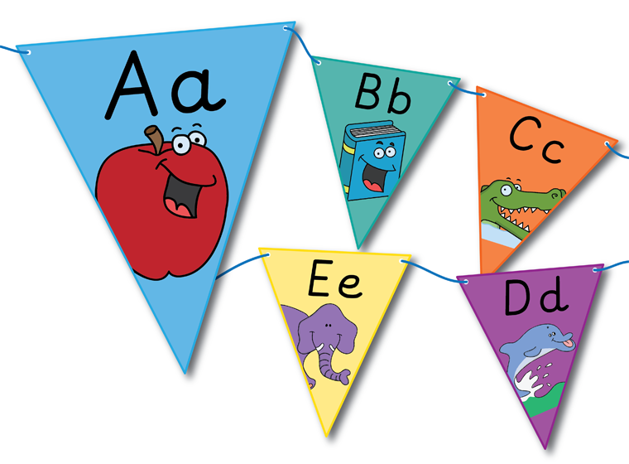
Phonics Workshop
Tuesday 4th October 2022

Slide 2
In school, we follow the Read Write Inc programme. Read, Write Inc is a fun and fast-paced programme which ensures your child is engaged in reading, so that they make good progress from their starting points.
.
Notes:
Previously we have taught Letter and Sounds along side Jolly phonics. Content is very similar but the delivery is different.

Slide 3
Terminology
Phoneme - sound
Graphemes – written symbol
Segmenting (Fred Talk) – is when we split up a word into individual sounds
Blending – is bringing together the sounds to read the word
Digraph -ai
Trigraph – igh

Slide 4
The sounds below are in the order they are taught from Reception until the end of Year 1.
Set 1 (Reception)
m, a, s, d, t, i, n, p, g, o, c, k, u, b, f, e, l, h, sh, r, j, v, y, w, th, z, ch, qu, x, ng, nk
Set 2 (Reception and Revised in Year 1)
ay, ee, igh, ow, oo, oo, ar, or, air, ir, ou, oy.
Parent video: How to say the sounds - Bing video
https://www.youtube.com/watch?v=BqhXUW_v-1s
Notes:
We teach the children three sounds a week in Reception. These are reinforced through the use of storybooks, word cards for the children to practice their Fred Talk and little rhymes for each sound.
Teach, Practise and Apply

Slide 5
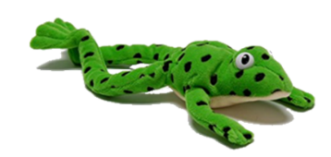
Fred Talk - blending
p a n
Notes:
Fred only uses the pure sounds. E.g. Fred wouldn’t say mat he would say m-a-t

Slide 6
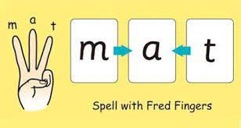
Fred Talk - Segmenting
Breaking down words for spelling.
Notes:
Finger pinch for each sound.

Slide 7
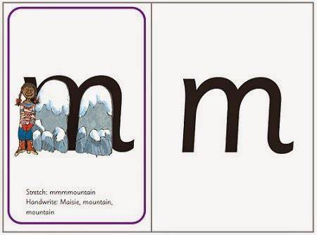
What does a Phonics lesson look like?
Notes:
We do teach the letter names but not within the phonics sessions. Apart from tricky words.

Slide 8
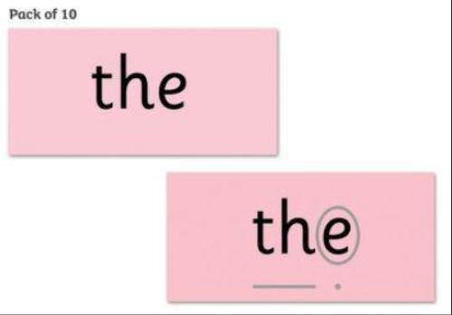
Tricky Words
These are TRICKY (red words)
Go against all rules that children are learning
No other way to read/write them other than memorising.
Notes:
Flags

Slide 9
Reading- school
Whole class
Guided
Individual
Notes:
Discuss the reason behind books with no words

Slide 10
Guided Reading
Speed sounds
Green words
Blending, segmenting and recall skills are then put into practise when reading.
1-1 Reading and Storytime
During reading we have a strong focus on COMPREHENSION
- What are the character’s feeling?
- What has just happened?
- Predicting what might happen next
Notes:
Tips: Write the sounds you can hear.

Slide 13
Reading Books
Home
Notes:
Discuss the reason behind books with no words

Slide 14
Decodable Books
Notes:
Children should be able to decode/ sound out each word. If they are finding it difficult please let us know.

Slide 15
Initial Sounds
Notes:
Specific learning – will write in their records to explain.

Slide 16
Resources
http://www.phonicsplay.co.uk
Notes:
Letters and Sounds Links placed on website.
Oxford Owls – class2021v Bram21

