Slide 1

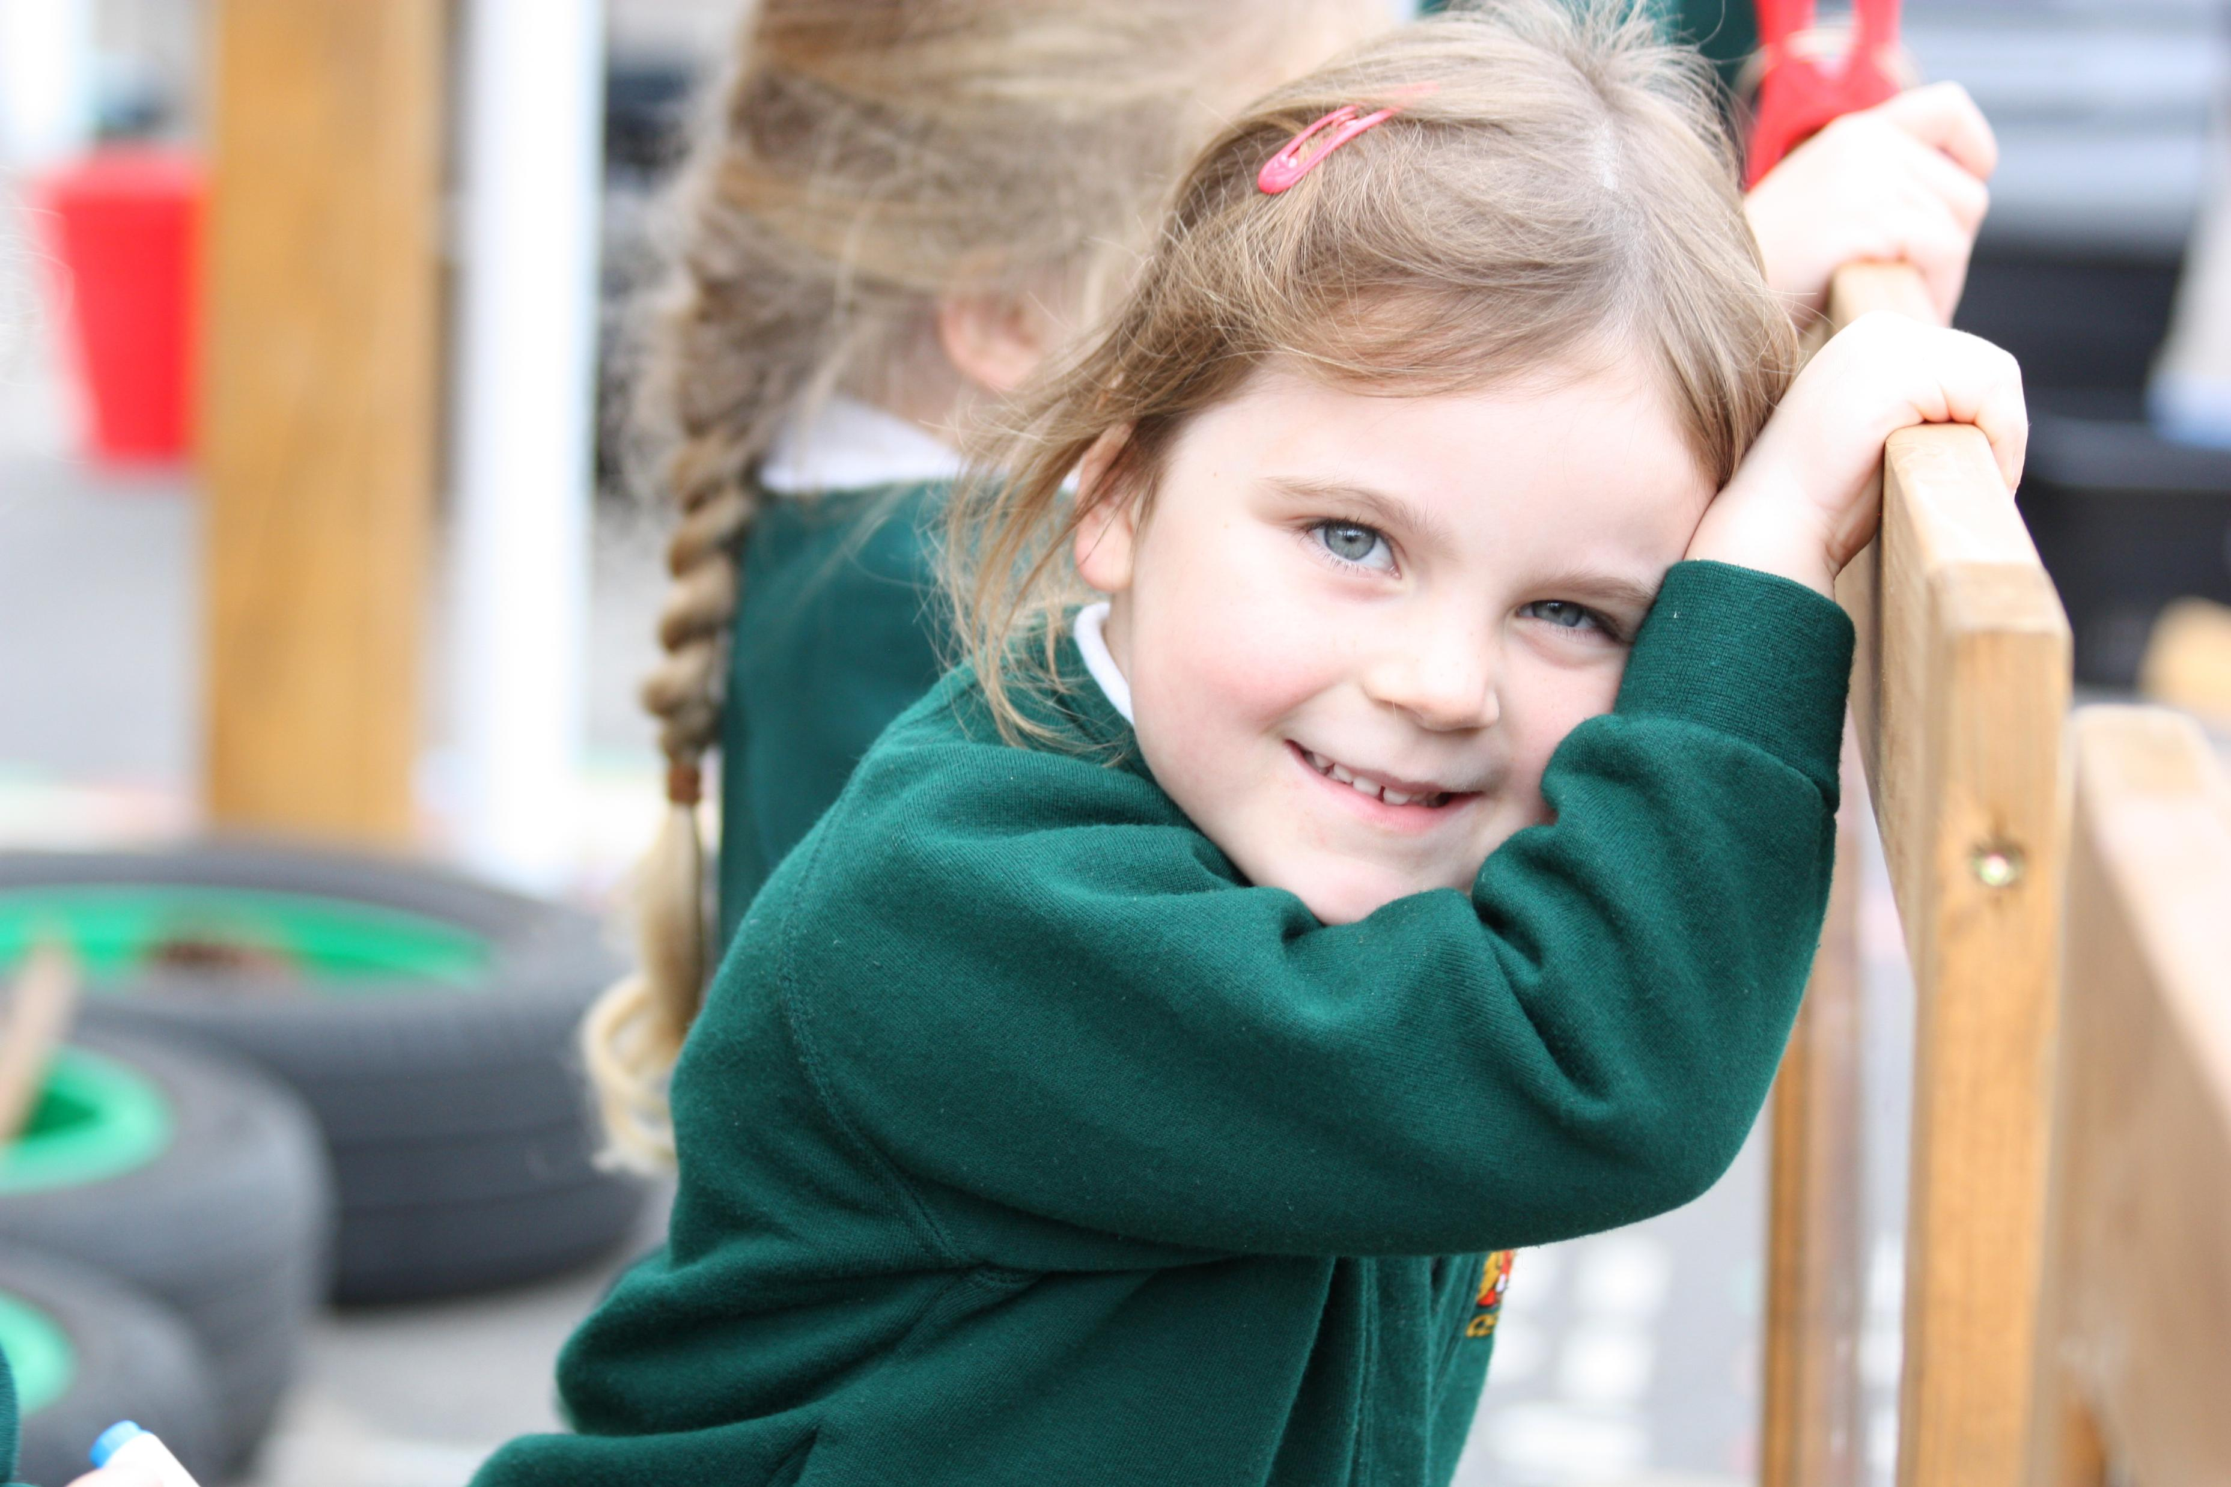
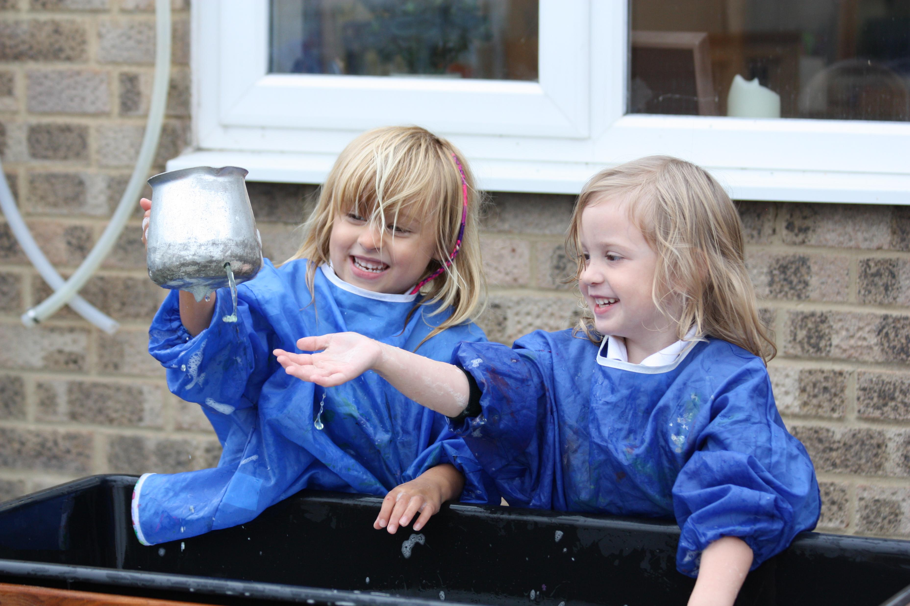
Reception Parent Information Evening
2026 – 2027 cohort

Slide 2
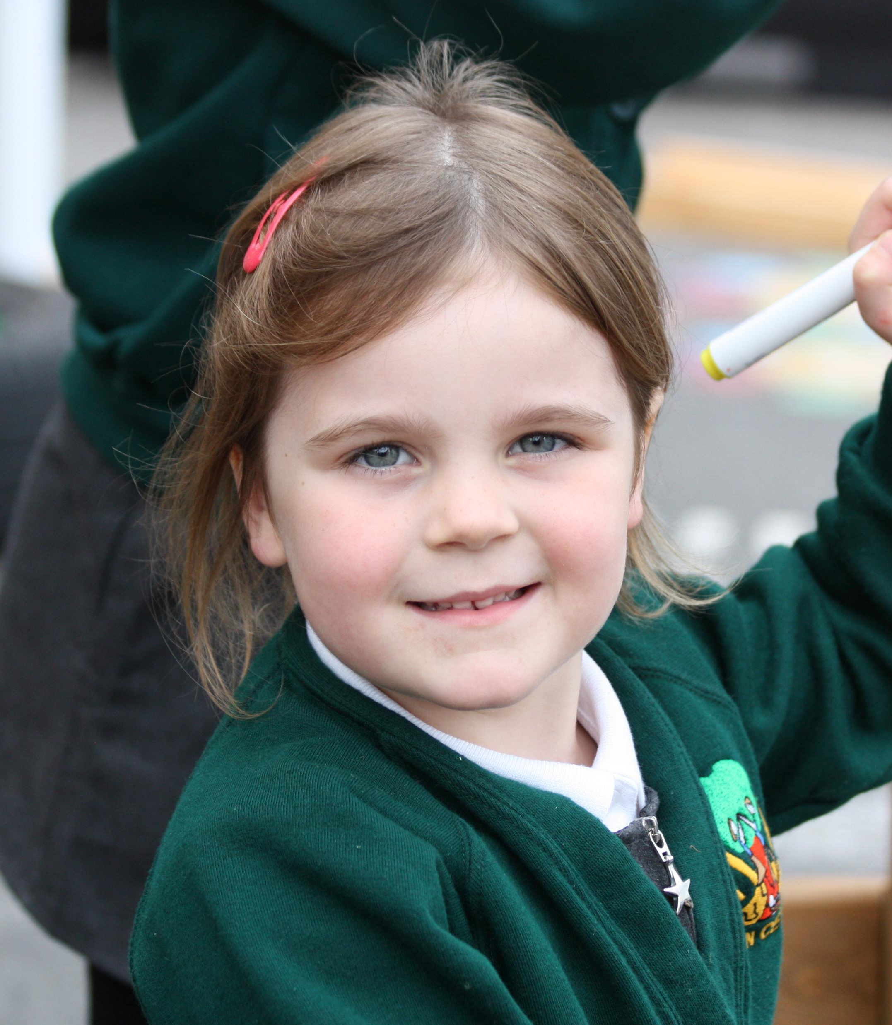
‘Shine brightly in learning and life’
Through nurturing aspiration, respect, courage and community, we empower every child to shine brightly in learning and life, making a positive difference in the world around them.
“Let your light shine” (Matthew 5:16)

Slide 3
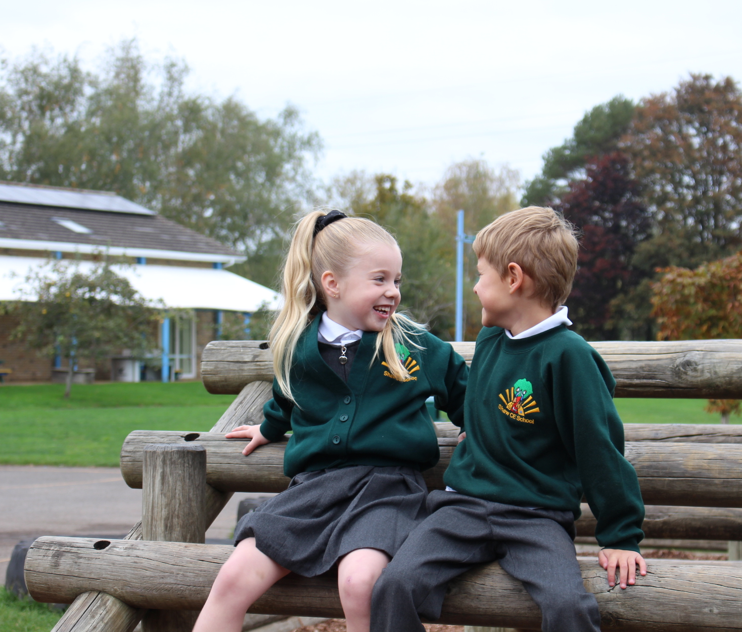
Aspiration
Respect
Courage
Community
Shaw Values

Slide 4


Slide 5
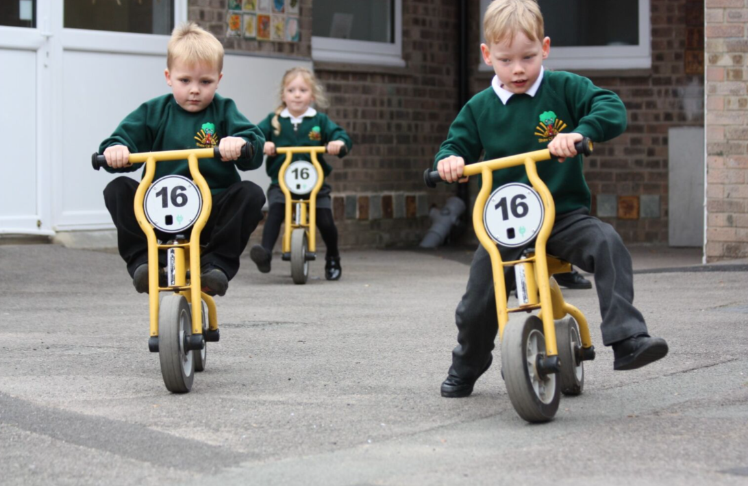


Our Reception Staff
The importance of positive and secure relationships in reception:
Supports emotional security and wellbeing: Secure relationships with reception teachers help children feel safe, valued, and confident, which is essential for managing separation from carers and adjusting to the school environment.
Promotes learning and engagement: When children trust their teacher, they are more willing to explore, take risks, and participate in activities, which supports early cognitive and social development.
Builds strong foundations for future relationships: Positive, secure interactions with teachers model healthy relationships, helping children develop communication skills, self-regulation, and the ability to form trusting connections with others.

Slide 6
Our EYFS Core Commitments
A nurturing inclusive environment with a strong sense of belonging
Exceptional teaching, high quality CPD and meaningful interactions
Oracy and language-rich environments
Immersive numeracy and literacy: books, rhymes and storytelling
Child-centered play-based learning
Equity for all groups of learners
Personal development and positive behaviour foundations
Strong parent and carer relationships

Slide 7



Slide 8
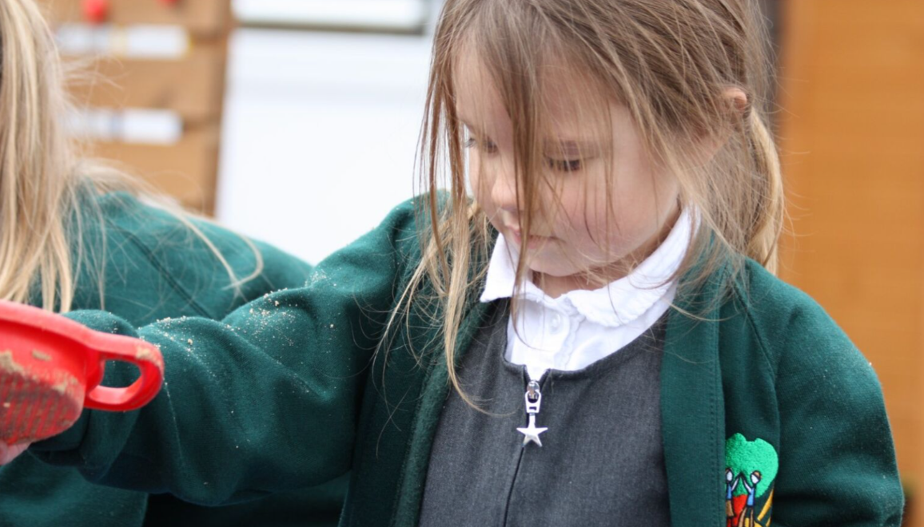

Shaw Golden Threads
What do we want our curriculum to offer all children at Shaw?
Knowledge and Skills Rich
Oracy Rich
Curiosity and Enquiry Rich
Christian Values
Notes:
Curriculum is ambitious for all learner and is progressive from reception through to year 6

Slide 9
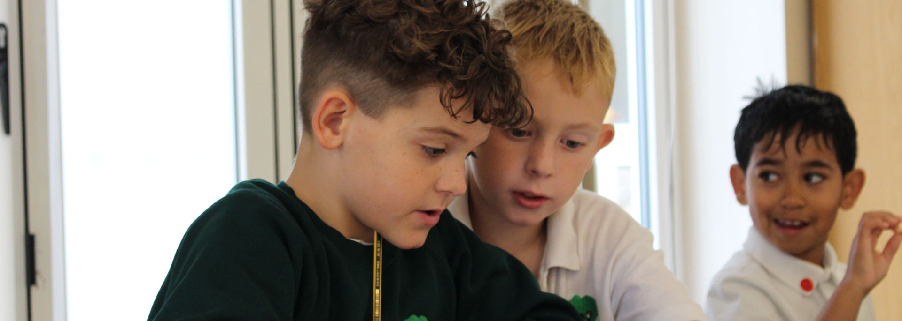
Our Reception Curriculum
At Shaw CofE Primary School, our Reception curriculum is carefully designed to be both progressive and ambitious for all children. We believe that every child deserves the opportunity to succeed, and our curriculum ensures that learning builds step by step, enabling each child to make strong progress from their individual starting points.
We place a strong emphasis on developing foundational skills, as these are the building blocks for all future learning. By securing these essential skills early, children are better prepared not only for Year 1, but for lifelong learning.

Slide 10












High quality texts
Across the reception year, children will have exposure to and will learn a number of high-quality texts and nursery rhymes. We do this through a talk for writing approach where children learn to orally retell a story using words and actions.

Slide 11

What are foundational skills?
Foundational skills are the core skills that children need in order to access all areas of the curriculum and thrive both in school and beyond. These include:
Communication and language – developing vocabulary, listening skills, and the ability to express thoughts and ideas clearly
Early reading and phonics – recognising sounds, blending words, and building a love of reading
Early writing – mark-making, letter formation, and beginning to write simple words and sentences
Mathematical understanding – number recognition, counting, and developing a secure sense of number
Personal, social, and emotional development – building confidence, resilience, independence, and the ability to work with others
Physical development – strengthening both fine motor skills (e.g. pencil grip) and gross motor skills (e.g. balance and coordination)

Slide 12


Slide 13


Slide 14


Slide 15
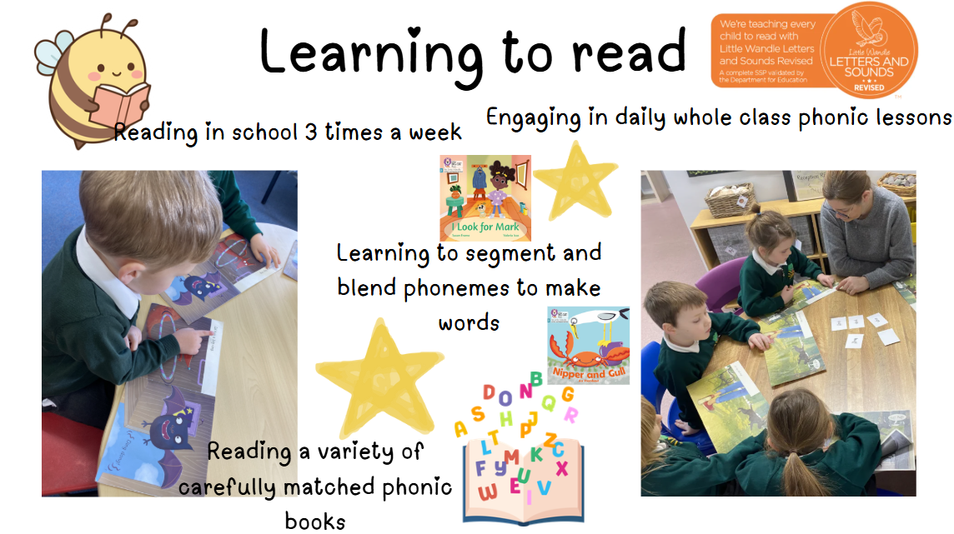

Slide 16


Slide 17
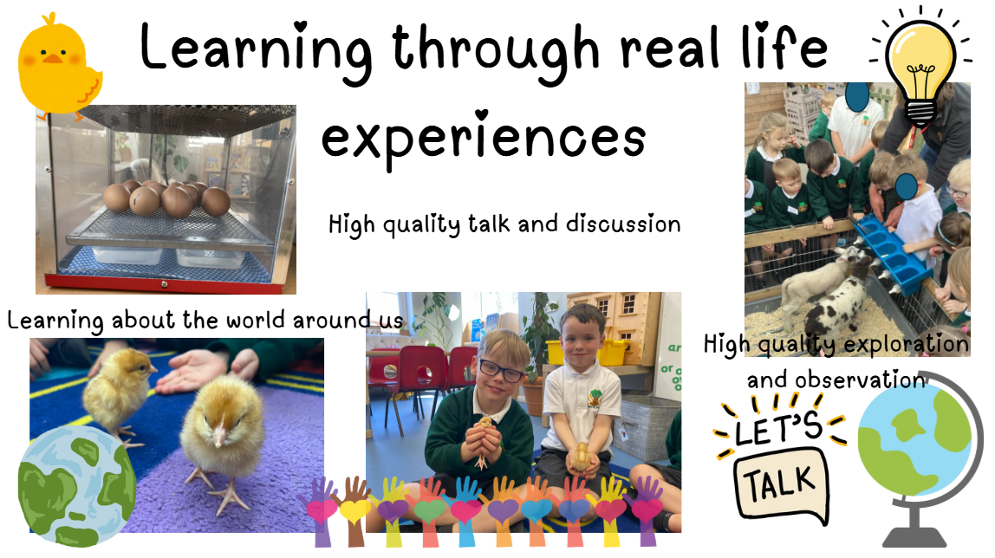

Slide 18
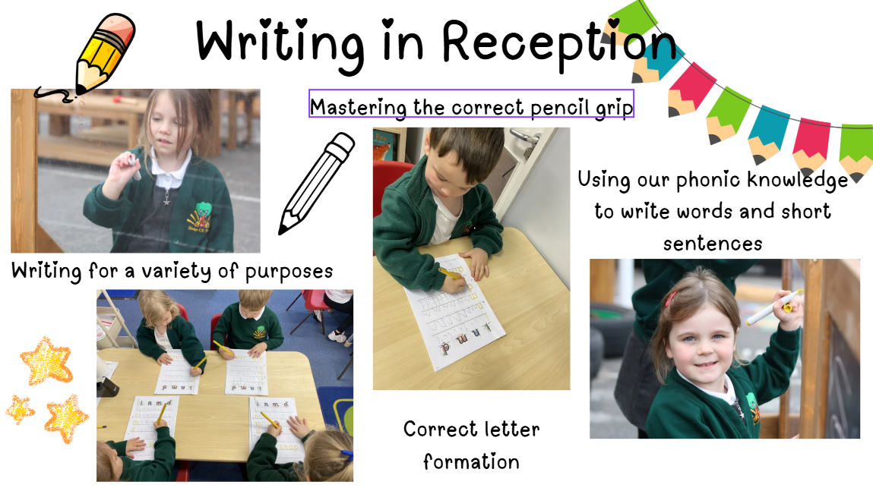

Slide 19
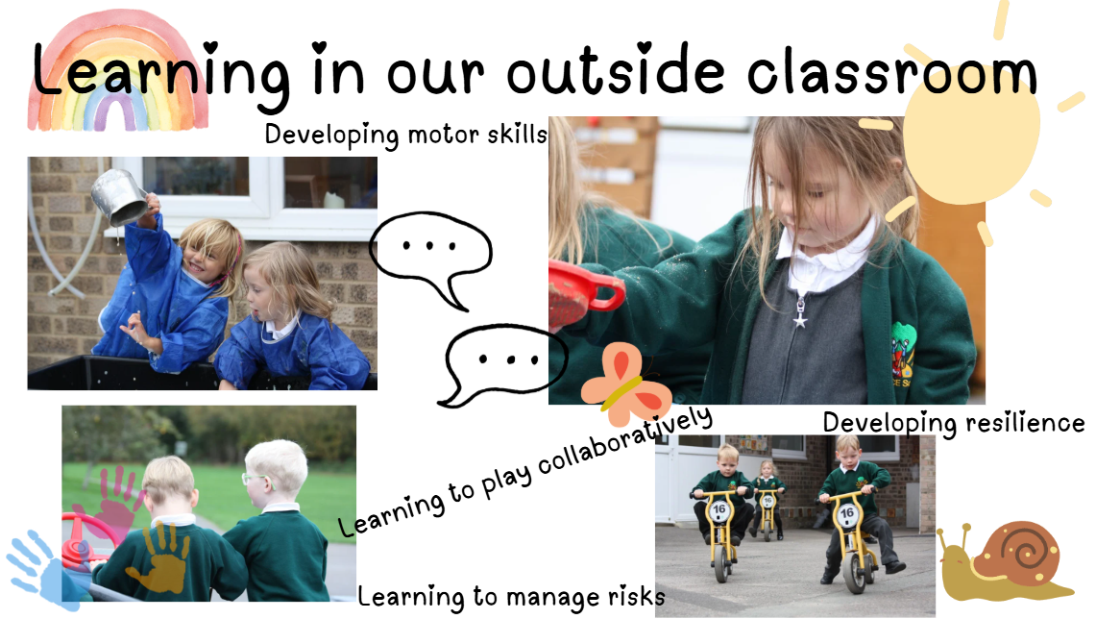

Slide 20


Slide 21
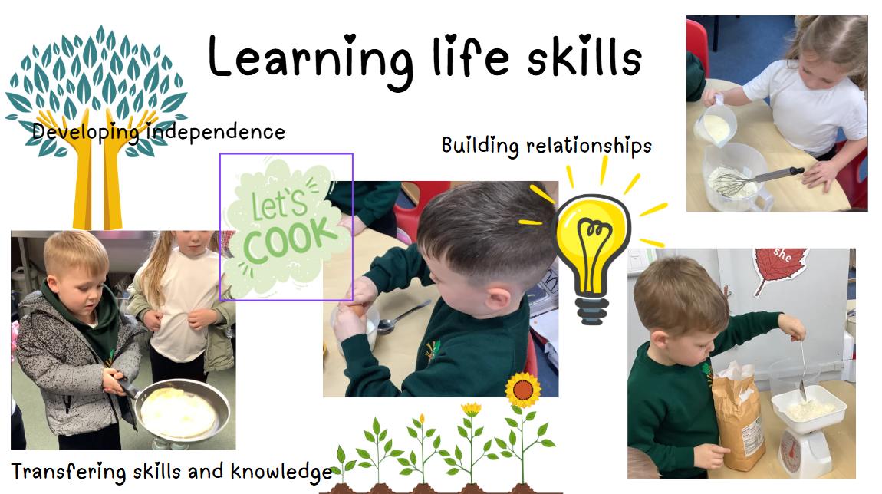

Slide 22
Fine motor activities – develop pencil control
Whole class phonics session
Group reading and fine motor tasks
Group work and enhanced provision
Whole class handwriting session
Lunchtime
Kind minds
Maths
Wider curriculum learning and activities
Group work and enhanced provision
Storytime/rhyme time
Home time
A typical day in reception

Slide 23
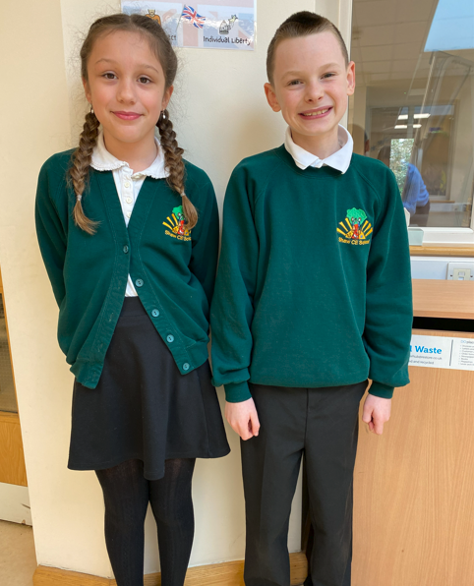
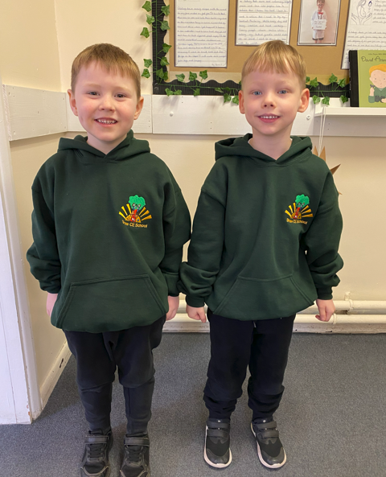
School Uniform Expectations
All uniform is available to purchase at SportsBug

Slide 24
Shaw bottle green sweatshirt or cardigan
Grey school trousers, skirt or shorts
White polo shirt
Black school shoes
Shaw bottle green book bag
School uniform

Slide 25
Shaw bottle green PE hoody or……
Shaw bottle green sweatshirt
Plain black or navy leggings, joggers or short
Plain white t-shirt
Trainers
All children wear their PE uniform to school on their PE days
PE uniform

Slide 26
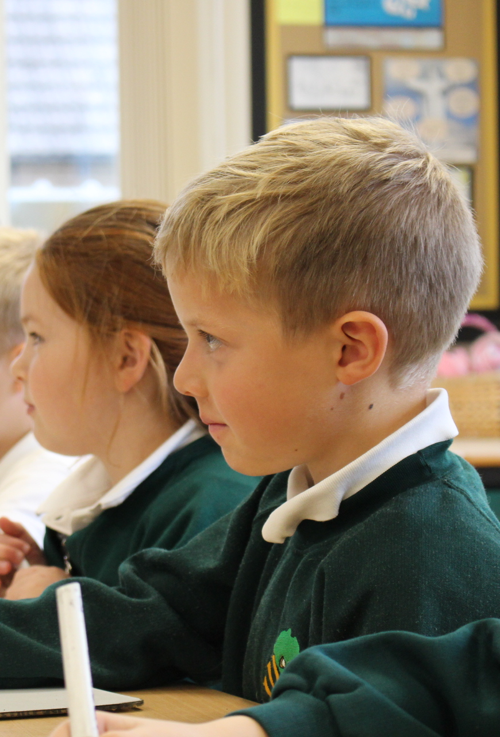




Equipment
To ensure children have everything they need, we ask that all children have the following in school each day:
School book bag
Water bottle – water only
Weather appropriate coat
A small drawstring bag with a spare set of clothes in

Slide 27
Key transition dates
Wednesday 24th June – 1.10 – 2pm – Family Picnic
Stay and play
Friday 3rd July – 1.10 – 2pm – Group A Stay and Play Session
Friday 3rd July – 2.10 – 3pm – Group B Stay and Play Session
Nursery and home visits
Tuesday 14th July – Mrs Munslow and Mrs Vines to visit nurseries and complete home visits

Slide 28
Key transition dates
Parent meetings with Mrs Munslow
Appointments will be 15-minutes long and will focus on key information all about your child:
Tuesday 30th June 1.30 - 5pm
Tuesday 7th July 3.30 - 5pm
Wednesday 8th July 3.30 - 5pm
Tuesday 14th July 3.30 - 5pm
Please sign up on the sign up sheets this evening

Slide 29
Key transition dates
Tuesday 1st and Wednesday and 2nd September – TD days – school closed to all pupils
Thursday 3rd and Friday and 4th September – Group A (9 - 11.30am) - Group B (12.30 – 3pm)
Monday 7th and Tuesday 8th September – All children (8.45 – 12.45pm)
Wednesday 9th September – All children full time (8.45 – 3.15pm)

Slide 30

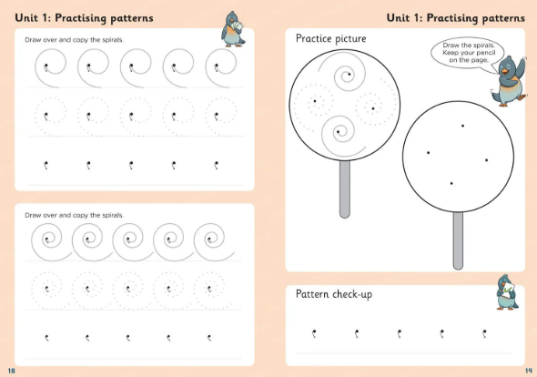



Welcome pack
All children who are starting Shaw Primary School will receive the following:

Slide 31




Parent communication
admin@shaw.wilts.sch.uk
01225 702544

