Slide 1
Year 4
September 2021

Slide 2
Welcome to Year 4
There are 2 classes in year 4, Yellow (4Y) and Orange (4O). Mr Clegg is Yellow class teacher and Mrs Yeomans is Orange class teacher.
We are ably assisted by Mrs Kiernan, Miss Stapleton and Mrs Paveen (On a Tuesday).
P.S. – The children are settling back into school very well! We would like to thank you for your continued support!

Slide 3
Help your child to be organised
English and Maths homework on Tuesdays (set on google classroom)
Learning logs, check the date
Spelling tests on Tuesdays
Swimming Orange –Tuesday
Swimming Yellow - Wednesday
PE kit (indoor) Monday
Games (outdoor) Thursday

Slide 4
English
English will be taught daily and will include reading, writing , handwriting and spellings.

Slide 5
Spellings
LSCWC
Practise in practical ways, making it as fun as possible
Weekly tests and used in writing

Slide 6
Reading
Reading book.
Reading homework
VIPERS
Reading Records

Slide 14
Writing
Use spellings and handwriting skills
Edit writing in learning logs
Use success criteria
Alan Peat sentence types

Slide 15
Maths
We want maths to be interesting, practical and fun. We do use worksheets but will also teach practical lessons with lots of equipment to help understanding.
Times Tables – By the end of year 4, your child should know all their times tables. At the end of this academic year, your child will have a Government times table test. This will be done via computer and the children will only have 5 seconds to answer each question. If you want to help your child at home please use TT rockstars – your child will be given a login during the next few weeks in school, but you can also help by practising times tables with your child.
Reasoning, we do quite a lot of work on enabling the children to explain their mathematical ideas – and why certain calculations work and others don’t.

Slide 16
Mental arithmetic
RaPa CoDa Numbo
Number bonds
Multiplication facts
Division facts
Mad minutes
Times Table Tests

Slide 17
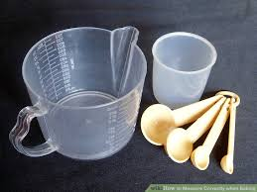
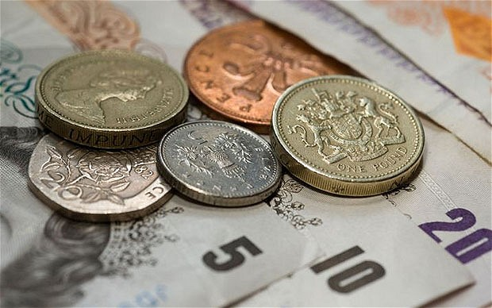
Practical maths
Telling the time
Using timetables
Baking and cooking
Helping with the shopping

Slide 18
PE & Games
PE every Monday. Games is every other Thursday.
Kit to remain in school for the entire half term.

Slide 19
Swimming
Children have begun swimming lessons at Rochdale baths. Orange class swim on a Tuesday afternoon and Yellow class swim on a Wednesday afternoon.
There is no jewellery allowed poolside, so if your child wears earrings could you please ensure this are taken out on your child’s swimming day.

Slide 20
Swimming >>>>>continued
Swimming can be exhausting for your child, so to give them energy we recommend bringing a healthy snack for when they return to school. This can be a piece of fruit or vegetables and the children will be given time to eat it upon their return to school.

Slide 21
Any questions?

