Slide 1



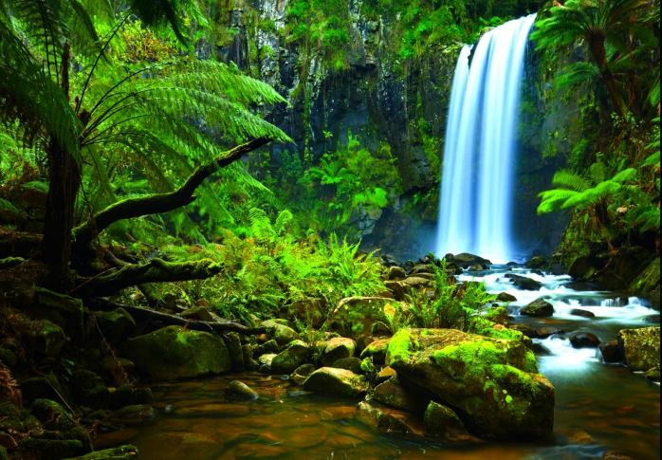
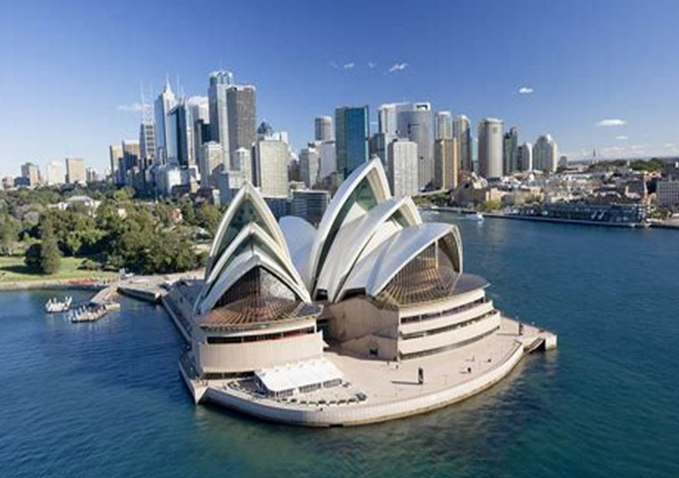



English and Reading
Maths
PSHE
In English, we will be reading the book The Bog Baby by Jeanne Willis. The outcome will be for children to write a finding narrative, looking at catching a creature and taking him home. Children will focus on writing instructions.
Key vocabulary:
dell bluebells enchanted tentatively protected gravel pale immediately eventually succulent
newts adventurous trudged tranquil thoroughly
damp adorable relieved murky odour
Children will be focusing on shape, recognising 2-D and 3-D shapes, vertices and lines of symmetry. We will also be looking at multiplication and division, and money.
Key vocabulary:
multiplication division equal groups unequal lots of groups of
multiplied divided shared array repeated vertices symmetry grouping half double odd even
change pound pence notes coins value
Place value tens ones 2-dimensional 3-dimentsional
In PSHE children will be looking at safety and the changing body. We will focus on how the internet can be used to help us and staying safe online, what a secret and a surprise is and learn the names of parts of the body including private parts. We will look at the PANTS rule, keeping safe near and when crossing roads. We will also look at understanding when we should take medicine.
ART
Year 2 Curriculum Overview- Spring Term 1
In art children will look at painting and mixed media. They will name the primary and secondary colours, talking and changes when two colours mix. We will describe colours and textures, using different tools to recreate texture. We will learn collage techniques and analyse our work.
Key vocabulary:
Collage, details, mixing, overlap, primary colour, secondary colour, surface, texture.
Topic- Location, Location
Geography
If you could live anywhere in the world, where would it be and why?
Grammar
In geography, the children will be looking at ‘why is our World wonderful’ where they identify and locate the characteristics of the UK on the map, they will recognise human and physical features and locate them. Children will be able to explain the difference between oceans and seas, naming and locating the five oceans. They will use an aerial photograph to draw a sketch map.
Key vocabulary:
Aerial photograph Capital city Continent
Country Fieldwork Data collection Landmark
Locate symbol tally chart vegetation
We will focus on:
Formation of adjectives using ful and less
Use of suffixes ly to turn adjectives to adverbs
Use exclamations and question marks.
In science, children will look at the uses of everyday materials. They will be able to name different materials and their purposes. Children will be able to name the properties that make materials suitable for their use and understand that stretching, twisting, bending and squashing can cause some solid objects to change shape.
Key vocabulary:
Elastic Flexible Property Suitable Bend
Fabric Glass Material Metal Object
Plastic Pull Push Rock Stretch Squash Block graph Record
RE
PE
The theme for this term is Dance. Pupils will understand that a dance and routine can be performed in a variety of ways.
Key vocabulary:
inside outside freeze travel balance beats stimulus gesture unison cannon
How do stories help Hindus live their lives?
We will recognise that many stories have a message and how stories tell us something about ourselves and the world. We will look at how Hindus treat other people and care for the world
Key vocabulary:
Hindu Namaste Meditation Compassion

