Slide 1
Parents’ Meeting Introduction to Read Write Inc.
Notes:
Approximately 20 minutes is needed for this session.
Notes are provided to help you lead the presentation.

Slide 2
Shelley First School Read Write Ink Parents Information Meeting
Monday 18th September 2023

Slide 3
Welcome
Read, Write, Inc
&
Early Reading Lead:
Mrs Donaghy

Slide 4
Welcome
Reception Second Teacher &
Phonics Teacher
Mrs Dyson

Slide 5
What is Phonics?
Phonics - are the sounds that our alphabet represent.
We have 26 letters, 44 sounds
It is the most difficult language to crack!
We need to make sure our children learn these sounds quickly and that they are embedded. We repeat, practise and repeat again and again and again. Consolidation and repetition is key!

Slide 6
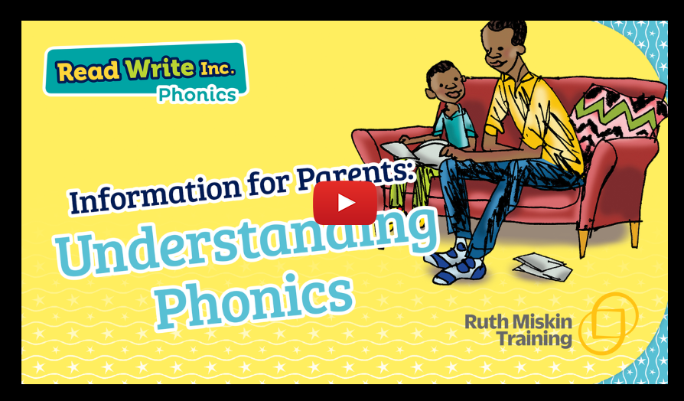
What is Read Write Inc?
https://schools.ruthmiskin.com/training/view/qKhQFKxB/XQODuuOb

Slide 7
How Do We Teach The Sounds?
Speed Sounds
The sounds are split up into 3 sets.
There are BOUNCY sounds…
…and STRETCHY sounds!

Slide 8
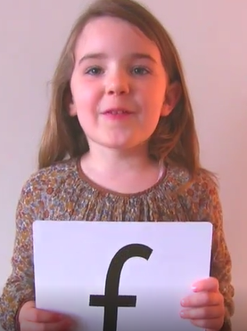
How to pronounce our set 1 sounds…
https://schools.ruthmiskin.com/training/view/qGLQIMvQ/ZvMIkyY1

Slide 9
Blending Sounds
Once the children have learnt some sounds, they can start to blend them to begin to read words.

Slide 10
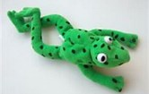
Fred Talk
Fred the Frog helps us to learn our sounds!
He only speaks in sounds!
He helps the children listen to the sounds and begin to blend the words without reading them.
Let’s see if you can do it!

Slide 11
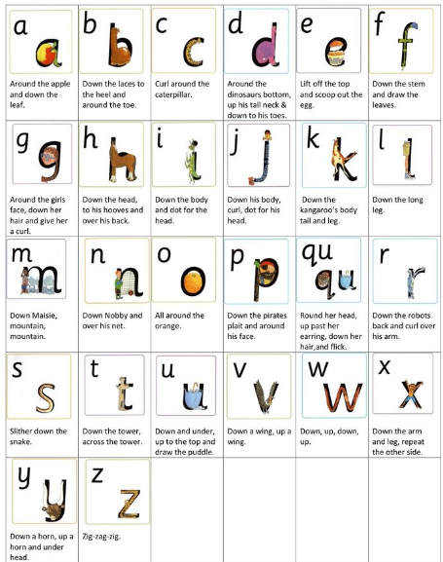
Rhymes to Write!
To help children write the sounds we use a rhyme to help.
These link to the letter pictures.
When children write, they sit at desks. They are taught the correct sitting position and pencil grip.

Slide 12
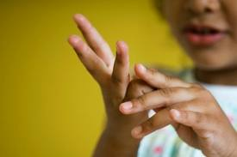
Writing Words
Once children are secure writing some letters, as with reading, we begin to blend the letters to write some words.
Fred is back!
Fred Fingers!

Slide 13
Reading Books
RWI gives children books that contain the sounds they know.
They read a book in class with a partner. This book is matched to the sounds they know.
They read the book 3 times:
First read – decoding
Second read – fluency
Third read – comprehension
Children bring this book home to practise, please try to listen to your child read daily or multiple times through the week.
It is so important for you to write in your child's yellow reading diary when you have listened to them read! This helps us in school know how they are finding their reading books at home.

Slide 14
Why read with your child?
https://schools.ruthmiskin.com/training/view/SzCeN8DB/AdCJ3PGP

Slide 15
Reading changes everything
Teach a child to read and keep that child reading and we will change everything.
And I mean everything.
Jeanette Winterson

Slide 16
Recap
RWI teaches children BASIC skills to ensure they become confident readers and writers.
Stage not age – reading book are matched to children's individual abilities.
Assessment is continuous. If a child is finding phonics tricky, we will provide extra support through targeted interventions. We will also inform parents and may provide phonics videos to watch at home.
Home practise is vital – we need to work together.
Please write in your child's yellow reading diary.

Slide 17
Questions?

Slide 18
Online resources available
Ruth Miskin Parents’ Page:
http://www.ruthmiskin.com/en/parents/
Ruth Miskin Facebook:
https://www.facebook.com/miskin.education
Free e-books for home reading:
http://www.oxfordowl.co.uk/Reading/

Slide 19
Reading feeds the imagination, it expands
horizons and offers new and exciting ways of
seeing and making sense of our lives and of
the world around us.
Michael Morpurgo

Slide 20
Thank you for your time today, I do hope you have found this session useful.
Please feel free to have a look at the resources.
if you have any questions – please ask.

