Slide 1
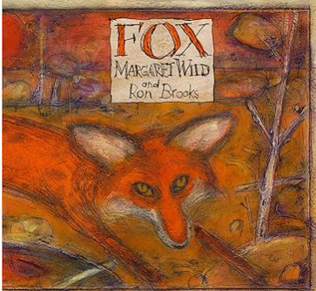

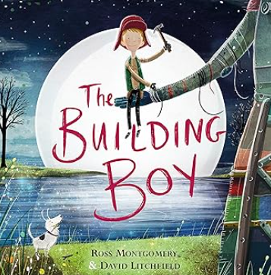

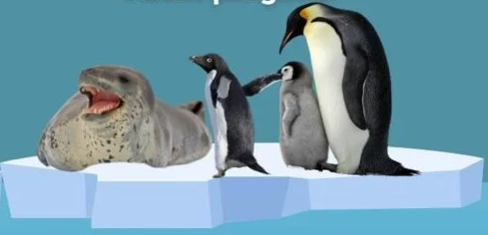
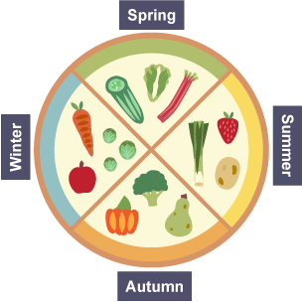


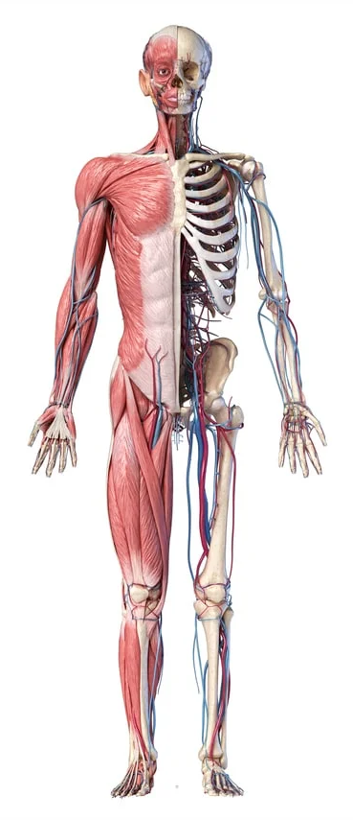


English and Reading
English lessons will be focus on the book Fox by Margaret Wild.
We will be using the pictures and narrative from the vehicle text
to help us to write our own Fable narrative and information report.
In Reading Response, we will explore vocabulary and practise the skills of inference, explaining, summarising, retrieving information and making predictions. Our focus texts are:
Maths
This half term we will be introducing formal written methods with regrouping and exchanging in our addition and subtraction work. We will also begin our Multiplication and division topic focusing on equal groups, arrays, sharing and grouping, recapping 2s, 5s and 10s times tables from year 2 and introducing 3s, 4s an 8s times tables.
Remember you can get lots of valuable times table practise in
using TT Rockstars. Please ask if you can’t remember your login!
PSHE
Our PSHE topic for this half term is health and wellbeing. We will explore key aspects of personal health and emotional wellbeing introducing vocabulary and concepts such as relaxation, goal setting, responsibility, and protection, helping pupils understand how to care for their physical and mental health.
\
Year 3 Curriculum Overview – Autumn 2
Grammar
We will build on the grammar already taught and introduce using prepositions to express time, place and cause e.g. before, after, during, in, because of); paragraphs as a way to group related material; recap using capital letters, full stops, question marks and exclamation marks to correctly demarcate sentences; use commas to separate items in a list.
Topic – Who lives in Antarctica?
ART/DT
Cooking & Nutrition: Eating Seasonally
Learning about seasonal foods and creating a seasonal food tart, this unit provides new lessons with teacher and pupil videos to develop
the children’s
food prep
skills.
Humanities: Geography
Who lives in Antarctica?
We will learn about how latitude and longitude link to climate and the physical and human features of polar regions with links to the explorer, Shackleton. We will begin to use and develop fieldwork skills using a compass, drawing a route map recognising and describing features of our school grounds.
Science
RE
In RE we will be learning about why people follow inspirational leaders.
PE
Our PE topic for this half term is gymnastics.
We will be developing the skills of balancing and travelling. They will plan, perform and repeat sequences of movement in a group. Please ensure that full PE kit is in school on both Mondays and Wednesdays.
Children will need: shorts, tracksuit bottoms and tracksuit top (all plain black or navy), plain white t-shirt and trainers.
Movement and nutrition
Our Science topic for this half term is movement and nutrition. Children will explore the role of skeletons and muscles, learning how the body uses energy and what constitutes a balanced diet.

