Slide 1
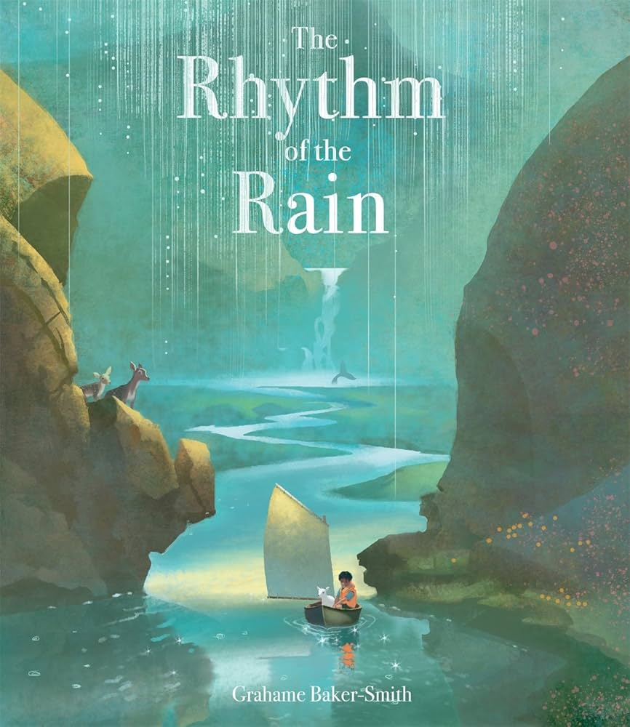

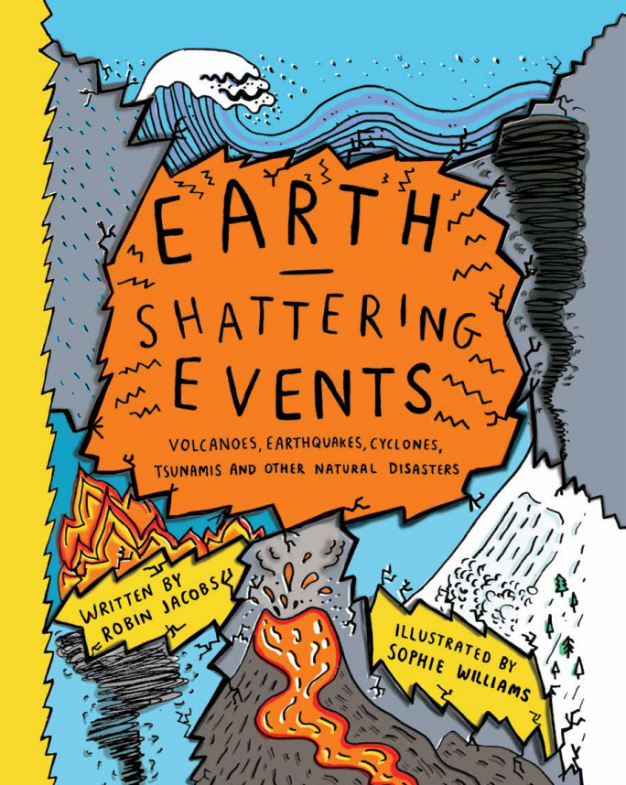

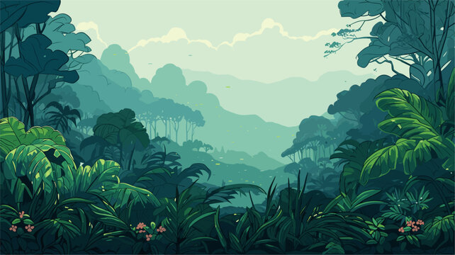

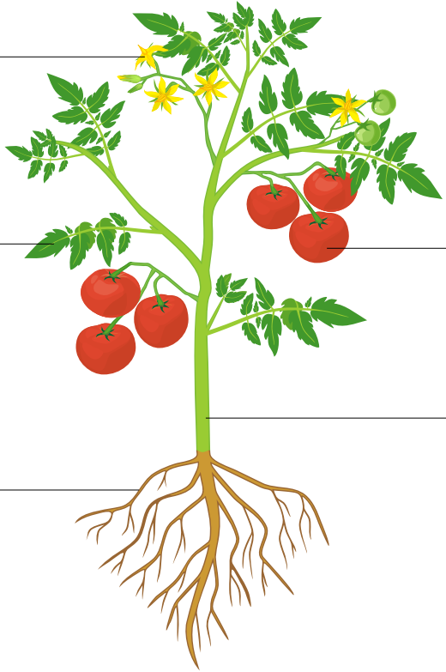


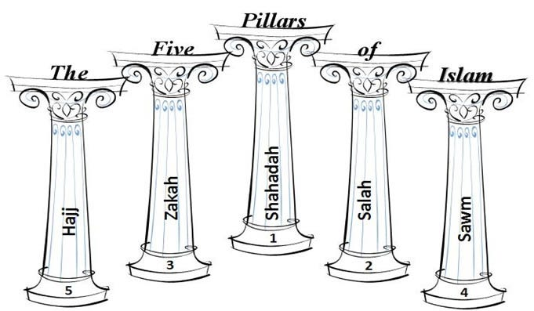
English and Reading
English lessons will be focus on the book The Rhythm of the Rain by Grahame Baker-Smith in Spring 1. We will be developing our descriptive writing skills to produces a setting description.
Our reading response lessons will be based on the non-fiction text Earth Shattering Events by Robin Jacobs – you can find an online version of this book here: Earth-Shattering-Events_FINAL.pdf
Maths
This half term we will be using multiplication facts from the 2, 3, 4, 5, 8 and 10 times tables to deepen our understanding of how multiplication and division work and can be calculated efficiently. We will use multiples of ten to simplify calculations and calculate quickly. Towards the end of this half term we will move onto length and perimeter.
Remember you can get lots of valuable times table practise in
using TT Rockstars. Please ask if you can’t remember your login!
PSHE
Our PSHE topic for this half term is safety and the changing body. We will explore ways to respond to cyberbullying or unkind behaviour online, develop skills as a responsible digital citizen, identify unsafe things people might do near roads unsafe and begin to recognise unsafe digital content.
Year 3 Curriculum Overview –
Spring 2
Grammar
We will build on the grammar already taught and build confidence in using ‘a’ or ‘an’ correctly before nouns; expressing time, place and cause using prepositions, conjunctions and adverbs; and use apostrophes to mark singular possession. We will begin to use paragraphs to group related material
when we write.
ART/DT
Drawing – developing drawing skills
Children will use their observation skills to describe specific shapes, textures or patterns in objects, shade following the four shading rules and use simple shapes to sketch the basis of their drawing before using lines and marks to add detail and texture.
Topic – Why are Rainforests important to us?
Humanities: Geography
Why are rainforests important to us?
We will learn about biomes, describe the location and key features of the Amazon Rainforest, name and describe the four layers of tropical rainforest, define the word indigenous and give an example of how indigenous peoples use the Amazon’s resources, summarise how the local woodland is used and suggest changes to improve the area.
Science
Plants: Plant Reproduction
Our Science topic for this half term is plant reproduction. Children will: identify what plants need to grow healthily; describe the structure and function of the parts of flowering plants; investigate how plants transport water; describe the life cycle of a flowering plant; explain seed dispersal methods.
RE
In RE we will be learning about Islam focusing on how the Five Pillars help Muslims to lead a good life.
PE
Our PE topic for this half term is gymnastics.
We will be developing the skills of balancing and travelling. They will plan, perform and repeat sequences of movement in a group. Please ensure that full PE kit is in school on both Mondays and Wednesdays.
Children will need: shorts, tracksuit bottoms and tracksuit top (all plain black or navy), plain white t-shirt and trainers.

