Slide 1


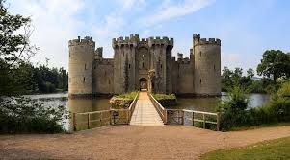
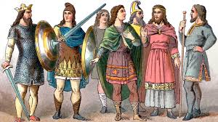



English and Reading
English lessons will be focus on the book Pip and Egg. We will be using the pictures and narrative from the vehicle text to help us to write our own narratives and setting description.
In Reading Response, we will explore vocabulary and practise the skills of inference, explaining, summarising, retrieving information and making predictions. We will also focus on improving our handwriting to ensure our reading is legible by others without our help.
Maths
This half term in maths, we will develop our understanding of place value, represent, order and partition numbers to 100 and 1,000. We will also practise fractions this half term looking at unit and non -unit fractions and making comparisons. We revise and strengthen our basic number knowledge, practising times tables. TT Rockstars and Hit the Button are brilliant online resources to support with this at home.
PSHE
Our PSHE topic for this half term is keeping safe.
We will be looking at cyber bullying, fake emails, AI, and making good choices.
Grammar
We will focus on formation of nouns, learning about word families. We will also use a range of conjunctions to express time, place and cause, e.g. ‘when’, ‘before’, ‘so’, because’, etc. We will build on our use of punctuation, such as capital letters, full stops, question
marks, exclamation
marks and
apostrophes for
contractions.
\
Year 3 Curriculum Overview –
Spring 2
Topic – Anglo Saxons
ART/DT
Castles- In DT we will be designing and planning a castle, after looking at different examples identifying and discussing the features that they need.
We will be looking at shape, nets and joining methods to construct a strong and stable structure.
Humanities: History
Anglo Saxons
Looking at the chronology of mankind from the Anglo Saxons to today, putting it in context of a historical times line. . We will also learn about what changed in Britian after the Anglo Saxons and suggest reasons for their invasion. We will look at their settlments, looking at artifacts and daily life.
Science
PE
Our PE topic for this half term is Netball. We will be developing the skills of controlling the ball, dribbling , positioning ourselves and passing the ball to teammates.
Please ensure that full PE kit is in school on both Mondays and Wednesdays.
Children will need: shorts, tracksuit bottoms and tracksuit top (all plain black or navy), plain white t-shirt and trainers.
Our Science topic for this half term is forces. They will learn about push, pull twists and magnatism.
We will also have science week in which we will learn about a scientist and perform some fun experiments to gain on hands on experiencece .
RE
In RE we will be learning about the Islamic faith. We will think about what it means to be Muslim and how Muslim people try to live. We will also learn about the 5 pillars of Islam and about The Quaran.

