Slide 1


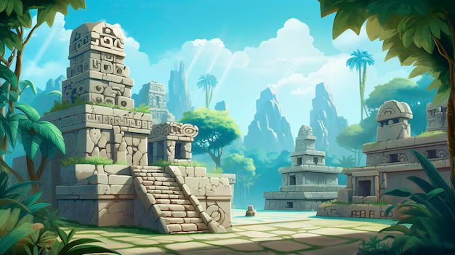



English and Reading
In English lessons we will be focussing on the story of The Lost Happy Endings. Children will develop their writing by focusing on using expanded noun phrases, fronted adverbials and direct speech to write a twisted narrative. Our reading is focusing on ‘The Snow Queen’ where children will learn a variety of reading skills linked to VIPERS.
Maths
During maths lessons this half term, we will be focussing on length and perimeter and we will start to explore fractions towards the end of the term. We will be spending extra time daily focusing on multiplication and division to prepare the children for the multiplication tables check (MTC).
This will be taken by all Year 4 children across the country in June 2025.
PSHE
Our PSHE topic
for this half term
is ‘Citizenship’. We will explore human rights and why these are important. We will also explore the range of groups that exist in the wider community and how these groups can focus on different areas of interest and the importance of local councillors.
Grammar
Grammar will be focusing on expanded noun phrases and the appropriate use of pronouns to aid cohesions. We will also explore the grammatical difference between plural and possessive –s.
We will also use inverted commas to punctuate direct speech.
Year 4 Curriculum Overview – Spring 2
Topic – Ancient Mayans
ART/DT
In ART, we will be working on the topic of Painting and Mixed Media: Light and Dark’. We will learn the difference between a tint and a shade and make our painting using these.
History
In History, we will be looking at ‘Ancient Mayans’. First, we will look at the importance of the rainforests and their beliefs. Next, we will name the features of the Ancient Maya cities and evaluate the reasons for the decline of the Maya civilisation.
In Science, we will be looking at Sounds and Vibrations. We will describe how sounds are made and heard through different mediums. We will explain the relationship between vibration strength and volume and volume and distance. Finally, we will explain the use of insulating materials.
RE
In RE, we will be exploring Sikhism. We will be learning about who Gurus are and how or why the lives of the Gurus have and continue to inspire Sikh believers.
PE
In PE this term, children will be developing their skills in dance, looking at creating new ways to move to music and using the stimulus to create new gestures.
Pleasure ensure that full PE kit is in school on both Tuesdays and Fridays.

