Slide 1

Key Stage 4
Guided Choices
Year 9 into 10
Subject: GCSE Art
Team Leader: Maria Fletcher
Notes:
**** See notes underneath each slide ****

Slide 2
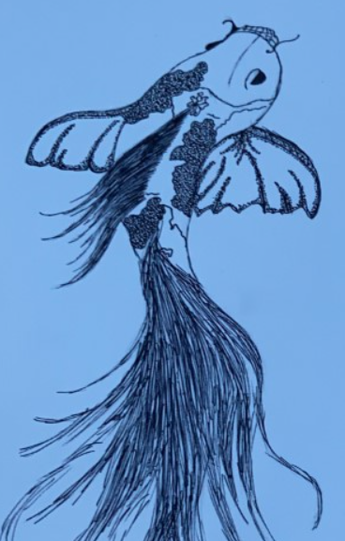
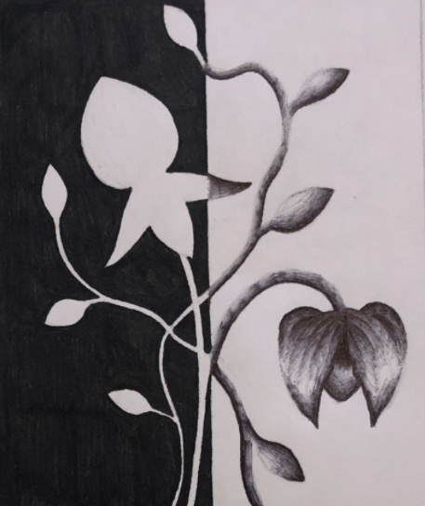
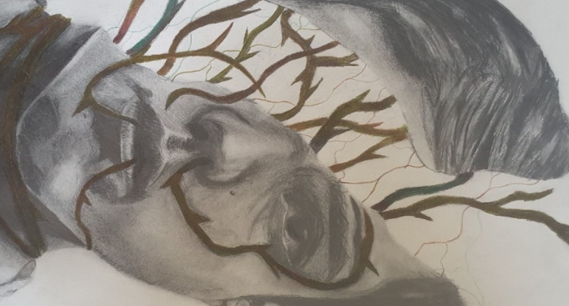
Course Topics
Year 10 | Year 11
What skills will I learn? Skills and techniques for a range of media Artist analysis and evaluation skills Recording and presentation skills How to create personal and meaningful responses which link to artists which have inspired you Which themes will we study? Natural Forms Reflections Introduction to ‘Fragments’ | Coursework and exam portfolios 'Fragments' theme Exam board theme
Notes:
Curriculum changed for Sept 2014 and again for Sept 2017; might have older brothers/sisters who have done a different model

Slide 3
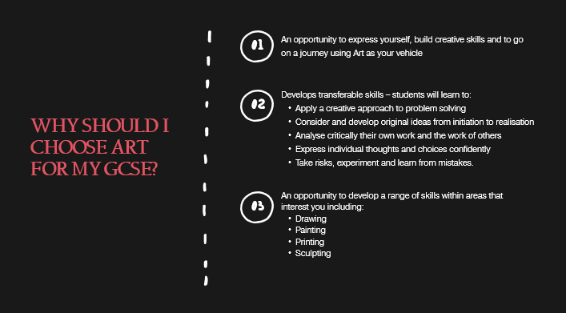
Which skills does the course require?

Slide 4
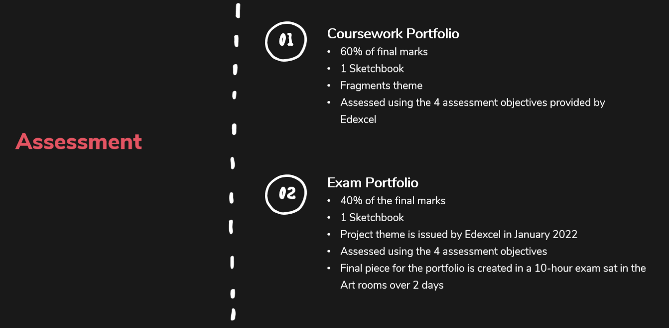
How is the course assessed?
Notes:
In addition …
More detail on all these later

Slide 5
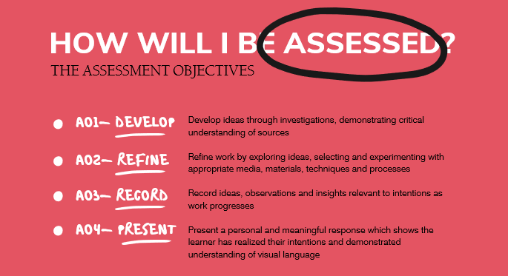
How is the course assessed?
Notes:
In addition …
More detail on all these later

Slide 6
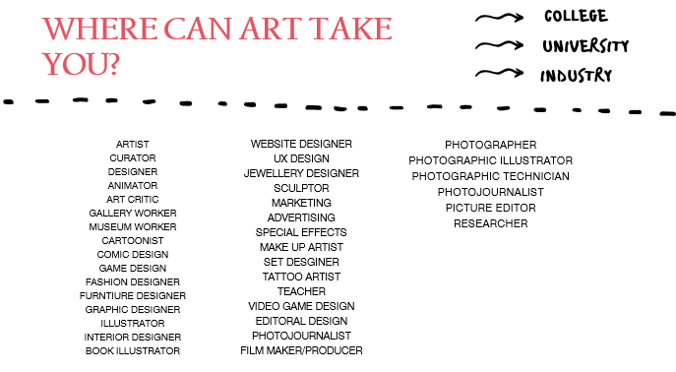
Careers Links

Slide 7
Frequently Asked Questions (FAQs)
  Do I need all my own materials?
  No, we ask for a small contribution to materials, but this covers all materials and sketchbooks.
  2. Do I need to be able to paint?
  Not necessarily, although this is Art and we will explore the medium of paint you do not have to use it within your portfolios if this is not your preferred way of working, we will guide you to use the media which gives you the best grades.
  3. Because it is Art does that mean there is no writing?
  We do have to follow the annotation guidance by the exam board which asks for students to evaluate their work, annotate studies and analyse contextual sources/artists.
Notes:
You will see that a grade 5 is higher than a grade C – we will be raising our expectations and efforts to meet this new higher standard

Slide 8
Views From Current Students
GCSE art was my favourite subject out of all 10 that I took. Not only because I love Art, but because of the other benefits I feel I gained from taking it as a subject. It taught me transferable skills such as patience, attention to detail, meeting deadlines, time management, analytical skills, and the ability to be critical of my work in a way that helps me improve. These skills are also very helpful to have gained in preparation for A Levels, University and any further education. It's also important to mention how art was an amazing outlet for me during the stress of GCSE's as it was a time every week I could focus on my artwork and forget about any other stress. Notably, this doesn't mean art was an easy subject or that it should be viewed as an easy pass, it required a lot of time, effort, self-determination, and motivation to get the work done and achieve the best grade I could. Overall, I believe art was the best decision I made at GCSE, so much so I am now studying it for A Level, which I never would have thought I would, but that is a result of how great the Art department is and how beneficial the support teachers gave me was. I always felt cared for and that the teachers were always there for me.
'I’ve really enjoyed art GCSE. It’s my favourite subject and gives me a chance to be independent and creative. My favourite section we have done is definitely our own topics as I feel it has allowed me to be myself and gives you a chance to have a say in your work , compared to other subjects in school. It’s also really rewarding once you have done a good piece , makes you feel proud of yourself!'
Notes:
Career ? A Levels ?
But we know that this isn’t always possible at this stage and is subject to (many !!) changes
We will guide students to keeping the overall package ‘broad and balanced’ … thus ensuring no doors are closed later in life

Slide 9
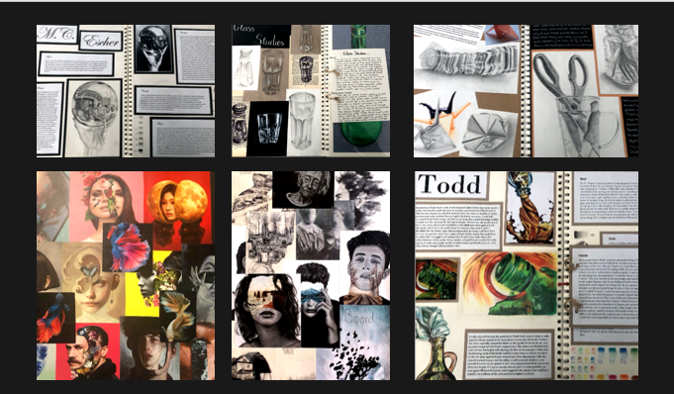
Student work

Slide 10
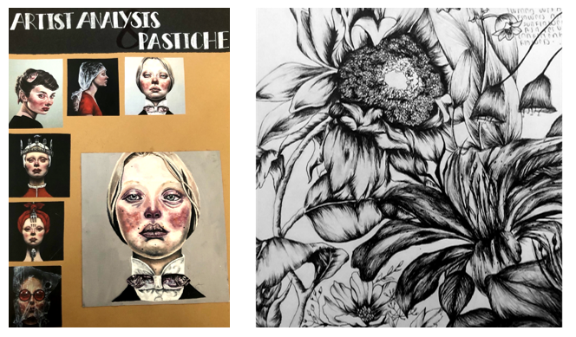
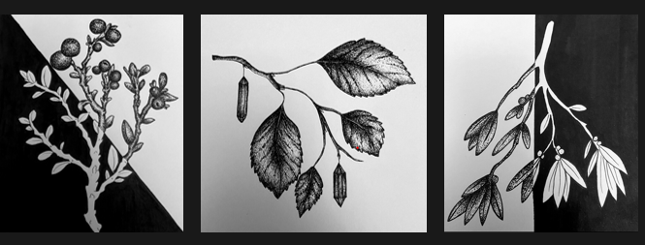
Student work

Slide 11
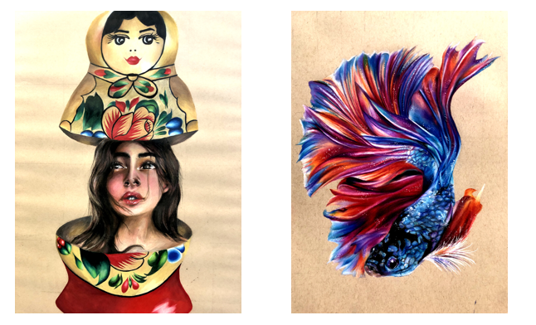
Student work

Slide 12
Contact Details For Further Questions…
mfletcher@tscacademy.org.uk
Notes:
Reinforce choices returns deadline

