Slide 1
Key Stage 4
Guided Choices
Year 9 into 10
Subject: GCSE Business
Team Leader: Rebecca Jephson
Notes:
**** See notes underneath each slide ****

Slide 2

Course Topics
Notes:
Curriculum changed for Sept 2014 and again for Sept 2017; might have older brothers/sisters who have done a different model

Slide 3
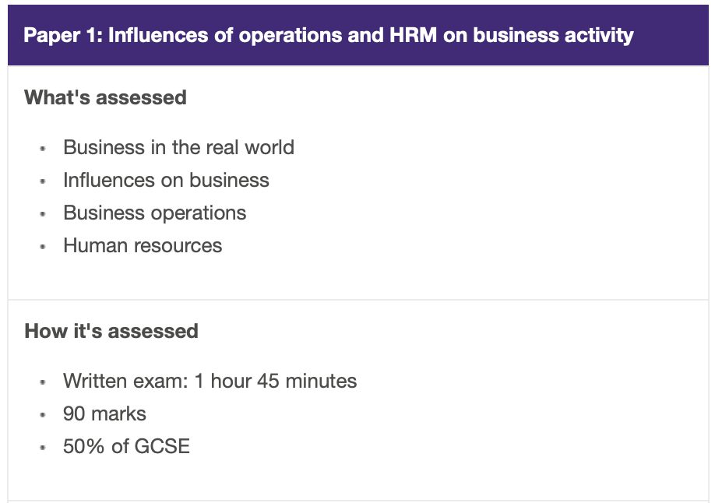
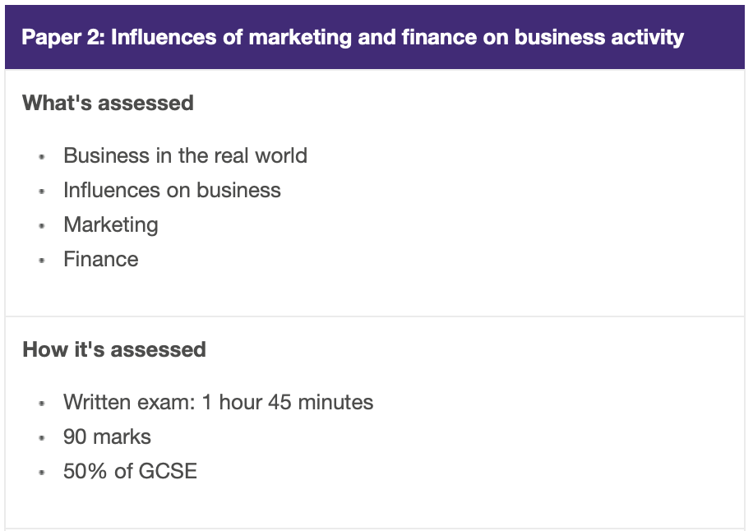
How is the course assessed?
Notes:
In addition …
More detail on all these later

Slide 4
Frequently Asked Questions (FAQs)
Is Business difficult?
  The most difficult thing about Business is learning the terminology. Businesses tend to use words that we don’t hear in day-to-day life. Once you have grasped the business language it is simple from there.
If I’m not very good at English, will I struggle?
  You will have to write answers to questions up to 12 marks which means writing in paragraphs and explaining your point. You will get a lot of help with how to structure these answers.
If I’m not very good at Maths, will I struggle?
  You will have to do calculations in Business, but the actual Maths required is simple. If you can add, subtract, divide, multiply and interpret a graph you will be fine.
Notes:
You will see that a grade 5 is higher than a grade C – we will be raising our expectations and efforts to meet this new higher standard

Slide 5

Views From Current Students
I’m going to university to study Business and Finance next year
Business is my favourite subject
I want to own my own business
I know loads more about managing money
I like learning about real businesses like ASOS
Marketing is the most fun part
Notes:
Career ? A Levels ?
But we know that this isn’t always possible at this stage and is subject to (many !!) changes
We will guide students to keeping the overall package ‘broad and balanced’ … thus ensuring no doors are closed later in life

Slide 6

What are my favourite parts of the course?
The best thing about Business is that there is something for everyone!
Some students enjoy Maths and get on well with the Finance topic, others are really good at arguing their opinion so they enjoy the decision making questions, some students enjoy the branding and social media part of the Marketing topic.
Because we study all parts of running a business, everyone has chance to find out what they are really good at.
Notes:
Potential importance of full EBacc (and Language in particular) for University applications
Science could be Double/Combined Science or 2/3 from Ph, Chem, Biol, Computer Sc
All students will choose AT LEAST one of Hist/Geog or MFL or Computer Science in their Y9/10/11 Guided Pathways – this helps keep it ‘broad and balanced’
Emphasise difference between achieving the FULL EBacc (grades 5+ in all the subjects) and the requirement for all students to choose at least one EBacc subject
Students will be guided down this pathway if we believe it is appropriate for them; all students can access this pathway and study for the full EBacc
Not just about the full EBacc – these subjects individually are known as the facilitating subjects as they are good subjects that are valued in the world beyond year 11

Slide 7
Contact Details For Further Questions…
rjephson@tscacademy.org.uk
Notes:
Reinforce choices returns deadline

