Slide 1
Key Stage 4
Guided Choices
Year 9 into 10
Subject: Computer Science
Team Leader: Mr Walsh
Notes:
**** See notes underneath each slide ****

Slide 2
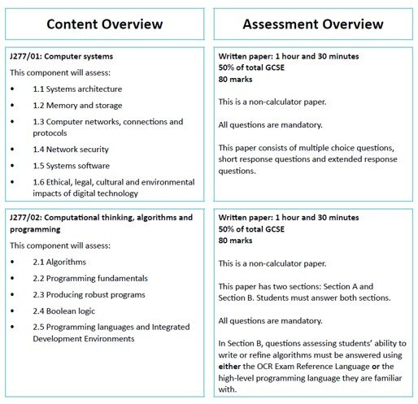
Course Topics
Notes:
Curriculum changed for Sept 2014 and again for Sept 2017; might have older brothers/sisters who have done a different model

Slide 3
Which skills does the course require?
The course requires students to have an interest in technology, be logical, methodical and enjoy problem solving.
It would also be advantageous interested in a career in engineering, computing or related technical areas.

Slide 4
How is the course assessed?
2 Exam Papers
1hr 30min each
80 Marks per paper
50/50% weighting of exams
Notes:
In addition …
More detail on all these later

Slide 5
Careers Links
This course will enable students to proceed to qualifications at Level 3 and potentially Higher Education.
These include A-Level Computing, along with many different careers, including App development, programming, cyber security, games programming, web development and network management.

Slide 6
Frequently Asked Questions (FAQs)
What programming language will I learn? Python
Will I be playing games? No, you learn how to make them.
My child is good on computers? You don’t have to be good on computers to be good at computer science.
Do I have to be good at programming? Not necessary the course is not 100% coding, you just have to learn how to understand it.
Notes:
You will see that a grade 5 is higher than a grade C – we will be raising our expectations and efforts to meet this new higher standard

Slide 7
Views From Current Students
“You learn whilst you are having fun….”
“The lessons are really enjoyable but challenging.”
“You learn about how computers work”
“Computer Science has helped me in all my academic lessons”
Notes:
Career ? A Levels ?
But we know that this isn’t always possible at this stage and is subject to (many !!) changes
We will guide students to keeping the overall package ‘broad and balanced’ … thus ensuring no doors are closed later in life

Slide 8
What are my favourite parts of the course?
Computer Science is a Science!
It will go towards your EBacc
You will get to learn another language
It helps you think differently
It increases your self-resilience
It prepares you for the world you live in.
Notes:
Potential importance of full EBacc (and Language in particular) for University applications
Science could be Double/Combined Science or 2/3 from Ph, Chem, Biol, Computer Sc
All students will choose AT LEAST one of Hist/Geog or MFL or Computer Science in their Y9/10/11 Guided Pathways – this helps keep it ‘broad and balanced’
Emphasise difference between achieving the FULL EBacc (grades 5+ in all the subjects) and the requirement for all students to choose at least one EBacc subject
Students will be guided down this pathway if we believe it is appropriate for them; all students can access this pathway and study for the full EBacc
Not just about the full EBacc – these subjects individually are known as the facilitating subjects as they are good subjects that are valued in the world beyond year 11

Slide 9
Final Comments
Computer Science is a challenging but a rewarding GCSE.
It allows you to obtain the necessary skills to progress in all your other studies.

Slide 10
Contact Details For Further Questions…
jwalsh@tscacademy.org.uk
Notes:
Reinforce choices returns deadline

