Slide 1
Key Stage 4
Guided Choices
Year 9 into 10
Subject: Design Technology
Team Leader: James Wilson
Notes:
**** See notes underneath each slide ****

Slide 2
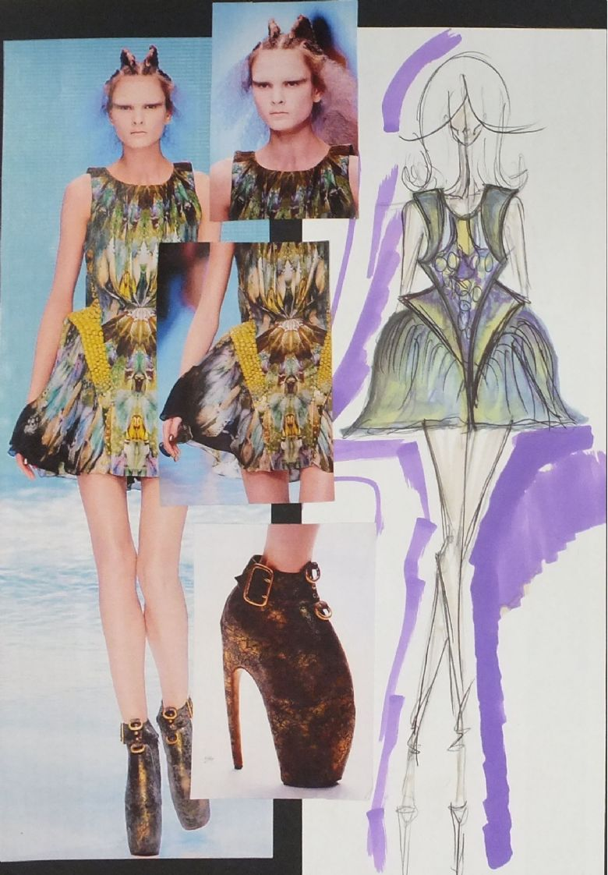
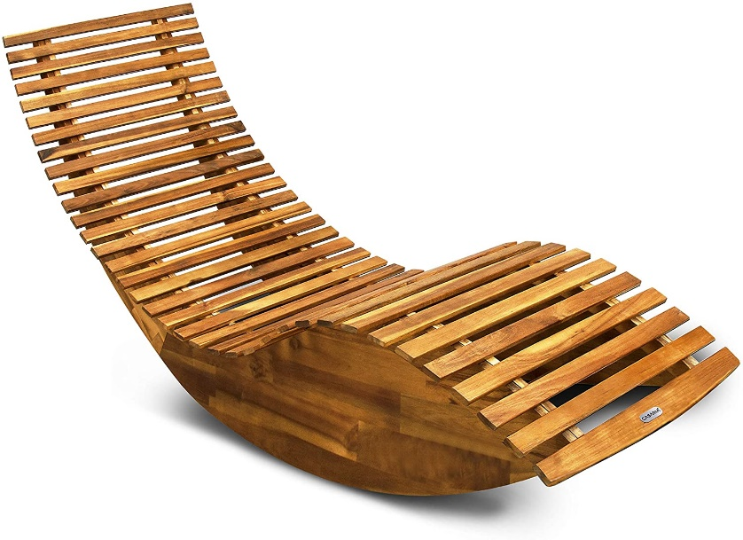

Course Topics
Design Technology
Specialising in -
Timbers
Systems
Textiles
Notes:
Curriculum changed for Sept 2014 and again for Sept 2017; might have older brothers/sisters who have done a different model

Slide 3
Which skills does the course require?
Are you creative?
Enjoys making things?
Able to spot a problem and help solve it?
Do you enjoy learning new skills?
Does new technology fascinate you?

Slide 4
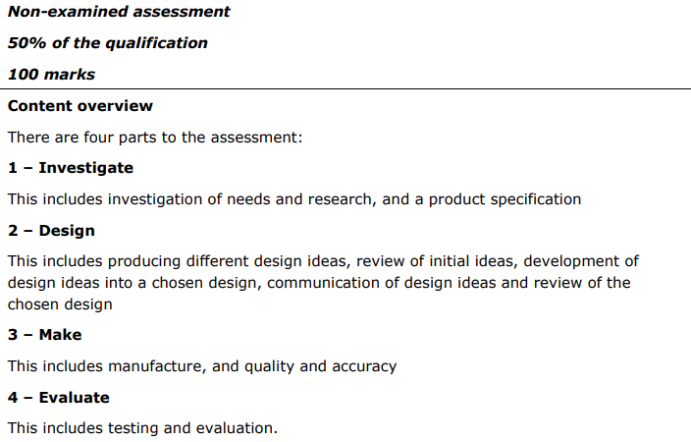
How is the course assessed?
50% of your DT GCSE is NEA
This means coursework and a practically made prototype that you have designed and made.
Notes:
In addition …
More detail on all these later

Slide 5

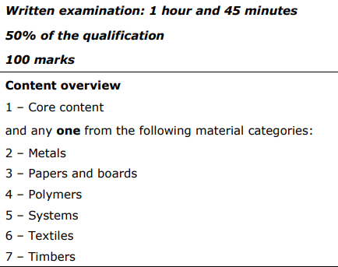
50% Exam
Your exam will be based on your specialist subject

Slide 6
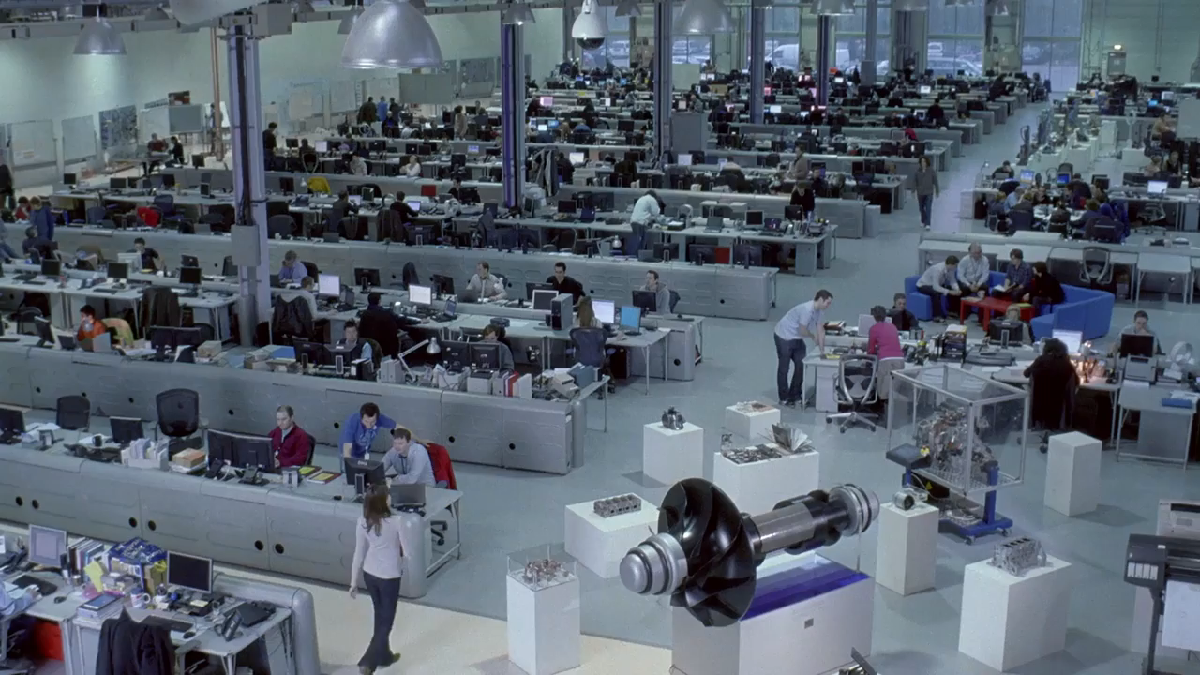
Careers Links

Slide 7
Frequently Asked Questions (FAQs)
Do you just get to make things? – No.
Design Technology covers a range of design skills including research, design drawings, modelling and development - before making a final prototype.
Is there an exam? Yes.
This will make up 50% of your final GCSE Grade but the other 50% comes from your final year design and make task done in school.
Notes:
You will see that a grade 5 is higher than a grade C – we will be raising our expectations and efforts to meet this new higher standard

Slide 8
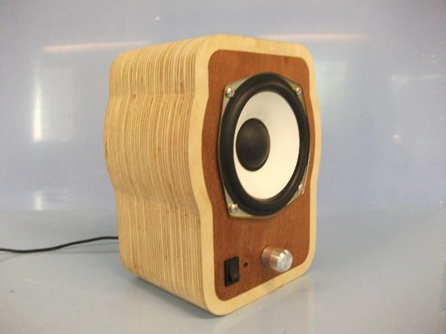
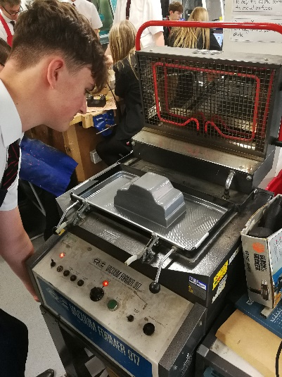
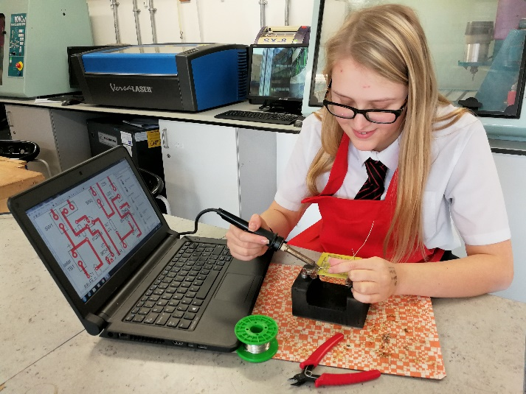
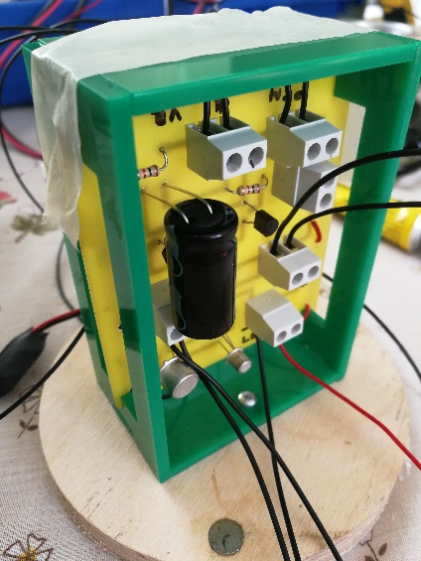
Views From Current Students
Making something which looked like it could be sold in a shop or online.
DT gave me the chance to study electronics further.
I enjoyed being able make things and use the machines to build my design.
Doing something different from my other studies.
Notes:
Career ? A Levels ?
But we know that this isn’t always possible at this stage and is subject to (many !!) changes
We will guide students to keeping the overall package ‘broad and balanced’ … thus ensuring no doors are closed later in life

Slide 9
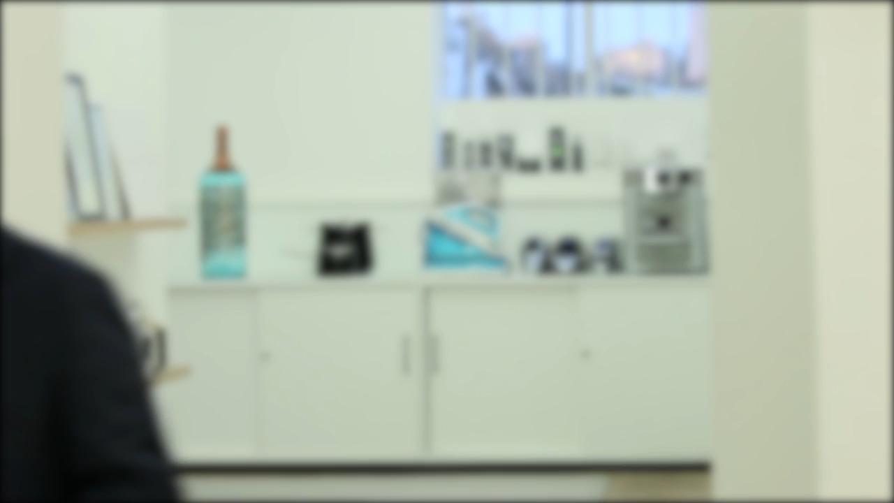
Notes:
Potential importance of full EBacc (and Language in particular) for University applications
Science could be Double/Combined Science or 2/3 from Ph, Chem, Biol, Computer Sc
All students will choose AT LEAST one of Hist/Geog or MFL or Computer Science in their Y9/10/11 Guided Pathways – this helps keep it ‘broad and balanced’
Emphasise difference between achieving the FULL EBacc (grades 5+ in all the subjects) and the requirement for all students to choose at least one EBacc subject
Students will be guided down this pathway if we believe it is appropriate for them; all students can access this pathway and study for the full EBacc
Not just about the full EBacc – these subjects individually are known as the facilitating subjects as they are good subjects that are valued in the world beyond year 11

Slide 10
Contact Details For Further Questions…
jwilson@tscacademy.org.uk
Notes:
Reinforce choices returns deadline

