Slide 1
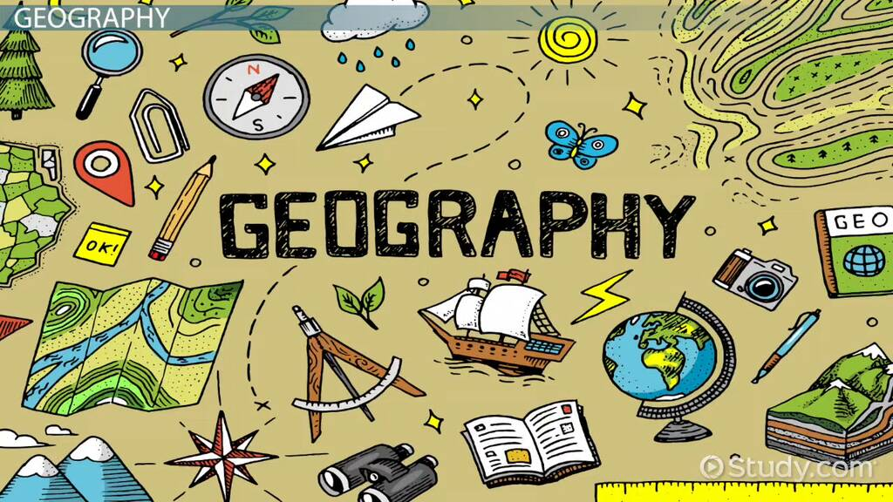

Key Stage 4
Guided Choices
Year 9 into 10
Subject: Geography
Team Leader: Mr S Allott
Notes:
**** See notes underneath each slide ****

Slide 2
Course Topics
Physical Geography: Living with the Physical Environment
1. The challenge of natural hazards. Students will look at tectonic hazards (Earthquakes), Atmospheric Hazards (Hurricanes) and Climate Change. Students will look at the causes, impacts and management of these different hazards.
2. The Living World. Students will look at what we mean by ecosystems and biomes and where they are found around the world. Students will study in detail the Tropical Rainforests and Cold Environments. Students will look at the characteristics of these areas, the climate, the plants and animals living there. Students will look at how people are using these areas and the impacts of this and think about how we can manage these areas.
3. Physical Landscapes in the UK. Students will look at the coastal and river environments found in the UK. Students will look at the processes that happen in these environments and the landforms that these processes form. Students will look at human interactions in these areas and the impact of this, for example flooding and coastal erosion. Students will finish by looking at human management in these areas.
Notes:
Curriculum changed for Sept 2014 and again for Sept 2017; might have older brothers/sisters who have done a different model

Slide 3
Course Topics
Human Geography: Challenges in the Human Environment
1. Urban issues and challenges. Students will look at why people are living in urban areas and how this varies around the world. Students will look at the challenges caused by growing urban populations and how this can be managed.
2. The changing economic world. Students will look at what we mean by development and investigate the development in Nigeria and the UK. Students will think about why development levels vary and what can be done to improve and address this.
3. The challenge of resource management. Students will look at food, water and energy. Students will think about how the demand for these resources has changed and the impact that this is having. Students will explore the solutions to some of these challenges and impacts.
Notes:
Curriculum changed for Sept 2014 and again for Sept 2017; might have older brothers/sisters who have done a different model

Slide 4
Course Topics
Students will complete two days of fieldwork. One day will be looking at an aspect of physical geography and the second day will be looking at an aspect of human geography.
Students will complete a full investigation where they plan their fieldwork, collect their data, present this in the form of graphs and then analyse these.
Students will evaluate their investigations and think of possible improvements.
Notes:
Curriculum changed for Sept 2014 and again for Sept 2017; might have older brothers/sisters who have done a different model

Slide 5
How is the course assessed?
Students will follow the GCSE AQA specification.
The course will be assessed through 3 exams completed at the end of Year 11.
Paper 1 (Physical Geography) which is a 1 hour 30-minute exam worth 35% of the course.
Paper 2 (Human Geography) which is a 1 hour 30-minute exam worth 35% of the course.
Paper 3 (Pre-release material/Issue evaluation, fieldwork and geographical skills) which is a 1-hour exam worth 30% of the course.
Notes:
In addition …
More detail on all these later

Slide 6
Which skills does the course require?
Critical thinking- thinking about issues and how they impact people, places and the environment.
Numeracy- analysing and discussing data.
Map analysis- analysing and discussing maps.
Formulating arguments- using information to discuss both sides of an issue and form your own conclusions.

Slide 7
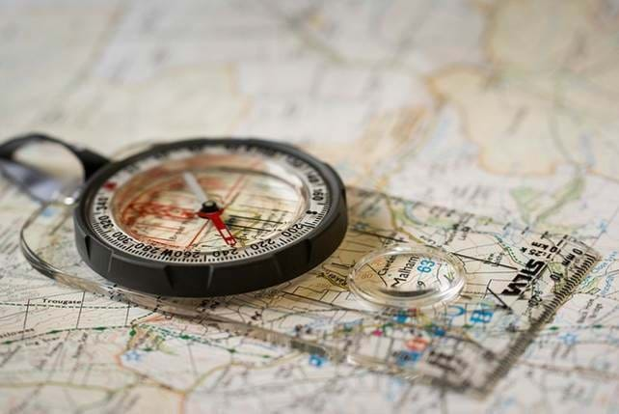

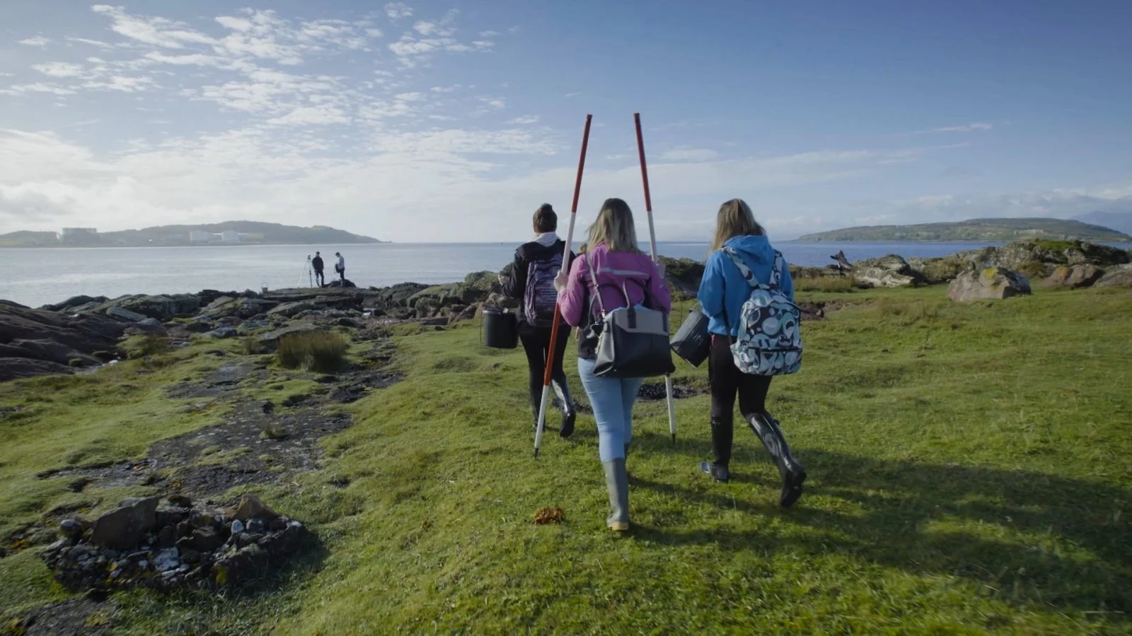
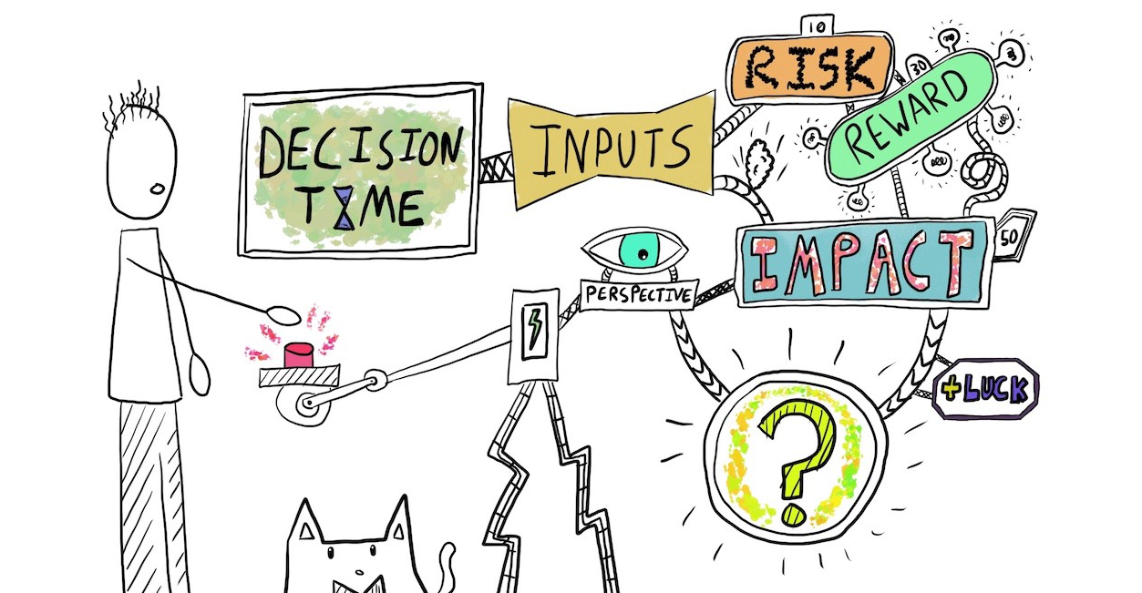

Which skills does the course require?
.
Studying Geography helps you develop a wide range of skills which are useful beyond the classroom.
Mapping
Graphs
Fieldwork
Data analysis
Analytical thinking

Slide 8
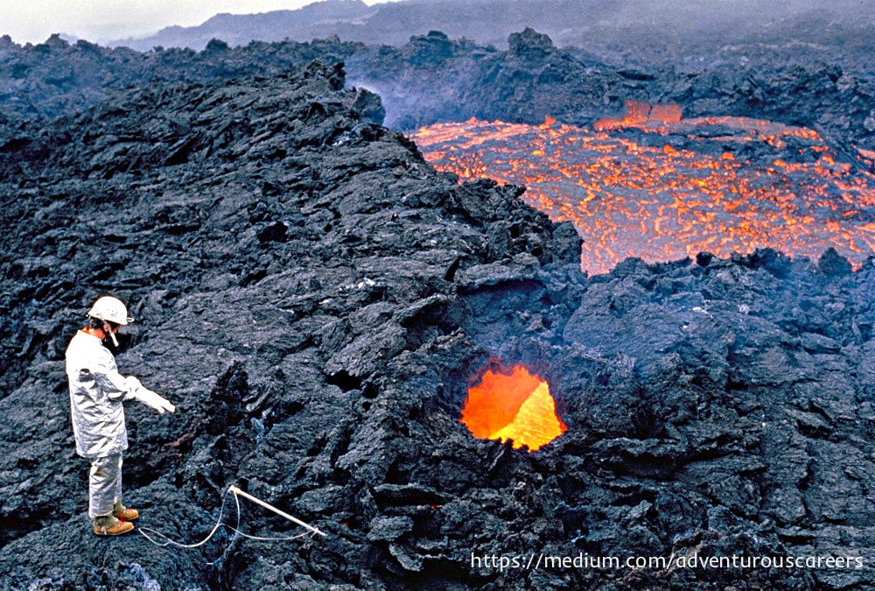

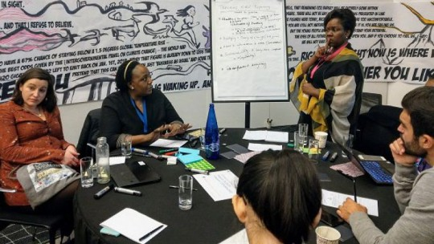
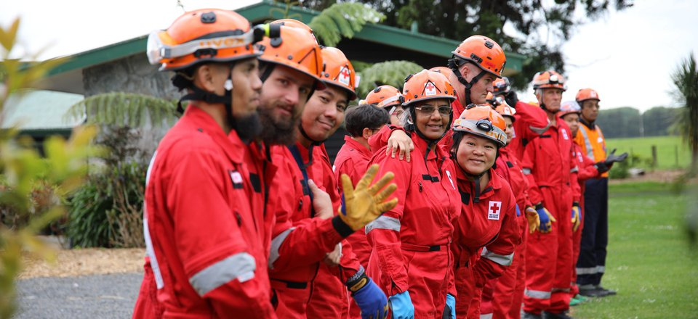
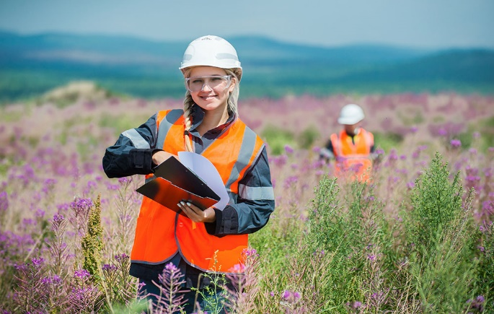

Careers Links
Volcanologist
Geographers are very employable, with the skills, knowledge and understanding gained during a geography qualification held in high regard by employers. Studying Geography opens up a wide range of job opportunities, and if your career path is to be varied, you will need transferable skills and flexibility. Geography provides you with these.
Urban planner
International development
Disaster response
Renewables
Conservationist

Slide 9
Careers Links​
The army value geography for its critical thinking skills, and use of maps and data.
Logistics- planning routes that goods and lorries take.
Renewable energies and climate scientists will be important jobs in your life time due to climate change.
Emergency manager specialists- to run the emergency services during disasters such as flooding and earthquakes needs you to be a critical thinker who can use information and maps well.

Slide 10
Views From Current Students
Geography has taught me life skills, such as how to be more sustainable, which is very important in today’s world as climate change is happening very rapidly.
I took GCSE geography because it is a very enjoyable subject where you learn about the world around you and how everything in the natural world works alongside one another.
You begin to see connections with everything you see around you.
Both human and physical aspects of geography have difficult topics, but the subject is so captivating that you quickly grasp them.
Studying GCSE geography is a great experience because having learnt about the natural world I can now see these things happening around me and I know how it works and why it is important.
Notes:
Career ? A Levels ?
But we know that this isn’t always possible at this stage and is subject to (many !!) changes
We will guide students to keeping the overall package ‘broad and balanced’ … thus ensuring no doors are closed later in life

Slide 11
Views From Current Students
Lessons were fun and engaging.
I have learnt quite a few good life skills through this course such as map reading and how to prepare for natural hazards (if you are ever unfortunately in one).
Geography is key to a lot of jobs in the current world.
I took geography because it’s the best subject, better than history😏 it’s an all round good subject to take.
It gives you a greater understanding of the world and how it works and helps comparing different places compared to the UK.
Studying geography at GCSE has been enjoyable for me because I’ve never had a boring lesson in geography due to the variety of different topics you learn.
Notes:
Career ? A Levels ?
But we know that this isn’t always possible at this stage and is subject to (many !!) changes
We will guide students to keeping the overall package ‘broad and balanced’ … thus ensuring no doors are closed later in life

Slide 12
Views From Students
I’ve also learnt how problems in the world are caused, and what can be done to solve them.
It’s also good because I’ve learnt all about how to be more environmentally friendly.
I went on to study Geography at the University of Nottingham and employers were attracted to the transferable life skills I had developed from GCSE.
Geography helped me make sense of the world around me.
Notes:
Career ? A Levels ?
But we know that this isn’t always possible at this stage and is subject to (many !!) changes
We will guide students to keeping the overall package ‘broad and balanced’ … thus ensuring no doors are closed later in life

Slide 13
What are my favourite parts of the course?
Volcanoes, earthquakes and tropical storms- it is really exciting learning about natural disasters.
Ecosystems- learning about beautiful rainforests and fascinating animals.
Cities- seeing how busy cities across the world have different issues. I would love to visit lots of these places.
Notes:
Potential importance of full EBacc (and Language in particular) for University applications
Science could be Double/Combined Science or 2/3 from Ph, Chem, Biol, Computer Sc
All students will choose AT LEAST one of Hist/Geog or MFL or Computer Science in their Y9/10/11 Guided Pathways – this helps keep it ‘broad and balanced’
Emphasise difference between achieving the FULL EBacc (grades 5+ in all the subjects) and the requirement for all students to choose at least one EBacc subject
Students will be guided down this pathway if we believe it is appropriate for them; all students can access this pathway and study for the full EBacc
Not just about the full EBacc – these subjects individually are known as the facilitating subjects as they are good subjects that are valued in the world beyond year 11

Slide 14
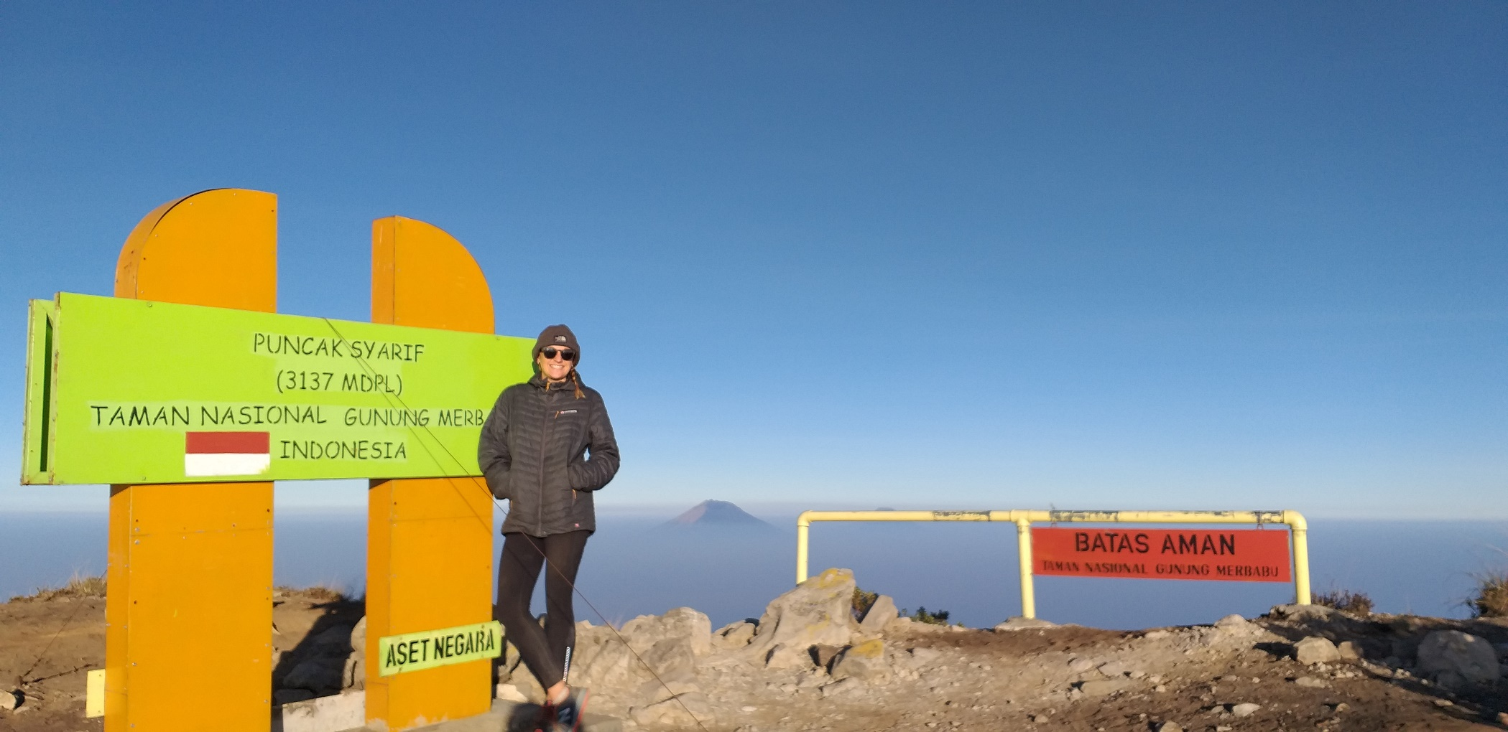
What are my favourite parts
of the course?
“I love both human and physical Geography. In particular, I love teaching and learning about the natural environment, development and what we can do to live in a more equal, sustainable world. Geography makes me want to travel the world, to explore different landscapes and cultures – and helps me understand those places when I’m there”
Notes:
Potential importance of full EBacc (and Language in particular) for University applications
Science could be Double/Combined Science or 2/3 from Ph, Chem, Biol, Computer Sc
All students will choose AT LEAST one of Hist/Geog or MFL or Computer Science in their Y9/10/11 Guided Pathways – this helps keep it ‘broad and balanced’
Emphasise difference between achieving the FULL EBacc (grades 5+ in all the subjects) and the requirement for all students to choose at least one EBacc subject
Students will be guided down this pathway if we believe it is appropriate for them; all students can access this pathway and study for the full EBacc
Not just about the full EBacc – these subjects individually are known as the facilitating subjects as they are good subjects that are valued in the world beyond year 11

Slide 15
Contact Details For Further Questions…
Contact any of the Geography Team in Humanities at the Academy or by email:
Mr S Allott: sallott@tscacademy.org.uk
Mr M Dodson: mdodson@tscacademy.org.uk
Miss K Milne: kmilne@tscacademy.org.uk
Notes:
Reinforce choices returns deadline

