Slide 1
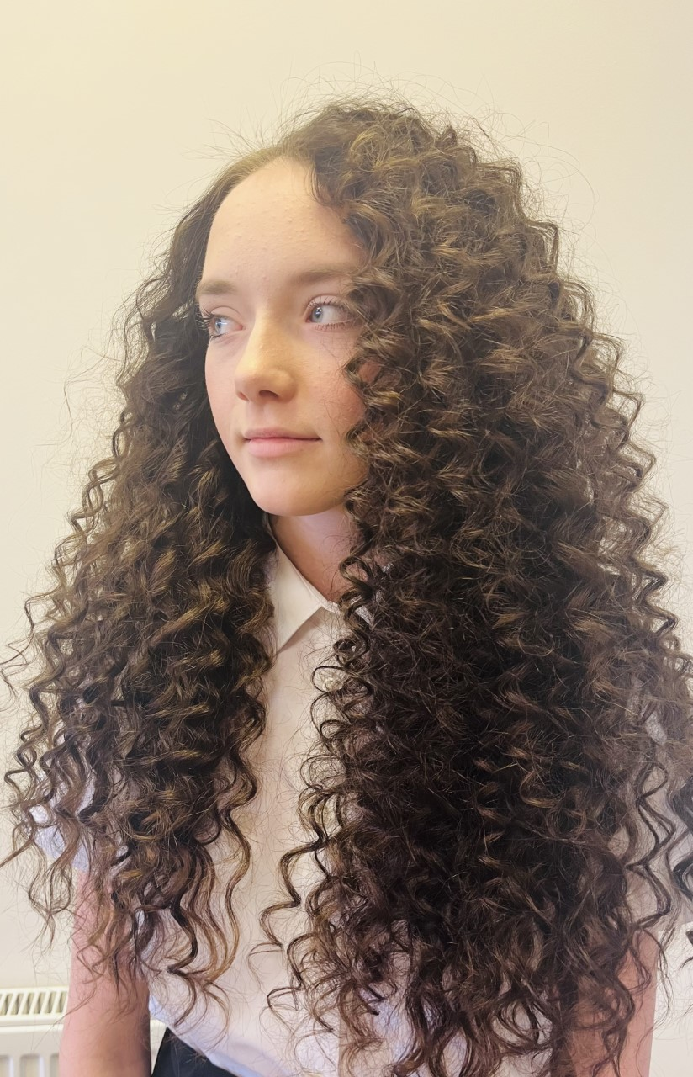
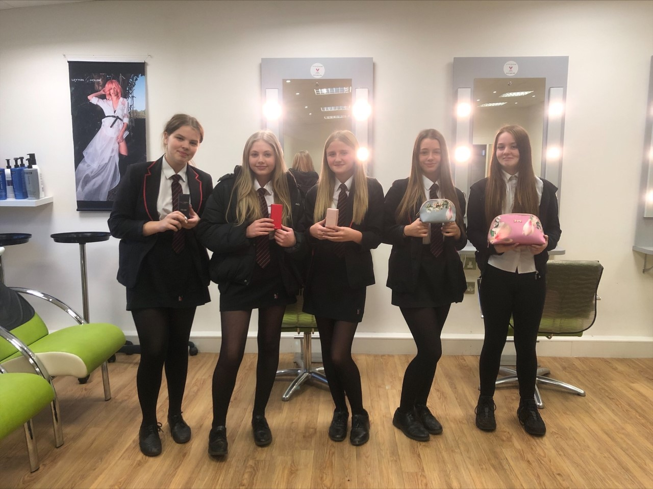

Key Stage 4 Guided Choices
Year 9 into 10
Subject: Hairdressing Lecturer: A Giles
Team Leader: Kirsty Price

Slide 2
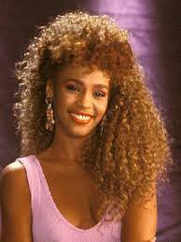
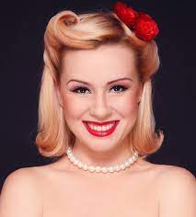
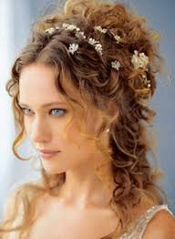
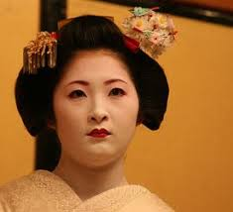
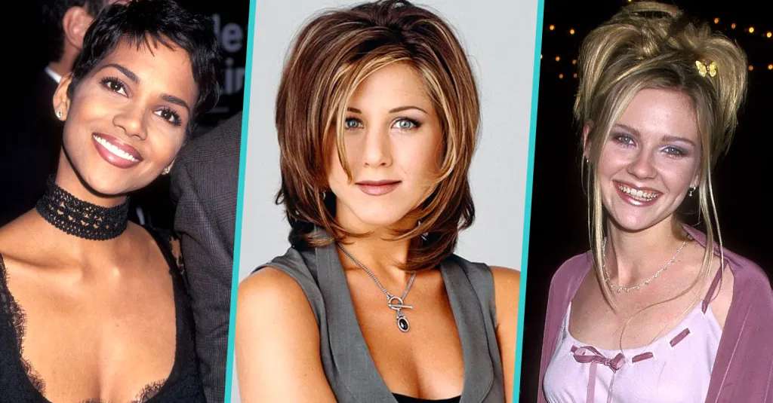

Course Topics
Unit 201
Exploring the world of Hair and Beauty
Unit 202
Science of Hair and Beauty
Unit 203
Design in the Hair and Beauty Sector

Slide 3
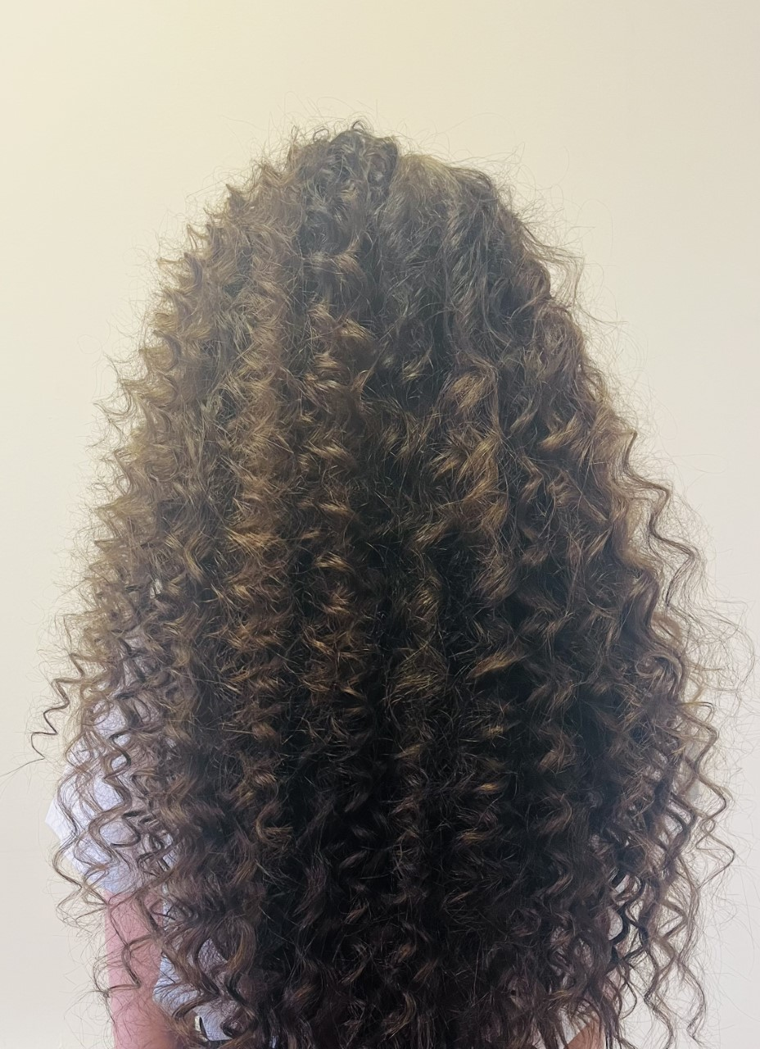
Which skills does the course
require?
Team Work Research
Punctuality Creativity
Commitment Meet deadlines
Passion Stamina
Cleaning Writing / IT Skills

Slide 4

How is the course assessed?
Exam
Synoptic assignment

Slide 5
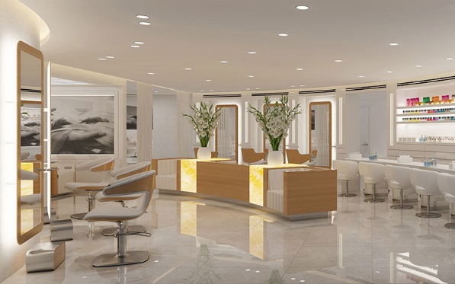
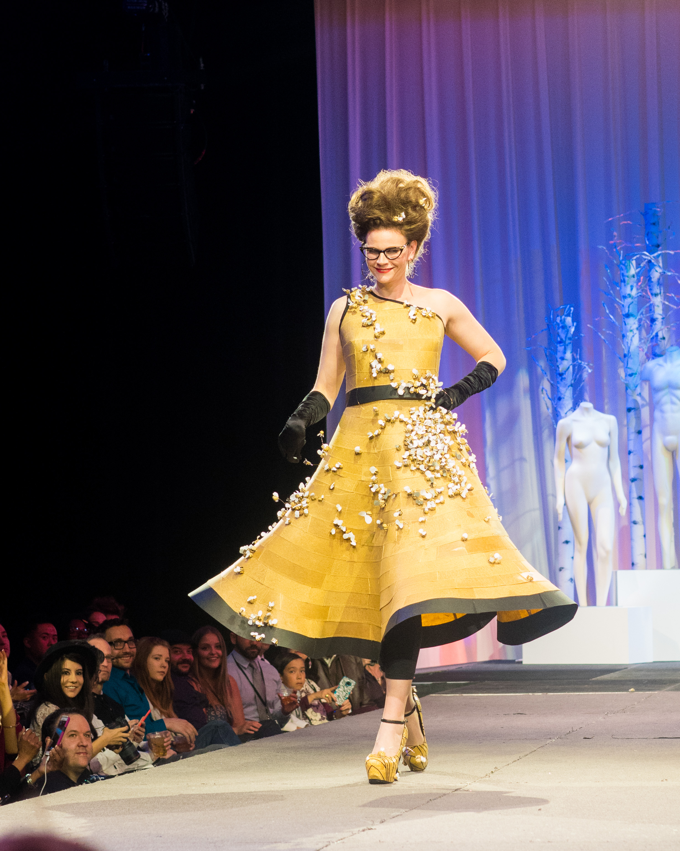
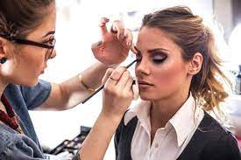

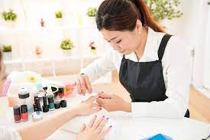

Careers Links
Make-up artist
Be a st Be a stylist or
Own your own salon
Media, fashion and photographic
Working for a Manufacturer
Working on Cruise Liners Nail technician

Slide 6
Frequently Asked Questions (FAQs)
How much of the work is Theory and how much is Practical?
One hour of theory and two hours of practical per week.
Is the job well paid?
Wages are lower initially but there is no limit when qualified.
What is the difference between a Full-time course and an apprenticeship?
A full-time course is where a person works in a training salon and has theory lessons for 3-4 days a week.
An apprenticeship is where a person works in a real salon 4 days per week and goes to College for theory and training 1 day a week.

Slide 7
Views From Current Students
I think that this course is very good because it teaches us stuff about work which is good to know for the future
It can be difficult but enjoyable as well
It is very in depth and you will learn more than you think but it is really fun
The hairdressing course is a good opportunity for people to be creative.

Slide 8
What are my favourite parts of the course?
Learning from a real professional who has done the job
My favourite part is getting to do whatever you like on hair and be creative, and the environment in the salon is more friendly than normal lessons
Learning about new styles and how to get faster and better at doing them
Learning about hairstyles, make-up and nails that are from different era’s. I find this interesting.
My favourite thing
is working
in a real salon

Slide 9
Contact Details For Further Questions…
Mrs Giles
01623 663472
agiles@tscacademy.org.uk

