Slide 1

Key Stage 4
Guided Choices
Year 9 into 10
Subject: GCSE Photography
Team Leader: Laura Jones
Notes:
**** See notes underneath each slide ****

Slide 2
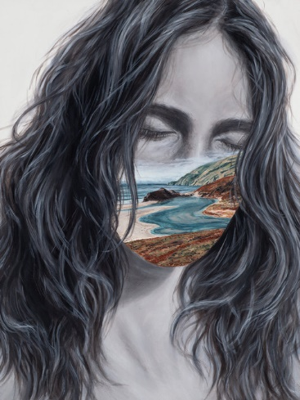
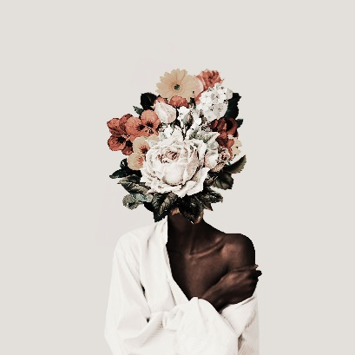
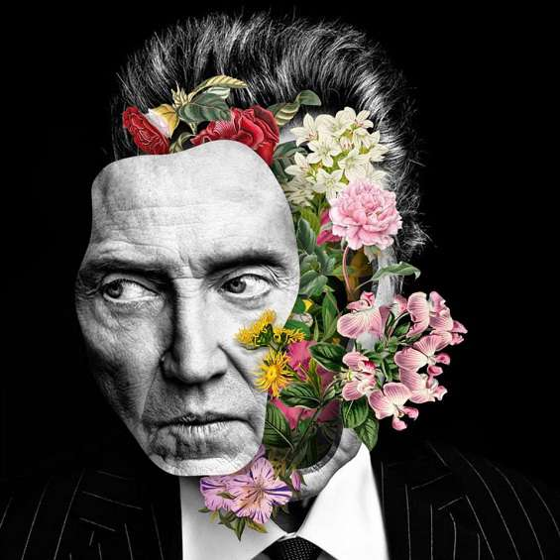
Course Topics
Year 10 | Year 11
What will I do? Range of workshops learning new skills Understand how to analyse sources to inspire your own work Learn how to record and present in your digital workbook Respond to exciting and engaging photographers Project Themes: Formal Elements Natural forms Portraiture - Identity | Year 11 is split into a coursework and exam element You will complete 2 projects Coursework project: 'Fragments' theme Exam Project: Exam board theme
Marcelo Monreal
Beau B Frank
Jeff Manning
Karl Blossfeldt
Notes:
Curriculum changed for Sept 2014 and again for Sept 2017; might have older brothers/sisters who have done a different model

Slide 3
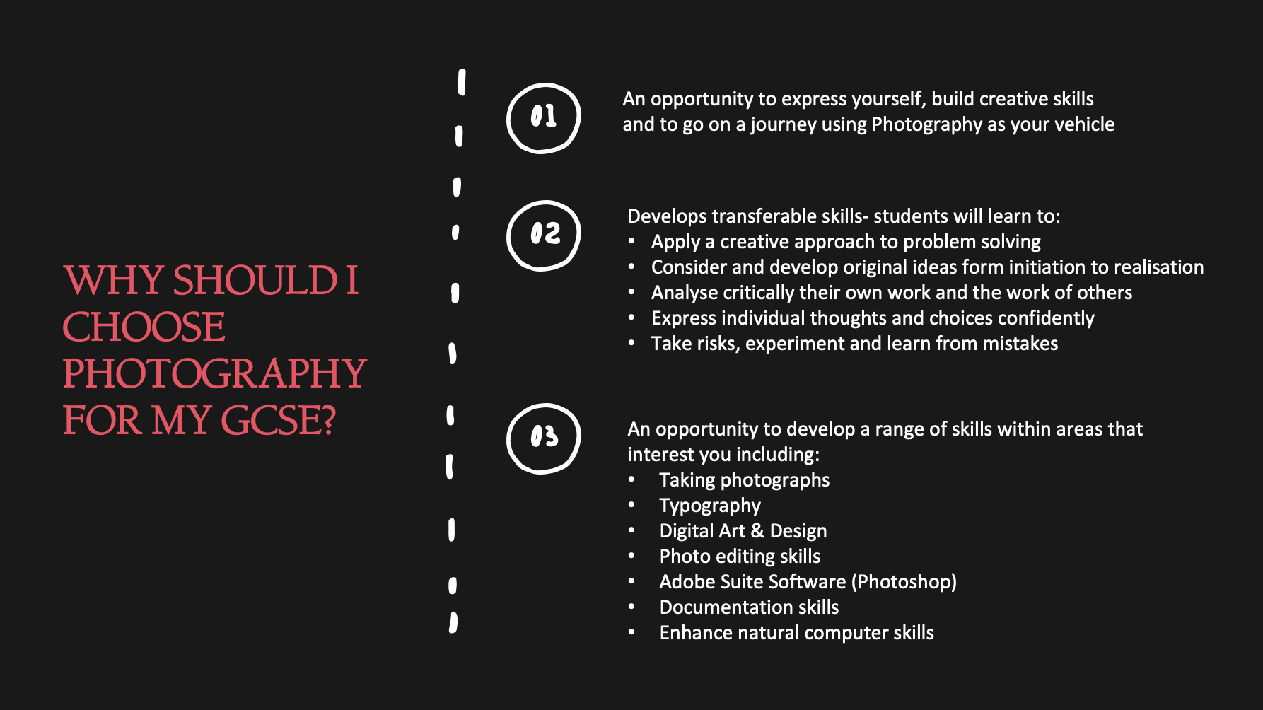
Which skills does the course require?

Slide 4
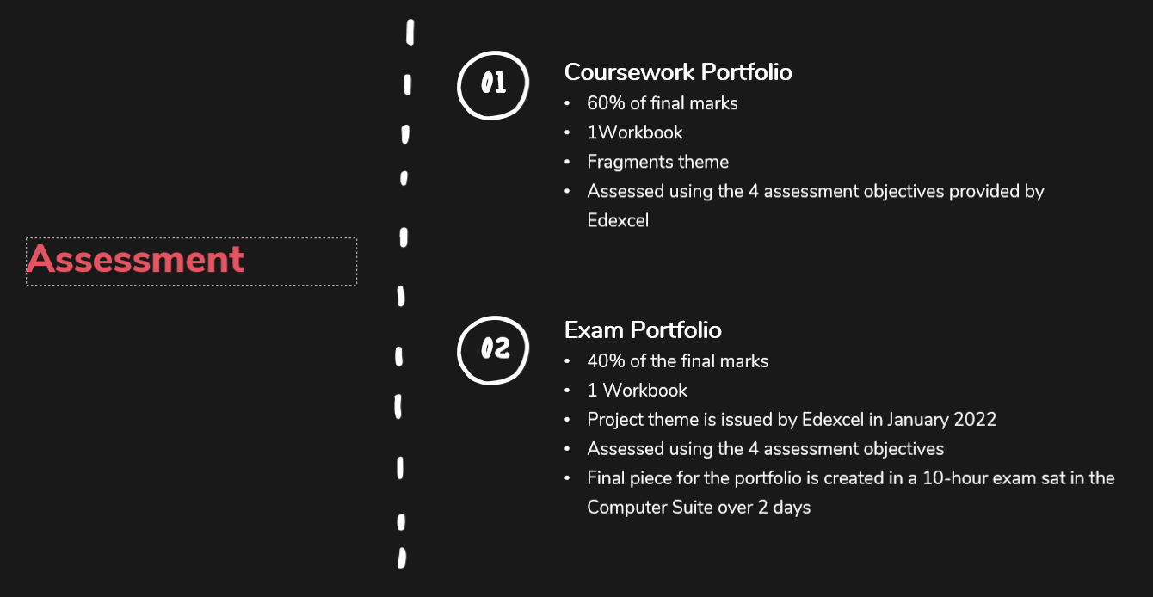
How is the course assessed?
Notes:
In addition …
More detail on all these later

Slide 5
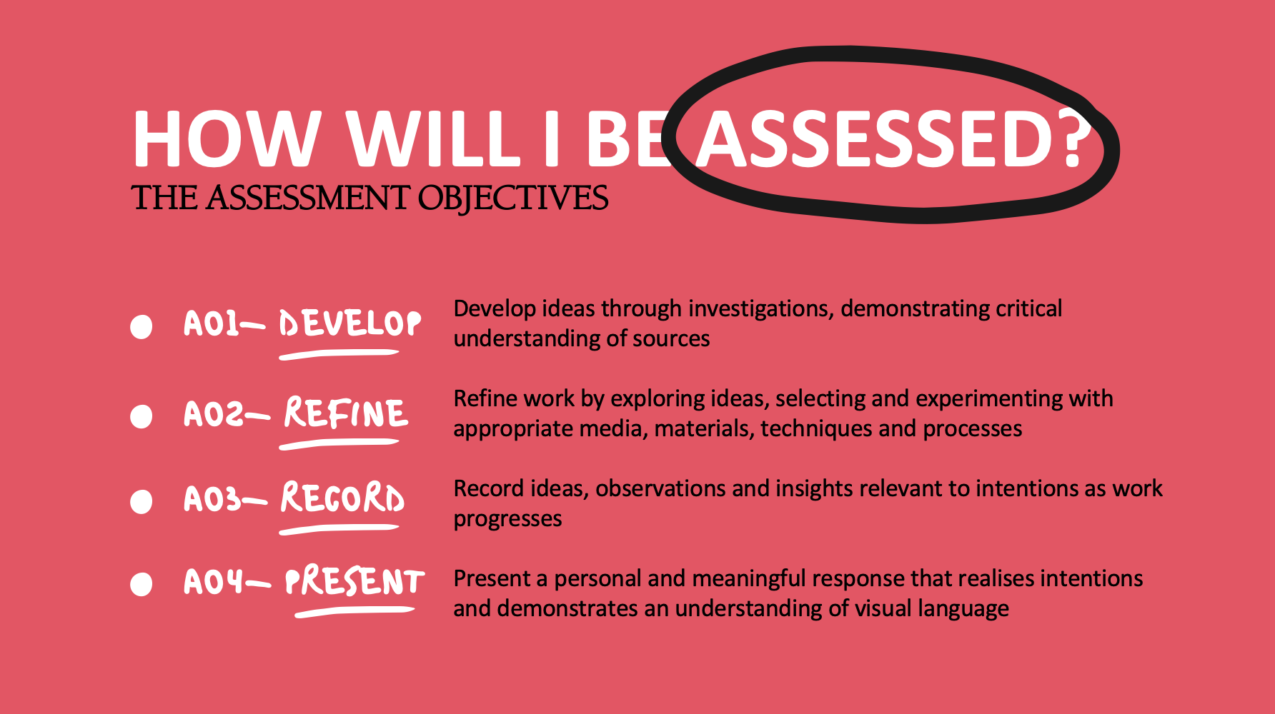
How is the course assessed?
Notes:
In addition …
More detail on all these later

Slide 6

Careers Links

Slide 7
Frequently Asked Questions
(FAQs)
1.Do I need a camera?
No, the Art department has a selection of cameras available for you to use.
2. Do I need to have any prior knowledge about Photography?
Not necessarily. All the knowledge and skills you need in order to pass this course will be taught during the lessons.
3. Do I need to have Adobe Photoshop at home to be able to edit work?
No, most photo editing will be done during school using Adobe Photoshop. However, there are lots of great alternative platforms that you can use if you wish to work at home such as Pixlr or Photopea.
4. Can I work on my project at home if it is saved on the school computers?
Yes, you can save your PowerPoint into your school One Drive account to be able to access at home.
5. Because it is a creative subject, does that mean there is no writing?
We do have to follow the annotation guidance by the exam board which asks students to evaluate their work, annotate studies and analyse contextual sources/photographers.
Notes:
You will see that a grade 5 is higher than a grade C – we will be raising our expectations and efforts to meet this new higher standard

Slide 8
Views From Current Y10 Students
”I’ve enjoyed taking and editing photos and getting to know the subject. The course allows us to explore different aspects of photography, like colour and different photography styles. I like how the course is interesting and always fun”.
“What I have enjoyed the most so far this year is learning about Denise Ippolito and doing the experiments with foam and food colouring. The thing I like about this course is how supported you feel doing your work and learning something new every lesson. The course allows me to explore different areas within Photography and different ways I can use Photoshop”.
“I love it, my favourite part is putting the work on the PowerPoint because I love presenting things well and the course helps a lot with Photoshop and using it effectively”.
“I really enjoy doing a practical nearly every week or two. It’s fun to be learning different things”.
Notes:
Career ? A Levels ?
But we know that this isn’t always possible at this stage and is subject to (many !!) changes
We will guide students to keeping the overall package ‘broad and balanced’ … thus ensuring no doors are closed later in life

Slide 9
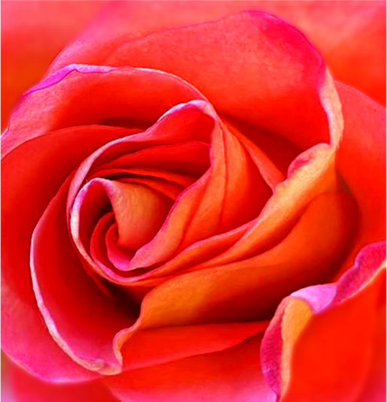
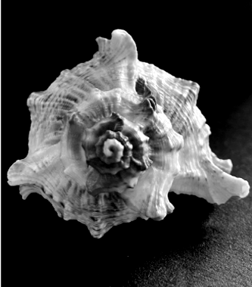
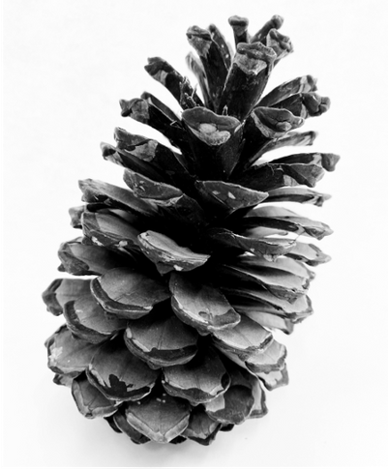
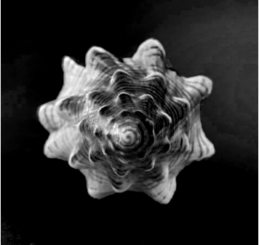
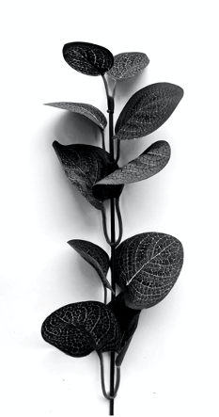
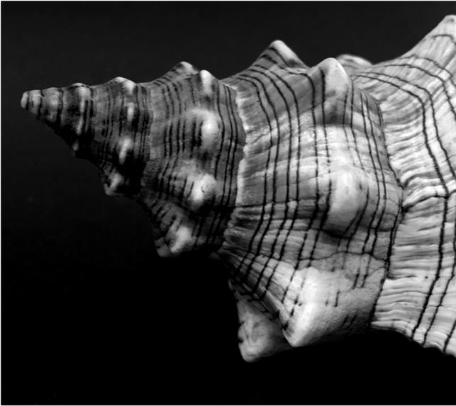
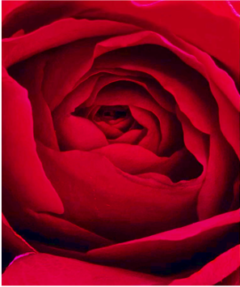
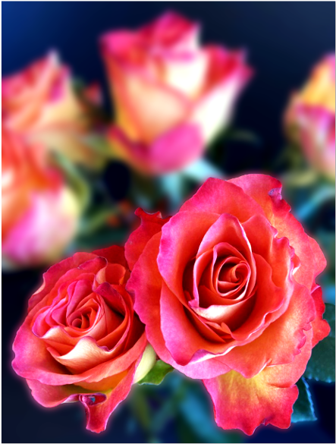
Student Work

Slide 10
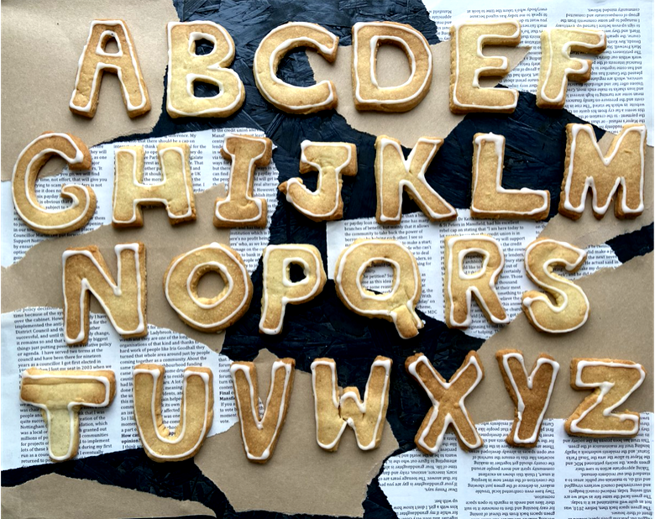
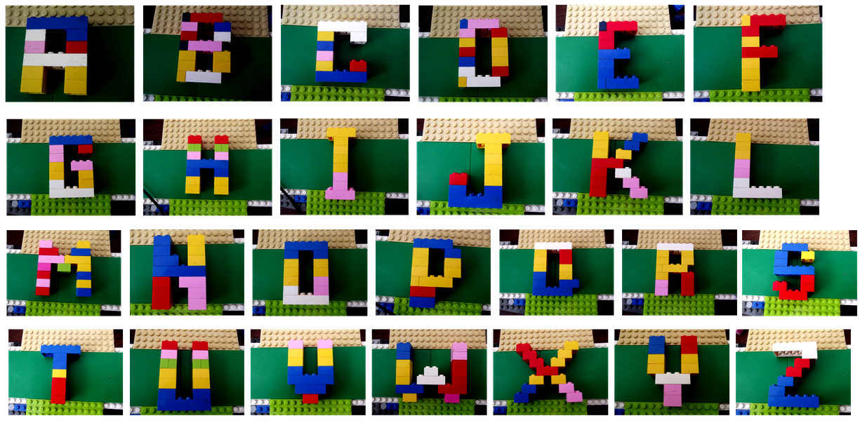
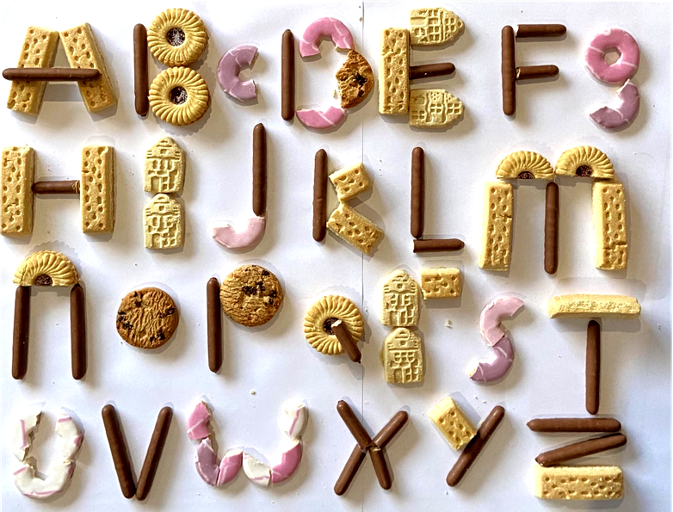
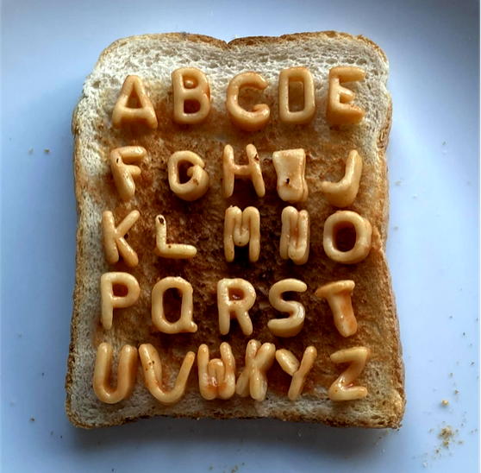

Student Work

Slide 11
Contact Details For Further Questions…
rdunn@tscacademy.org.uk
Notes:
Reinforce choices returns deadline

