Slide 1
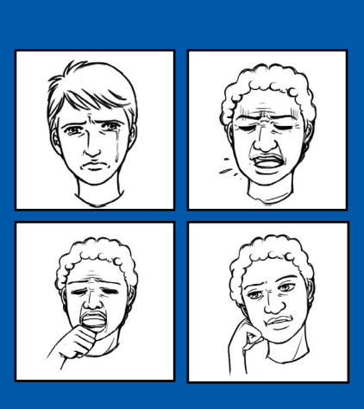
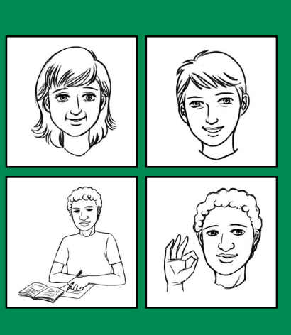
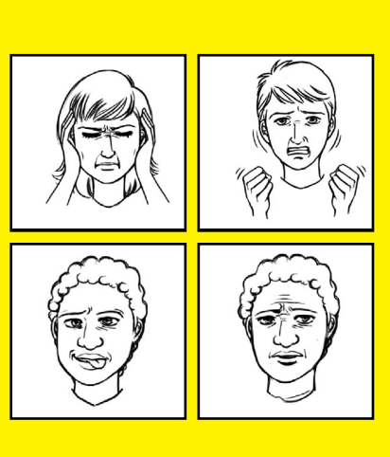
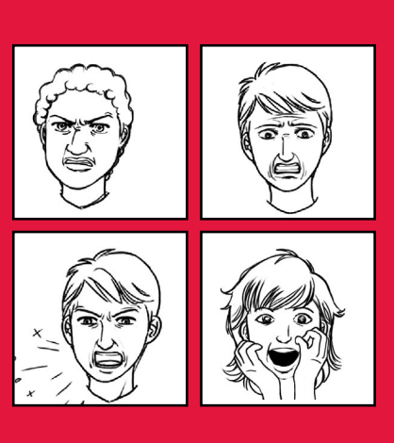
THE ZONES OF REGULATION
What they are and how we use them at SJS

Slide 2

Aims of the session:
To understand what we believe about feelings in our school.
To have an overview of self-regulation
To understand why we as a school have chosen to use ‘The Zones of Regulation’
To understand how ‘The Zones of Regulation’ work
To understand how to create a ‘toolkit’ of strategies to support children.
To talk to yourself with compassion!
Notes:
Most of our internal wiring around behaviour was set up when we were children - we might have different beliefs now but our wiring is still there and this can make it hard to respond differently when we are under stress. Confronting and changing these beliefs can be emotional and it’s easy to tell ourselves we should know better or should have responded differently - so please try to exercise compassion with yourself - if we can have compassionate self-talk then we are more likely to be able to approach our children with compassion as well.

Slide 3
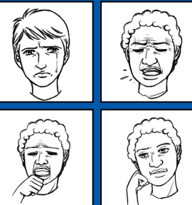
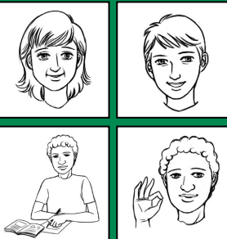
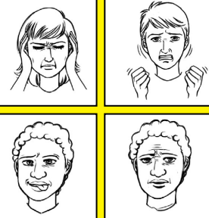
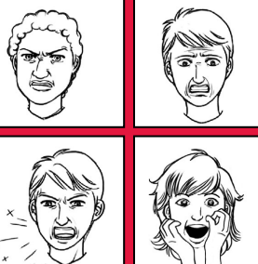
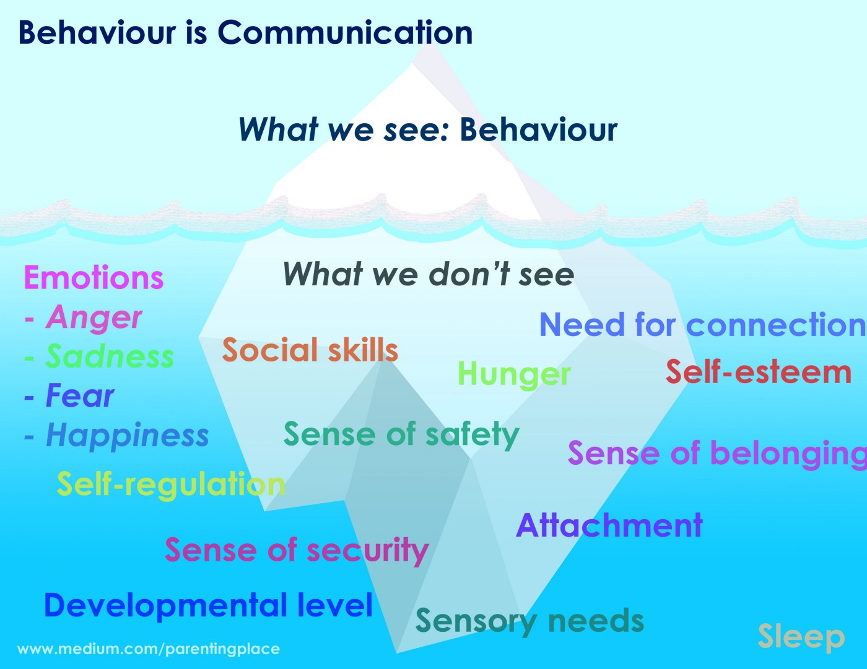
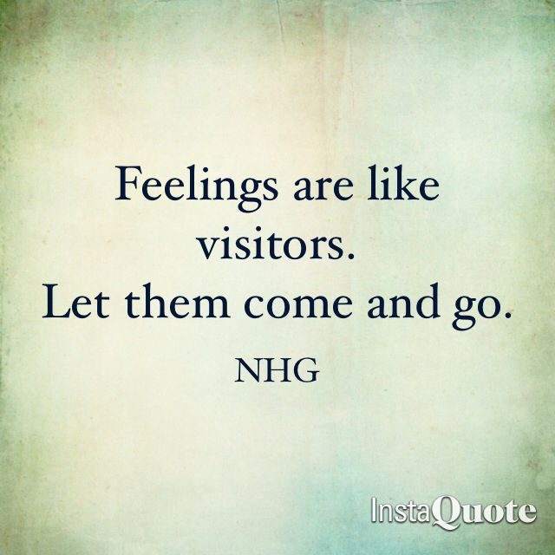
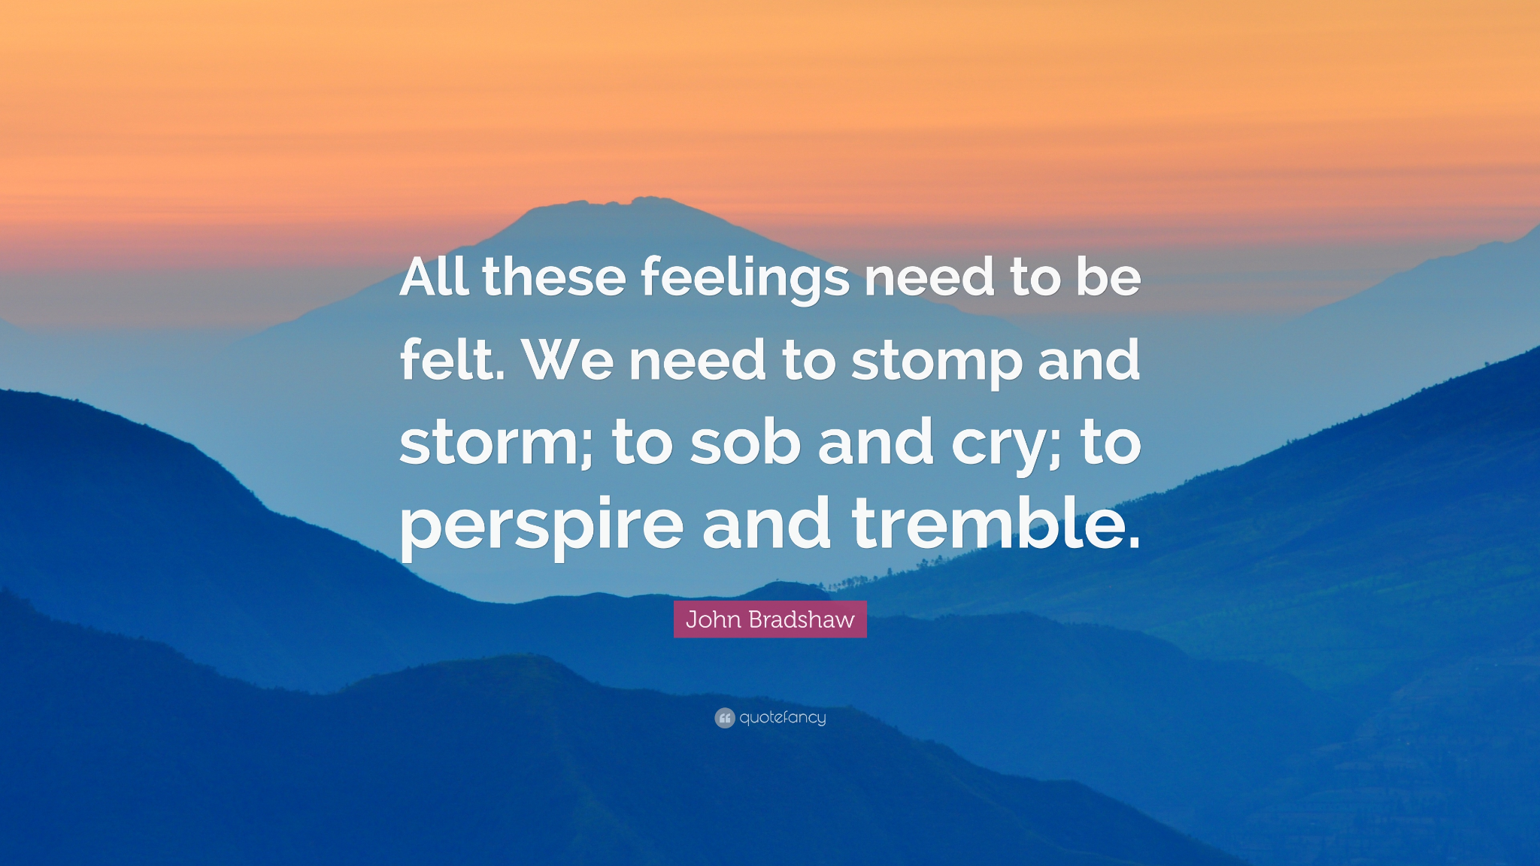
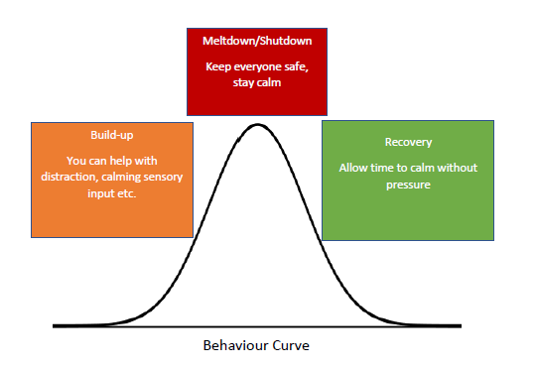
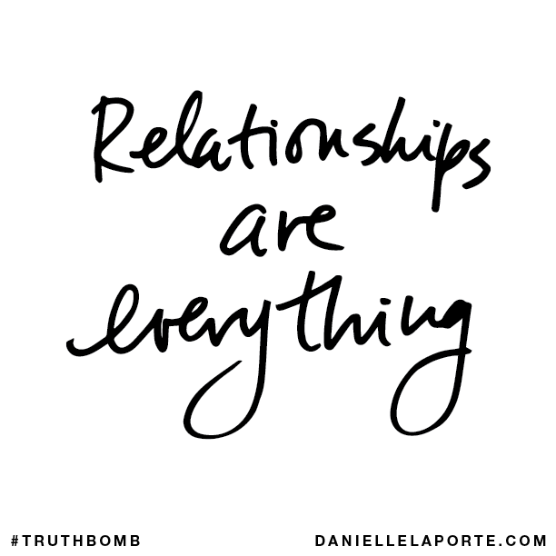
Feelings: what we believe
Notes:
All behavior is a form of communication. It is not always easy to understand what we are being told but with patience and reflection we can begin to unpick what the problem for that child may be.
much of today’s popular advice about children's behaviour ignores the world of emotions. instead, it relies on child-rearing theories that address the children's behaviour, but disregards the feelings that underlie that behavior- Gotman 1997
We welcome all emotions at school and try ou best to support children with them. However, accepting emotions does not mean we do not believe in teaching children how to manage their emotions.

Slide 4


SELF-REGULATION
“…is defined as the capacity to manage one’s thoughts, feelings and actions in adaptive and flexible ways across a range of contexts.” Jude Nicholas
It encompasses:
• Self-control
• Resilience
• Self-management
• Anger management
• Impulse control
• Sensory regulation
Notes:
Self regulation is a high order skill, as adults we may have times when we find it difficult. Some people will find it harder than others. Our children are learning these things, but it is a journey that starts in YrR and does not end at Yr6.

Slide 5


WHY IS SELF-REGULATION IMPORTANT?
Life is 10% what happens to us and 90% how we react to it. Charles Swindoll
Research has found that higher academic achievement is more likely when interventions include self-regulation components.
Typically, children who can self-regulate will turn into teens who can self-regulate.
Notes:
This is why self regulation is important. We believe in equipping our children with skills that support them to be successful members of our community and society moving forward into adulthood.

Slide 6


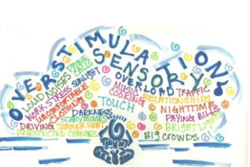
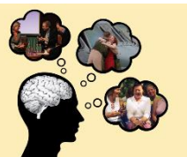
A person who can self-regulate is able to:
• remain CALM AND ORGANISED in a stressful situation
(executive functions)
• cheer themselves up after a disappointment
(emotional regulation)
• know when they are experiencing sensory overload and make adjustments (sensory processing)
• understand when it is appropriate to cheer and shout and when to be quiet (social cognition)

Slide 7
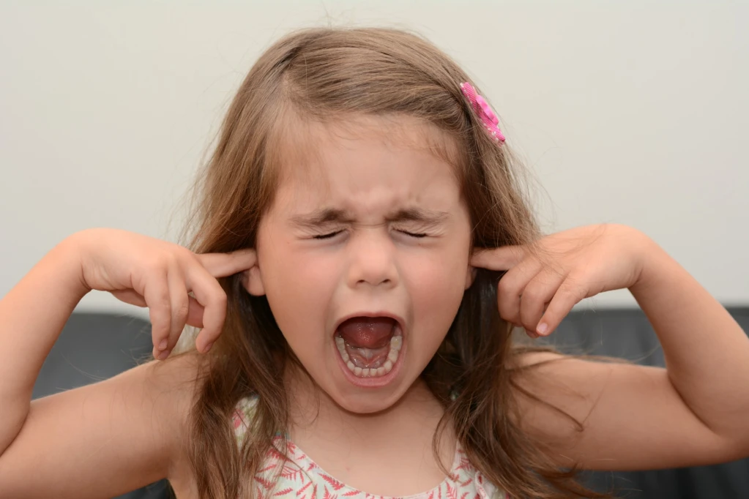

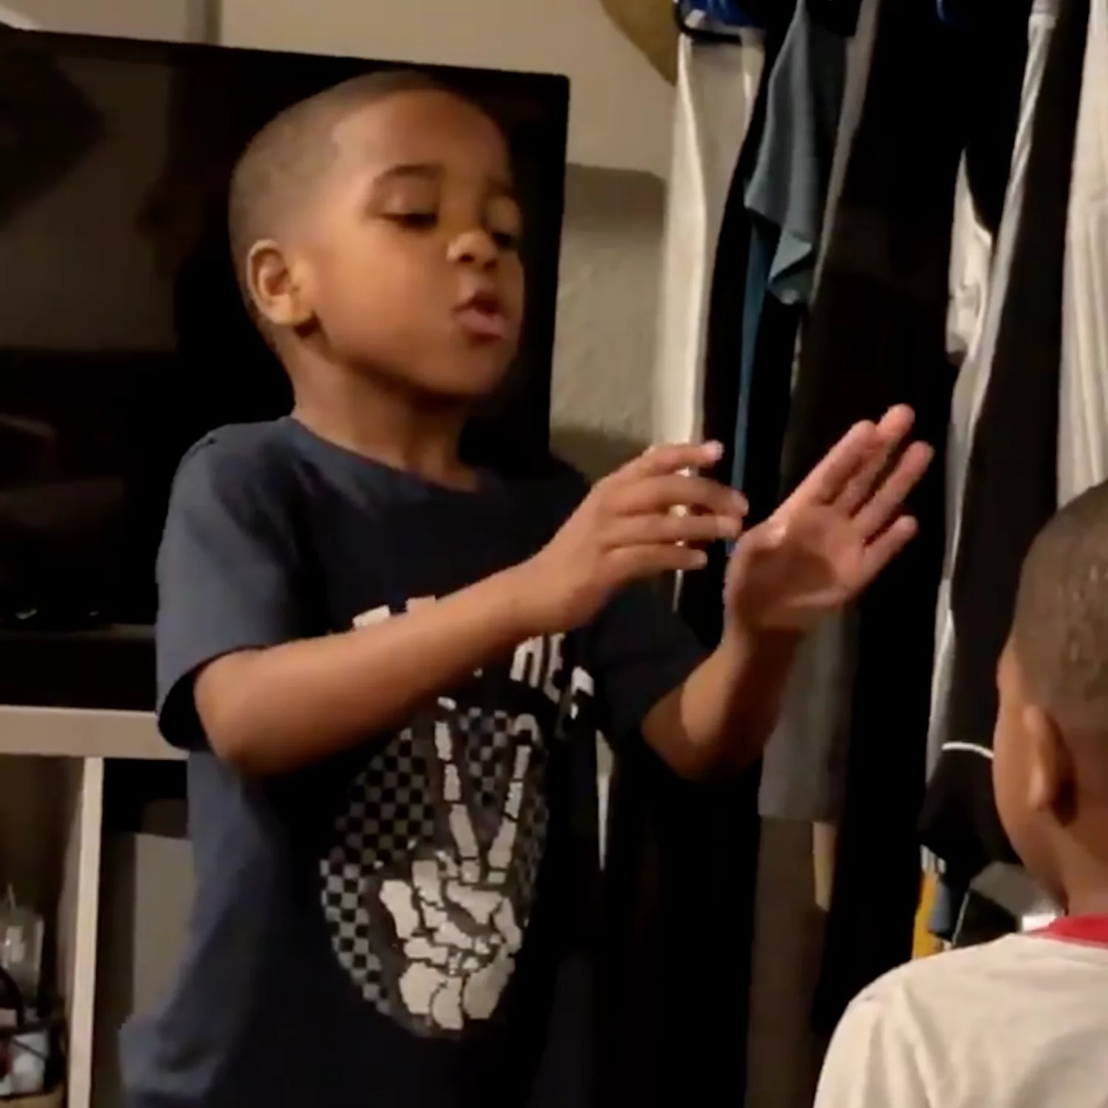
Regulation journey
Unable to regulate at all
Co-regulation (able to regulate alongside a trusted adult)
Self-regulation (able to notice and regulate own feelings)

Slide 8
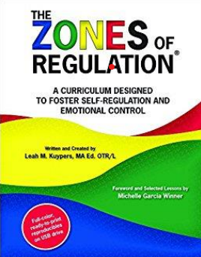
What is ‘ZONES of regulation’?
The ZONES is a concept designed by Leah Kuypers, a licensed occupational therapist, to help children gain skills in the area of self-regulation.
The ZONES of Regulation help us think, talk and teach about how we are feeling.
The ZONES are designed to help children recognise when they are in different zones as well as learn how to use strategies to change (or remain in) the zone they are currently in.

Slide 9
What is ‘ZONES of regulation’?
The ZONES teach children:
Vocabulary of emotional terms,
How to recognise their own emotions,
How to detect the emotions of others,
What may trigger certain emotions,
How others may interpret their behaviour,
Problem solving skills.

Slide 10
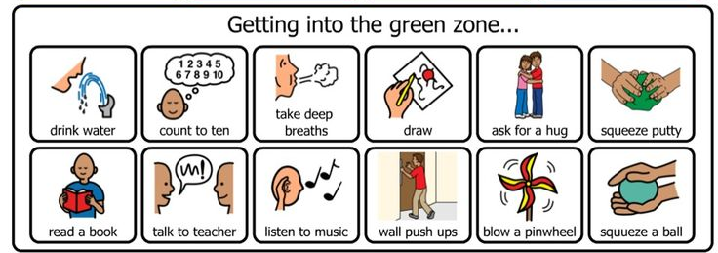
Why teach the ZONES of regulation?
Provides a common language to discuss emotions – a language that is non-judgemental.
Simple for children to understand but helpful for all!
Teaches healthy coping and regulation strategies.

Slide 11
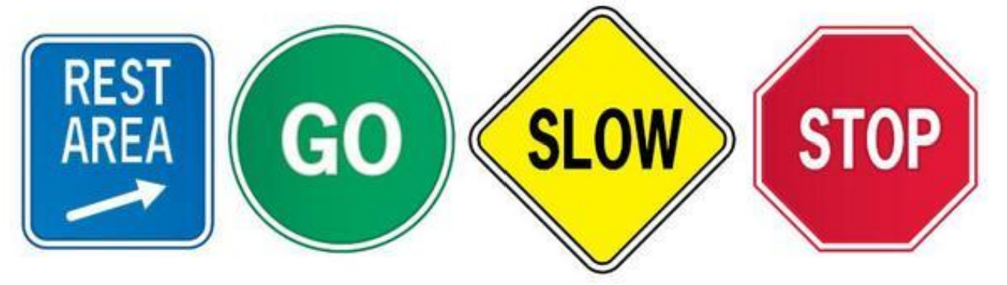
What are the ZONES?
Blue Zone Sad, sick, tired or bored (low state of alertness – brain and/or body is moving slowly or sluggishly) | Green Zone In control, calm, happy and ready to learn (regulated state of alertness) | Yellow Zone: More intense emotions/states but able to maintain control; frustrated, worried, silly, scared, excited or overwhelmed (heightened state of alertness but still have some control) | Red Zone Elated, angry, wild, terrified. (heightened state of alertness, out of control)
.

Slide 12
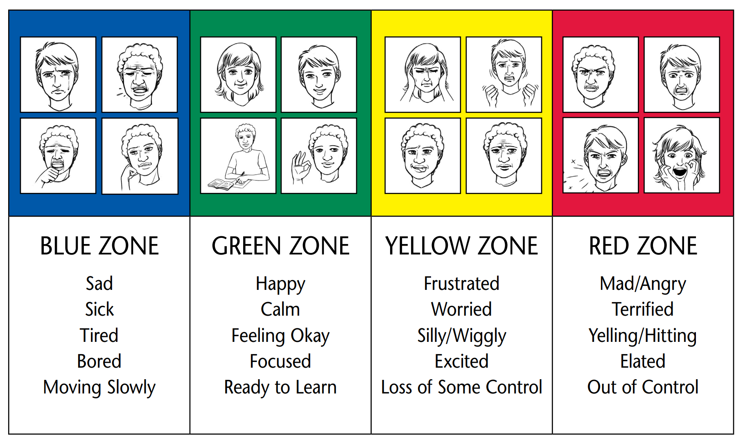
What are the ZONES?

Slide 13
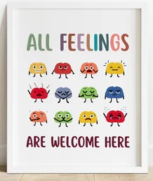
Key points:
There is no ‘bad’ Zone. But it can be unhelpful to be in certain zones at certain times (eg cannot learn well while in yellow zone, or at all while in red zone).
Everyone experiences all of the Zones at different times and in different circumstances - often all four every day.
We can’t change the way children feel BUT we can help them manage their feelings/states and behaviours until they can do this by themselves. “It’s OK to be angry but it is not OK to hit…”
You can be in more than one Zone at a time (eg. sad AND angry).
Notes:
We do not use shaming language or tone of voice - oooh dear i think you may be going into the red zone. This is not helpful.
Can think of it as moving through the zone - avoids the feeling or permanence

Slide 14
Key points:
If a child is confidently using words to describe their emotions, they don’t need to revert to Zones language HOWEVER it is useful for them to know the strategy groups that will help them. Eg. sick or tired = blue zone strategies.
If a child is in the Red Zone…
• Limit verbal interactions and correction – this is not a teachable moment.
• Wait until child is regulated before discussing use of tools
Plan for if/when child is in Red Zone. “I wonder if this strategy would help…?”
Notes:
It is also useful for children including older children to recognise when they may feel in a certain zone and what tools they could use to get back to green.

Slide 15
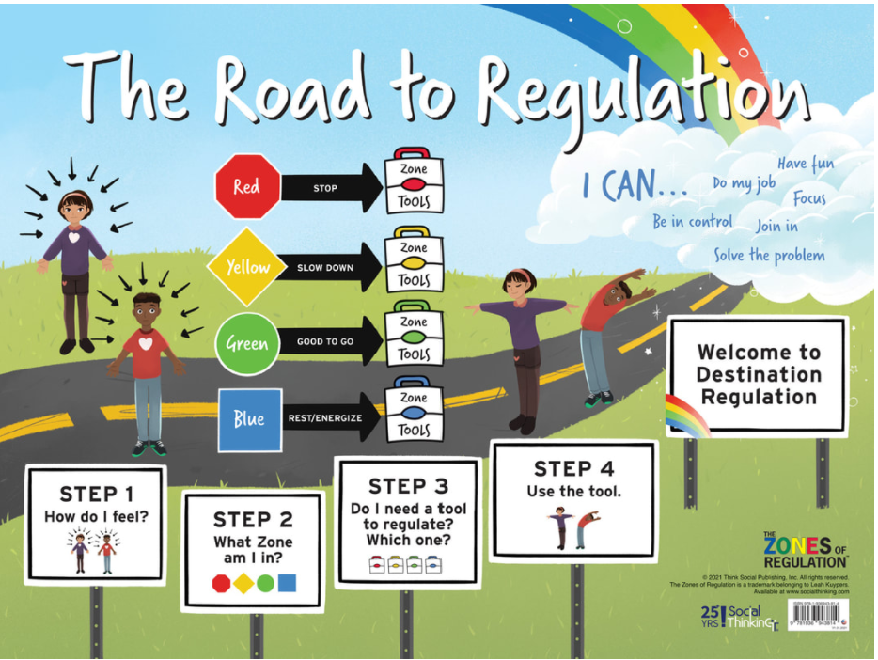

Slide 16
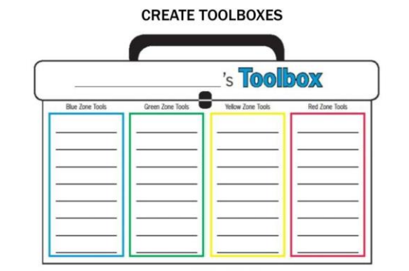
Understanding ZONES tools
Children have their own toolkit of strategies that they develop over time.These will be different from each other, and agreed with the teacher. They help the child cope with moving through each particular zone
Blue Zone tools help wake up our bodies, feel better and regain control | Green Zone tools help us stay calm, focused and feeling good. These are often proactive strategies. | Yellow Zone tools: help us regain control and calm ourselves. | Red Zone tools help us stay safe while we express our feelings, and start to calm down.

Slide 17
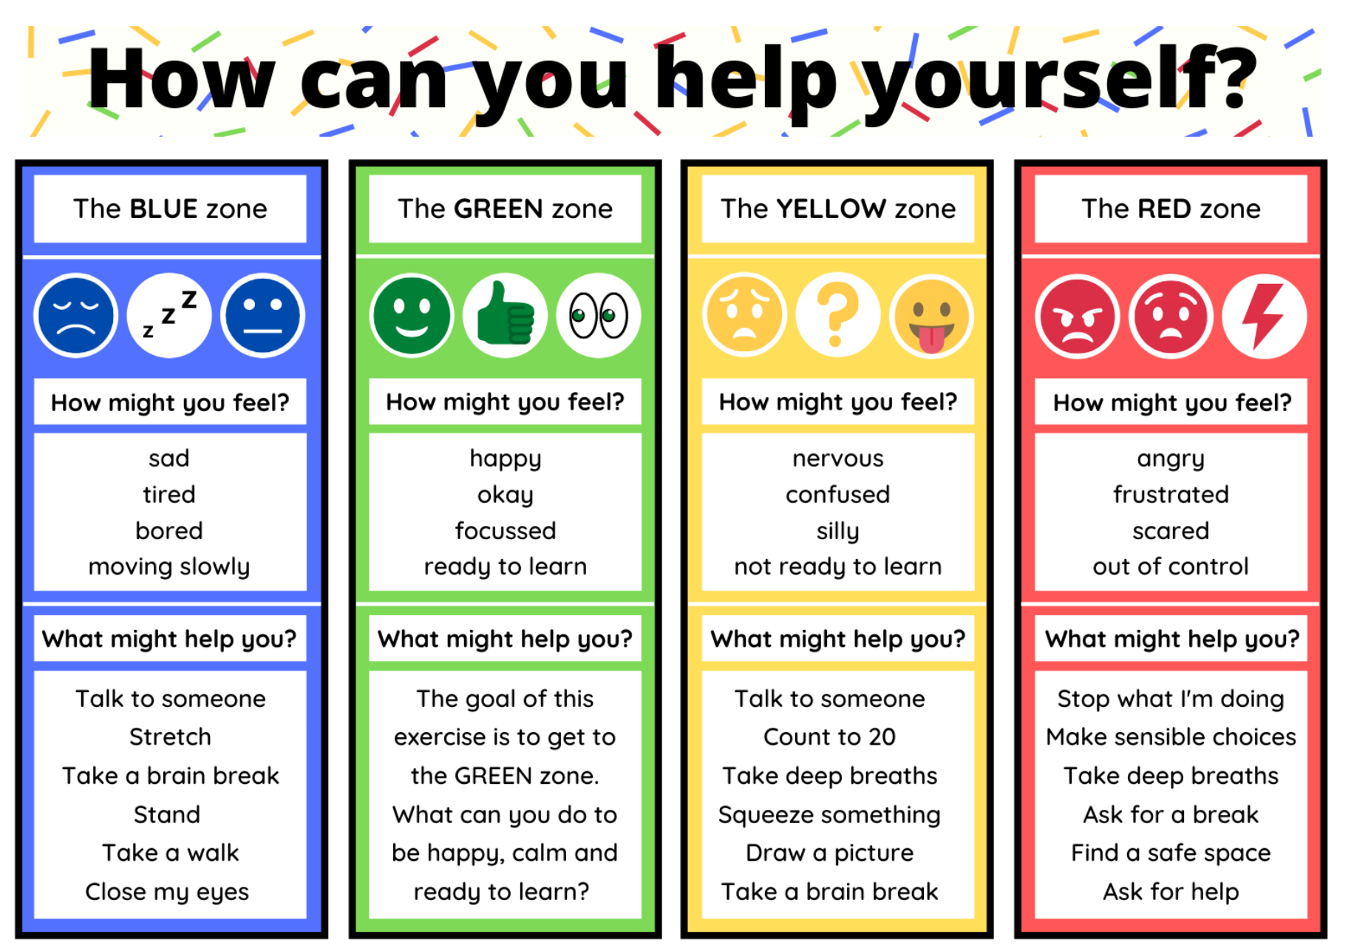

Slide 18
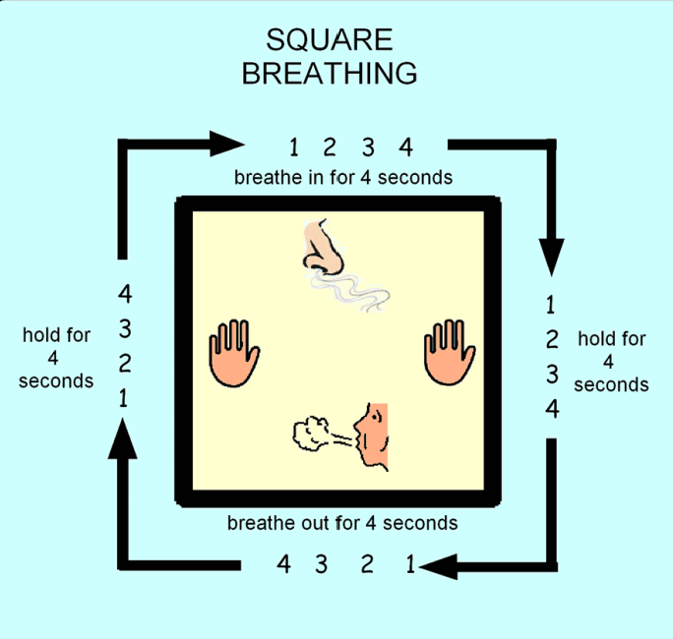
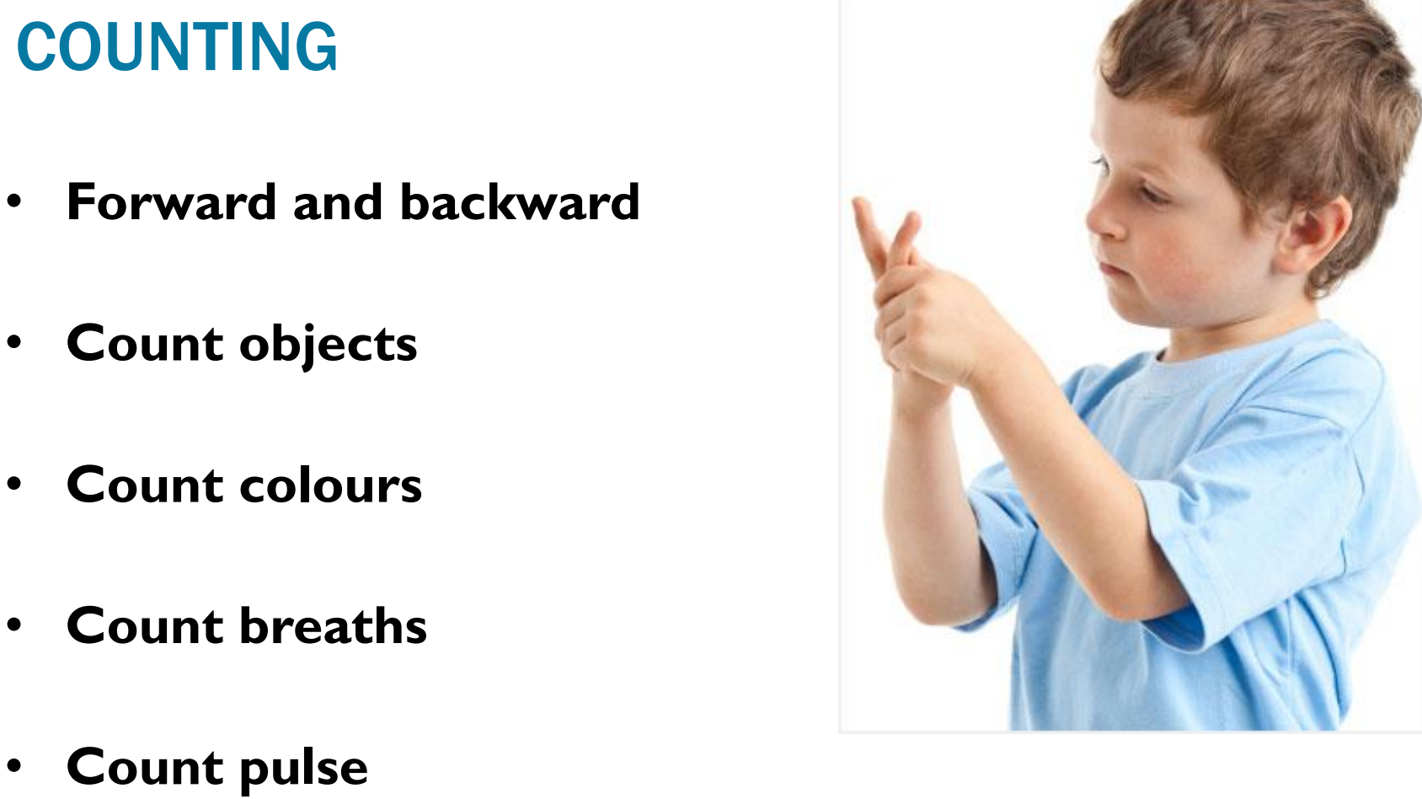
Tools for self regulation
Notes:
We will need to teach the strategies to all children to enable them have an effective toolbox.

Slide 19
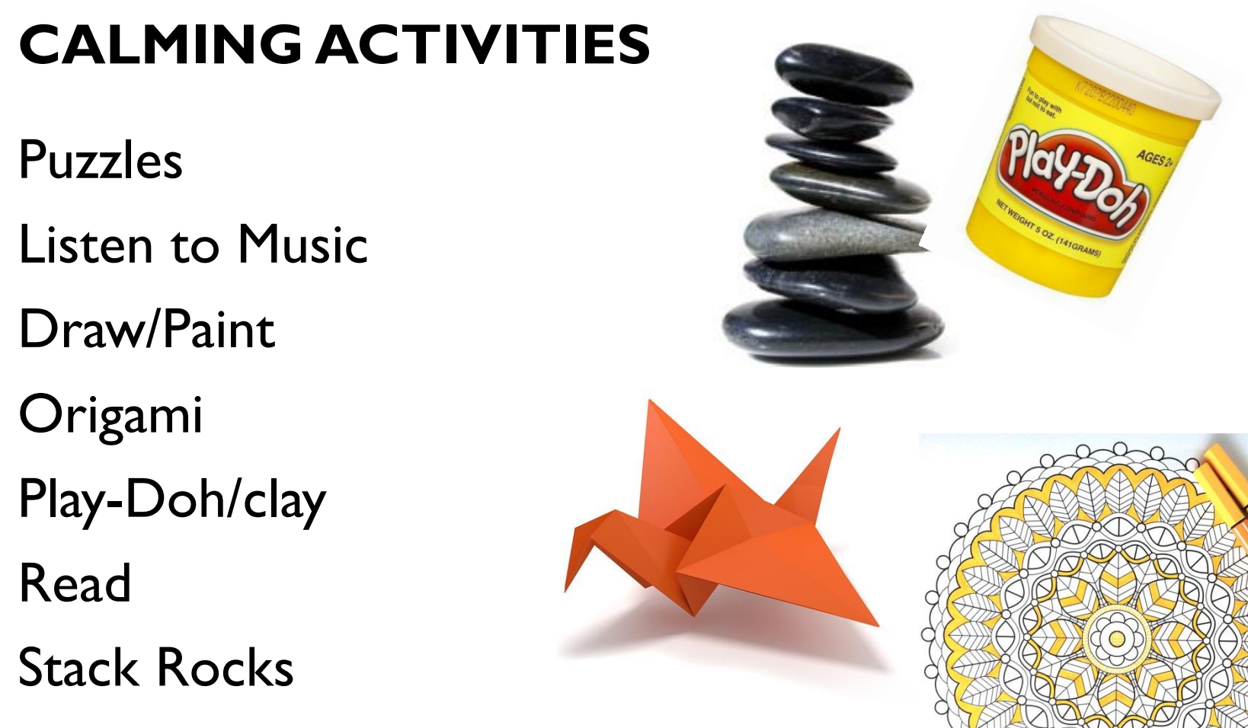
Tools for self regulation
Notes:
We will need to teach the strategies to all children to enable them have an effective toolbox.

Slide 20
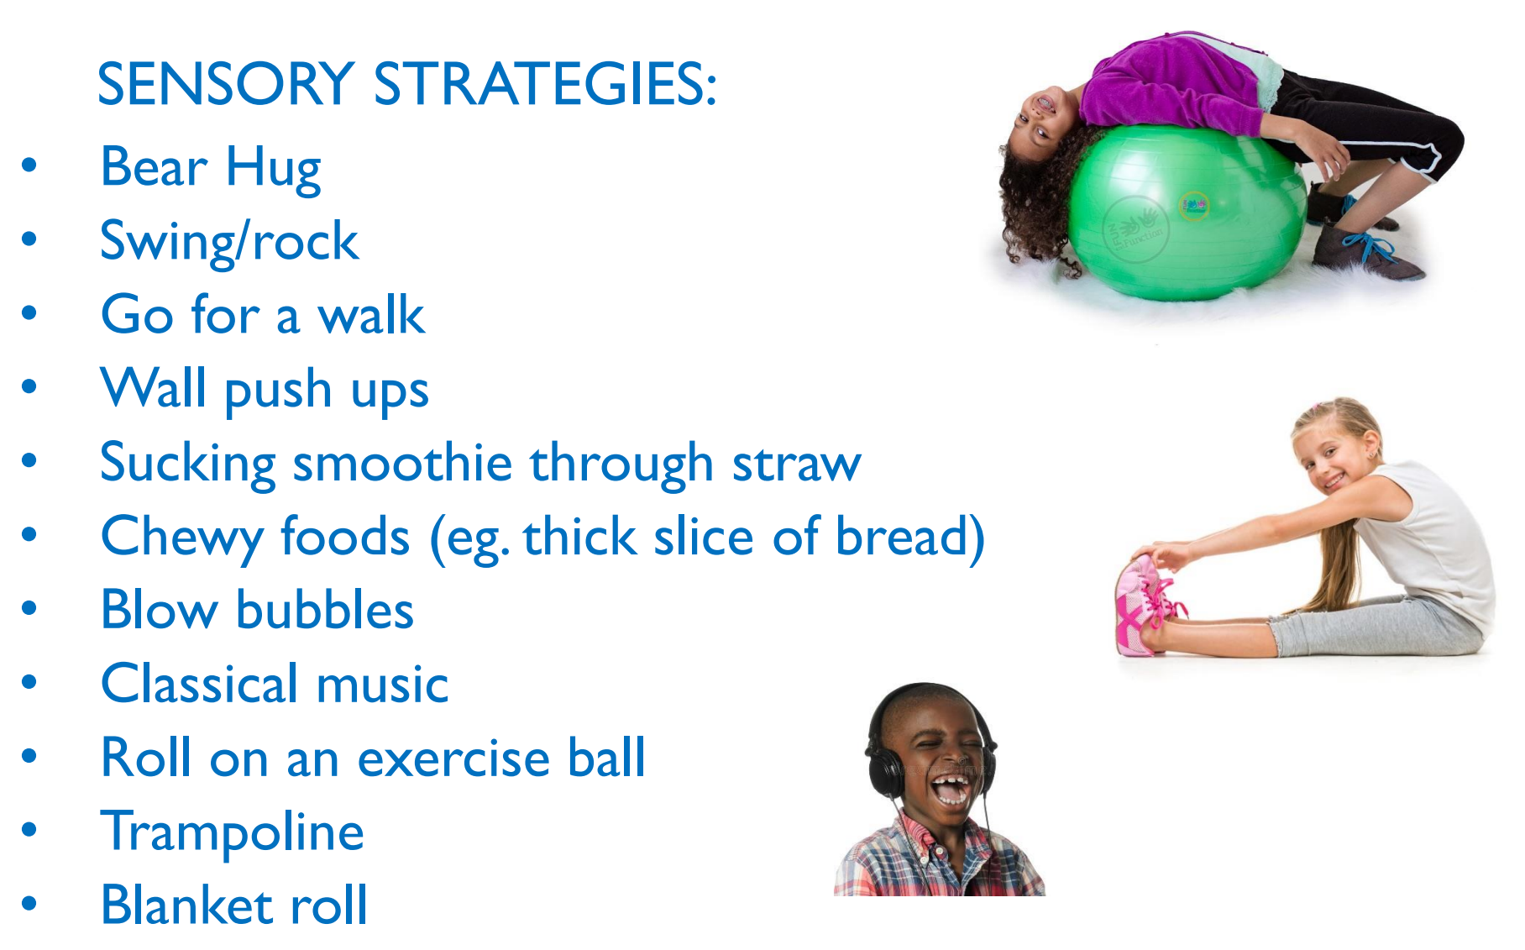
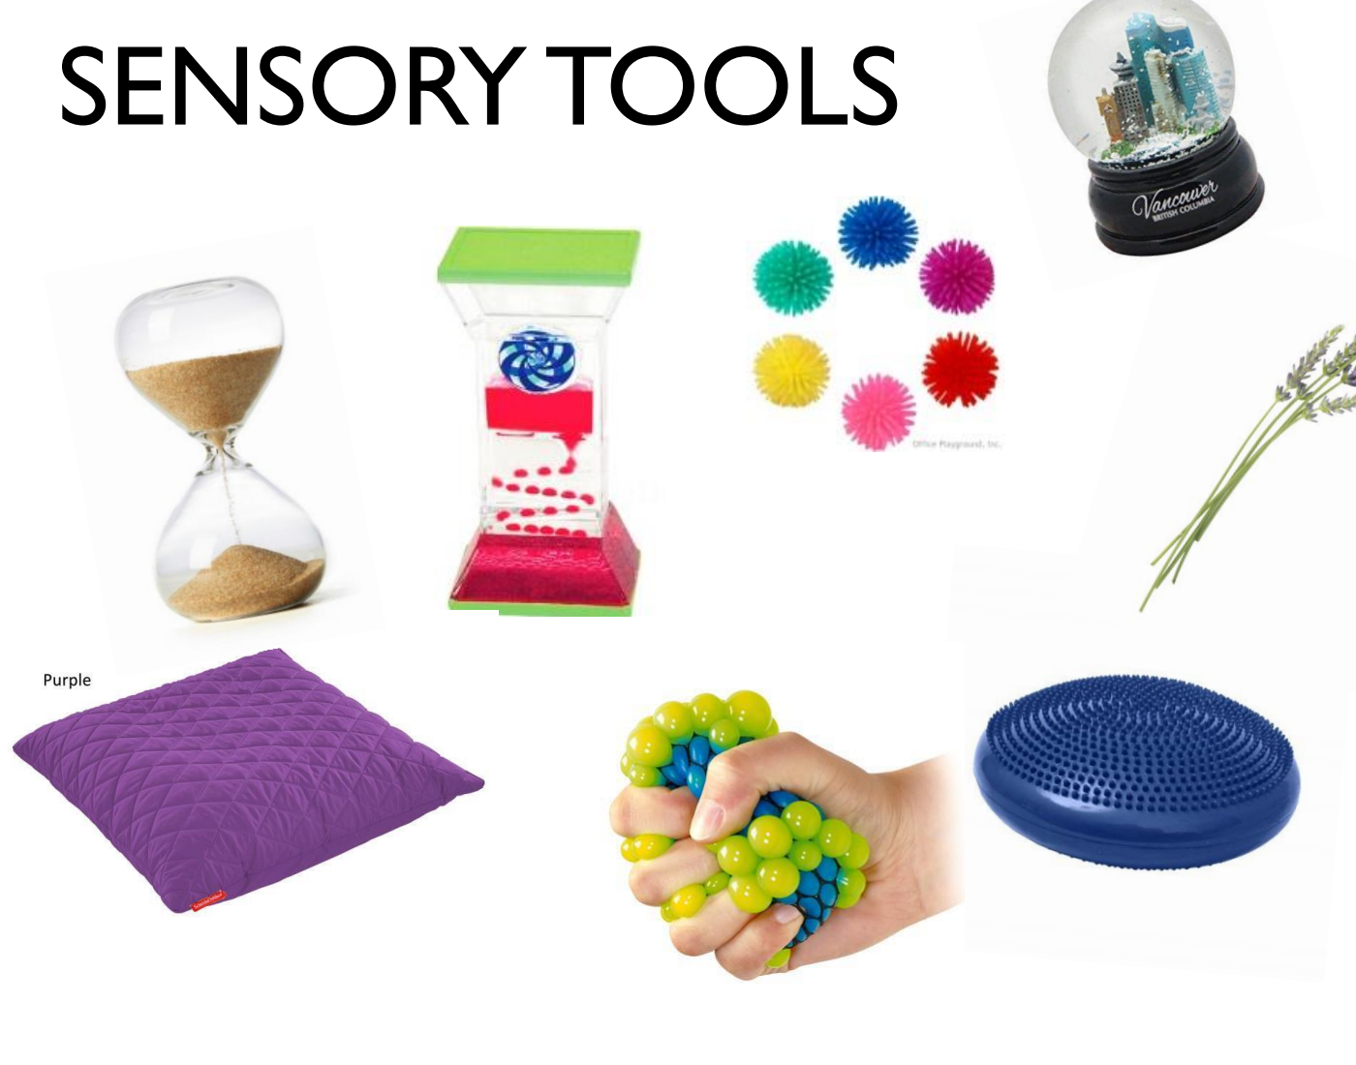
Tools for self regulation
These are not a treat, but a tool to help the children while they move towards regulation
Notes:
We will need to teach the strategies to all children to enable them have an effective toolbox.

Slide 21

Ideally…
I feel… and I need…
Notes:
We want children to know that it’s actually OK to have feelings and needs - that the feelings are not permanent, but they are valid, and each child has the right to take up space, to be struggling, and to have needs that - as a child - they cannot yet manage alone.

Slide 22
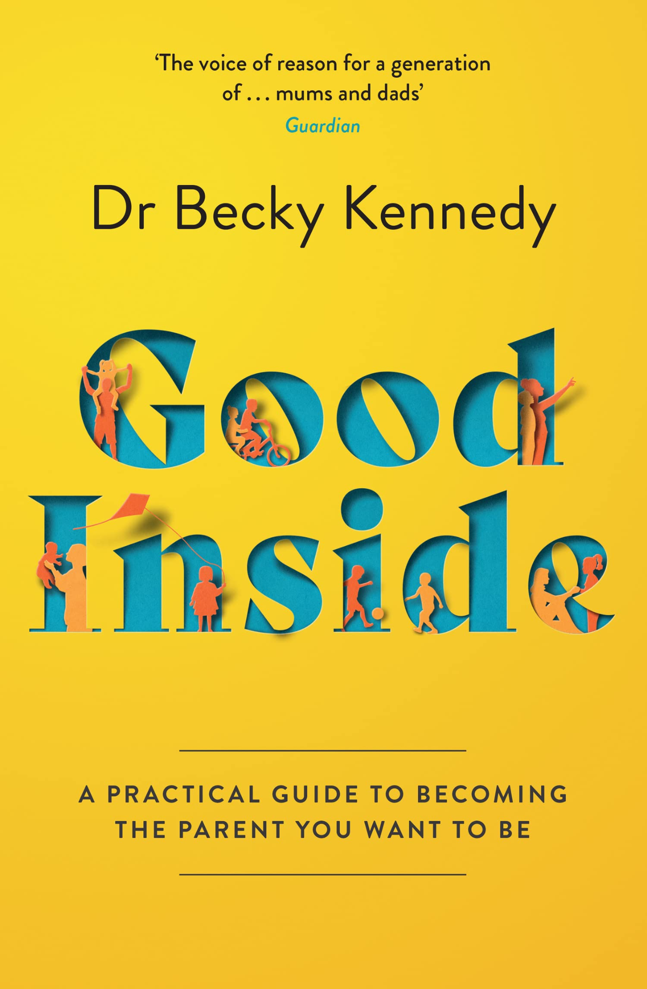

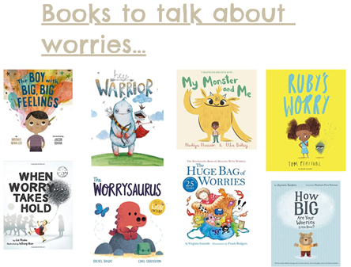
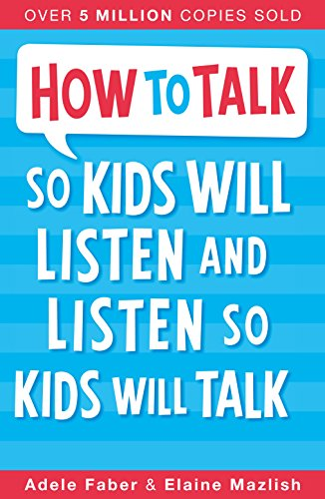
Useful resources
Good Morning Miss Foster

Slide 23

Aims of the session:
To understand what we believe about feelings in our school.
To have an overview of self-regulation
To understand why SJS have chosen to use ‘The Zones of Regulation’
To understand how ‘The Zones of Regulation’ work
To understand how to create a ‘toolkit’ of strategies to support children.

