Slide 1



Year 4 Curriculum Information

Slide 2


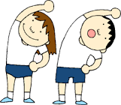







Hockey and Gymnastics
Chronology and Technology
Strength and Skills
States of matter
Autumn 1
Better than Stone
Maths
Value of 1000
Sketching
Online Safety and Research
Narrative and Information Text
Whole Class Reading
Wisdom

Slide 3


Rugby and Dance
(Rock ‘n’ Roll)
Respecting ourselves + others
Settlements and Impacts
Sound
Autumn 2
Ticket to Ride
Maths
Rounding
Music - Calypso
Travel Brochure and Persuasive Blog
Angels
Whole Class Reading
Coding

Slide 4
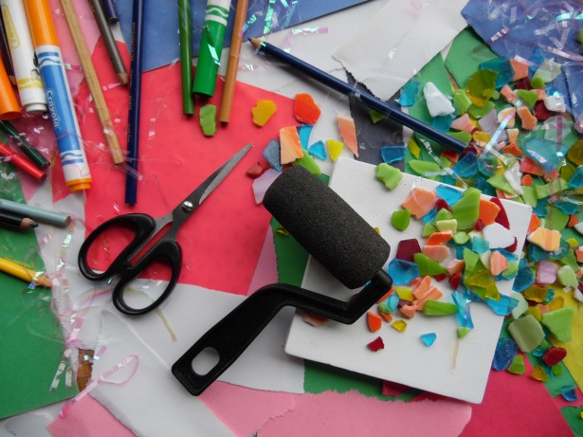
Running and Gymnastics
Mechanisms
Society
Forces
Managing our
feelings
Spring 1
Roman Invasion
Maths
4 digit addition + subtraction
Music
Diary and Play Script
Service
Coding
Whole Class Reading

Slide 5
Natural disaster and impacts
Tennis and dance
Making a difference to the environment
Digestion
Spring 2
Eruptions and Disruptions
Maths
Multiplication
Colour
Narrative and documentary
Symbols
Online Safety and video
Whole Class Reading

Slide 6
Location and climate
Jumping and OAA (Outdoor adventurous activity)
Keeping ourselves safe
Classification
Summer 1
Wild!
Maths
Fractions
Sculpture
Narrative and information page
Neighbours
Multimedia
Whole Class Reading

Slide 7
Joining
Cricket and dance
SRE and drugs
Animals - food chains
Summer 2
Rags to Riches
Coming soon!
Maths
Fractions and division
Music
Whole class reading
Diary and speech
Enlightenment
Multimedia

Slide 8

Basic skills
End-of-year expectations:
Handwriting - joined and legible
Times tables up to 12 x 12 (for MTC)
Spelling - all Year 2 words, all Year 3 and 4 curriculum words

Slide 9
Basic skills
What do we do in school?
Daily handwriting practice
Daily times table learning following the number sense scheme
2 spelling lessons a week
Daily grammar retrieval practice

Slide 10


Homework Expectations
Every week:
2 x reading actual levelled book with 2 reflections to either summarise, predict or give an opinion
2 x Reading Plus to improve fluency
Practise curriculum spelling words
15 mins TT Rockstars

Slide 11
What can you do?
Encourage your child to complete their home learning every week
Attend ‘Share my learning’.
The next one will be Thursday 23rd November
Attend our Autumn 2 History showcase at the end of term - date TBC

