Slide 1
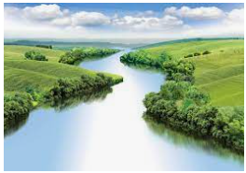
Biomes
Outcomes for this topic:
To use maps to locate areas with different biomes.
To raise questions about the climate and living conditions in a particular biome.

