Slide 1
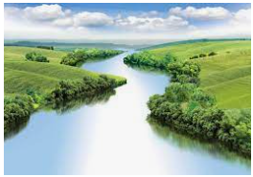
Climate Zones
Outcomes for this topic:
To use and explain the term ‘climate zone’.
To locate and identify different climate zones.
Discuss and compare the climate zones of the UK to a different country.

