Slide 1
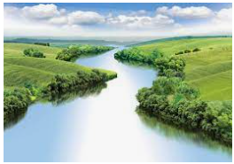
Countries of the World
Outcomes for this topic:
To name and locate countries of the world.
Use maps to locate features of the world, eg. Rivers, mountains, major cities.

