Slide 1
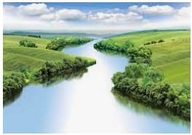
Longitude and Latitude
Outcomes for this topic:
Locate the Equator on a map.
Locate the lines of longitude and latitude on a map.
Locate the Tropics of Capricorn and Cancer on a map.
Draw conclusions about the climates of countries on the Equator and on the Tropics.

