Slide 1
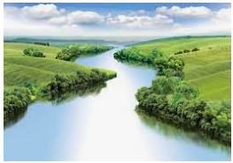
Map Skills
Outcomes for this topic:
To use maps, atlases, globes and digital mapping to name and locate counties and cities of the UK.
To use maps to locate features of the world eg. mountains, volcanoes and areas affected by earthquakes.
To use the four points of a compass, symbols and keys.
To be introduced to four-figure grid references.
To make a map of the school and plot features on to them to show a route.

