Slide 1
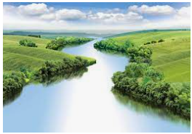
Map Skills
Outcomes for this topic:
To use maps, atlases, globes and digital mapping to locate countries in Europe (including Russia)
To study maps to make different assumptions about Russia. In particular use maps to draw conclusions about the locations of settlements.
To use eight points of a compass.
To use four-figure grid references.
Use recognised symbols to mark out local areas of interest on maps.

