Slide 1
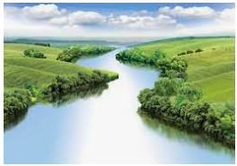
Map Skills
Outcomes for this topic:
To use maps, atlases, globes and digital mapping to locate countries of the world and describe features studied.
To use maps to locate features of the world eg. Rivers, mountains, major cities, biomes.
To use eight points of a compass.
To use four-figure grid references and six-figure grid references.

